Slide 1
Dial calipers

Slide 2
Safety and Precautions
Keep Caliper away from water, oil, solvents and any other liquids.
Do not lubricate the Caliper’s moving parts.
Do not exceed the 6” capacity of Caliper.
Handle carefully; the Caliper is a delicate instrument.
Do not disassemble Caliper.
Use caution when handling. The Caliper has sharp, machined edges.
Do not drop or overtighten during use.
After use, wipe off and place in storage case and keep in secure and dry location out of reach of children.
The warnings, precautions, and instructions discussed in this instruction manual cannot cover all possible conditions and situations that may occur. It must be understood by the operator that common sense and caution are factors which cannot be built into this product, but must be supplied by the operator.

Slide 3
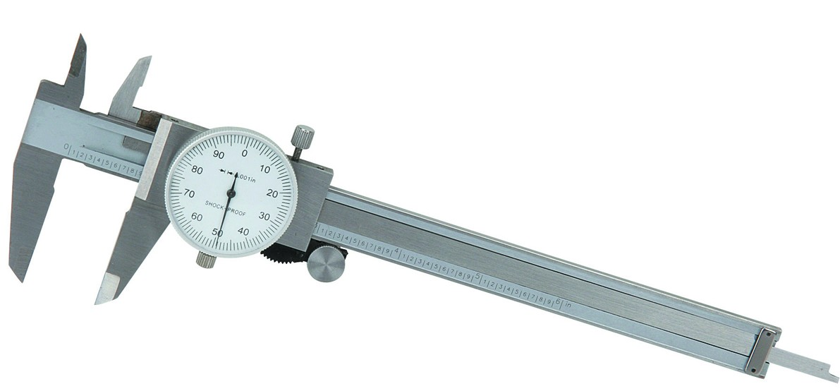
Cleaning and Maintenance
BEFORE EACH USE, inspect the general condition of Caliper. Check for loose screws, misalignment or binding of moving parts, cracked or broken parts, and any other condition that may affect its safe operation.
AFTER USE, clean external surfaces of the product with clean cloth.
STORE in carrying case and keep in dry and secure location.

Slide 4
Parts List and Assembly Diagram

Slide 5
Operating Instructions
Make sure upper and lower Outside Diameter Jaw (2) faces are clean. See Fig. A.
Loosen Slide Scale Lock (6) by turning it counterclockwise.
Use Thumb Roll (1) to close Outside Diameter Jaws (2).
Sliding Index Edge (7) should line up at “0.”
To adjust (if needed), loosen the Dial Adjustment Lock (3) by turning it counterclockwise.
Set the Dial (5) by turning the Dial Adjustment (4) either clockwise or counterclockwise until the Dial Needle points to “0”.
Lock the Dial (5) on its “0” setting by tightening the Dial Adjustment Lock (3) clockwise. The Caliper is ready to use.

Slide 6
Operating Instructions
To read the Scale and Dial, the Sliding Index Edge (7) features readings in inches (0.001” and 0.010” per call-out segment) See Figure B
Read the Scale Measurement Point in inches and tenths of inches (such as 0.5”). Then read the Dial Needle on the Dial in thousandth of an inch (such as .081”).
Combine the two readings for a final reading of “0.581.”

Slide 7
Operating Instructions
To use the Caliper to measure the outside diameter of an object, close the Out- side Diameter Jaws (2) over the object, making sure that the item rests squarely on the Jaws. See Figure C.
Make note of the value along the Sliding Index Edge (7). Then read the whole number indicated by the dial arm. Finally, note the numbers of lines after the whole number. For example, values 1.5, 30 and 3 will read as 1.5”, 0.030” and 0.003”, which equal 1.533”.

Slide 8
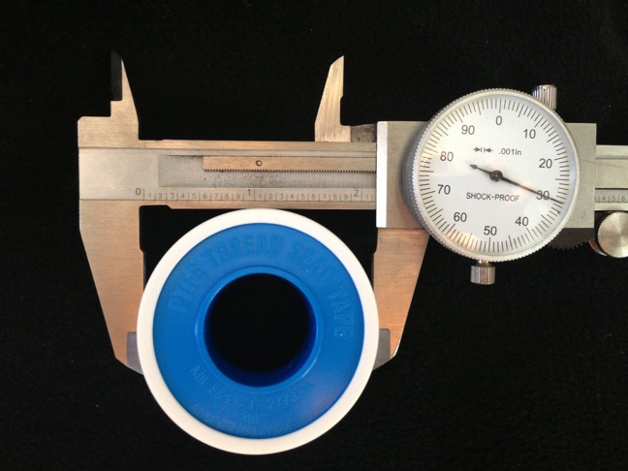

Slide 9
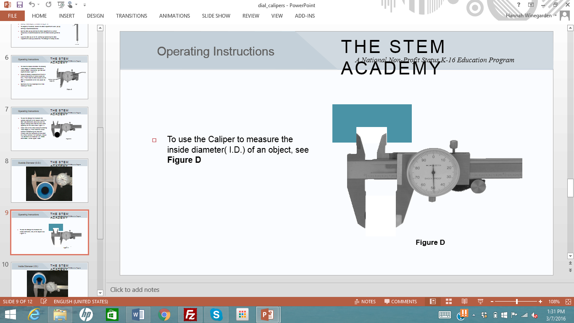
Operating Instructions
To use the Caliper to measure the inside diameter( I.D.) of an object, see Figure D

Slide 10
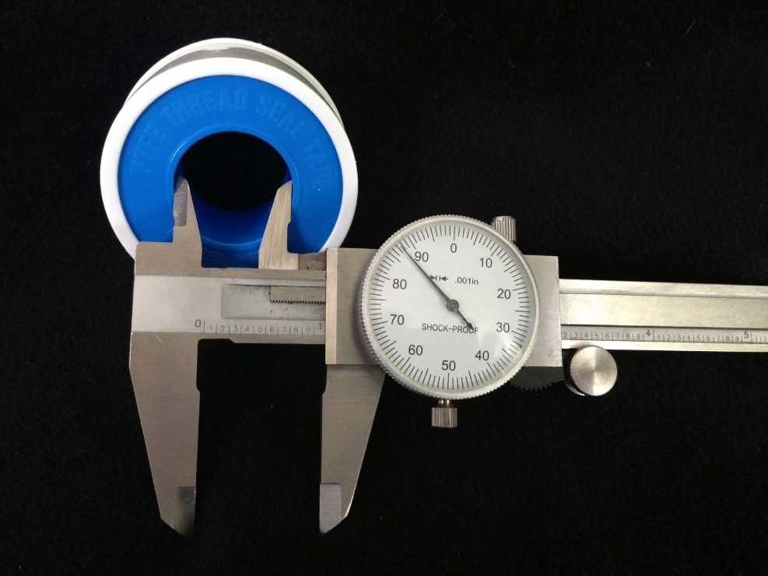
Inside Diameter

Slide 11
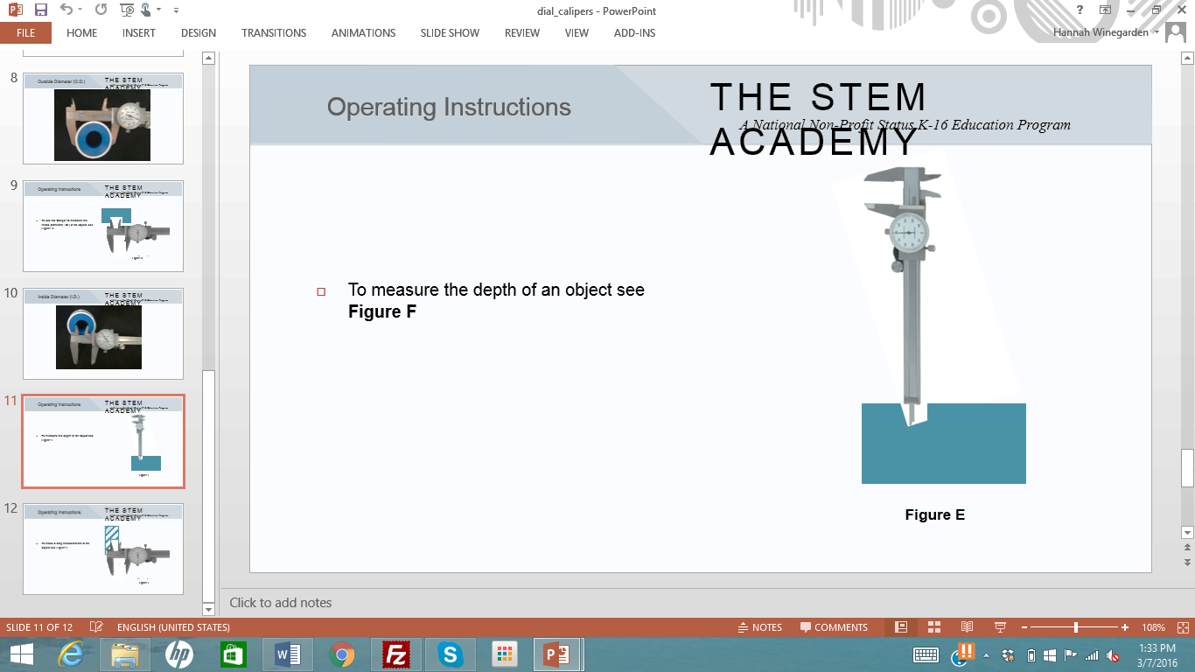
Operating Instructions
To measure the depth of an object see Figure F

Slide 12
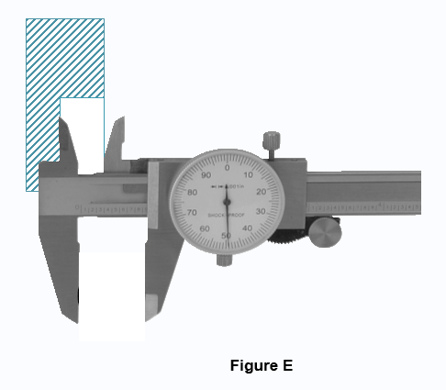
Operating Instructions
To make a step measurement of an object see Figure E

