Slide 1
Concurrent engineering and teamwork

Slide 2
Introduction
Engineering schools requiring students work in teams
  Collaborative study groups
  Laboratory groups
  Design groups
    as part of individual classes
    participating in extracurricular competitions
Team emphasis mirrors management philosophy

Slide 3
Why Do Corporations Focus on Teamwork?
Engineers asked to solve complex problems
More factors in design than ever before
Teams understand more through collaboration
Many corporations are global, operations spread all around
Concurrent engineering widely employed due to time to market changes
Corporations increasing project management principles

Slide 4
Increasing Complexity of Projects
1800s
  Musket had 51 parts
Civil War era Springfield
  140 parts
Bicycle (late 1800s)
  200+ parts
Automobile
  10s of 1000s of parts
Boeing 747 aircraft
  5 million+ components
  Over 10,000 person-years of design time

Slide 5

More Than Just One Part
Modern design problems involve individual parts AND subsystems
  Mechanical
  Electrical
  Controls
  Thermal
  Many Others
Each requires specialists acting in teams

Slide 6
Engineer Design Factors
Initial Price
Life Cycle Costs
Performance
Aesthetics
Overall Quality
Ergonomics
Reliability
Maintainability
Manufacturability
Environmental Factors
Safety
Liability
World Market Acceptance

Slide 7
Engineers are Doers
Involves solving difficult problems
Finding technical solutions while considering numerous constraints
Make things happen

Slide 8

International Factor
Many corporations are international in scope
Requires communication and sharing data electronically
Teams may never physically meet
  At any point in a 24-hour period in any part of the world, an engineer may be working on the product

Slide 9
The Need for Speed
Concurrent engineering achieves better designs and brings the product to market more quickly
Time to Market
  Total time needed to plan, prototype, and procure materials and to create marketing strategies, devise tooling, begin production and bring new product to the market

Slide 10
Concurrent vs Traditional
Concurrent Engineering
  Parallel operation
  Everyone is working together
  Marketing, manufacturing, and procurement personnel involved from design stage
Traditional Business Practice
  Each step is done serially
    One at a time
  One person works on one project at one time

Slide 11
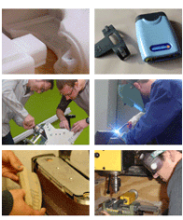
Use of Terms
Use of teams and new technologies have changed the process of engineering
  CAD/CAM
  Rapid Prototyping
  Shared Data
  Advanced Communications

Slide 12
Speed
Timely delivery of products to marketplace
Critical for profits
Do not compromise quality to meet demands
“We have seen what wins in our marketplaces around the globe: speed, speed, and more speed.”
        Jack Welch - Former CEO of GE
“Reduce product development time to 1/3, and you will triple profits and growth.”
        - Business Week

Slide 13
Project Management Uses Teamwork
Developed in 1950s and 1960s as a way to manage defense contracts
Way of organizing individuals by products/projects not function
Cross-functional team approach
  Not vertical divisions

Slide 14
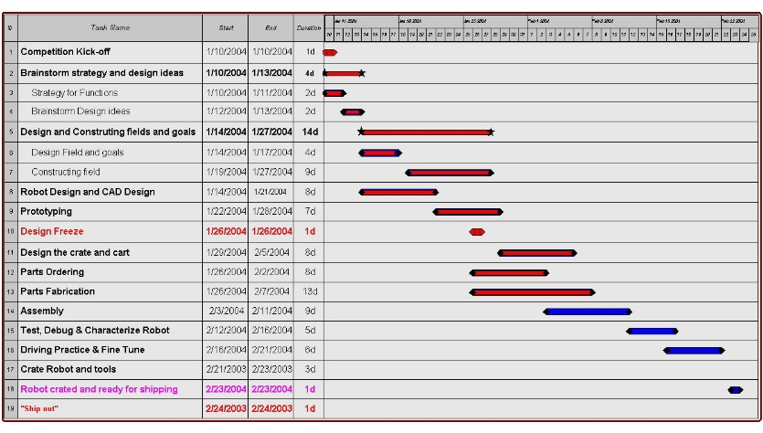
No Easy Task
Project managers never given all the time, people, and money needed
  Mirrored in student design teams
  Uncomfortable, but prepares for engineering world
Planning work, schedules, and direct resource use
  Gantt Charts
Example of a Gantt Chart

Slide 15
Group vs Team
Group
  Several individuals in some proximity to one another
Team
  Two or more persons working together to achieve a common purpose
A Team IS NOT the same as a Group!!!

Slide 16
Teams
Purpose
  Its task at hand, reason it was formed
Collective style is how the members worked together
  Each has own style, approach, dynamic, and ways of communication
Friendship IS NOT a requirement for successful team

Slide 17
Factors of a Successful Team
Common goal or purpose
Leadership
  Every member contributes
Each member makes unique contributions
Effective team communication
  Effective meetings, honest and open discussion
Creative Spark
Harmonious relationships among members
Effective planning and use of resources

Slide 18
Qualities of a Successful Individual Team Member
Attendance
  Attends all meetings on time (Dependable)
Responsible
  Accepts and completes tasks on time
Abilities
  Meets team’s needs fully for the purpose
Creative and Energetic
  Is excited and has a positive attitude
Personality
  Encourages, creates productive and fun setting

Slide 19
Growth Stages of a Team
Teams require nurturing
Must pass through several development stages before becoming successful
Every team challenge is to grow through these stages and achieve performance

Slide 20
Stage 1: Forming
Team members become acquainted with
  One another
  The Leader
    Or they choose
  Team’s Purpose
  Overall level of commitment (workload) required
Learn one another’s personalities, abilities, talents, and weakness

Slide 21
Stage 2: Storming
Enormity and complexity of task sinks in
  May discourage
One person doing ALL the work is FAILURE
Leadership is critical and must focus team on task and strengths during rough times

Slide 22
Stage 3: Norming
Members begin to accept one another instead of complaining
Shared expectations or rules among the team
Feelings of closeness, interdependence, unity, and cooperation develop

Slide 23
Stage 4: Performing
Teams accomplish a great deal
Responsibilities distributed and executed individually
Each member holds the other accountable
Members may pitch in to help one another
Leader becomes indistinguishable

Slide 24
Stage 5: Adjourning
Team disbands
Accomplished goals
Successful teams may feel euphoric
Underperforming team may feel disappointment or anger

Slide 25
Team Leadership Structures
Traditional
Participative
Flat
Consultant
Teams need to choose a structure that models how they want to behave

Slide 26
Traditional Model
Strong leader who directs the actions
May have little participation or discussion from team
Separation between leader and other team members

Slide 27
Participative Model
Leader positioned closely to all members
Short, direct communication
Direct accountability of the leader to all members
Dependence on leader on team’s participation

Slide 28
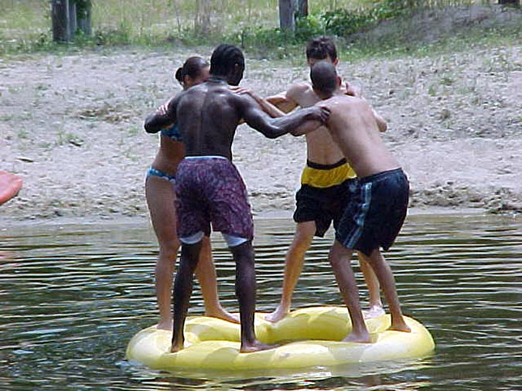
Flat Model
Emphasizes leader’s role as a working team member
Leader is an equal to the team, not above
Can you pick out the leader?

Slide 29
Consultant Model
Relationship between student team and instructor
Instructor is not part of the team will be nearby to serve as a resource
  Advise team
  Technical Consultant
  Intervention
  Disciplinary Actions

Slide 30
Modes of Team Action
Consensus
Majority
Minority
Averaging
Expert
Authority Rule Without Discussion
Authority Rule With Discussion

Slide 31
Consensus
Decision in which all members find common ground
Opportunity to express views and hear others
Not a unanimous vote

Slide 32
Majority
Option that receives the most votes wins
Takes less time than meeting consensus
Provides less creative dialog
Minority may become alienated

Slide 33
Minority
Small subset of a team makes decision
Expedites the decision
Team communication is less
  Some members may be prevented from contribution

Slide 34
Averaging
Compromise in the worst form
Accomplished with haggling, bargaining, cajoling, and manipulating
Extreme opinions cancel out
Little productive discussion
Least informed cancel votes of knowledgeable

Slide 35
Expert
Best teams recognize and seek this person out
Decision made with accurate, expert knowledge
Sometimes experts may disagree on best course of action because of their knowledge

Slide 36
Authority Rule Without Discussion
Strong leader makes decisions without discussing with team first
Works well with small, administrative, decisions
Greatest disadvantage is team’s trust in leader may be undermined

Slide 37
Authority Rule With Discussion
The leader makes the final decision
Seeks out team input first
Team members are part of the process and feel valued

Slide 38
Getting Going In Teams
Determine to give your best to help team grow and accomplish purpose
Do not expect perfect teammates
Be careful about first team impressions
Be a leader
Help team achieve own identity and personality
Be patient
Evaluate and grade yourself and team’s performance

Slide 39

Character of a Leader
Great teams need great leadership
  Without it, humans tend to drift, act alone, and lose purpose
Ensure team members remain focused and maintain positive attitude

Slide 40
Leader Attributes
Focus team on purpose
Be a team builder
Plan well and utilize resources effectively
Run effective meetings
Communicate effectively
Promote team harmony by fostering positive environment
Foster high levels of performance, creativity, and professionalism

Slide 41
Leadership Styles
Task-Oriented
  Concerned of team’s purpose and task at hand
  Plan the schedule
  Define the work
  Assign task responsibilities
  Set clear work standards
  Urge task completion
  Monitor results
People-Oriented
  Warm and supportive toward team members
  Develop team rapport
  Respect followers’ feelings
  Sensitive to followers’ needs
  Show trust in followers
Successful team needs both styles of leadership

Slide 42
Team Grading and Reports
Purpose accomplished?
Results high or low quality? Why?
Team grow through all stages? Detours?
Reflect on personality
Evaluate members on report card
  Example Next slide
Evaluate team leaders. Effective?
Honestly evaluate your contribution

Slide 43
Team Member Report Card
Criteria |  | Team Member
 | Name 1 | Name 2 | Name 3
Attendance
Responsible
Abilities
Creative
Average Grade

