Slide 1
Air infiltration

Slide 2
Heat Loss Calculation Review
H_{L}=(Surface Area) (U-Factor) (rT)
U-Factor = 1 / R_{Value-Overall}
  R_{Value}
    Individual materials resistance level to heat flow
rT = Change in temperature
Notes:
http://www.grc.nasa.gov/WWW/k-12/WindTunnel/Activities/Pascals_principle.html

Slide 3
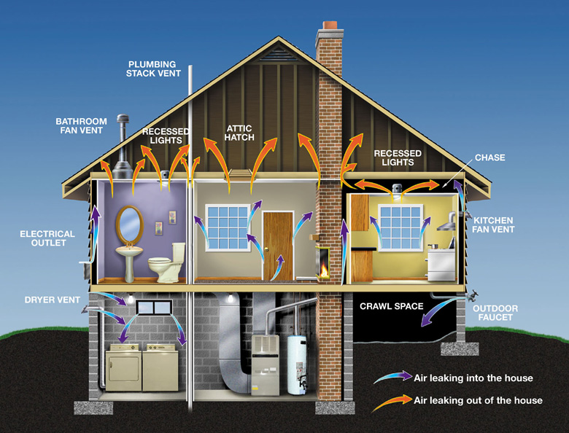
Air Infiltration
As structure gaps increase, air infiltration increases and heat loss increases
http://www.energystar.gov/ia/home_improvement/images/house-leaks-with-text-780.jpg

Slide 4
Air Infiltration Calculation
Q = L_{x} P((A)(rT) + (B)(V²))
Q = Airflow in ft³/min
L_{x} = Leakage Area
A = Stack Coefficient = .0156
B = Wind Coefficient = .0119
V = Wind Velocity = x
  Madison Average is 9.0 mph

Slide 5
Leakage Area = L_{x}
To solve for L_{x} we need to know what
the Lateral Leakage (L_{L}) is
  Lateral Leakage areas are exposed joints in a structure
L_{L} = (Exposure)(Area)+…+ (Exposure)(Area)
L_{x} = (L_{L})(.07in²)
  .07in² = Constant L_{L} for every 1 lnft²
    lnft = Linear Foot

Slide 6
Air Infiltration & Heat Loss
Due to the infiltration
of air, heat will be lost
  As structure gaps increase,
  air infiltration increases,
  and heat loss increases
We need to calculate
how air infiltration
impacts heat loss
http://www.energystar.gov/ia/home_improvement/images/house-leaks-with-text-780.jpg

Slide 7
Air Infiltration & Heat Loss Calculation
(L_{x}/12) (C) (rT) = H_{A}
C = HVAC Constant = 1.085
H_{A} = Heat Loss due to Air Infiltration in BTU / hour

Slide 8
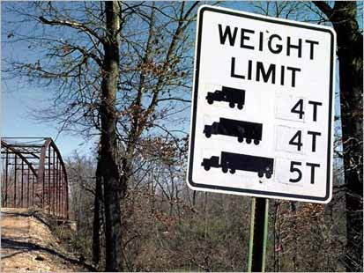
Safety Factors and Airflow
Safety factor (S.F)
  Plan ahead
Average person needs
Q = 0.28 ft³/min
  5Q = 1.4 ft³/min
Plan for a S.F. of 2
  Q = 2.8 ft³/min
http://blogs.abcnews.com/photos/uncategorized/2007/08/02/ap_bridge_weight_070802_mai.jpg

Slide 9

Balloon Effect
If only one hole
(that are not L_{L}) exists,
a balloon effect will occur
Solution = Have more than one hole to accommodate
http://www.studioe3.com/lessons/images/new3.gif

Slide 10
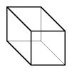
Example
NOTE: This example is not an example about the Case Study, rather an example on how to use the calculations.
We have a Rectangular Prism structure with the following parameters:
  Length = 6’
  Width = 4’
  Height = 4’
http://www.newbedford.k12.ma.us/elementary/gomes/stjohn/Subjects/Math/Geo/rectangular%20prism.jpg

Slide 11
Example
‘Find the exposed Surface
Area of the structure
Total Surface Area =
2lw + 2hw + 2lh =
2(6)(4) + 2(2)(4) + 2(6)(4) =
112’
http://www.newbedford.k12.ma.us/elementary/gomes/stjohn/Subjects/Math/Geo/rectangular%20prism.jpg

Slide 12
Example
Solve for L_{L} & L_{x}
L_{L} = (exp)(area)+…+ (exp)(area) =
(4)(6)+(4)(4)+(4)(4) =
(24) + (16) + (16) =
L_{A} = (L_{L})(0.07) =
(56)(0.07) =
56’
3.92 in²
http://www.newbedford.k12.ma.us/elementary/gomes/stjohn/Subjects/Math/Geo/rectangular%20prism.jpg

Slide 13
Example
Solve for Airflow needed
  5 people need 2.8ft³/min = Q
  Accommodate for Balloon Effect (2)
Q(2) = L_{x} P((A)(rT) + (B)(V²))
2.8(2) = L_{B} P((.0156)(80) + (.0119)(9.0²))
5.6 = L_{B} P((1.248) + (0.964))
5.6 = L_{B} P(2.212)
5.6 = L_{B} (1.487)
5.6/1.487 = L_{B}
3.766 = L_{B}

Slide 14
Example
Is L_{B} < L_{A} ?
If Yes
  Proceed to Air Infiltration &
  Heat Loss Calculations
If No
  Add gaps to make L_{B} < L_{A}
  Redo L_{A} to ensure L_{B} < L_{A}
  Repeat process until Yes
  Remember to subtract every gap added to the structure from the Surface Area

Slide 15
Example
L_{B} < L_{A} is correct
Solve for Q to ensure suffocation does not occur
Q = L_{A} P((A)(rT) + (B)(V²))
Q = 3.92 P((.0156)(80) + (.0119)(9²))
Q = 5.622 ft³/min
Is Q/2 > 2.4 ft³/min?
  5.622 / 2 = 2.811 ft³/min
  Reconfirms that there is enough Airflow for
  breathing with a safety factor of 2

Slide 16
Example
Find Heat Loss due to Air Infiltration
(L_{A}/12) (C) (rT) = H_{A}
(3.92/12)(1.085)(80) = H_{A}
28.355 BTU/ Hour = H_{A}
Remember:
  1 average person gives off 368.604 BTU/Hour of heat
  5 average people give off 1843.020 BTU/Hour of heat

Slide 17
Example
Figure out what overall R_{Value} is needed to maintain heat inside shelter at 60ºF
H_{L} – H_{A} = (Surface Area)(U-Factor)(rT)
1843.020 – 28.355 = (112)(U)(80)
1814.665 = (8960)(U)
1814.665 / 8960 = U
0.203 = U
0.203 = 1/R_{value}
R_{value} = 1/0.203
4.926 = R_{value} of all materials needed on each wall section

Slide 18
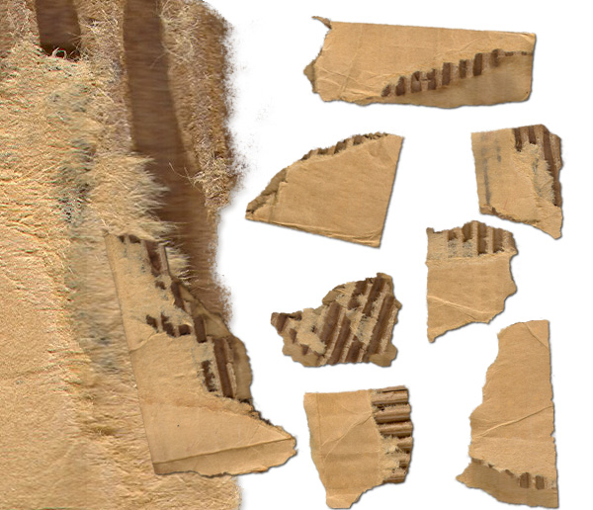
Example
Figure out the Wall Section materials and R_{values} of
those materials to meet
the U-Factor needed
FYI = 1/8” Corrugated Cardboard has an
R_{value} of 0.184
http://digitalvintagelabels.com/images/LabelTrader_ABitofCardboard1_600.jpg

