Slide 1
Introduction to
Thermodynamics
Heat Transfer,
Thermal Conductivity,
and Resistivity

Slide 2
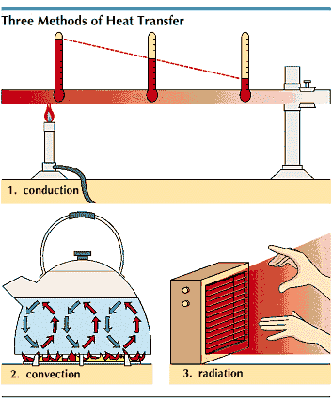
Heat Transfer
Heat is Transferred from a warm to a cool surface by:
  Conduction
  Convection
  Radiation
http://cache.eb.com/eb/image?id=63238&rendTypeId=4
Notes:
http://www.grc.nasa.gov/WWW/k-12/WindTunnel/Activities/Pascals_principle.html

Slide 3
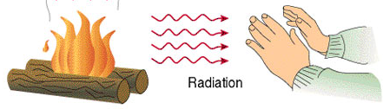
Heat Transfer - Radiation
Heat flows to a cooler surface through space
  Space = Air or Air Pocket
The air is warmed from
a warmed surface
http://www.beodom.com/assets/images/blog/principles-thermal-insulation/heat-transmittance-means.jpg

Slide 4
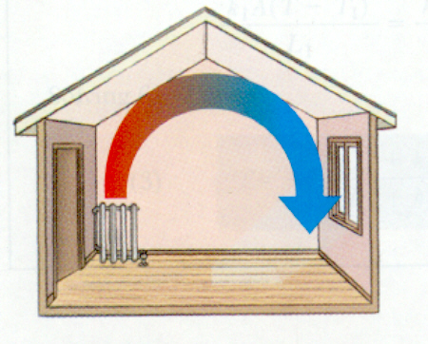
Heat Transfer - Convection
Warm surface heats the surrounding air
Cooler air moves in to take place of warm air causing a convection current
http://www.physics.arizona.edu/~thews/reu/convection1.bmp

Slide 5
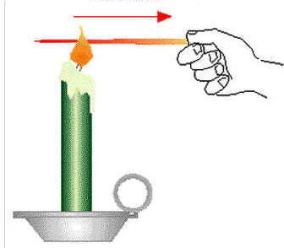
Heat Transfer - Conduction
Heat moves through
a solid material
Denser the material, the better it conducts heat
http://www.antonine-education.co.uk/Physics_GCSE/Unit_1/Topic_1/conduction.jpg

Slide 6
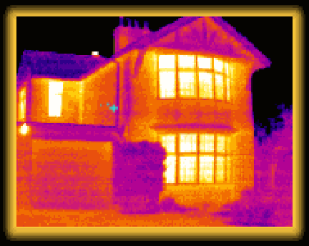
Temperature Transfer i.e. Heat Loss or Gain
The amount of heat that passes through the exterior surface of a building
Some Temperature Transfer will ALWAYS occur, regardless of the material (R_{value})
Always from Hot to Cold
Measured by Delta T (rT)
http://www.instablogsimages.com/images/2007/09/07/heat-loss_179.gif

Slide 7
Thermal Conductivity
The amount of heat that flows from one face of a material through the material to the opposite face
Defined as the amount of heat transferred through a 1 sq-ft surface area, 1” thick, with a temperature difference of 1ºF

Slide 8
Resistivity
The ability of materials to resist the transfer of heat
Materials with low (poor) resistance qualities
are conductors
Materials with high resistance qualities are insulators

Slide 9
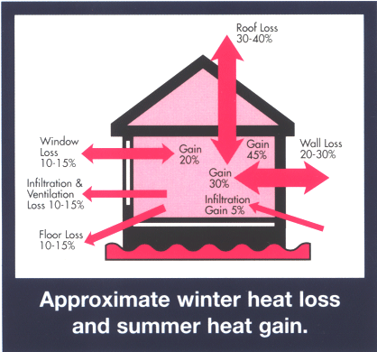
Insulation
A material used to stop
the transfer of heat
Made from vegetables, minerals, plastics, and metals
Stops heat transfer, blocks moisture, stops sound, resists fire, and resists insects
http://www.cosyinsulation.com.au/images/house_large.gif

Slide 10
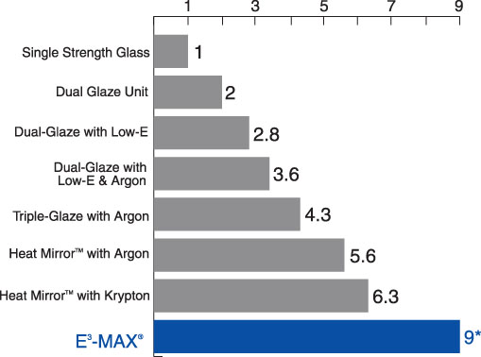
R Values
Measurement of the effectiveness of an insulating material
Higher the R-value, the greater the resistance to heat flow
http://www.phillipshomesolutions.com/Windows/R-VALUECHART.jpg

Slide 11
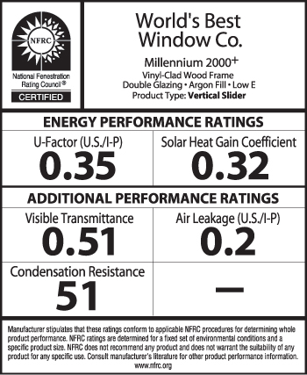
U Factor
To determine the combined Thermal Conductivity of all materials in a structure, including spaces, the U Factor is used.
Is the reciprocal of the totaled R-Values (1/r)
http://www.efficientwindows.org/toolkits/images/nfrclabel.jpg

Slide 12
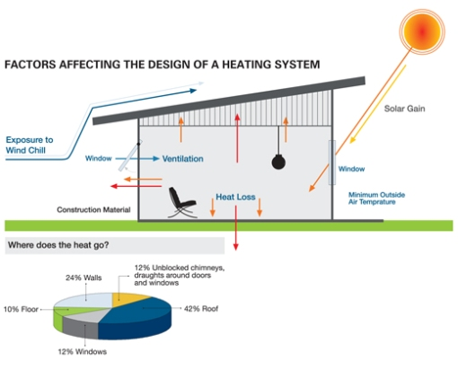
Heat Loss Calculation
Formula:
HL=(Area)x(U-Factor)x(rT)
Calculated in British Thermal Units (BTU) per hour
Multiply interior volume by constant 0.018 for average amount of lost BTU for infiltration
http://www.home-heating-systems-and-solutions.com/images/factors_affecting_heating.jpg

