Slide 1
Electromagnetism

Slide 2
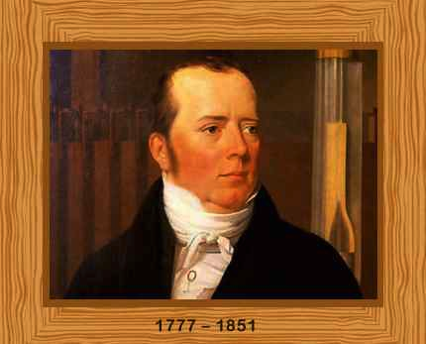
In 1819, Hans Christian Oersted
accidentally discovered that a
compass needle deflected when
the current was switched on.
Notes:
http://www.grc.nasa.gov/WWW/k-12/WindTunnel/Activities/Pascals_principle.html

Slide 3
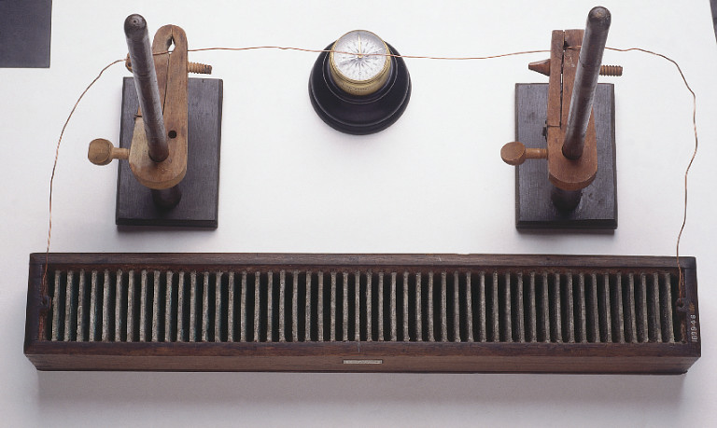
Oersted’s Experiment

Slide 4
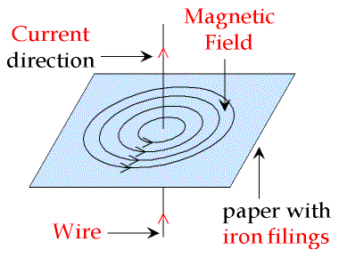
Magnetic field pattern around a straight wire.
The resulting magnetic field lines form concentric circles around the wire.

Slide 5
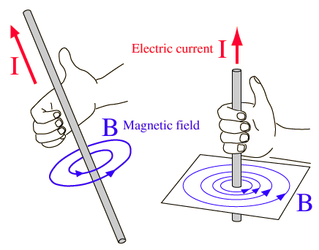
The Right-Hand Grip rule can be used to predict the direction of the magnetic field

Slide 6
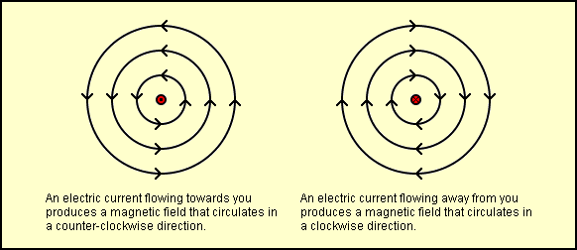
Magnetic field around a wire carrying current
The magnetic field of a long, straight current-carrying wire is stronger:
1) when it is closer to the wire, or
2) when a larger current flows through the wire.

Slide 7
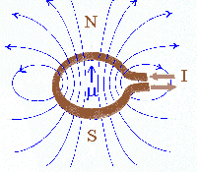
Magnetic field pattern around a flat coil
The magnetic field of a straight wire wound into a flat coil.
The magnetic field at the center of the coil is stronger as the magnetic field lines are closer.

Slide 8
Magnetic field pattern around a flat coil
There are two ways to increase the magnetic field strength at the center of the flat coil:
1) Increase the current.
2) Increase the number of turns of the coil.

Slide 9
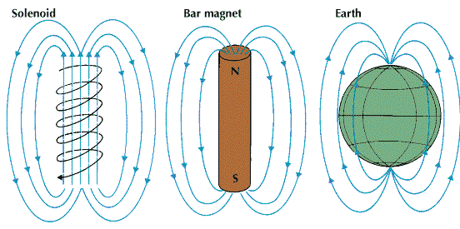
Magnetic field pattern around a flat coil
A solenoid is obtained by increasing the number
of turns of a flat coil.
The resulting magnetic field pattern of a solenoid resembles that of a bar magnet.

Slide 10
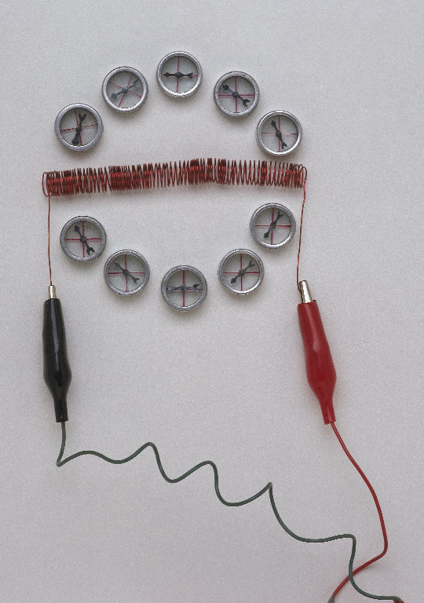
Magnetic field pattern around a flat coil
The magnetic field strength in a
solenoid can be increased by:
1) increasing the current,
2) increasing the number of turns per unit length of the solenoid, or
3) placing a soft iron core within the solenoid. The soft iron core concentrates the magnetic field lines, thereby increasing the magnetic field strength.

Slide 11
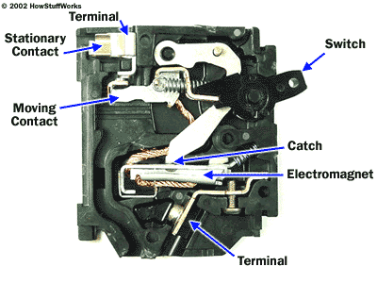
Uses of Electromagnets
1) Circuit Breaker - A safety device that switches off the electric supply when excessive current flows through the circuit. Uses an electromagnet to open the circuit.
Normal condition
Notes:
The basic circuit breaker consists of a simple switch, connected to either a bimetallic strip or an electromagnet. The diagram shows a typical electromagnet design.
The hot wire in the circuit connects to the two ends of the switch. When the switch is flipped to the on position, electricity can flow from the bottom terminal, through the electromagnet, up to the moving contact, across to the stationary contact and out to the upper terminal.

Slide 12
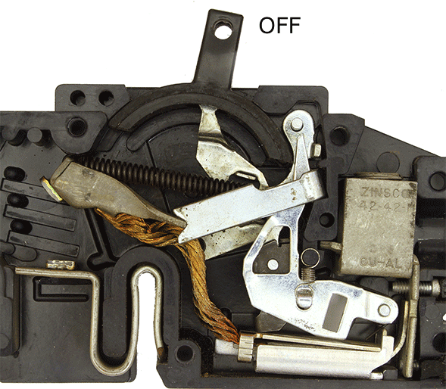
Uses of Electromagnets
Circuit breaker in operation
Notes:
The electricity magnetizes the electromagnet. Increasing current boosts the electromagnet's magnetic force, and decreasing current lowers the magnetism. When the current jumps to unsafe levels, the electromagnet is strong enough to pull down a metal lever connected to the switch linkage. The entire linkage shifts, tilting the moving contact away from the stationary contact to break the circuit. The electricity shuts off.

Slide 13
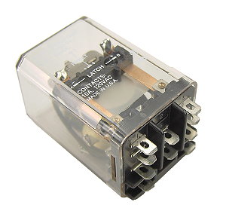
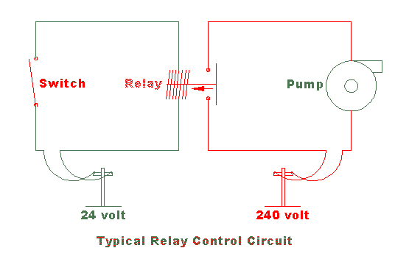
Uses of Electromagnets
2) Magnetic Relay - A device to control the switch of another circuit without any direct electrical contact between them.

Slide 14
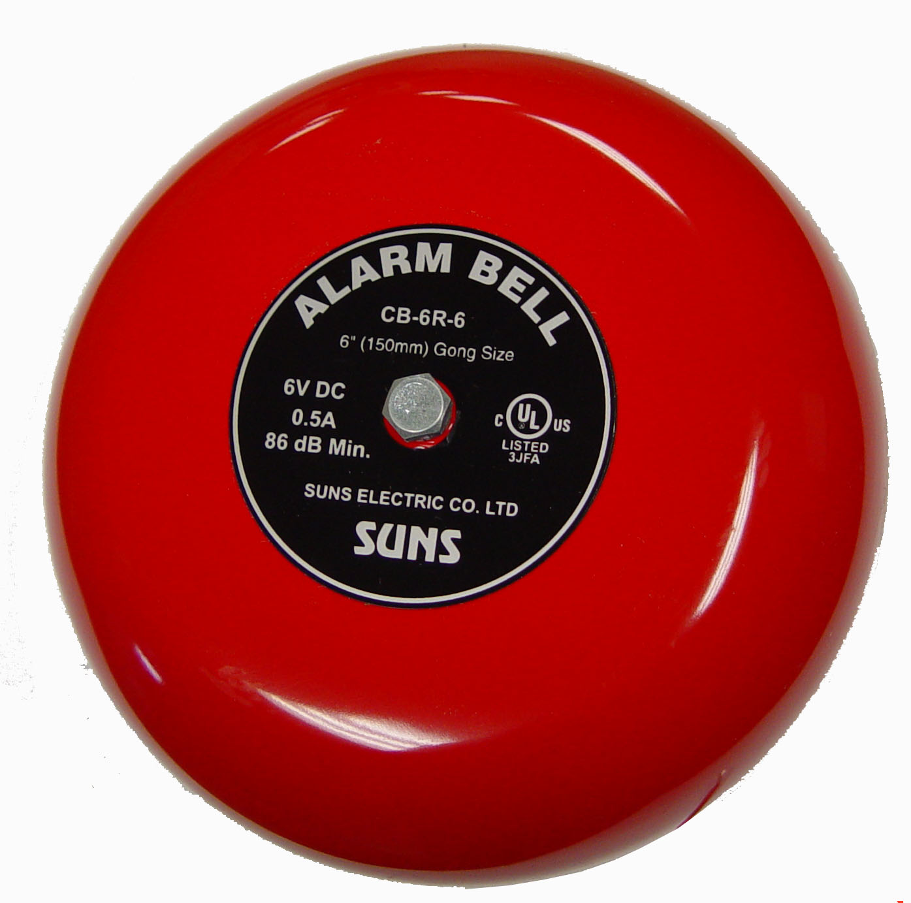
Uses of Electromagnets
3) Electric Bell - The electromagnet forms the core of the electric bell.

Slide 15
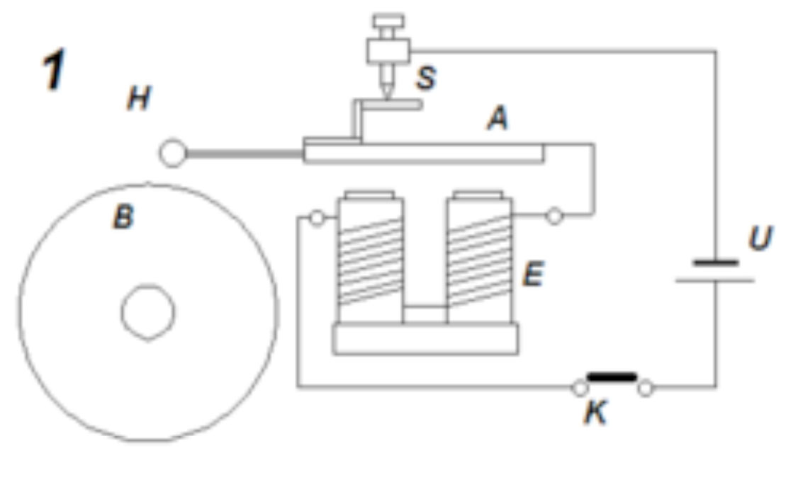
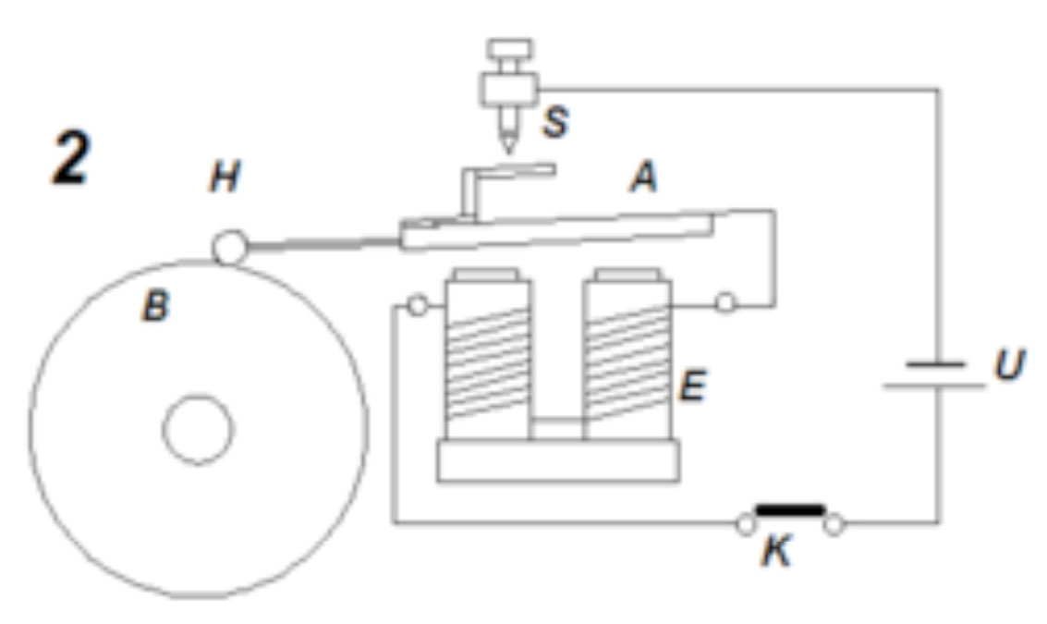
Uses of Electromagnets
Notes:
The electromagnet becomes magnetized, attracting the soft iron armature and the hammer strikes the gong. However, the circuit will break and the electromagnet loses its magnetism and the springy metal strip pull back the armature and the circuit is closed again. The process repeats.

Slide 16
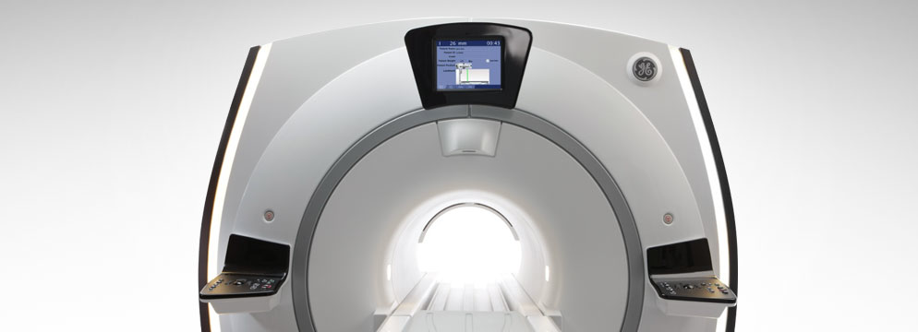
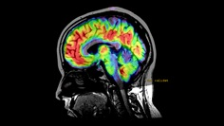
Uses of Electromagnets
4) Magnetic Resonance Imaging (MRI) - A popular method of medical imaging that provides views of tissues in the body. It is a large scanner containing a solenoid made of superconductors.

Slide 17
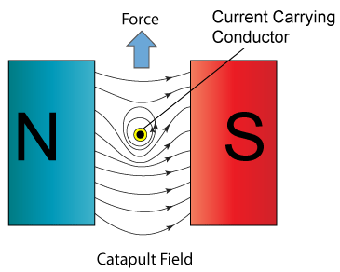
Force on current-carrying conductors
When you placed a current-carrying wire in a magnetic field, the wire experiences a force. This is called the motor effect.

Slide 18
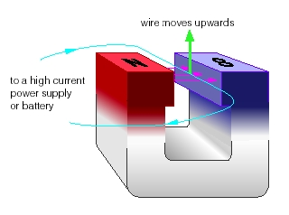
Force on current-carrying conductors
- This force acts perpendicular to both the direction of the
current and the direction of the magnetic field.

Slide 19
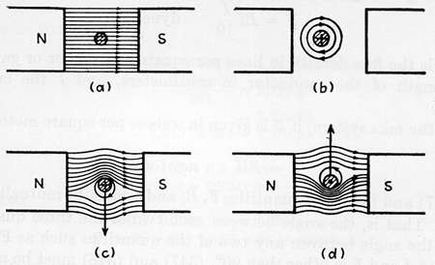
Force on current-carrying conductors
A change in the direction of the current in the wire will cause a change in the direction of the force, with the direction of the magnetic field staying constant.
Similarly, a change in the direction of the magnetic field will cause a change in the direction of the force, with the direction of the current in the wire staying constant.

Slide 20
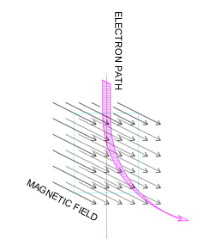
Force on charge particles
When you placed a charged
particle in a magnetic field, it
experiences a force.
The direction of deflection for these charged particles can be predicted by Fleming’s left hand rule.

Slide 21
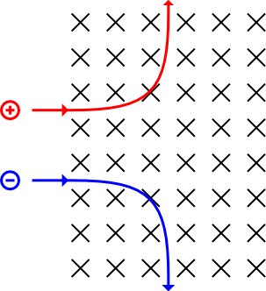
Force on charge particles
Magnetic field into page
Positively charged particle deflected upwards
Negatively charged particle deflected downwards
A change in the direction of the magnetic field will cause a change in the deflection of the charged particles, with the direction of the particles staying constant.

Slide 22
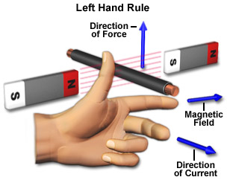
We can easily deduce the direction of the force on the current-carrying wire when it is placed in a magnetic field using Fleming’s Left-Hand Rule.
It helps us to predict the direction of motion or force.

Slide 23
Why does a current-carrying conductor experience a force when placed in a magnetic field?

Slide 24
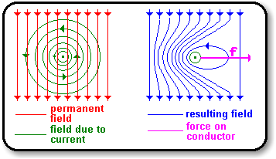
Magnetic fields that are in the same direction make the combined fields stronger.
Magnetic fields that are in opposite direction make the combined fields weaker.

Slide 25
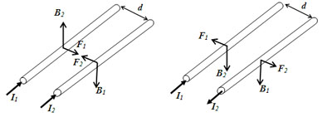
Force between two parallel wires
If we place two current carrying wires held parallel to each other, they always attract or repel each other. The direction of force of attraction is given by the Fleming’s left hand rule.
Notes:
According to the Fleming’s left hand rule, if we stretch our fore finger , middle finger and the thumb of left hand so that they are mutually perpendicular to each other, then the fore finger indicates the direction of produced magnetic field due to the another wire, middle finger indicated the direction of current in the wire and the thumb indicates the direction of force.

Slide 26
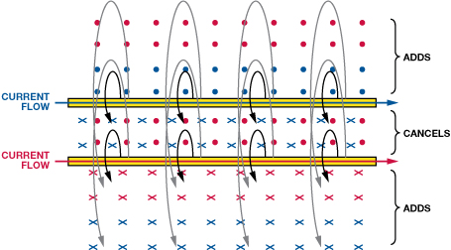
Force between two parallel wires
Parallel wires carrying currents will exert forces on each other. One wire sets up a magnetic field that influences the other wire, and vice versa. When the current goes the same way in the two wires, the force is attractive.

Slide 27
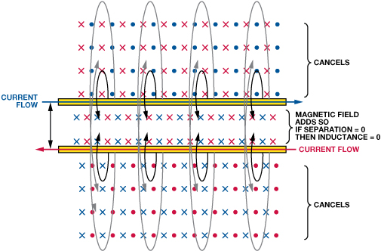
Force between two parallel wires
Parallel wires carrying currents will exert forces on each other. One wire sets up a magnetic field that influences the other wire, and vice versa. When the currents go opposite ways, the force is repulsive.

Slide 28
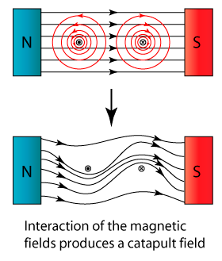
Force on a current-carrying rectangular coil in a magnetic field
The catapult effectt shows the force on a wire in a magnetic field when current flows through the wire.
Notes:
It follows then that a wire in a field from a permanent magnet will feel a force when current flows through it. The magnetic field generated around the wire by the current will interact with the field around the magnet and the two fields will push or pull on each other.
The magnetic field around a straight wire is circular. The magnetic field between two attracting poles is straight. When the two interact, the wire is pushed away from the field between the attracting poles at right angles (90°) both to the straight field lines and to the direction of current flow.

Slide 29
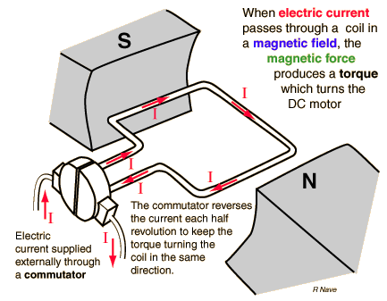
DC Motors
A direct current (DC) motor is a fairly simple electric motor that uses electricity and a magnetic field to produce torque, which turns the motor.
Notes:
A split - ring commutator (sometimes just called a commutator) is a simple and clever device for reversing the current direction through an armature every half turn. The commutator is made from two round pieces of copper (held apart and do not touch each other), one on each side of the spindle. A piece of carbon (graphite) is lightly pushed against the copper to conduct the electricity to the armature. The carbon brushes against the copper when the commutator spins.
As the motor rotates, first one piece of copper, then the next connects with the brush every half turn. The wire on the left side of the armature always has current flowing in the same direction, and so the armature will keep turning in the same direction.

Slide 30
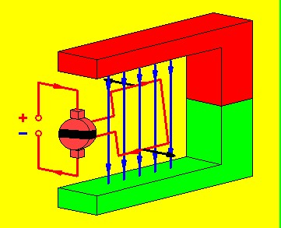
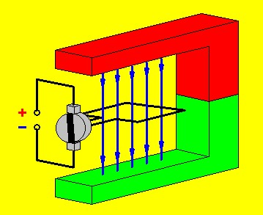
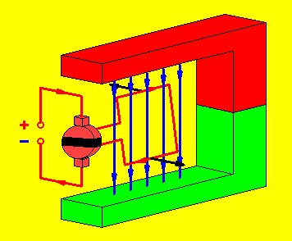
DC Motors
Current in this arm flowing from left to right.
Current stops flowing momentarily in the coil but inertia will propel it to make contact once again, reversing the current in the coil.
Current in the same arm reverses, flowing from right to left.

Slide 31
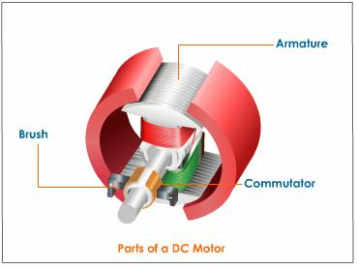
DC Motors
To increase the turning effect on the wire coil, we can:
increase the number of turns on the wire coil.
increase the current in the coil.
Insert a soft-iron cylinder at the center of the coil of wires.

Slide 32
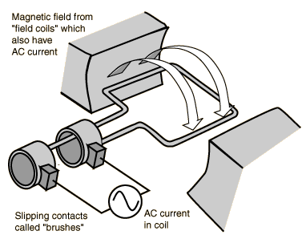
AC Motors
An AC motor is an electric motor that is driven by an alternating current.
It consists of two basic parts, an outside stationary stator having coils supplied with alternating current to produce a rotating magnetic field, and an inside rotor attached to the output shaft that is given a torque by the rotating field.
Notes:
s in the DC motor case, a current is passed through the coil, generating a torque on the coil. Since the current is alternating, the motor will run smoothly only at the frequency of the sine wave. It is called a synchronous motor. More common is the induction motor, where electric current is induced in the rotating coils rather than supplied to them directly.
One of the drawbacks of this kind of AC motor is the high current which must flow through the rotating contacts. Sparking and heating at those contacts can waste energy and shorten the lifetime of the motor. In common AC motors the magnetic field is produced by an electromagnet powered by the same AC voltage as the motor coil. The coils which produce the magnetic field are sometimes referred to as the "stator", while the coils and the solid core which rotates is called the "armature". In an AC motor the magnetic field is sinusoidally varying, just as the current in the coil varies.

Slide 33
DC/AC Motor Comparison
 | DC Motor | AC Motor
Similarities | 1. To convert electrical energy to rotational mechanical energy. | 1. To convert electrical power to rotational mechanical energy.
Differences | Commutator present. Cheap. Fixed speed. Requires direct current. | Absence of commutator (use slip rings). Expensive. Variable speed. Requires alternating current.

Slide 34
Reference
http://electronics.howstuffworks.com/circuit-breaker2.htm
http://sciencecity.oupchina.com.hk/npaw/student/glossary/img/flemings_left_rule_1.jpg
http://3.bp.blogspot.com/_PyvjcvYfRLk/SGNJZMpFH-I/AAAAAAAAAIc/iHWx7ovRjww/s400/catapult-field.png
http://www.gonefcon.com/trucktcom/m_wire_force.jpg
http://www.aspexcorp.com/images/scan-coil-2.jpg
http://upload.wikimedia.org/wikipedia/commons/3/3d/Path_of_charged_particles_in_a_magnetic_field.png
http://www.analog.com/library/analogdialogue/archives/41-06/AD41-06_FIG-13.jpg
http://www.analog.com/library/analogdialogue/archives/41-06/AD41-06_FIG-14.jpg
http://h2physics.org/wp-content/uploads/2010/05/forcebetweenwires.jpg
http://www.one-school.net/Malaysia/UniversityandCollege/SPM/revisioncard/physics/electromagnetism/images/turning-effect-field.png
http://www.gcsescience.com/pme10.htm
http://keterehsky.wordpress.com/2010/03/10/8-2-force-in-electromagnet/
http://image.wistatutor.com/content/magnetic-effects-electric-current/dc-motor-parts.jpeg
http://hyperphysics.phy-astr.gsu.edu/hbase/hph.html

