Slide 1
Ohm’s law

Slide 2
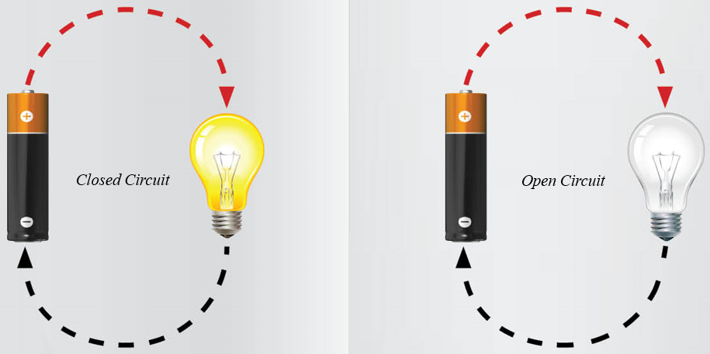
Closed Circuit
A circuit must be closed so that current can travel from the source, through the object of resistance back to the source.

Slide 3
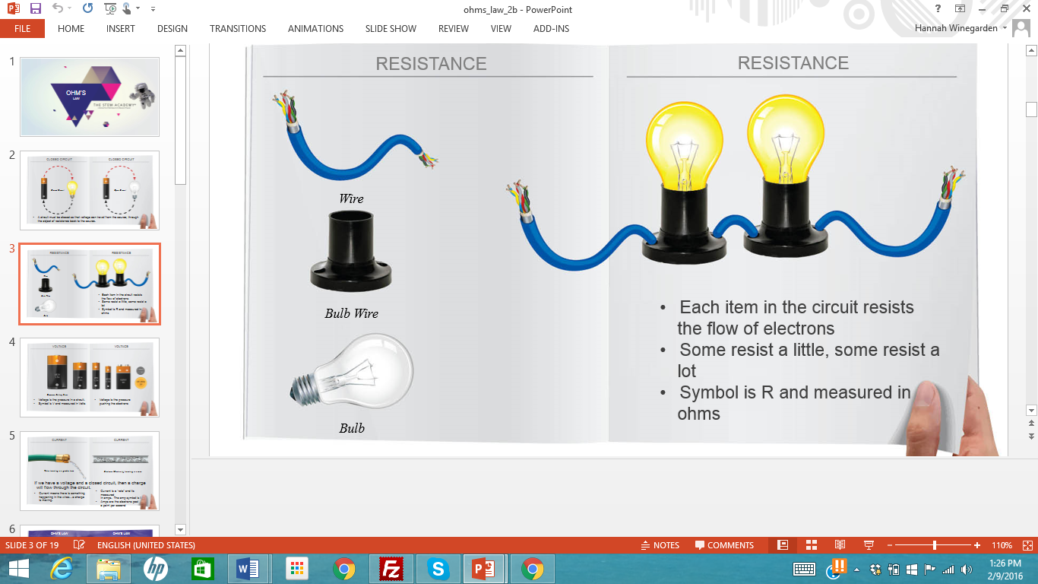
Resistance
Each item in the circuit resists the flow of electrons
Some resist a little, some resist a lot
Symbol is R and measured in ohms

Slide 4
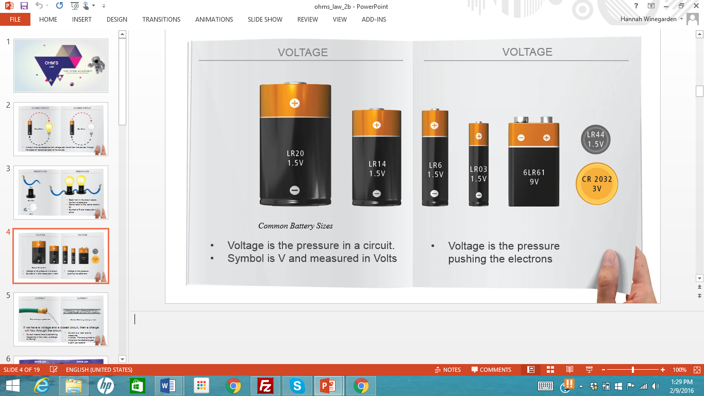
Voltage
Voltage is the pressure in a circuit.
Symbol is V and measured in Volts
Voltage is the pressure pushing the electrons

Slide 5
Current
Current means there is something happening in the wires…a charge is moving.
Current is a “rate” and its measured in amps. The amp symbol is an A
Amps are the electrons past a point per second
Examples: water in a garden hose and/or electrons in a wire

Slide 6
Ohm’s Law
Ohm’s law states that the current through a conductor between two points is directly proportional to the potential difference across the two points. Introducing the constant of proportionality, the resistance, one arrives at the usual mathematical equation that describes this relationship:
I=V/R

Slide 7
Ohm’s Law
I is the current through the conductor in units of amperes, V is the potential difference measured across the conductor in units of volts,
R is the resistance of the conductor in units of ohms.
More specifically, Ohm’s law states that the R in this relation is constant, independent of the current.

Slide 8
Ohm’s Law
By knowing any two values of the Voltage, Current or Resistance quantities we can use Ohms Law to find the third missing value.
To find the Voltage, ( V ) [ V = I x R ]
V (volts) = I (amps) x R (Ω)
To find the Resistance, ( R ) [ R = V ÷ I ]
R (Ω) = V (volts) ÷ I (amps)
To find the Current, ( I ) [ I = V ÷ R ]
I (amps) = V (volts) ÷ R (Ω)
Notes:
By knowing any two values of the Voltage, Current or Resistance quantities we can use Ohms Law to find the third missing value. Ohms Law is used extensively in electronics formulas and calculations so it is "very important to understand and accurately remember these formulas".
To find the Voltage, ( V )
[ V = I x R ] V (volts) = I (amps) x R (Ω)
To find the Current, ( I )
[ I = V ÷ R ] I (amps) = V (volts) ÷ R (Ω)
To find the Resistance, ( R )
[ R = V ÷ I ] R (Ω) = V (volts) ÷ I (amps)

Slide 9
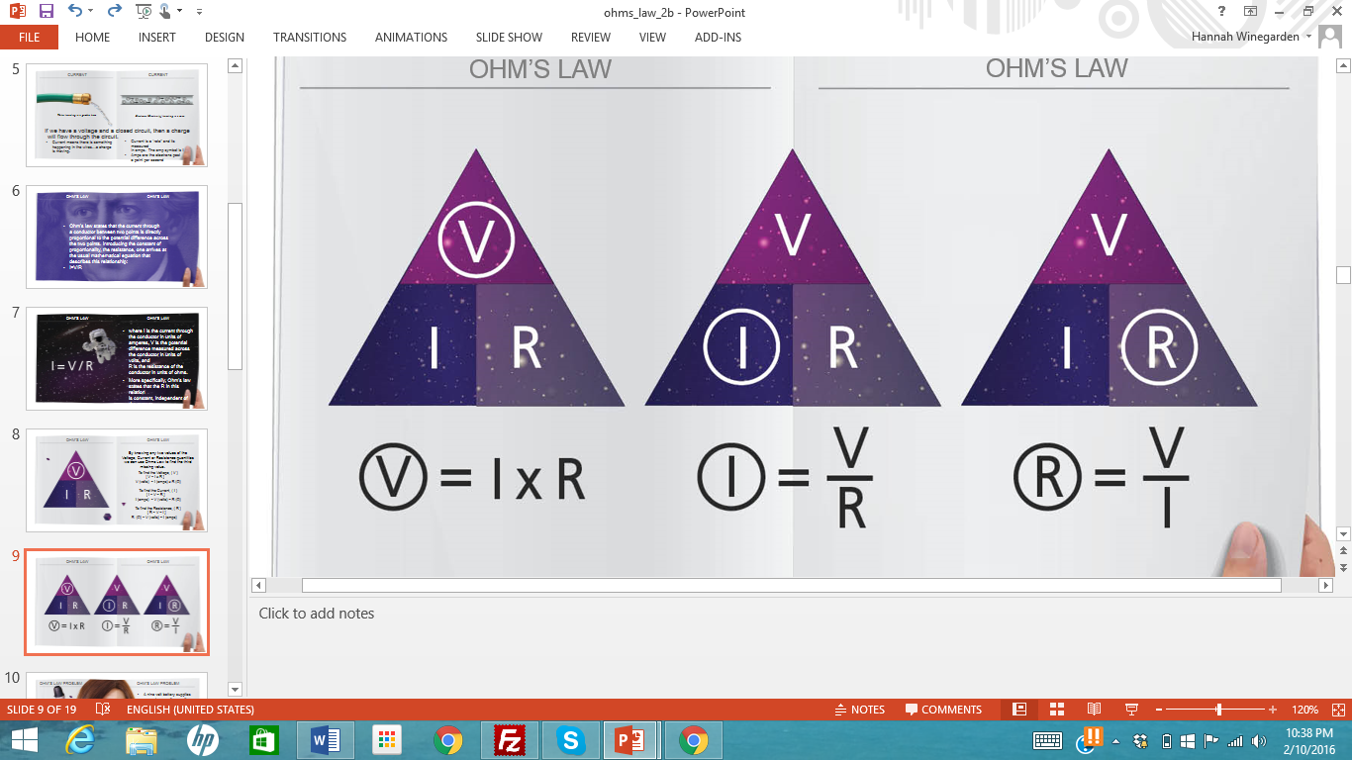

Slide 10
Ohm’s Law Example Problem:
A nine volt battery supplies power to a cordless curling iron with a resistance of 18 ohms. How much current is flowing through the curling iron?

Slide 11
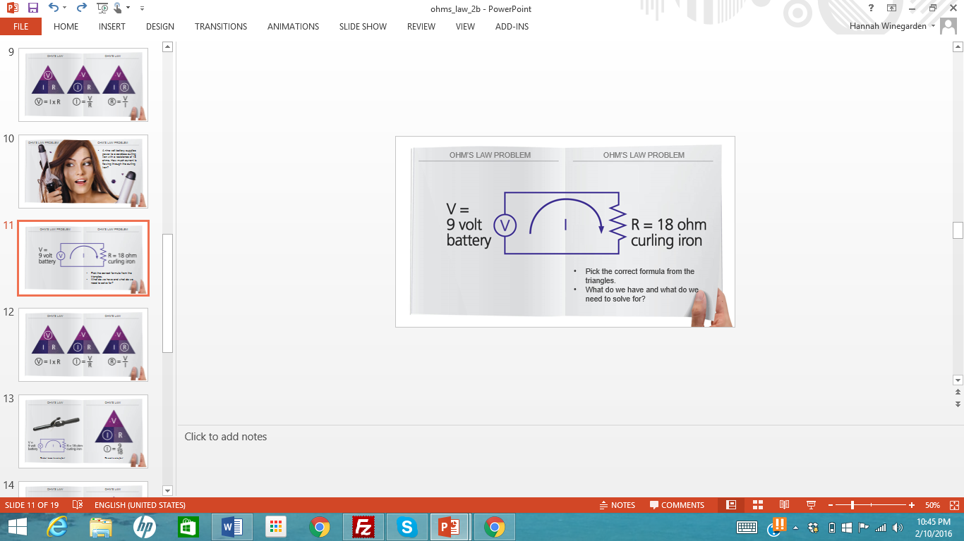
Step 1: Pick the correct formula from the triangles.
Think: What do we have and what do we need to solve for?

Slide 12
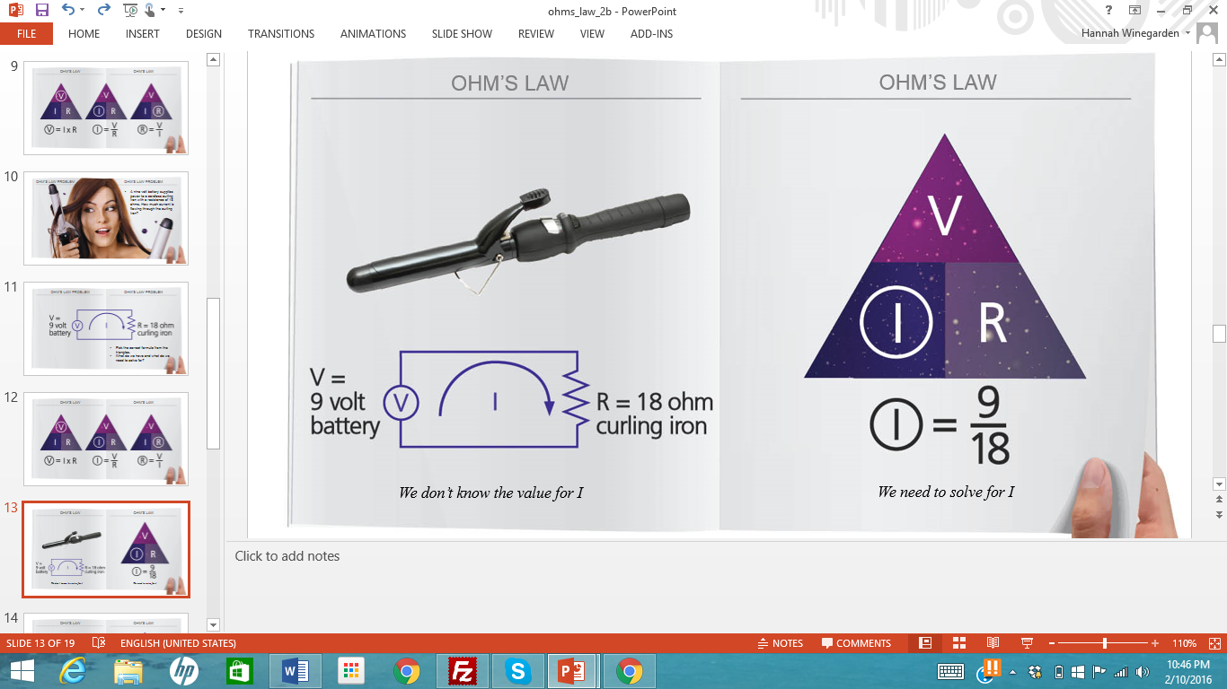
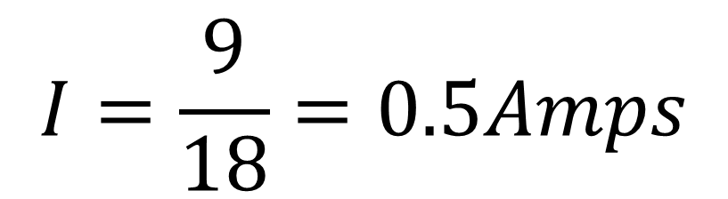
$$I=\frac{9}{18}=0.5Amps$$

