Slide 1
The Parallel Circuit

Slide 2
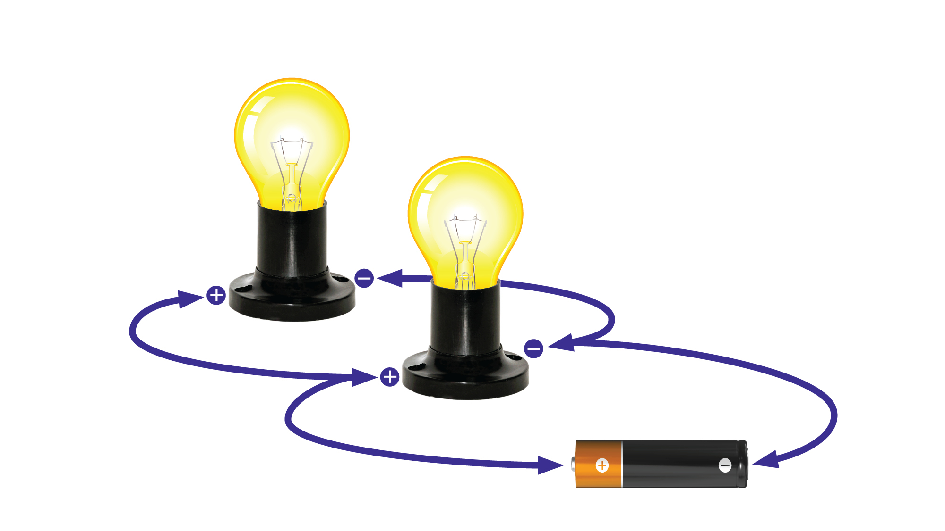
^{Parallel Circuit}

Slide 3
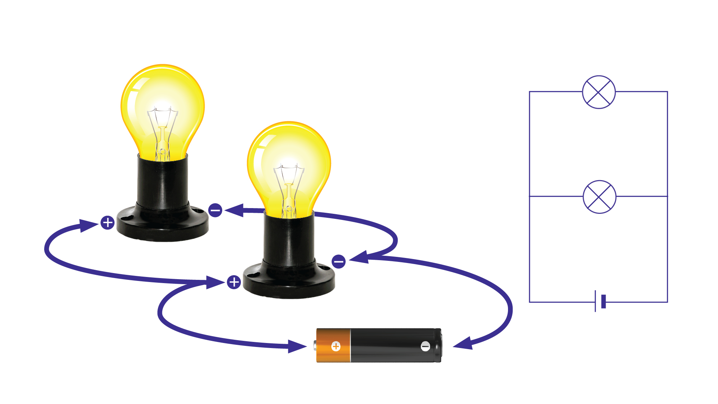
Has at least one point where current divides
Current takes multiple paths
Paths are also called branches
^{Parallel Circuit}

Slide 4
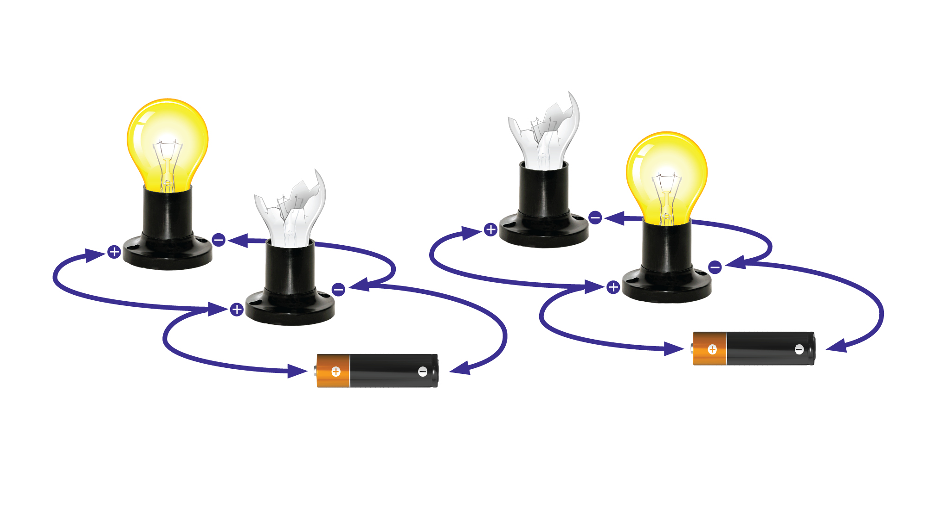
^{Parallel Circuit}
^{Parallel Circuit}
When one bulb in the circuit is removed, the other bulbs in the parallel branches stay lit.

Slide 5
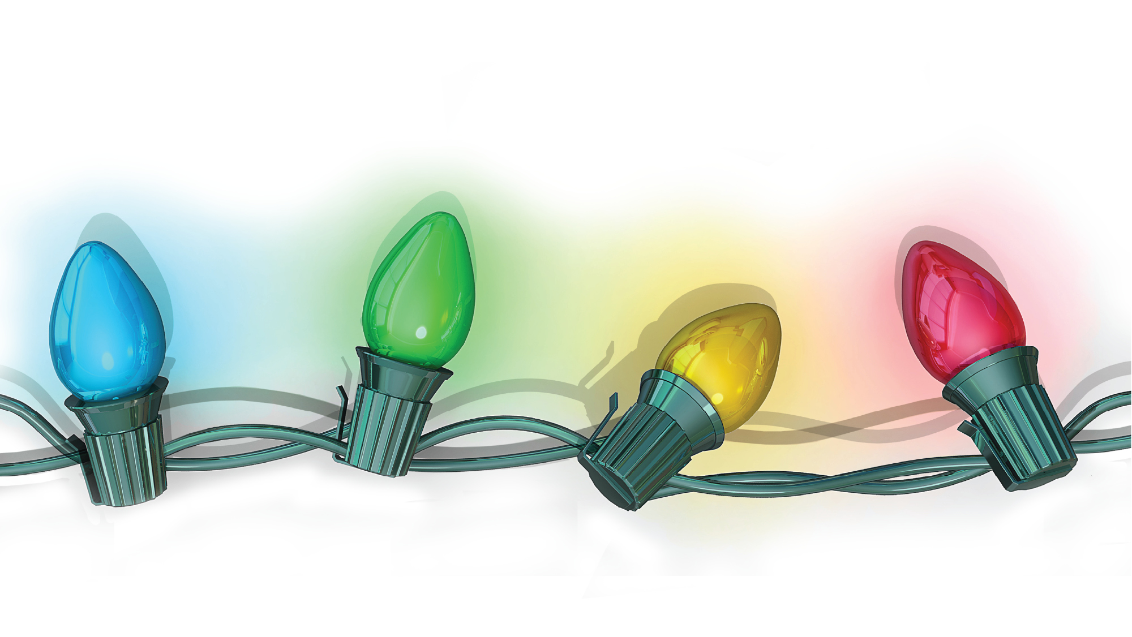
If you add another light
(additional resistor):
The total resistance of the circuit goes down
The current in the circuit goes up when you add another path

Slide 6
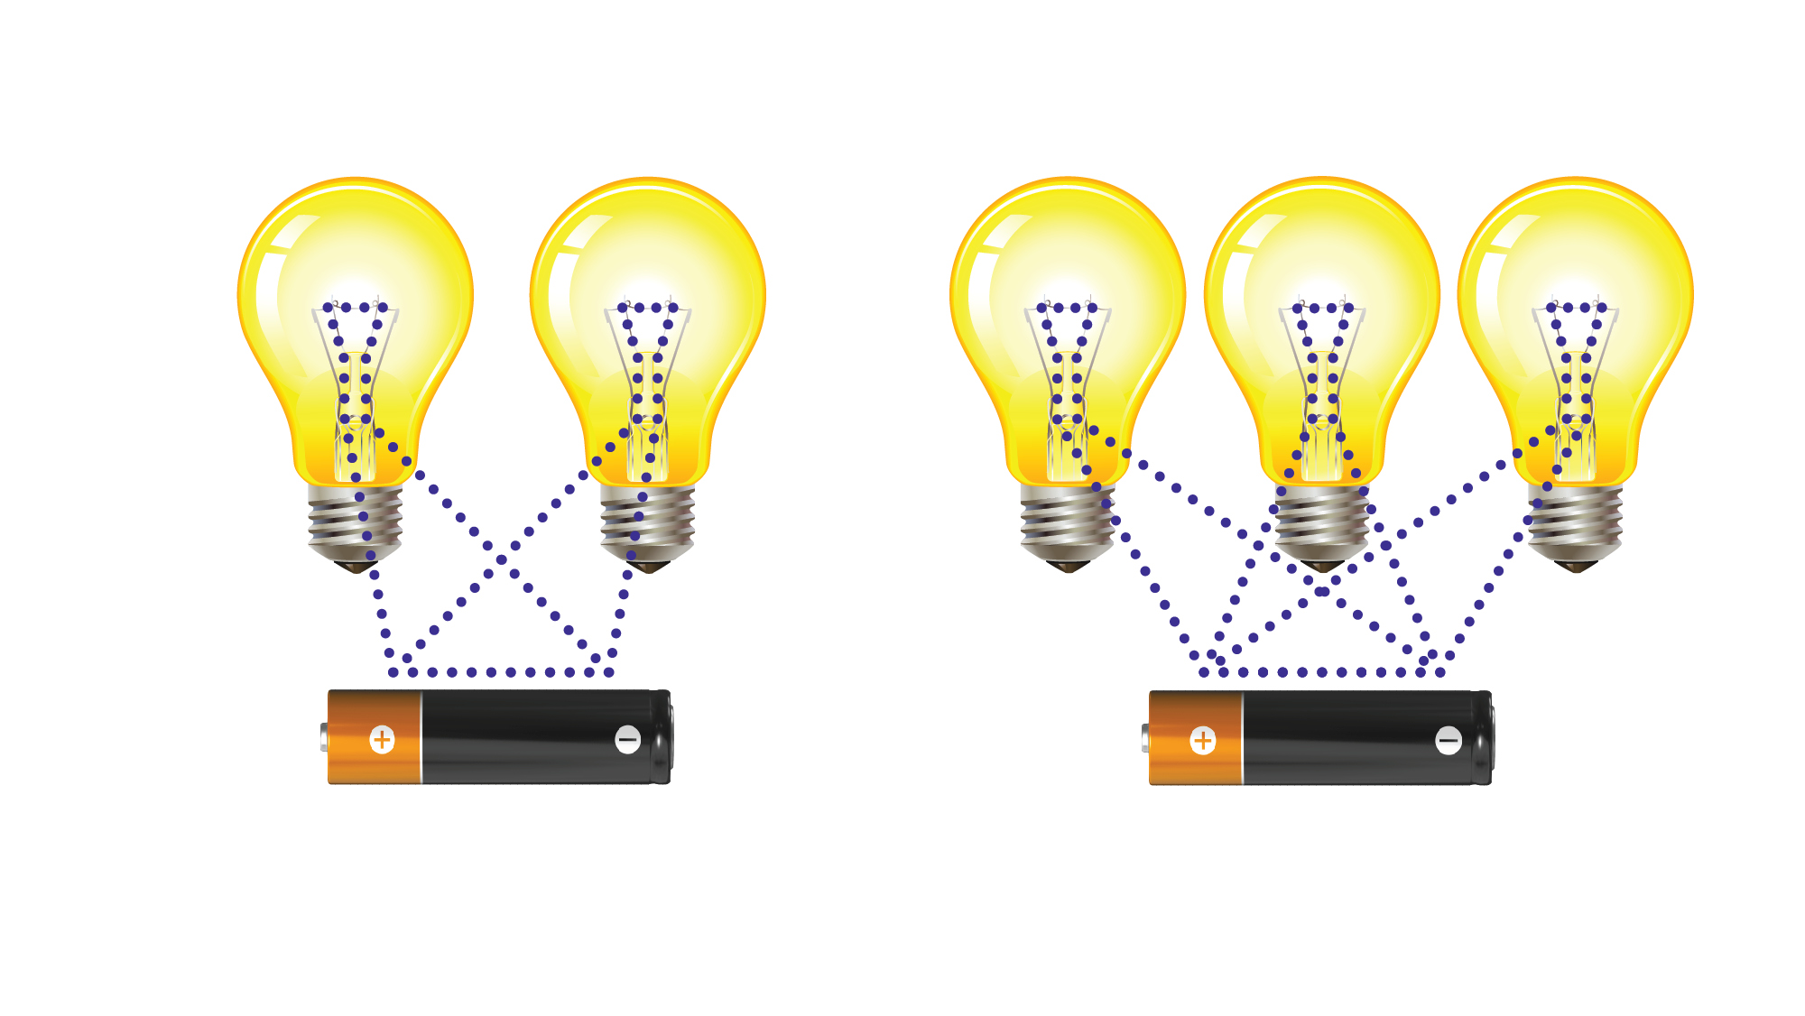
Notice how the three bulbs are just as bright
as the two with the same power

Slide 7
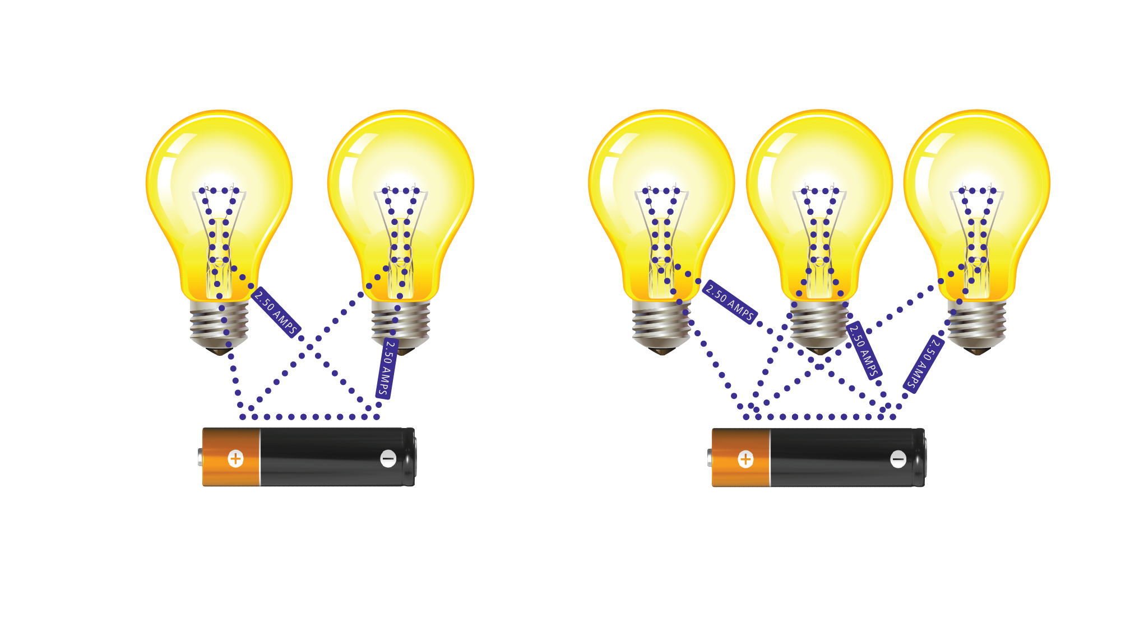
Notice how current is the same in the circuit no matter
the number of bulbs. This is measured in amps.

