Slide 1
The Series Circuit

Slide 2
^{Series}

Slide 3
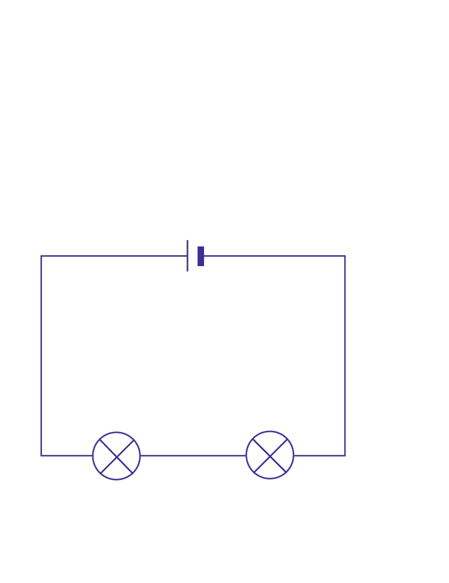
Current only takes one path for electrons
The current flows through every part of the circuit

Slide 4
When one bulb in a series circuit goes out, they all go out

Slide 5
If you add another light
(additional resistor):
The total resistance of the circuit goes up
The current in the circuit goes down, but will be the same in the entire circuit

Slide 6
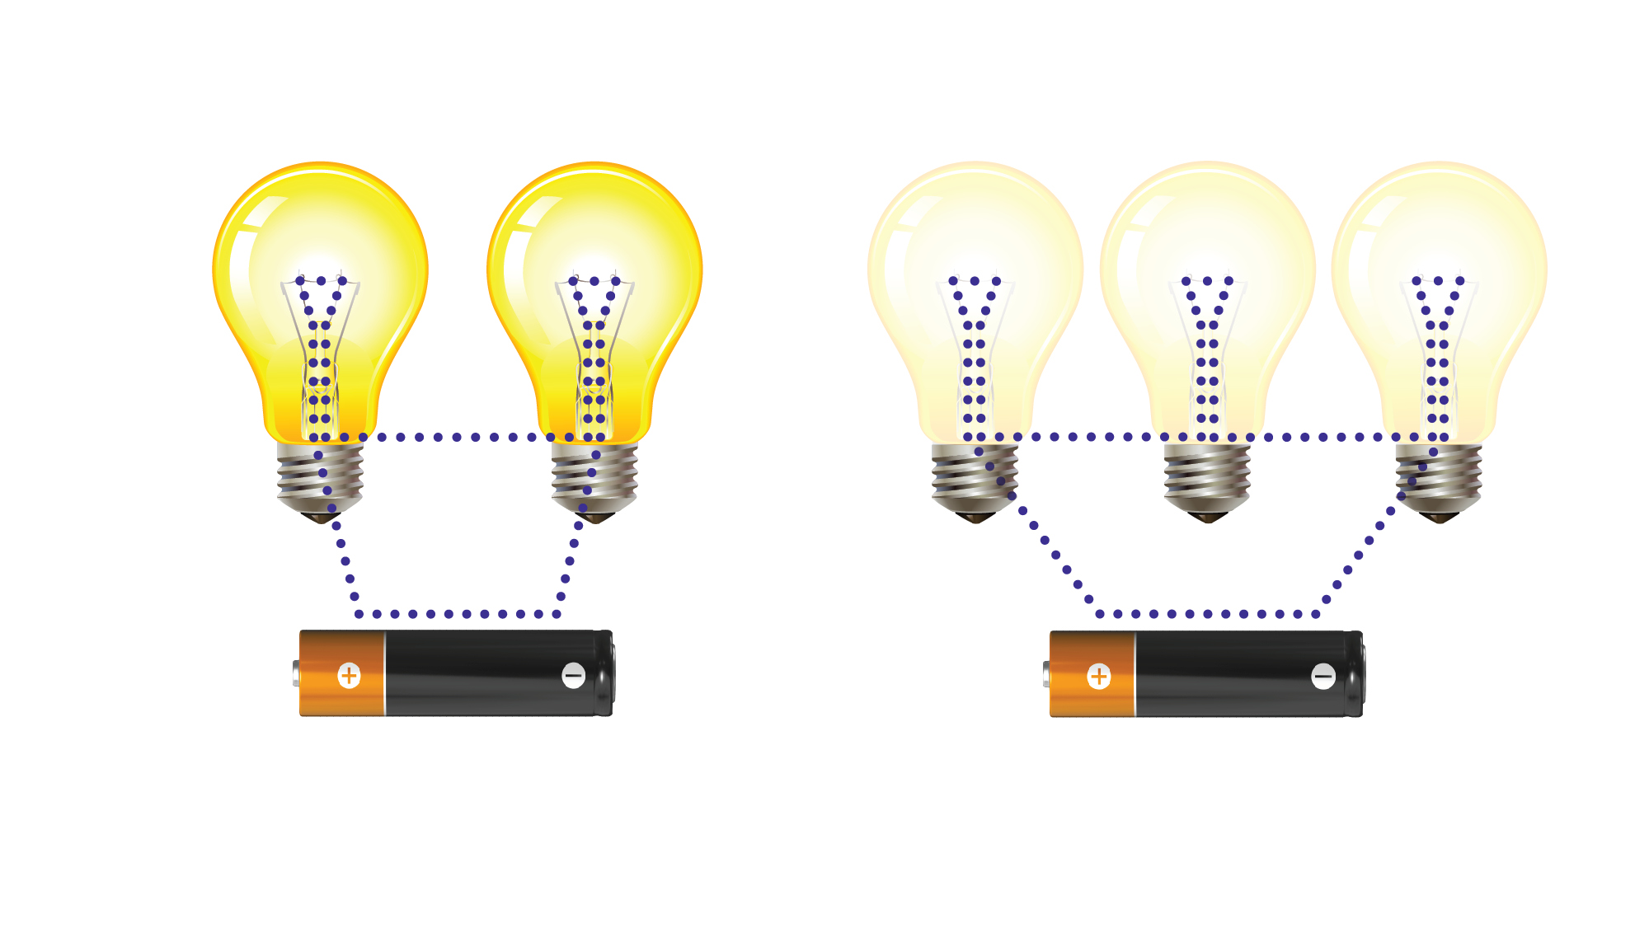
Notice how the three bulbs are dimmer than the two

Slide 7
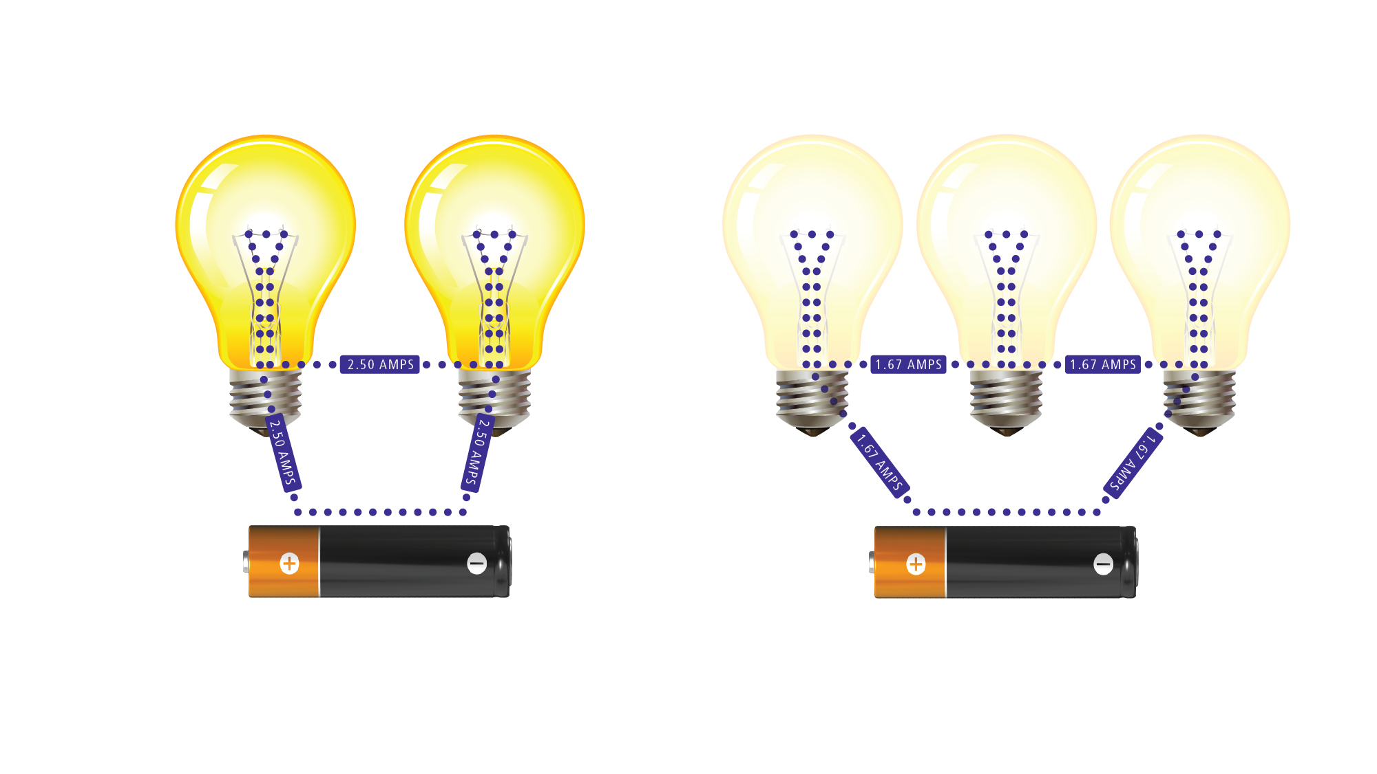
Notice how the current in the entire circuit goes down with a third bulb. This is measured in amps.

