Slide 1
Short Circuit &
protection Devices

Slide 2
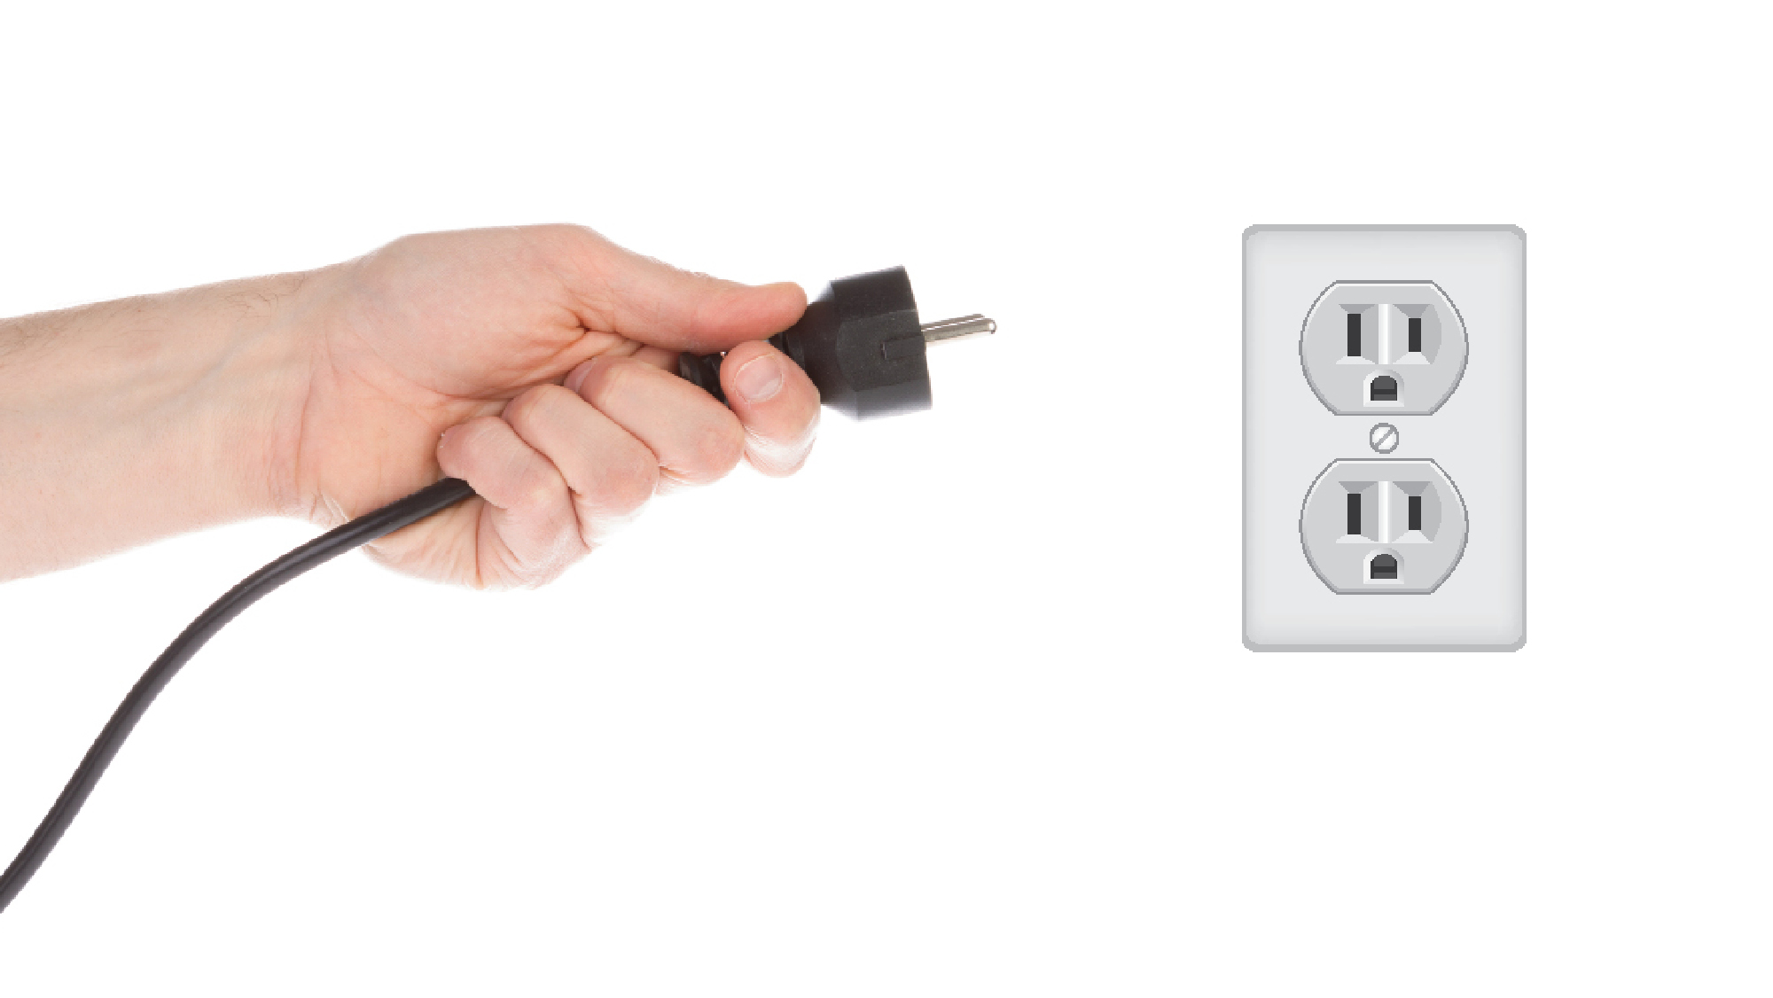
Most circuits usually have a load and two terminals that are connected to a load
The load can be things like an LED light, a blender or any object that converts electrical energy into another form of energy.

Slide 3
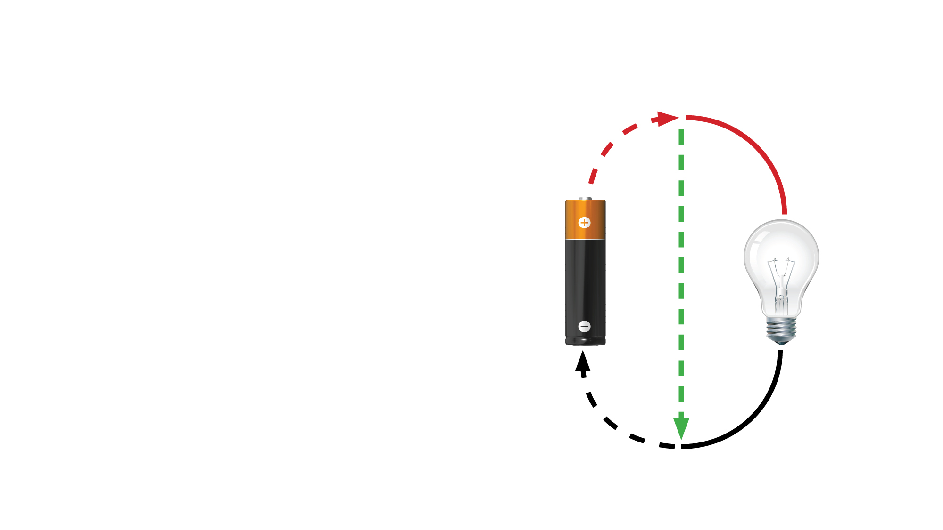
A short circuit occurs when
two or more bare wires or connections touch each other
This is an unintended path
for the electricity and can cause damage to the device, people or the environment
it is placed in.

Slide 4
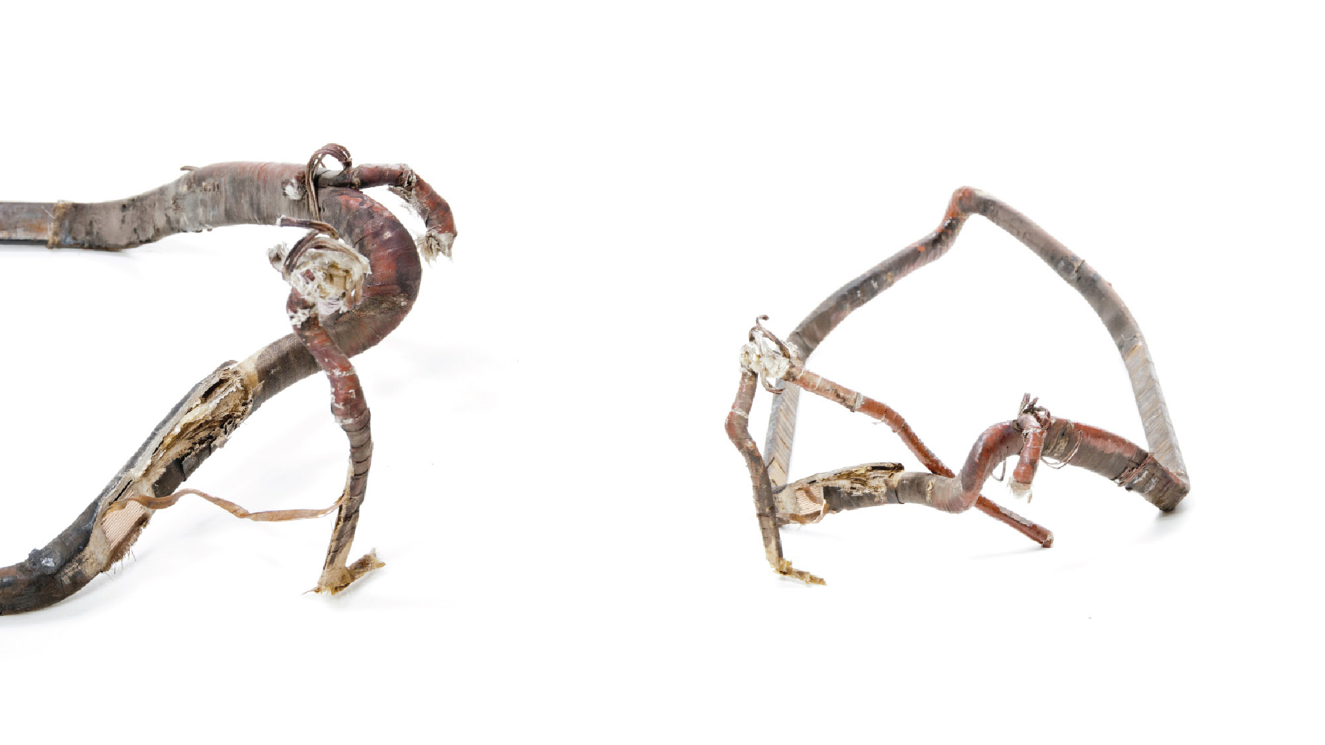
Often bad or frayed insulation on wires is an indicator
of a potential short circuit.

Slide 5
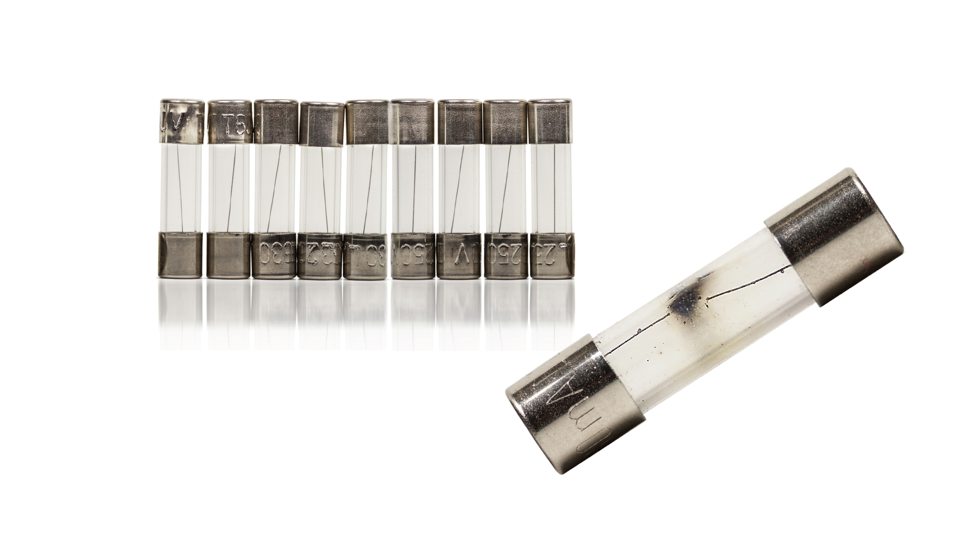
If a problem occurs in an electrical circuit, a fuse is used to break the connection and save the device or environment.
^{Blown Barrel Fuse}

Slide 6
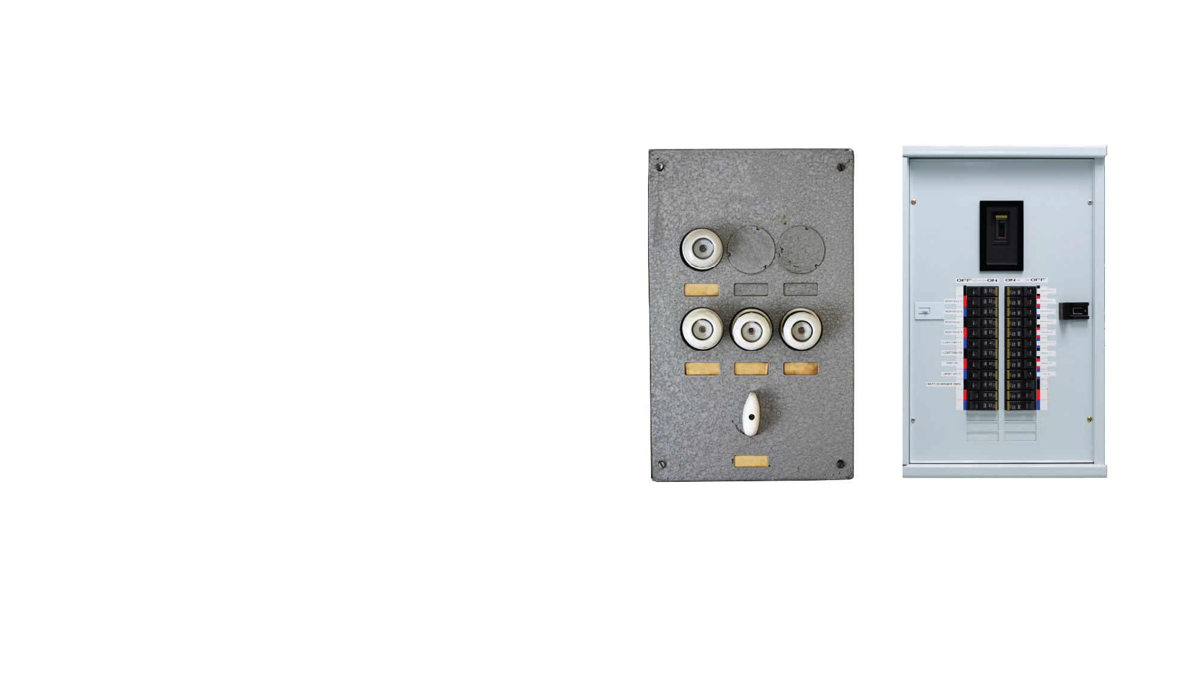
In your house or apartment building, a fuse box or circuit breaker is used to protect the electrical circuits.
  Fuse boxes use cylindrical fuses that have to
  be replaced
  Circuit breakers “trip”
  when overloaded and
  have to be reset,
  not replaced.
^{Fuse Box}
^{Breaker Box}

Slide 7
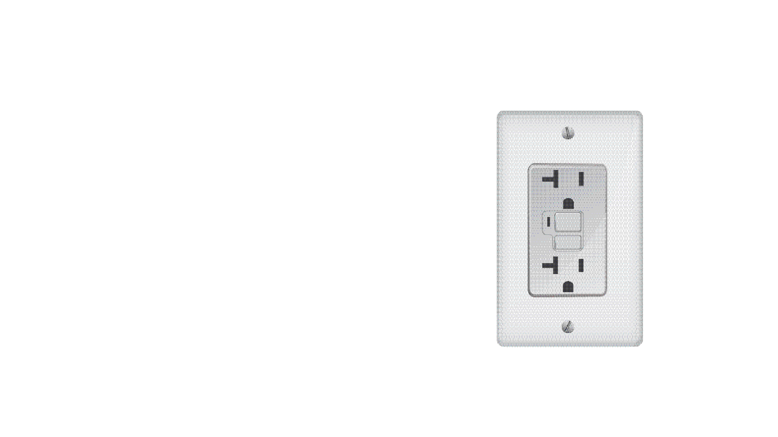
A GFCI outlet protects people
from electrical shock, it is different from a fuse
  GFCI monitors the amount of current flowing from the hot (small slot) to neutral (large slot)
Even with a small mismatch in current, the GFCI trips the circuit at the outlet to protect.
Often these outlets are used outdoors, or near a sink
^{GFCI Outlet}

Slide 8
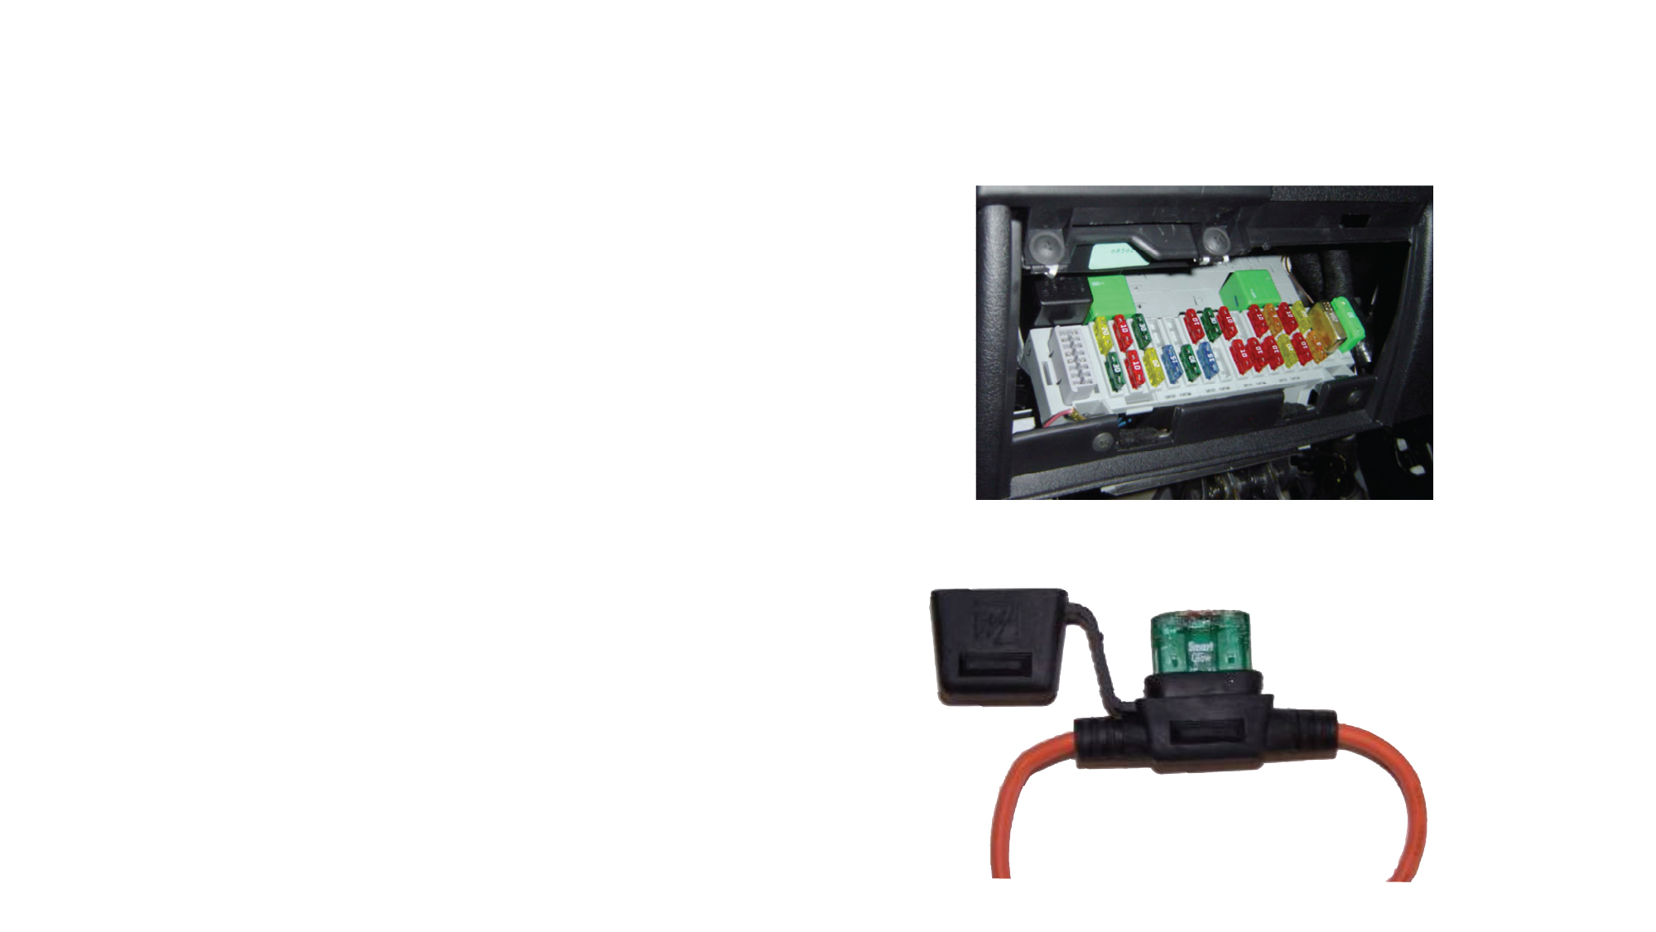
In your car there are multiple
fuses in various places
  Fuse boxes can be in or
  under the dashboard
  Fuse boxes can be in the
  engine compartment
In-line fuses can also be used and are along the wire it protects
^{Fuse Box}
^{In-line Fuse}

Slide 9

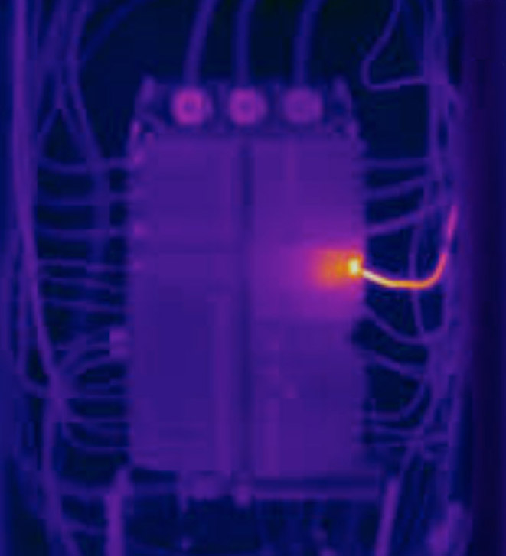
^{130.2ºf}
When replacing a fuse or
breaker, only use the correct
size for the circuit
  Undersized protection devices
  will trip quickly
  Oversized protection devices have
  the potential to cause damage to
  the device or environment
ALWAYS use the correct protection device, bypassing the fuse or using material other than the fuse can cause shock, damage to the
device or the environment
^{Thermal image of an}
^{overheating circuit breaker}
^{54.4}

