Slide 1
Pneumatics

Slide 2

What does Pneumatics mean?
Derived from the Greek word pneumatikos
  Means “to come from the wind”
Describes using air power to complete a task.
  Blowing dust off the table using your mouth is technically a pneumatic task.
Notes:
http://misheli.image.pbase.com/u12/elsinger/large/3156433.blowing.jpg&imgrefurl=http://www.pbase.com/elsinger/image/3156433&h=800&w=758&sz=66&hl=en&start=8&tbnid=vmQnCj2o9jdR8M:&tbnh=143&tbnw=135&prev=/images%3Fq%3Dblowing%26svnum%3D10%26hl%3Den%26lr%3D%26safe%3Dactive

Slide 3
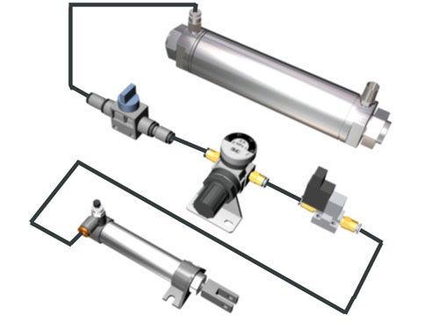
How do Pneumatics work?
Pneumatics work by using air that is more dense than regular air to apply pressure to something
Pneumatics require an open-circuit to operate efficiently
  No return necessary

Slide 4
What is Pressure?
Pressure is the amount of force applied to an area of a material
  Pounds per Square Inch
    Amount of force (in lbs) applied to an area
    (in square inches)
  Pascal
    Amount of force (in N) applied to an area (in square meters)
      Newton (N) = Amount of force necessary to move one kg one meter per second (F=ma)
Put your thumb on the table.
  Your thumb takes up approximately one square inch.
Press down LIGHTLY
  You will exert a force of somewhere around ½ a Pound
Therefore, the pressure you exert on the table is about .5PSI (Pounds per Square Inch)

Slide 5
How do we use this Pressure?
Due to the formula to get pressure (Pressure=Force/Area) we know that pressure will exert a force onto anything with an area
  A Piston or drive tooth has a surface area that the pressure will push against, thus exerting force
If an pneumatic nail gun has a hammer that measures ½ an inch
in diameter, and there is 100 psi supplied through the air line,
50 pounds of force are exerted
on the hammer
What if the hammer measures ¼” in diameter?

Slide 6
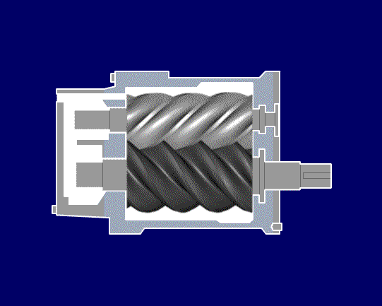
How do you Create Pressure?
In Pneumatics, we create pressure by compressing the air
  Forcing more air into an area, thus resulting in higher pressure created
  Pumps create compressed air
  by forcing more air into a container without a release
    Tanks must be strong
    to withstand pressure

Slide 7
How do we use this Pressure?
Normal Air
We use a system to create, transport and use this pressure
  Compressor
  Transfer Lines
  Usage point
  Exhaust
Air Compressor
Transfer Line
(hose)
Usage
Exhaust

Slide 8
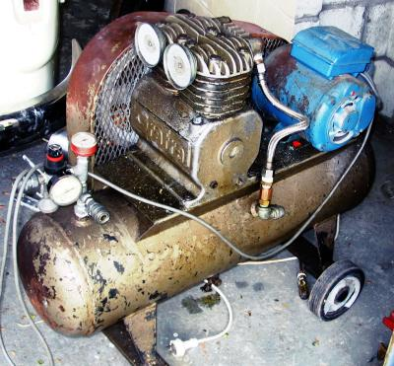
Compressor
Pistons, Lobes or Gears operate
to compress the air
  Air is let in through a valve or port
  Air flows into cylinder or gap between lobes
  Piston or lobes decrease area available
  for air to take up, thus compressing it
  Air is forced into a holding tank and
  stored to build up pressure
  Air is released by use of a regulator
This process can be run backwards as well, to force air out, to create a vacuum
Notes:
http://en.wikipedia.org/wiki/Image:Air_compressor.jpg

Slide 9
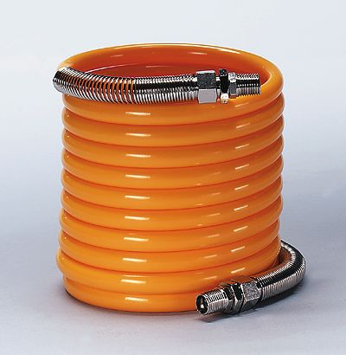
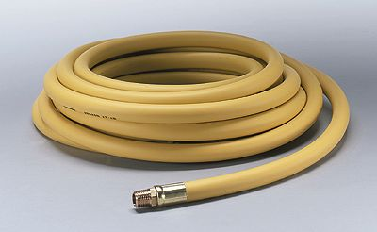
Transfer Lines
Transfer lines for air are usually pretty thin and flexible
  Can range from 1/8” to 1”
  in diameter
  Bigger hose can cause a reduction in pressure unless
  there is a sufficient supply
Notes:
http://www.coleparmer.com/catalog/large_image.asp?img=7916100.jpg
http://www.coleparmer.com/catalog/large_image.asp?img=7916133.jpg

Slide 10
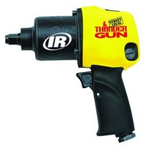
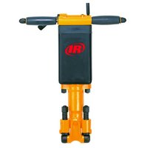
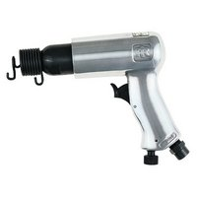
Usage Points
Compressed Air can perform lots of functions
  Running air motors
    Driving vanes causing motors to rotate
  Providing quick forceful blasts repetitively
    Power hammers
  Provide constant streams of air
    Cleaning off parts and tools
  Releasing or activating controls
    Air Brakes
Notes:
http://www.irtools.com/

Slide 11
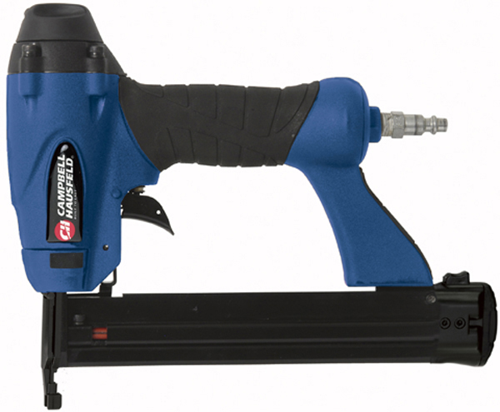
Exhaust
Air Exhaust Port
Due to the fact that air does not need to be recycled into a storage tank, the system is simpler
  No return hoses necessary
  Air is released into atmosphere, and new air is compressed
  into system
  Air can be released directly
  after usage
Notes:
http://www.campbellhausfeld.net/webapp/wcs/stores/servlet/ProductDisplay?catalogId=10001&storeId=10051&productId=66179&langId=-1&parent_category_rn=10573

Slide 12
How do Pneumatics work?
In a system with no leaks, volume of air cannot be depleted
  20mL of air will be transferred, but not depleted or increased
Changing the volume of a cylinder can change the way
we use the pressure transferred
  A smaller volume will result in faster movement of the ram
  A larger volume tube will result in slower movement of the ram,
  but the possibility for greater force
Pneumatics forces act equally on all walls of closed system
  Fluid pressure dynamic

Slide 13
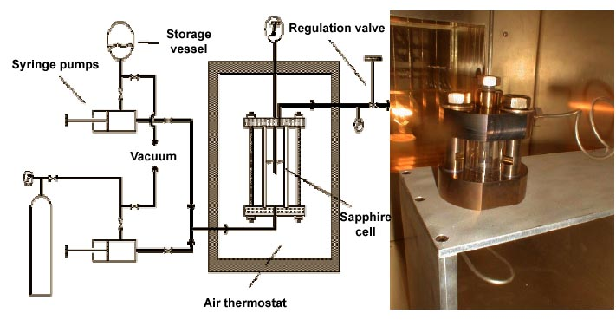
How do Pneumatics work?

Slide 14
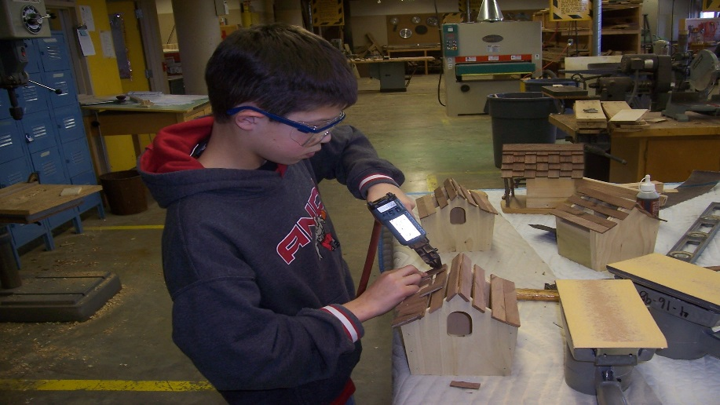
Pneumatics
Pneumatics will often provide a slower response to the input, due to the fact that air is compressible
  Air will compress into line, and will not move equal distance until this compressed pressure evens out
  Friction can build up in a pneumatic system due to a lack of lubrication
Notes:
http://www.msd.k12.mo.us/vocational/woodworking/2004-05%20woodworking%20pics/MS%20projects%202nd%20quarter%2004/MS-bird%20house,%20Dominic%20nail%20gun.jpg

