Slide 1
What is Fluid Power?

Slide 2

http://www.nfpa.com

Slide 3
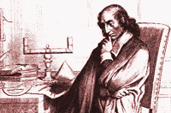
About fluid power
Fluid power is energy transmitted and controlled by means of a pressurized fluid, either liquid or gas.
The term fluid power applies to both hydraulics and pneumatics.
Hydraulics uses pressurized liquid, for example, oil or water; pneumatics uses compressed air or other neutral gases.

Slide 4
Definitions
Pascal's law states that when there is an increase in pressure at any point in a confined fluid, there is an equal increase at every other point in the container.
Force= Pressure x Area
F
Pressure= Force
Area
Area= Force
Pressure
P
A
Notes:
http://www.grc.nasa.gov/WWW/k-12/WindTunnel/Activities/Pascals_principle.html

Slide 5
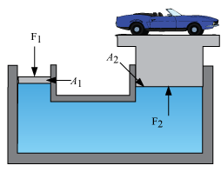
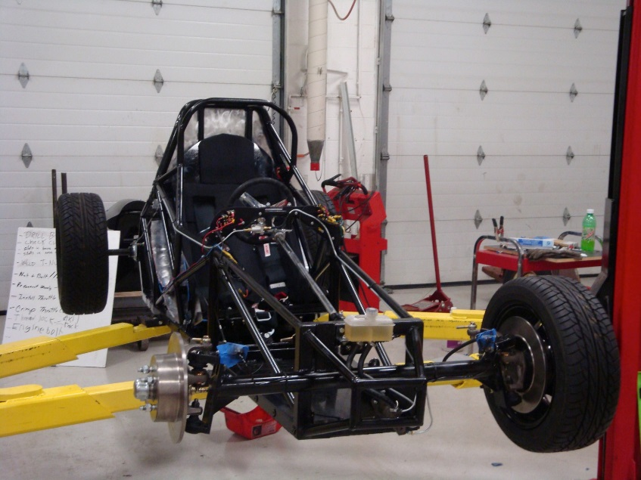
Formula HS car on a hydraulic lift

Slide 6
The advantages of fluid power
Fluid power systems provide many benefits to users including:
Multiplication and variation of force-Linear or rotary force can be multiplied from a fraction of an ounce to several hundred tons of output.
Easy, accurate control-You can start, stop, accelerate, decelerate, reverse or position large forces with great accuracy. Analog (infinitely variable) and digital (on/off) control are possible. Instantly reversible motion-within less than half a revolution-can be achieved.
Multi-function control-A single hydraulic pump or air compressor can provide power and control for numerous machines or machine functions when combined with fluid power manifolds and valves.
High horsepower, low weight ratio-Pneumatic components are compact and lightweight. You can hold a five horsepower hydraulic motor in the palm of your hand.
Low speed torque-Unlike electric motors, air or hydraulic motors can produce large amounts of torque (twisting force) while operating at low speeds. Some hydraulic and air motors can even maintain torque at zero speed without overheating.
Constant force or torque-This is a unique fluid power attribute.
Safety in hazardous environments-Fluid power can be used in mines, chemical plants, near explosives and in paint applications because it is inherently spark-free and can tolerate high temperatures.

Slide 7

How do we use this Pressure?
Mobile: Here fluid power is used to transport, excavate and lift materials as well as control or power mobile equipment. End use industries include construction, agriculture, marine and the military. Applications include backhoes, graders, tractors, truck brakes and suspensions, spreaders and highway maintenance vehicles.
Notes:
http://www.holtca.com/Free-Downloads.htm

Slide 8
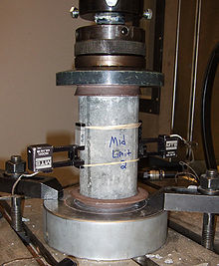

Fluid power applications
Industrial: Here fluid power is used to provide power transmission and motion control for the machines of industry. End use industries range from plastics working to paper production. Applications include metalworking equipment, controllers, automated manipulators, material handling and assembly equipment.
Notes:
http://en.wikipedia.org/wiki/Image:Air_compressor.jpg

Slide 9
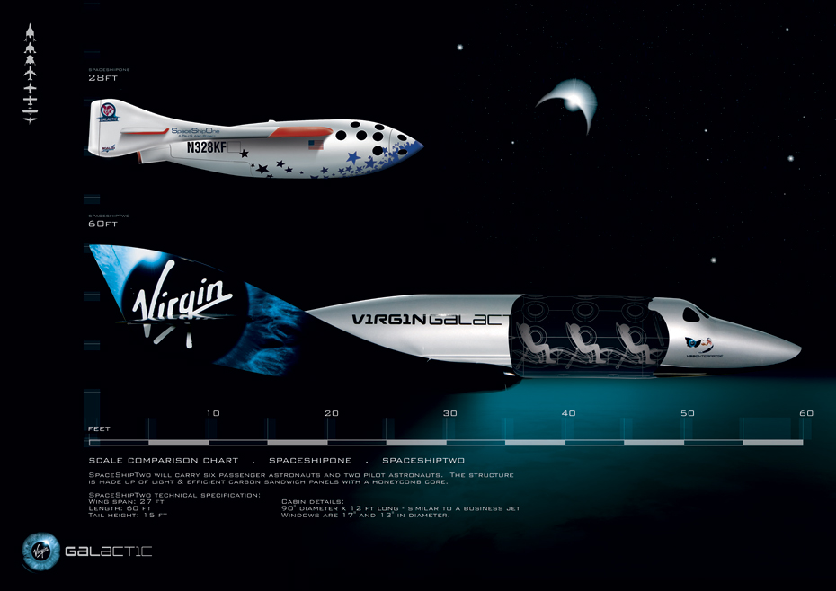
Fluid power applications
Aerospace: Fluid power is used for both commercial and military aircraft, spacecraft and related support equipment. Applications include landing gear, brakes, flight controls, motor controls and cargo loading equipment.
Notes:
http://www.coleparmer.com/catalog/large_image.asp?img=7916100.jpg
http://www.coleparmer.com/catalog/large_image.asp?img=7916133.jpg

Slide 10
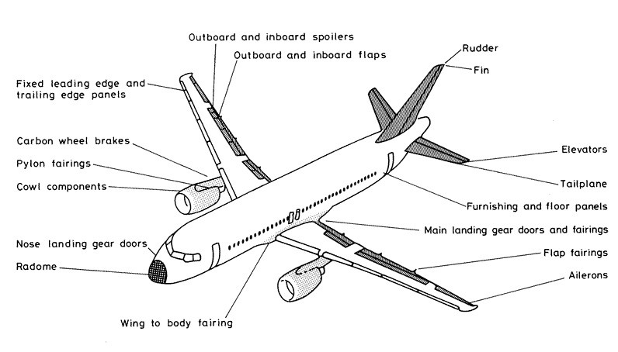
Hydraulic uses in aircraft
Primary Flight Control
Elevator
Secondary Flight Control
Flaps
Slats
Utility System (Other parts)
Landing gear
Rudder
Ailerons
Spoiler
Brakes
Gear steering
Stairs
Notes:
http://www.irtools.com/

Slide 11
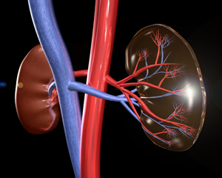
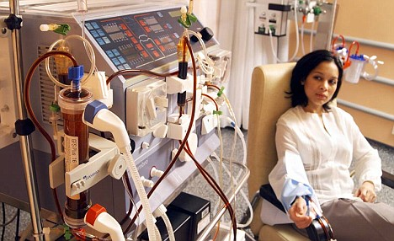
Exhaust
Medical: Fluid power is used in many medical devices including kidney dialysis machines. Some of these machines have up to 180 hydraulic components of the 8,000 parts that make up their design.
Notes:
http://www.campbellhausfeld.net/webapp/wcs/stores/servlet/ProductDisplay?catalogId=10001&storeId=10051&productId=66179&langId=-1&parent_category_rn=10573

Slide 12
Fluid power system
A typical fluid power system includes the following components:
Hydraulic pump or air compressor, which converts mechanical power to fluid power.
Cylinder or motor, which converts fluid power to linear or rotary mechanical power.
Valves, which control the direction, pressure and rate of flow.
Filters, regulators and lubricators, which condition the fluid.
Manifolds, hose, tube, fittings, couplings, etc., which conduct the fluid between components.
Sealing devices, which help contain the fluid.
Accumulators and reservoirs, which store the fluid.
Instruments such as pressure switches, gauges, flow meters, sensors and transducers, which are used to help monitor the performance of a fluid power system.

