Slide 1
Process Organization: Flow Charts & Gantt Charts
Planning & Scheduling Systems:
From Design to Fabrication

Slide 2
Lesson Objectives
Upon completion of this lesson, students will be able to:
Define Flow Chart and Gantt Chart
Identify uses for a Flow Chart and Gantt Chart
Read a Flow Chart & Gantt Chart
Create a Flow Chart and Gantt Chart for a simple process

Slide 3
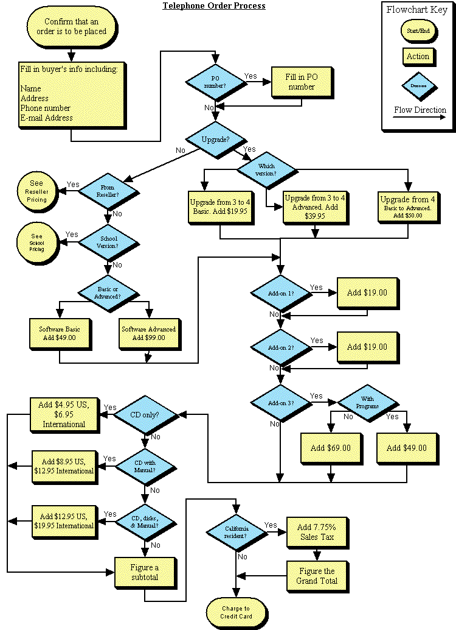
What Is a Flow Chart?
Graphical Organizer
Used to show how a System Process will be completed
Divides tasks to be completed into different categories
Actions, Decisions, Queues
Breaks the large process down into small sections

Slide 4
Why do we use Flow Charts
Monitor the Inputs, Resources, Outputs & Feedback associated with a system process
Easily identify how an action item fits into the process of the system
Increase Efficiency

Slide 5
Flow Chart Components-Leaders
Shows direction of movement
Leaders do not cross

Slide 6
Flow Chart Components-Start/End
Clearly OVAL in shape
Indicate where a process starts and ends
Start oval can also name the process being performed
START
END

Slide 7
Flow Chart Components-Action Box
Indicates an action will take place
Brief description of action is written inside
One leader line in, one leader line out
ACTION

Slide 8
Flow Chart Components-Decision Box
Indicates where a decision must be made
At least two leaders must leave the box, to indicate what happens based on the decision made
DECISION
BOX

Slide 9
Flow Chart Components-Queue
Indicate where a input is taken from, or where an output is stockpiled
Should clearly be drawn as a circle
Leaders can lead to a Queue, from a Queue, or both
QUEUE

Slide 10
Gantt Charts
Charting out Tasks, Responsibilities, & Completion Times

Slide 11
Scheduling
A Way of keeping tasks on track using Process Resource of Time as the guideline
When actions should occur
How long an action should take to complete
How long a process will take to complete
Who is responsible for the task to complete
What would happen on an automobile assembly line if:
the tires were scheduled to be put together backwards?
One process gets done in half the time of another?
The person that normally does a job is sick and someone else needs to fill in?

Slide 12
Pre-Assessment
Who has heard of a Gantt Chart?
What do you think a Gantt Chart is?
Or what is a Gantt Chart?
Have you used a Gantt Chart to plan and carry out projects?

Slide 13
Experiences with “Group” Projects
How did the project & experience go?
Was it easy to split up tasks for the project?
Did you have and stick with timelines
Was it easy to coordinate the tasks?
Was it easy to express the tasks & deadlines?
Were any techniques used to help make the project flow smoothly?
Wish there was a “better” way?

Slide 14
History of the Gantt Chart
Created by Laurence Gantt (1861-1919)
Mechanical Engineering, Management Consultant, & Industry Advisor
Visual tool of scheduled and actual time on project
Innovative practice of its time
Accepted & common practice today
Used on historical construction projects
Hoover Dam (1931)
Interstate Highway System (1956)

Slide 15

Where are Gantt Charts used?
Design & Engineering Projects
Construction Projects
Manufacturing Projects
Transportation Projects
Event Organization
Class Projects
Individual & Team

Slide 16
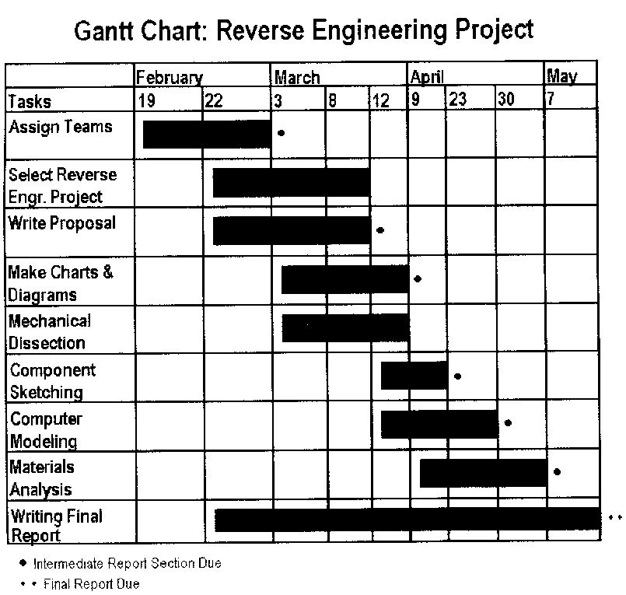
Gantt Chart Overview
Useful tool for planning and scheduling projects
Graphically represents the duration of a task
Monitors the progress of the entire project

Slide 17
Advantages of Gantt Chart
Planning & Scheduling
Assess how long a project should take
Lays out the order in which tasks need to be completed
Helps manage the dependent variables of the project
Monitoring a Project
Able to see what should be done at any point
Shows how different actions could bring project back on track

Slide 18
Disadvantages of Gantt Charts
May become confusing if more than 30 tasks are presented in a project
Does not represent the size of the project or the relative size of the tasks

Slide 19
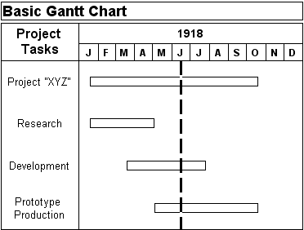
Evolution of the Gantt Chart
Basic Gantt Chart

Slide 20
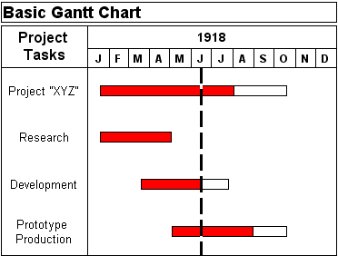
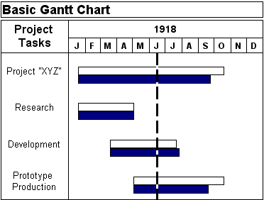
Evolution of the Gantt Chart
“Fill in the Bar” method to show project benchmarks and completion times

Slide 21
Sequential & Parallel Activities
Sequential
Activities dependent on other tasks to be completed first
Example:
Must design before you build
aka “Linear”
Parallel
Not dependent on other tasks being completed first
May be done at any stage of the project
aka “Nondependent”

Slide 22
Steps to Creating a Gantt Chart
List all activities in the plan
Head up graph paper with the time through to task completion
Plot the tasks on the graph paper
Schedule activities/tasks
Monitor the progress of the project

Slide 23

1) List all activities in the plan
Earliest start date
Estimated length of time it may take to complete
Sequential or Parallel activity
Show which tasks are sequential to the other

Slide 24
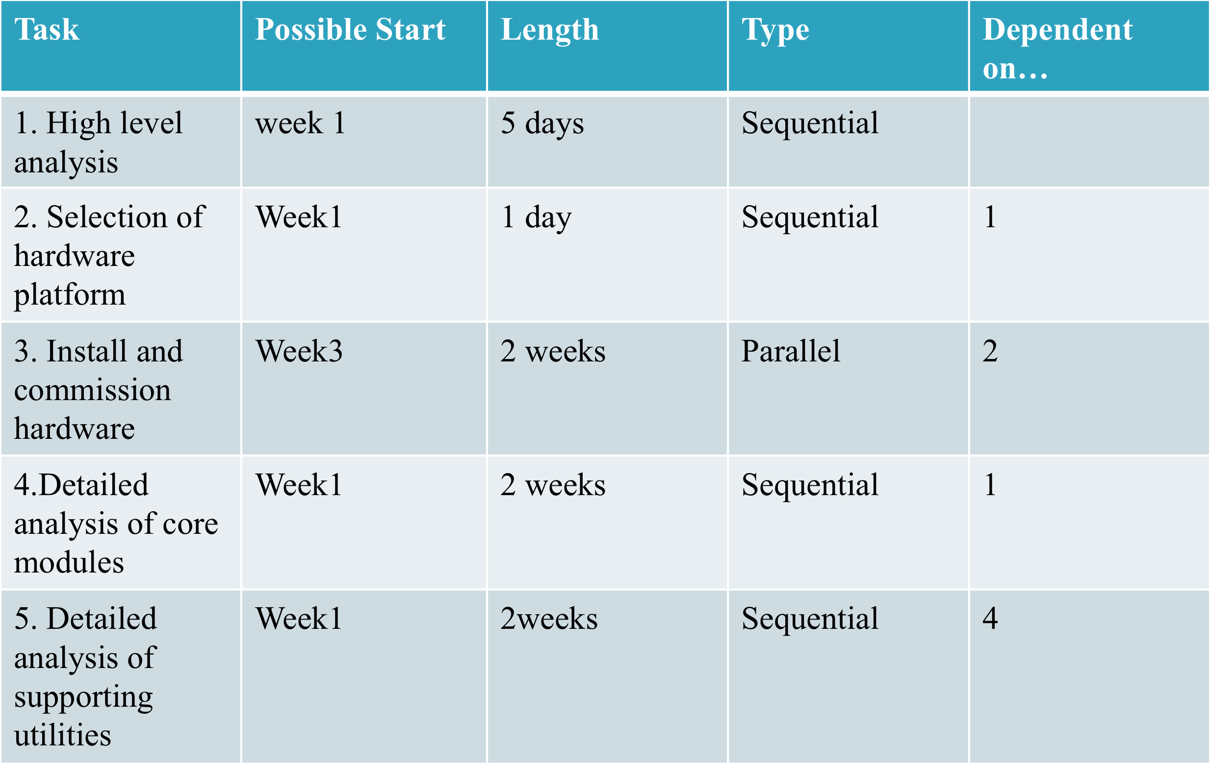
Step 1: List All Activities Example

Slide 25
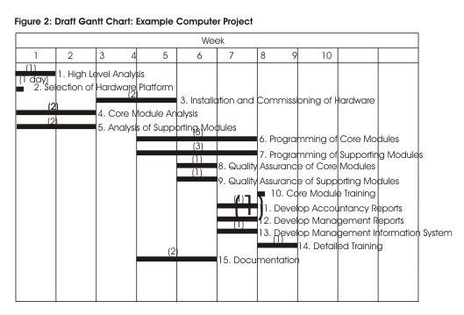
2) Head Paper with Time through Task Completion
Insert the time on the top of the graph paper
Years
Months
Weeks
Days
Hours
Minutes
Seconds

Slide 26
3) Plot the Tasks on the Graph Paper
Insert the task on the Gantt Chart
Within Chart
Not Recommended
Category at start of chart
Recommended
Generate a bar the length of the task

Slide 27
4) Schedule Activities
Schedule activities so that sequential actions are carried out in the required sequence
Where possible, schedule parallel tasks so that they do not interfere with sequential actions
Allow some time for holdups, overruns…

Slide 28
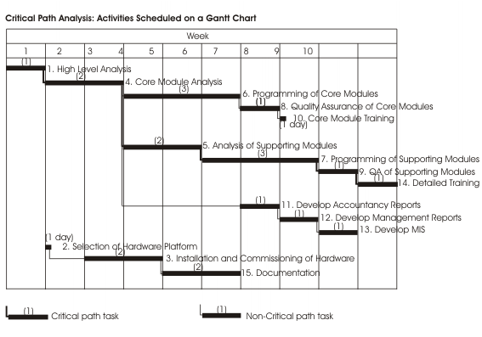
5) Monitor the Progress of the Project

Slide 29
Checking your Understanding
What are some benefits to using a Gantt Chart?
What projects would you use a Gantt Chart on?
What is the difference between Sequential and Parallel tasks?

Slide 30
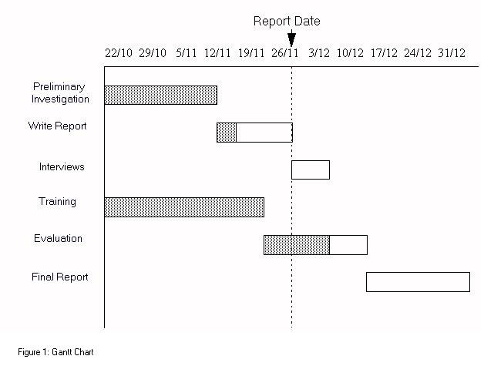
Checking for Understanding
It is Report Date #6
What is the team behind schedule on?
What is the team ahead of schedule on?
What task will be beginning this date?

Slide 31
Assignment: Flow & Gantt Chart
As an individual, you will develop an electronic Flow Chart and Gantt Chart for a simple task, Brushing Your Teeth.
Flow Charts can be made in programs such as Microsoft Word or Microsoft PowerPoint
Other programs available, but those listed are easily accessible from the school’s network
Gantt Charts can be made using Microsoft Excel

Slide 32
Helpful Information
Start by identifying all the needs to brush your teeth
Materials
Equipment
Labor
Process to complete objective
Sounds a lot like a Systems model…
Plug information in where most likely to be used and Flow away!
Gantt Chart developed based on Flow Chart

