Slide 1
Golf Course Case Study

Slide 2
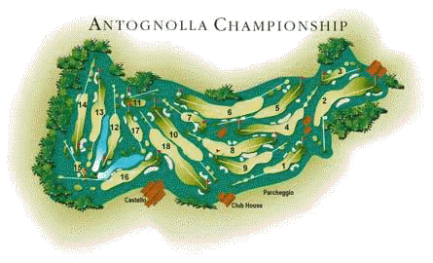
Gulf Course Case Study

Slide 3
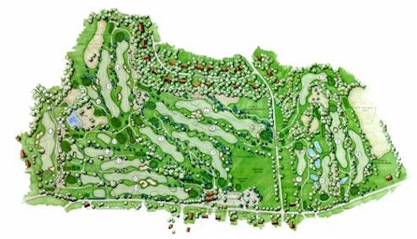

Slide 4
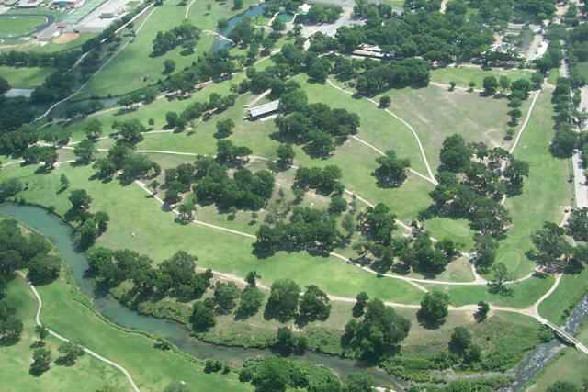

Slide 5
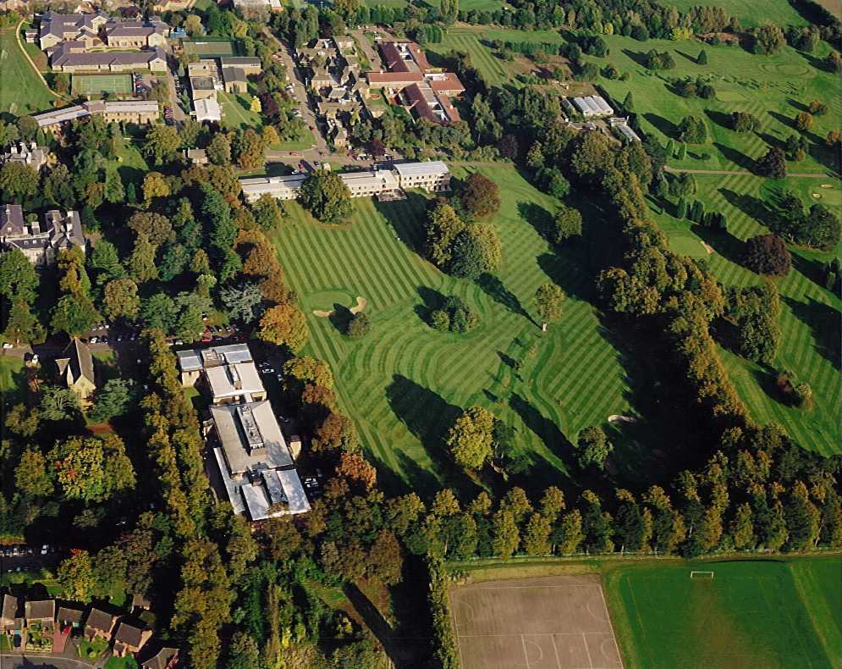

Slide 6


Slide 7
Course lengths and dimensions
  18 hole Regulation 70-72 Rating 6200-6500yards or 6700yards
4holes up to 250 yd
10holes@ 251-470
4holes 471-550≥ Champ. Yds

Slide 8
Flow Chart Components-Action Box
One golf architect suggests a series of par orders as 4-5-4-3-4-5-4-3-4 for one nine. This will achieve maximum variability.
The designer, however, may be forced to follow one par with another of the same par due to site limitations or other reasons.

Slide 9
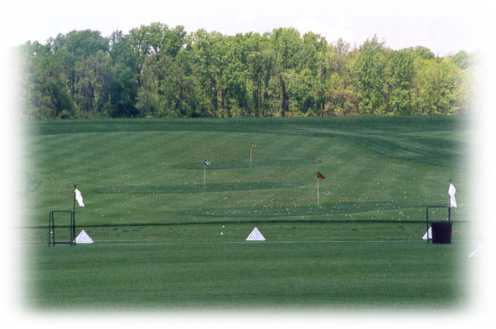
The Driving Range

Slide 10
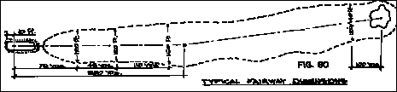
The Fairway
It is the fairway, which comprises the distance traversed and forms much of the visual experience for the golfer.

Slide 11

The Fairway

Slide 12
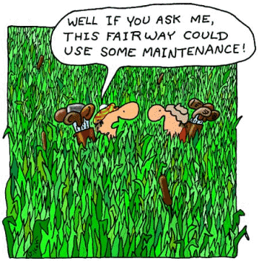

Slide 13
Hazards
The hazard should consist of a natural site feature whenever possible.
Bodies of water, existing sand areas, rough, depressions, or ridges offer opportunity to shape
the hole to fit the potential hazard.
Sand traps are a part of both traditional and contemporary golf, and their use should be thoroughly considered as an integral part
of the course design.

Slide 14
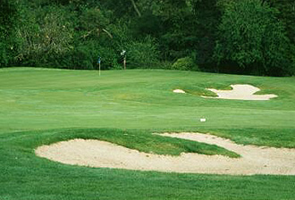

Slide 15
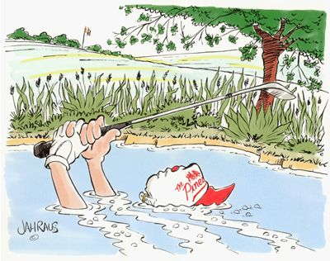

Slide 16
The Tee
Contemporary courses give a much greater emphasis upon the tee as a convenient and inexpensive means of introducing variability to the course layout.
By constructing several tees or one very large tee, the length of a hole may be revised as desired to vary the fairway character

Slide 17


Slide 18

The Green
A designer needs to pay attention to green design with respect to its circulation, topography, drainage, shape and orientation.

Slide 19
Helpful Hints
A Golfer should feel better after playing a round regardless of his score. The major considerations in designing a golf course are:
Playability for all level
Drainage
Maintenance

Slide 20
Helpful Hints
Contemporary design is essentially strategic as contrasted to Penal
Penal design punishes every bad shot thus tending to discourage all but professionals and low handicappers.

Slide 21
Helpful Hints
Strategic design envisages a course interesting for the master but not a monster for those less skilled who experience troubles enough. Strategic requires players to think.
Alternate routes, which are safer but longer, are provided for those not capable of distance and accuracy.

Slide 22
Helpful Hints
Because many players tend to slice, a hole
with the out-of-bounds on the right side can be hazardous to motorists and abutting activities.
Playing into the setting sun on any hole is annoying. On finishing holes it can spoil the entire round.

Slide 23
Helpful Hints
Be careful the elevation changes as players will either have to drive or walk the paths.

Slide 24
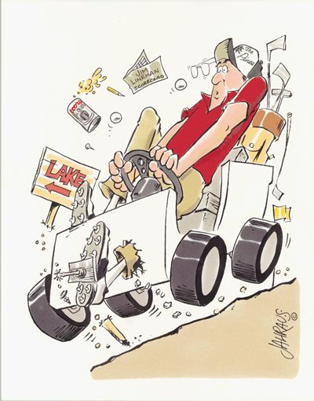

Slide 25
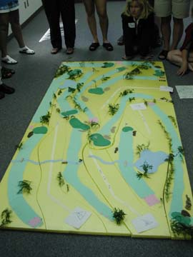
Time to
do it…

