Slide 1
History of the Trebuchet

Slide 2
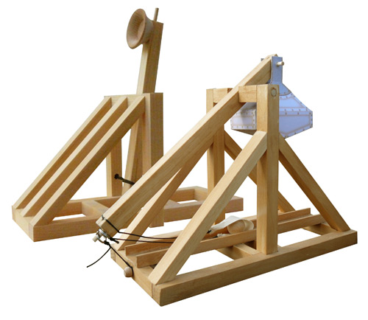
Background Knowledge
How would you define a trebuchet?
What’s a catapult?
What’s the difference
between the two?

Slide 3
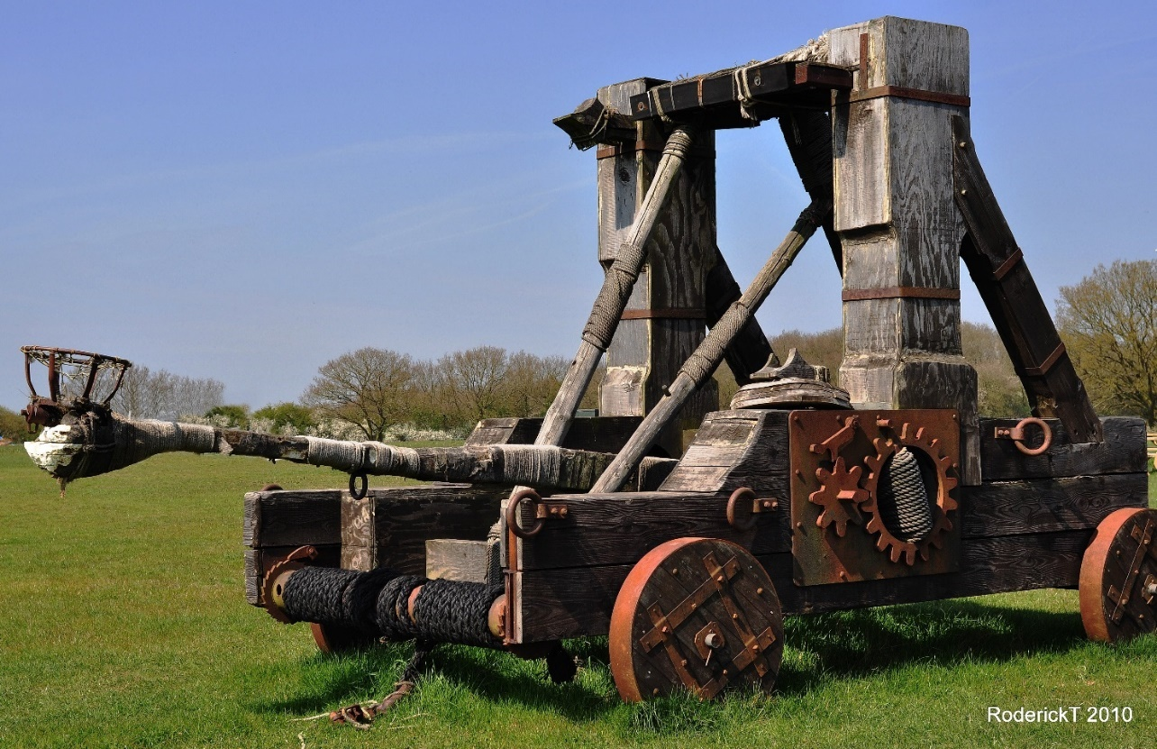
Catapult
Medieval siege machine, designed to hurl an object
Were used by the French and Europeans from 1216

Slide 4
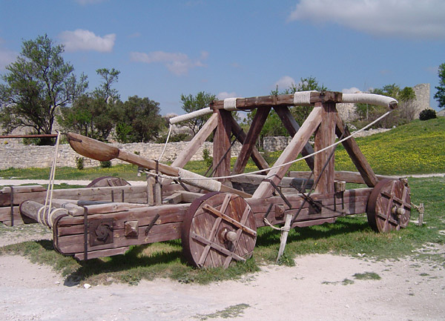
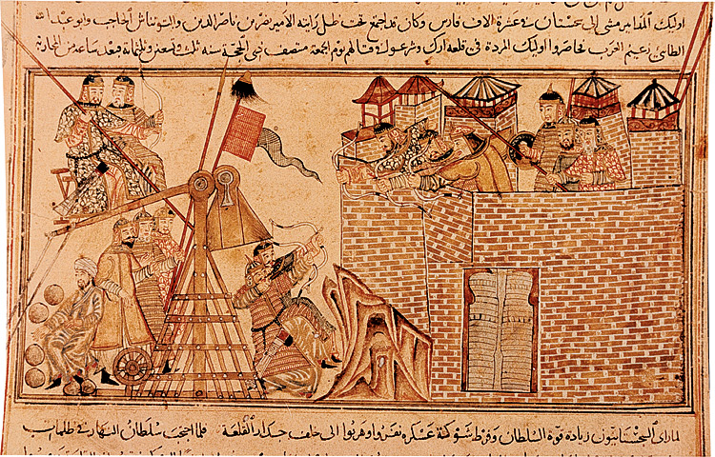
Mongol use of a catapult:
cerca 13th century
Replica of a catapult from
the Middle Ages

Slide 5
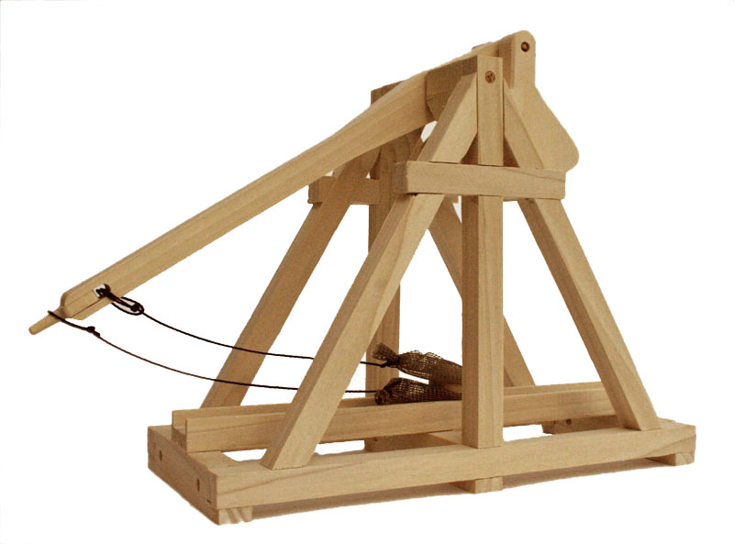
Future replacement: the trebuchet
What is the major difference?

Slide 6
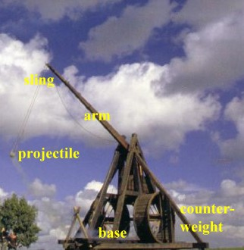
Parts of the Trebuchet
Counterweight-gives energy to the system
Base-supports the system
Arm-connects the sling and the counterweight
Projectile-the object being thrown
Sling-holds the projectile until enough energy is available to release it

Slide 7
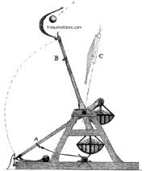
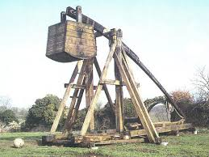
Becoming the Trebuchet
Use of a Counterweight
Sling on throwing arm adds extra velocity
Allows for a greater amount of potential energy than can be held via torsion in
the system
When fully extended,
the sling will add extra
length to the throwing
arm and allow for
greater leverage

Slide 8
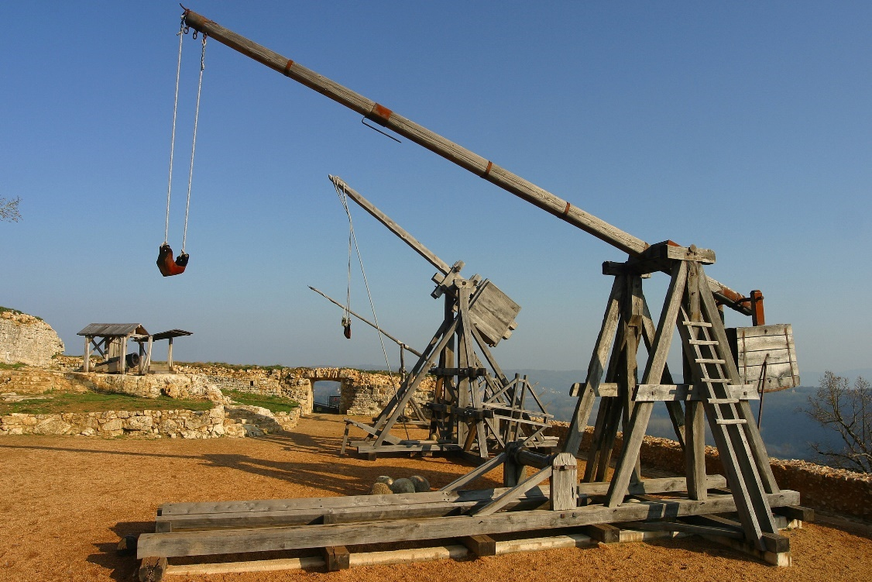
Ancient Uses of the Trebuchet
Used as siege weapons to break down and breach castle walls
Used to throw objects up to 300 kg over castle walls

Slide 9
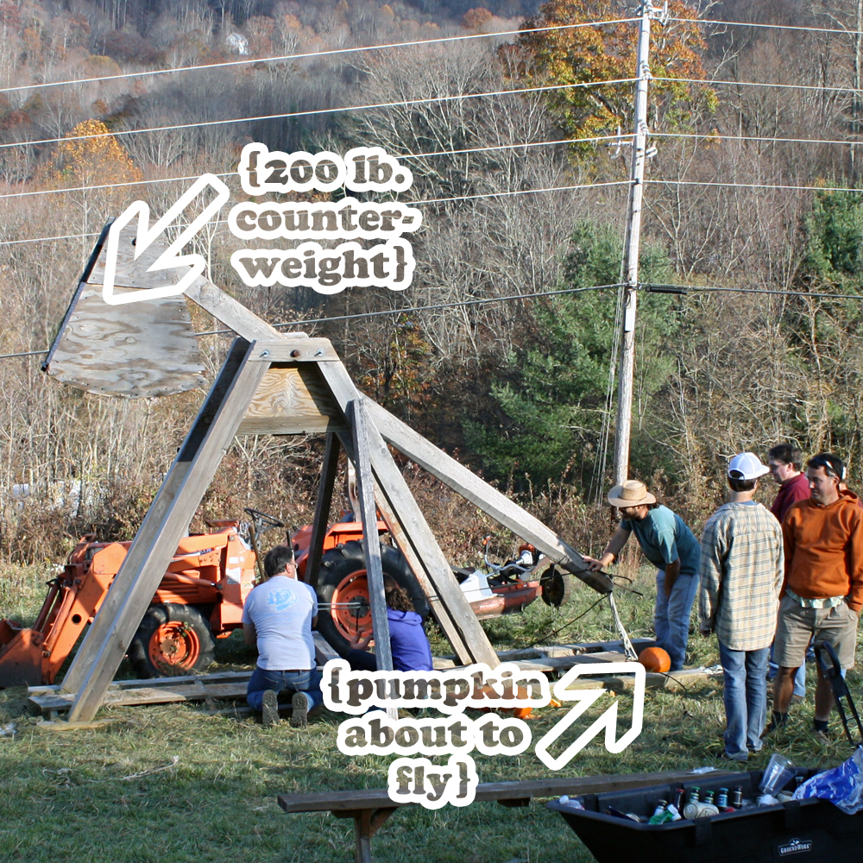
It’s all fun and games…
Think trebuchets are a thing of the past?
Think again!
To this day there are competitions for who can create the biggest, baddest trebuchet out there.
Take a look!

