Slide 1
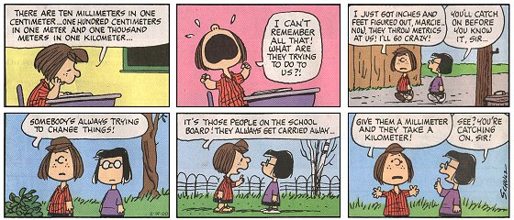
The Metric System & Measurements

Slide 2
Why is metric important?
All of the countries in green use the metric system. In order to communicate effectively around the world, understanding the metric system is essential.

Slide 3
Imperial vs. Metric (Length)
Imperial units are used in the USA (inches, gallons)
1 inch = 2.54 cm
1 cm = 10 mm milli = 1/1000 of a meter
100 cm = 1 m centi = 1/100 of a meter

Slide 4

Imperial vs. Metric (Volume)
1 US Gallon = 3.78 liters
          =~=~=~=~=

Slide 5
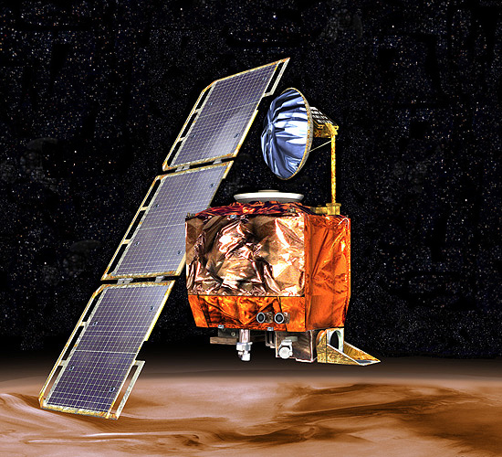
The importance of unit conversion
1999: NASA failure of a Mars orbiter
$125 million failure
How? Engineers used English units,
the NASA agency used metric.
With incorrect measurements,
came too close to Mars’s atmosphere and disintegrated.

Slide 6
Area & Perimeter (Rectangles)
Area: This describes the size inside of a shape
Perimeter: This describes the distance around a shape

Slide 7
Area & Perimeter (Circles)
Area = π*radius²
Perimeter = 2*π*radius

Slide 8
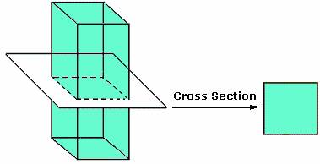
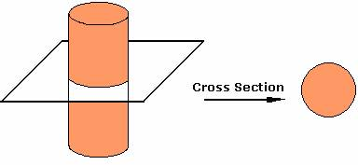
Volume
Ok, now that you've mastered the 2 dimensional aspects of these shapes, lets make them pop off the page in 3D!
You can think of volume as the area of an infinite number of layers inside of the object (the height).

Slide 9
Volume: Cubes and Cylinders
The specific “number” of layers within an object
corresponds to the height of that object.
This leads to a general formula…
V= (area of cross section) X height

Slide 10
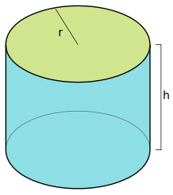
Some Examples:
Find the general formula for a general cylinder
First: identify the cross section
Second: find the area of the cross section
Third: use V= (area of cross section) X h
So…
Cross section: circle
Area of circle= πr²
Volume= πr²h

Slide 11
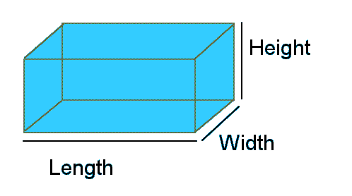
Some examples, but now with a prism
Here you have some freedom in choosing a cross section:
You can have the (length X width) be the area of the cross section,
OR the (width X height).
This would cause you to have different heights.
With a cross section of (length X width), the height=height.
With cross section of (width X height), the length=height.
For cross section 1: V= (length X width) X height
For cross section 2: V= (width X height) X length
Multiplication is commutative, meaning no matter what order you multiply the terms, you will get the same final answer.

Slide 12
Visual Representation of Volume

Slide 13
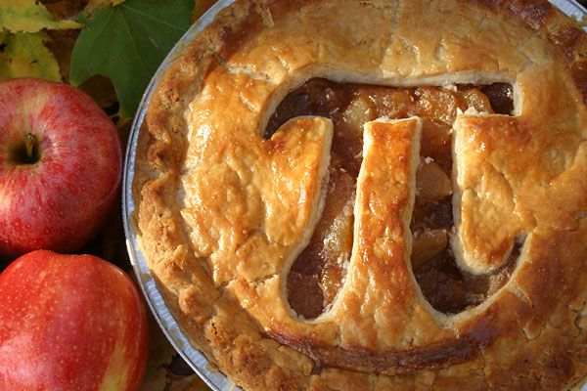
What is π?

Slide 14

Mass vs. Weight: What’s the difference?
667 N
150 lbs
68 kg
Same man, same mass/weight. Which value(s) indicate his weight,
and which value(s) indicate his mass?

Slide 15
Mass
Weight is a measurement of the amount of
pull being applied to an object by gravity.
Mass is the quantity of matter, or small pieces of stuff,
in a substance.

Slide 16
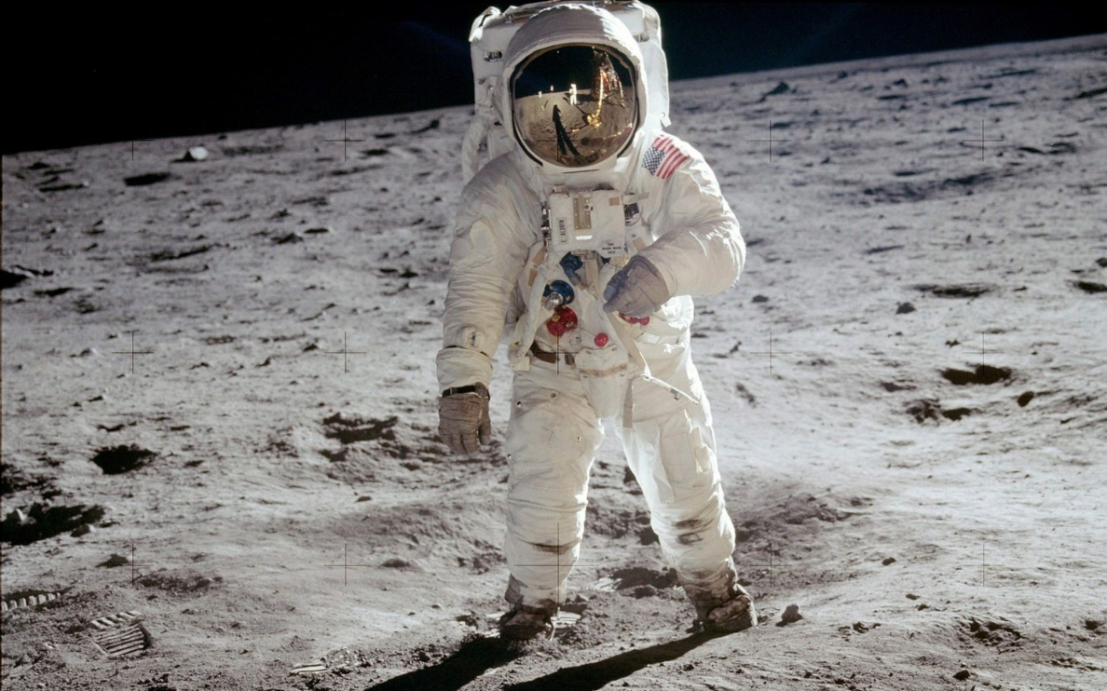
Traveling to the moon
On the moon, the gravitational pull on your body is less, so your weight decreases, but your mass stays the same.
Think of it as less of a pull on your body, but the same number of “particles” still make up your body.

Slide 17
Units of Mass
Empirical mass units: lb, ounce, ton
16oz = 1lb
1kg = 2.2lb
Metric mass unit: gram
1kg = 1000g

Slide 18
Density
Density is a way to figure out the mass of some object if
we know the size. Density is defined as mass/volume or
D = M / V.
We can reorganize the equation in order to solve for mass.
This way, if we know the size of the object and it’s density,
we will not need a scale to figure out it’s mass. This formula is
M= D*V

Slide 19
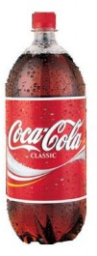
Let’s try one!
If a 2 liter soda bottle has a density of 1 gram / milliliter, what is the mass of the liquid in a full bottle?
(Have your final answer be in kg/L)

Slide 20
Solution
First, we need to convert g/mL to kg/L. Make sure your units cancel!
1 g X 1000 mL X 1 kg = 1 kg/L
1 mL 1 L 1000 g
The next part is easier… given that the bottle can hold 2 liters,
2 L X 1 kg = 2 kg
1 L

Slide 21
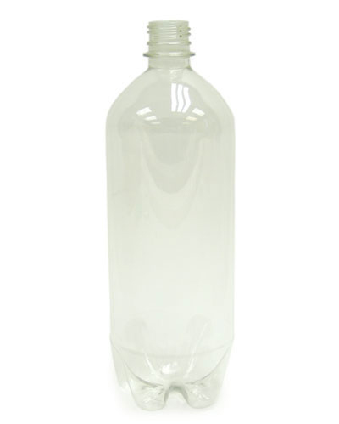
Example
Now assume the bottle is a cylinder with a diameter of 10 cm and height of 31 cm. What is the volume of the bottle?

Slide 22
Solution
r=diameter/2 → r=10 cm/2 → r=5 cm
A= πr² → =π(5)² → =25π cm²
V=Ah → =25π cm²*(31 cm) → 775π cm³

Slide 23
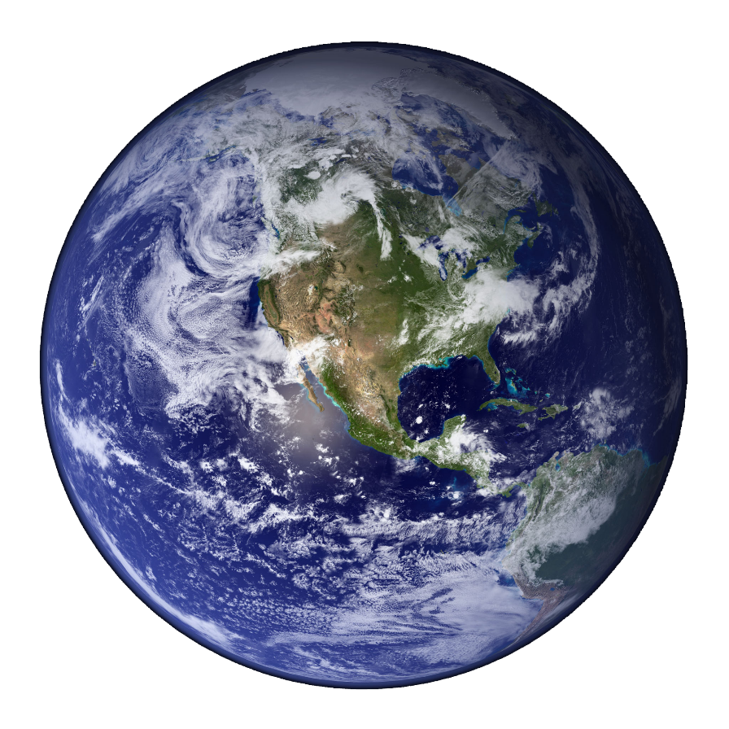
Volume of the Atmosphere
If the radius of the earth is 6370 km and the radius of the earth + the atmosphere is 6400 km, what is the volume of the atmosphere?
(Hint: volume of a sphere is (4/3)*π*radius³)

Slide 24
Solution
To solve this, you need to think about it as a sphere within a sphere. First you must find the volume of the larger sphere then subtract the volume of the smaller sphere. (4/3)*π*6400³ - (4/3)*π*6370³ = volume of atmosphere.
= 1.54x 10¹⁰ km³
What does this tell you about the relative size of the area we live in compared
to the size of earth?

