Slide 1
The Right Triangle and Trigonometry

Slide 2
The Right Triangle
This is a right triangle:
A right triangle is any triangle with a 90° angle (also called a right angle). The 90° angle has a square in it, which is shown above. Here are more examples:

Slide 3
Parts of a Right Triangle
There are special names for parts of a right triangle.
The hypotenuse is always the longest side and is across from the right angle. The legs are always touching the right angle. This is also called being adjacent.
Hypotenuse
Legs

Slide 4
Properties of the Right Triangle
Like all other triangles, the angles in a right triangle add to 180°
60°+30°+90°=180°
Since one of the angles is always 90°, the other two must add to 90°.
Right triangles also have some other unique properties.
60°
30°
90°

Slide 5
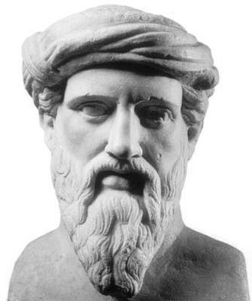
Pythagorean theorem
The Pythagorean theorem was created by Pythagoras, a Greek mathematician.
His theorem says:
a²+b²=c²
Where a and b are the lengths of the legs and c is the length of the hypotenuse.
c
a
b

Slide 6
Pythagorean Theorem
The Pythagorean theorem is very useful because it allows us to find the length of one side of a triangle if we know the length of others
Example: If we measure the two legs and find they are 3 and 4 inches long, how long is the hypotenuse?
c²=4²+ 3²
c²=25
c=5

Slide 7
Trigonometry
We know how to relate the three sides in a right triangle and we can also relate the three angles to each other, but how can we relate angles to sides and vice versa?
This is where trigonometry comes in.

Slide 8
Sine, Cosine, and Tangent
There are three important relations called sine, cosine, and tangent.
They all relate an angle to a ratio of sides.
These relations can be used to find an angle from two sides or a side from
an angle and another side.
c
a
θ
b

Slide 9
Memory Trick
It may seem hard to remember these relations. There is a memory trick to help with this.
It is the phrase: Soh Cah Toa
The phrase is an abbreviation of:
Sine= opposite side over hypotenuse
Cosine= adjacent side over hypotenuse
Tangent= opposite side over adjacent side

Slide 10
Sine Example
Let’s look at an example of this.
Find the hypotenuse in the triangle below:
To finish this problem you need to use a calculator to find 4/sin(30). The answer is 8.
c
4
30°

Slide 11
Another Example
This time find the angle from the two sides:
Again you must use a calculator to find the answer.
18
θ
12

Slide 12
Trigonometry Relations
Recall the Pythagorean Theorem:
a²+b²=c²
If we divide both sides by c² we get:
Recall that
We can use this for a substitution and obtain:
This is perhaps one of the most important relations in trigonometry.
c
a
b

Slide 13
More Trigonometry Relations
Another important relation involves tangent.
Recall:
We can modify tangent so that it appears as:
Again we make a substitution to obtain:
This is another important relation.

Slide 14
The Circle and Trigonometry
90°
We can also define trigonometry functions
(sine, cosine, tangent) in relation to the unit circle.
180°
0°
270°

Slide 15
Trigonometry on the Circle
Imagine a line sticking out of the center of the circle and rotating around as shown below.
As the
y
y
y
90°
90°
90°
θ
θ
180°
θ
180°
180°
x
x
x
0°
0°
0°
270°
270°
270°

Slide 16
Radians
Recall the formula for the circumference of circle:
For the unit circle, this means the entire circumference
is 2π. Half the circumference is π. One fourth the
circumference is π/2 and so on.
If we travel around the previous
unit circle starting from 0° we
obtain the following circle.
π/2
π
2π
3π/2

Slide 17
Radians
This new unit circle uses the units called radians. Radians are another way to measure angles.
2π radians=360°

Slide 18
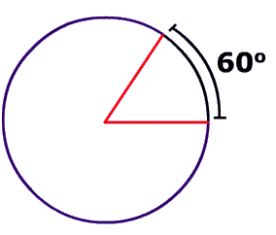
Converting Degrees to Radians
Convert the 60° angle to be in the form of radians.

Slide 19
Solution
Given the relationship 2π= 360°, this is just a simple unit conversion! Think of it as ° being one unit, and π being another.
60° X (2π/360°)= π/3

