Slide 1
Energy
Newton’s Laws
Potential and Kinetic Energy

Slide 2
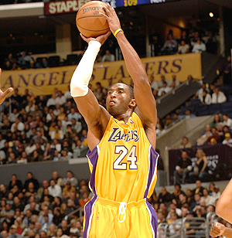
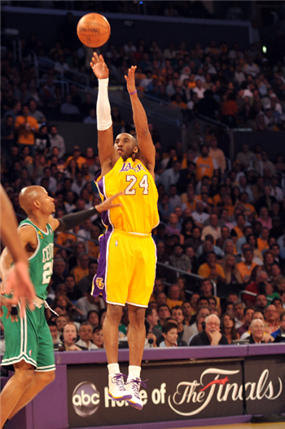
Where does the energy come from?

Slide 3
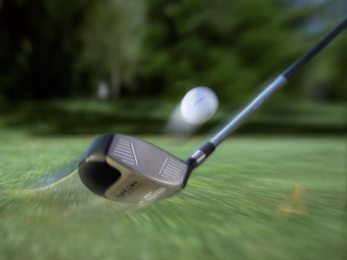

Newton’s First Law
An object at rest will remain at rest unless acted on by another force.
An object in motion will remain in motion unless acted on by another force.
What forces are acting on the golf ball that will eventually cause it to stop moving?

Slide 4
Application
Using Newton’s First Law, explain the importance of wearing a seatbelt.

Slide 5
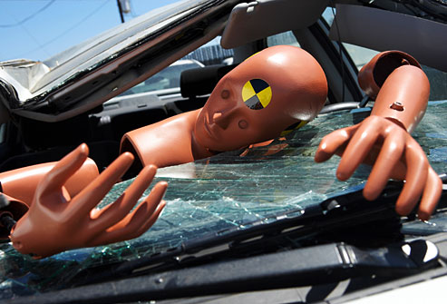
Explanation
Watch the attached video!

Slide 6
Newton’s Second Law
When a force acts on a mass, acceleration is produced.
You have a textbook and a desk. If you want both of them to accelerate equally,
how much force would you have to apply to each of them?
a. More force to the textbook
b. More force to the desk
c. Equal amount of force

Slide 7
Explanation
B is correct!
It probably made a lot of sense that you would need a larger force to move the desk, and there is a relationship that links these 3 variables: mass, acceleration, and force.
F=ma
The final answer for force will be in units of force, N or lb.
As you hypothesized, as m increases, a larger F is needed to obtain the same acceleration.

Slide 8
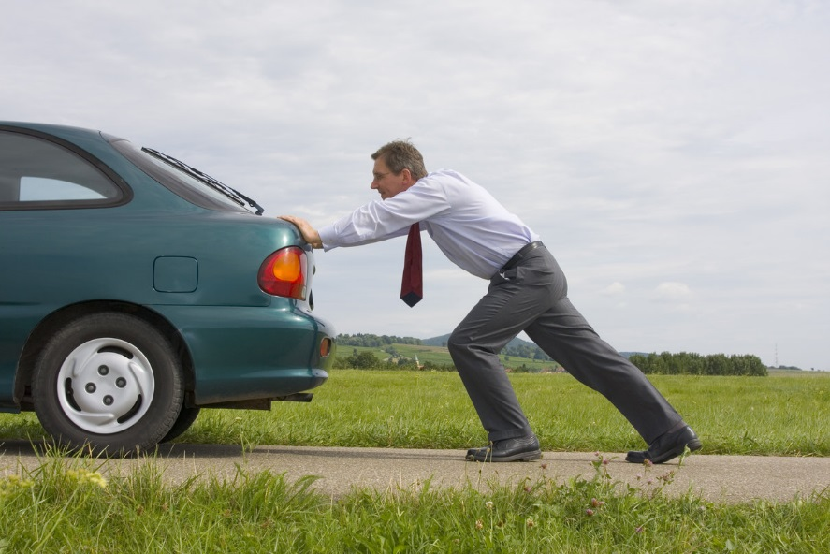
Try one!
Your car just broke down, and you have to push it to the nearest gas station. Your car weighs 2000 kg. How much force do you need to apply to the car to get it going at a steady acceleration of 0.05 m/s²?

Slide 9
Solution
According to Newton’s 2nd Law, F=ma
F= (2000 kg) X (0.05 m/s²) = 100 N

Slide 10
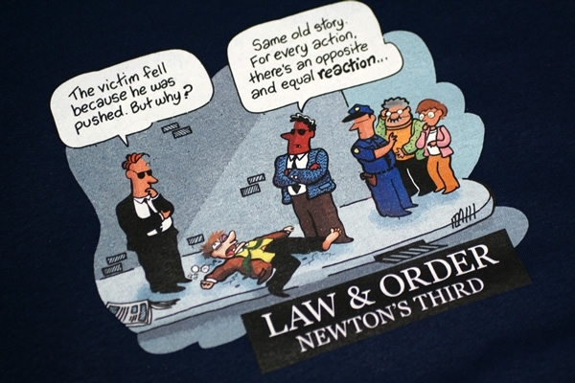
Newton’s Third Law
For every action there is an equal and opposite reaction

Slide 11

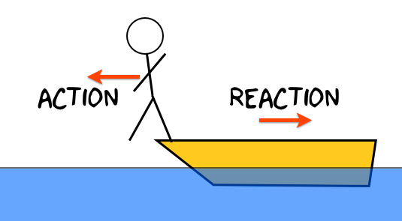
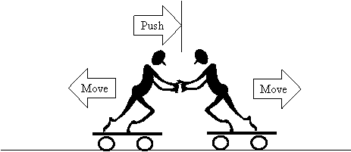

Identify the opposite reaction
Weight

Slide 12
Identify the opposite reaction
Seat
chair’s force

Slide 13
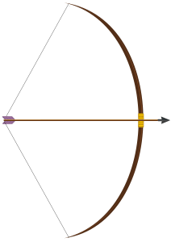
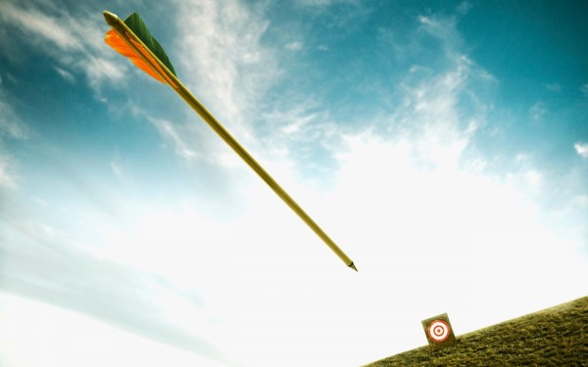
Potential & Kinetic Energy
Potential energy is defined as stored energy.
Kinetic energy is energy at work.
These come in pairs!
Look around you! What forms of potential and kinetic energy can you see?

Slide 14




Examples all around you!

Slide 15
Formulas
Potential Energy= mgh
    m= mass of object (kg)
    g= gravitational constant, 9.81 m/s²
    h= height of object (in meters)
Kinetic Energy= ½ mv²
    m= mass of object
    v= velocity (m/s)
The final answer of both PE and KE is in joules, or (kg·m²)/s²

Slide 16
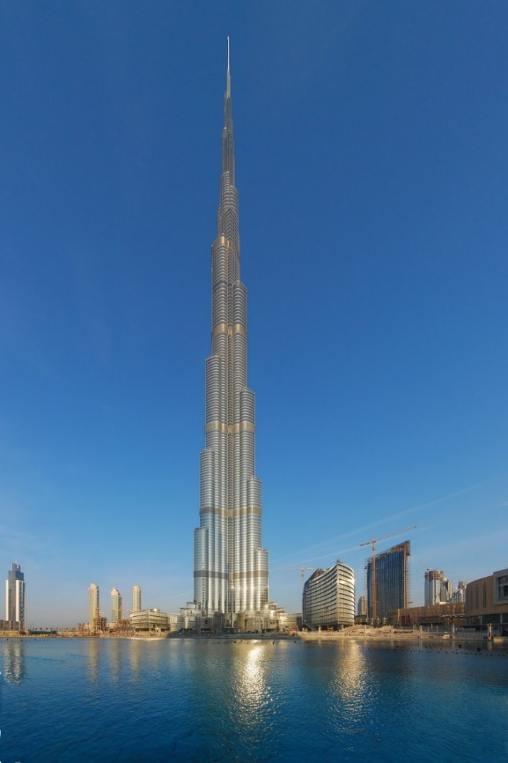
Try one!
The Burj Khalifa, in Dubai, is the tallest building in the world, measuring 828 meters. You plan on dropping a penny off the top of the Burj. The penny has mass 2.5 grams. Calculate the potential energy of the penny at the top of the building.

Slide 17
Solution
Convert grams to kg
2.5 g X 1 kg = 0.0025 kg
1000 g
Using the Potential Energy formula
PE= mgh = 0.0025 kg X 9.81 m/s² X 828 m = 20.31 joules

Slide 18
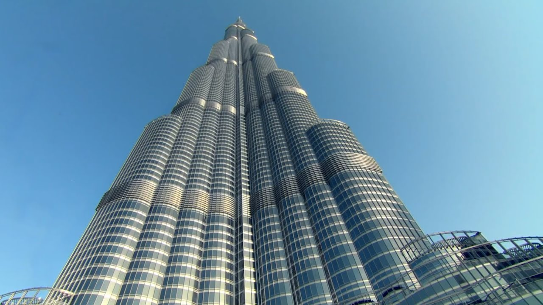
Finding Kinetic Energy
Using the same details from the last problem, calculate the kinetic energy of the penny when it has already fallen to half the height of the Burj, and has velocity 20 m/s at that point.

Slide 19
Solution
Kinetic Energy = ½ mv²
½ X (0.0025 kg) X (20 m/s)² = 0.5 joules

