Slide 1
Projectile Motion
Distance traveled by Projectile
Height, Velocity of Projectile

Slide 2

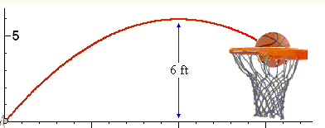
Projectile Motion
A curved motion formed by an object or a particle
(called the projectile). Projectile motion is affected by gravity
A perfect example is the path a basketball takes to reach
the hoop.

Slide 3
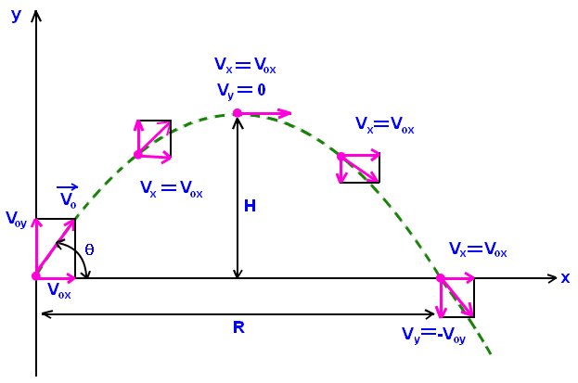
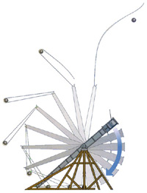
Applied to a trebuchet…
Similarly, the particle thrown out of a trebuchet would be the projectile and the curved motion it forms is the projectile motion.

Slide 4
Projectile Motion Formula
d = .5 g t² + v₀ t
d: final distance traveled by projectile
g: gravitational acceleration= 9.81 m/s²
t: total time travelled by the projectile (s)
v₀: initial velocity of the projectile (m/s)

Slide 5

You try!
A ball is released from the Eiffel Tower, which has
a height of 324 meters, with initial velocity of 0.
Suppose the gravitational acceleration is g. How
long will it take for the ball to reach the ground?
What if the ball is tossed upward with an initial
What if the ball is tossed upward with an initial velocity of 2 m/s?

Slide 6
Solutions
Looking for variable t.
324 m= (0.5)(9.81 m/s²)(t²) + (0t)
Solving for t²= (324)/(0.5*9.81)
Take the square root to get t= 8.13 s
Looking for variable t again, but now our v₀= 2 m/s
324 m= (0.5)(9.81 m/s²)(t²) + (2t)
Quadratic equation, with t as variable:
0= (0.5)(9.81 m/s²)(t²) + (2t) -324
Plugging in to calculator gives you values of -7.92 seconds and 8.33 seconds.
Can’t have negative time, so t= 8.33 seconds.

Slide 7
Conceptual Check-up
You drop a textbook, weighing 4 kg, a coin, weighing 2 g,
from the top of the Eiffel Tower, same initial height, no initial velocity.
Will the coin or the textbook reach the ground first?
(Hint: where is mass involved in projectile motion?)

Slide 8
Answer
Both the coin and the textbook will reach the ground at the same time!
Mass does not affect the projectile equation, so long as height,
initial velocity, and acceleration remain the same.

Slide 9
Formula
To calculate position in relation to time, use the formula
x= x₀ + v₀∆t + ½ a∆t²
Defining variables
x= new position t= time
x₀= original position a= acceleration
v₀= original velocity
You can use y and y₀ instead of x and x₀ when you are
looking for vertical distance traveled

Slide 10
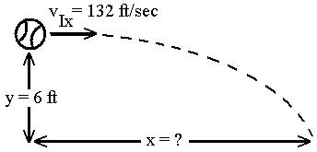
Further practice
The projectile has a initial velocity of 132 ft/sec horizontal to the ground at the height of 6 ft. Suppose that the gravitational acceleration (g) is 9.8 m/sec and there is no wind resistance. How long will it take for the projectile to fall to the ground? How far horizontally will it be from the initial point?

Slide 11
Solution
First, you need to convert (g) to ft/s²
9.81 m X 3.2808 ft = 32.15 ft/s²
s² 1 m
Using the given formula, y= y₀ + v_{y}∆t + ½ a∆t², solve for t
0= 6 + (0∆t) + ½ (-32.15)(t²)
-6(2) = t² → t= 0.6109 s
-32.15
Then, multiply t by V_{x} to solve for horizontal distance traveled
132 ft X 0.6109 sec = 80.64 ft
sec

Slide 12
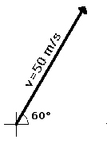
Beware!
If your velocity does not solely lie in the x or y direction you must resolve it into its specific x and y components to be plugged in to the above equation.
How do you resolve a velocity vector into its x and y components? Right triangle trigonometry!
          Resolve the given velocity into its x and y components.

Slide 13
Solution
Think of the velocity as the hypotenuse of the triangle.
To find V_{y}, or the velocity in the y direction
sin60°= opposite = V_{y} = V_{y}
hypotenuse V 50
Solving for V_{y}= 43.3 ft/s
To find V_{x}, or the velocity in the x direction
cos60°= adjacent = V_{x} = V_{x}
hypotenuse V 50
Solving for V_{x}= 25 ft/s
From here, you can find the distance traveled in both the x and y directions.

