Slide 1

TREBUCHET 2.0
Assembly Tutorials

Slide 2
Measuring Pipe
General Tips
Align end of pipe with zero end of ruler
Hold both pipe and ruler steady
Mark where desired

Slide 3
Cutting PVC
General Tips
Match up blade with mark measured
Whatever cutting tool or equipment you are using, it is important to make straight vertical cuts.

Slide 4
Priming and Gluing: Pipe to Joint
General Tips
Dry fit pieces together, double checking to be sure components fit together and aligned correctly.
  Mark the alignment with a sharpie
  Take apart, lightly smear primer on both pipe and joint
  Lightly smear cement on both pipe and joint. It is recommended to cement only a couple joints at a time, due to the cements set time.
  Fit together by twisting and pushing at the same time so sharpie marks line up. Do this in a timely manner, as the glue sets quickly.
  Hold joints together with pressure for 30 seconds to allow for proper adhesion

Slide 5
Step by Step Assembly Guide

Slide 6
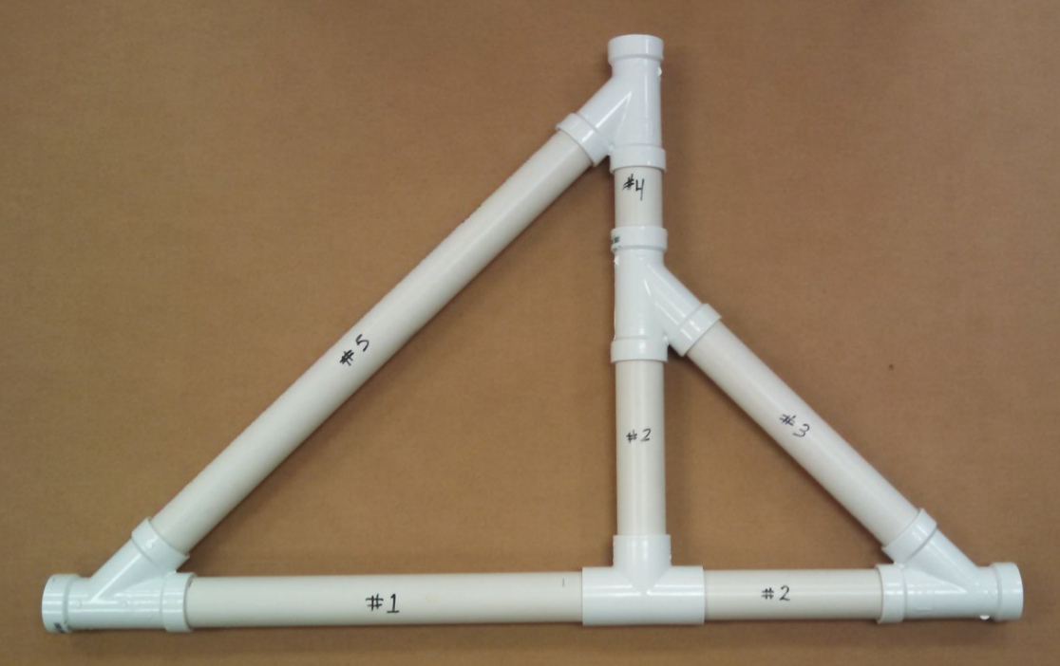
Base Side Parts list
Note: The following parts list is for one Base Side.
Pipe Fittings:
  (4) Wye connectors
  (1) Tee connector
Pipe (all pipes are 1 1/2”):
  #1- 16 3/4”
  #2- (2) 8 5/8”
  #3- 11 3/4”
  #4- 3 3/4”
  #5- 23 1/4”

Slide 7
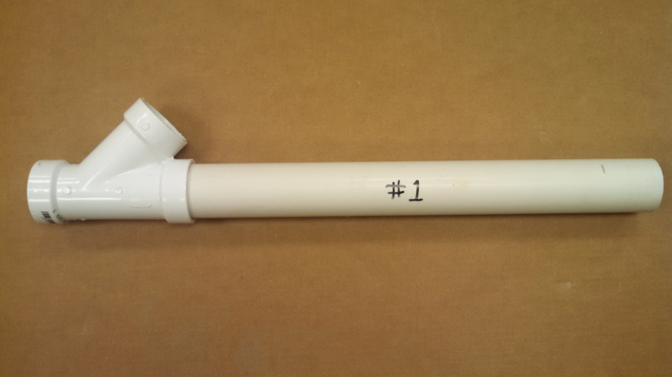
Base Side Assembly
Step 1:
  Add pipe #1 to a Wye as shown

Slide 8
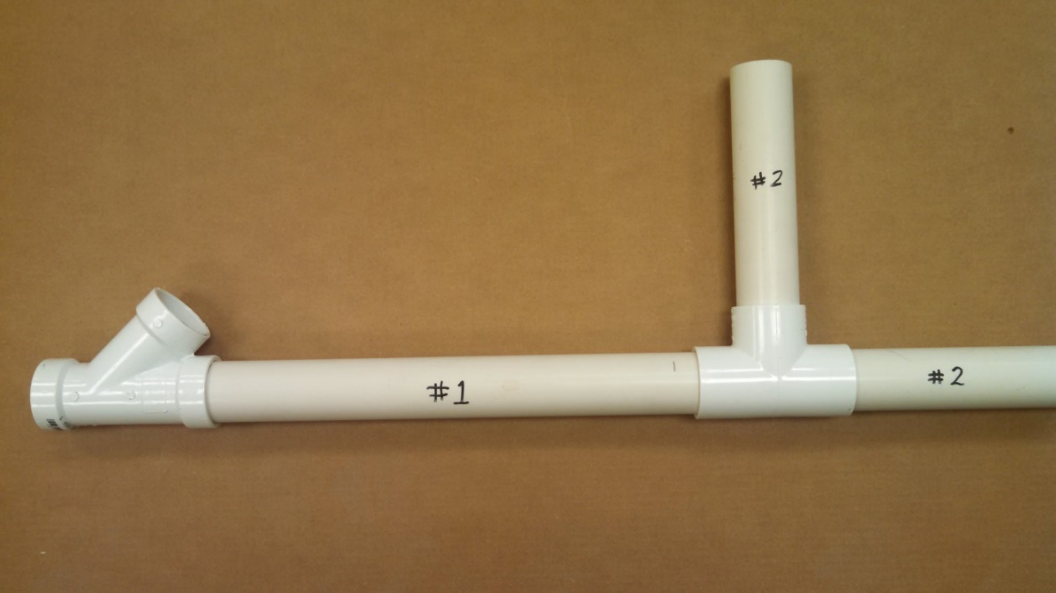
Base Side Assembly Cont’d
Step 2:
  Add a Tee to the end of pipe #1.
  Add pipe #2 to the top and right side of the Tee.

Slide 9
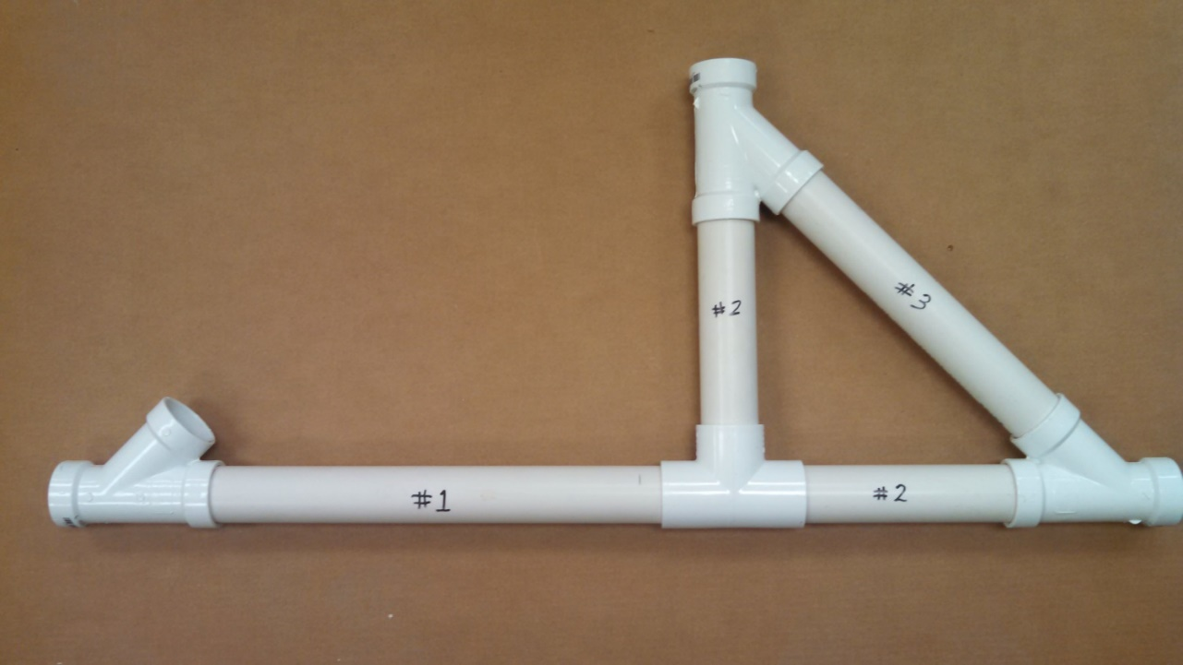
Base Side Assembly Cont’d
Step 3:
  Add a Wye to the top of vertical pipe #2
  Add the Wye and pipe #3 to the assembly

Slide 10

Base Side Assembly Cont’d
Step 4:
  Add pipe #4 and #5 as shown
  Add the Wye to the top of the assembly connecting pipe #4 and #5

Slide 11
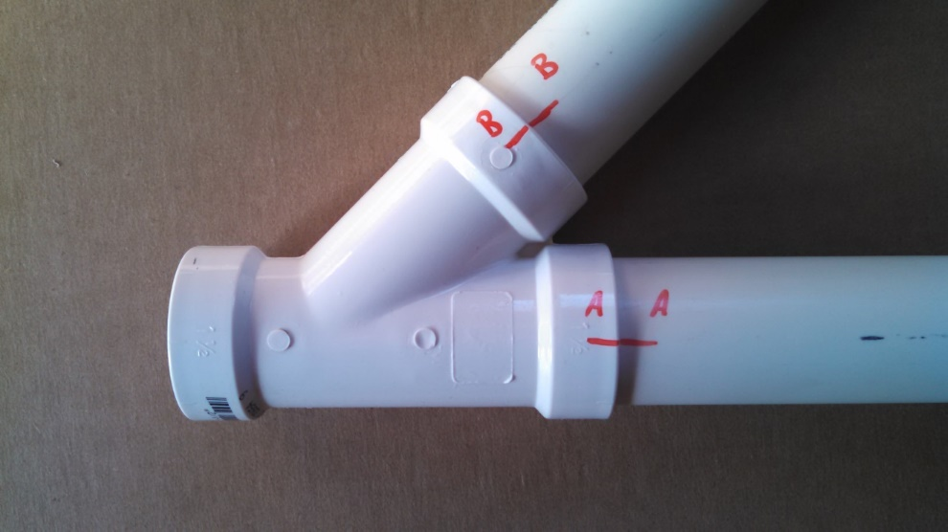
Base Side Assembly Cont’d
Step 5:
  With side flat on a table or ground, mark and label.
    This is critical for proper alignment when gluing.
    Use your method of choice. One example is shown below.

Slide 12
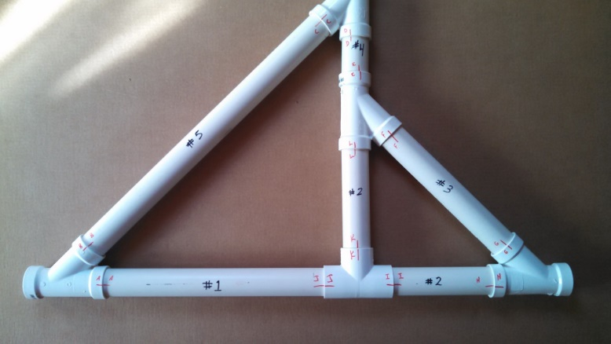
Base Side Assembly Cont’d
Step 6: Prime and Glue
  Take apart, lightly “paint” primer on both pipe and joint where they will be glued
  Lightly “paint” cement on both pipe and joint. It is recommended to cement only a couple joints at a time, due to set time.
  Fit together by twisting and pushing at the same time so sharpie marks line up. Do this in a timely manner, as the cement sets quickly.
  Hold joints together with pressure for
  30 seconds to allow for proper bonding.

Slide 13
Repeat Steps 1- 6

Slide 14
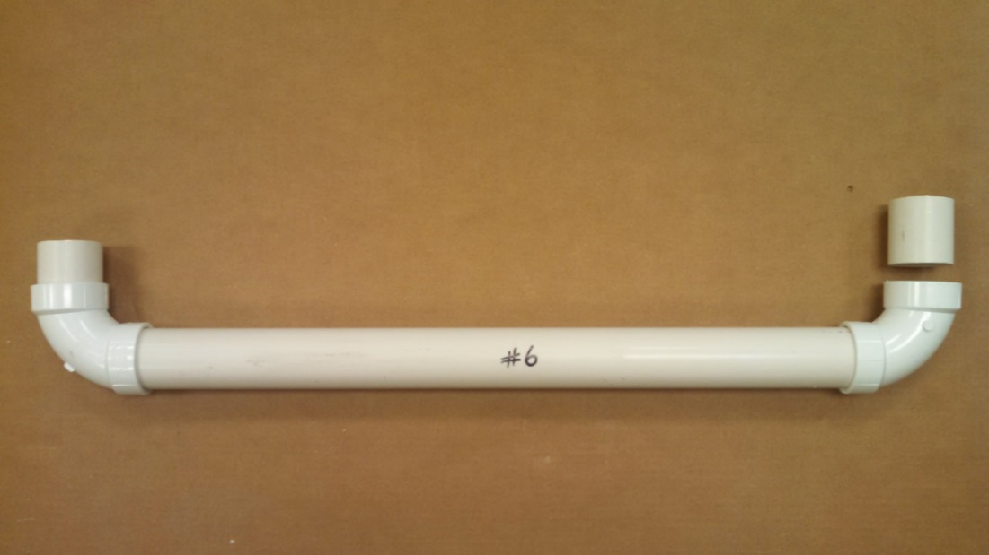
Side Connector Assembly Parts list
Note: The following parts list is for one side connector assembly.
Pipe Fittings:
  (2) 90˚ elbow
Pipe (1 1/2”):
  #6 23”
  (2) 2”

Slide 15
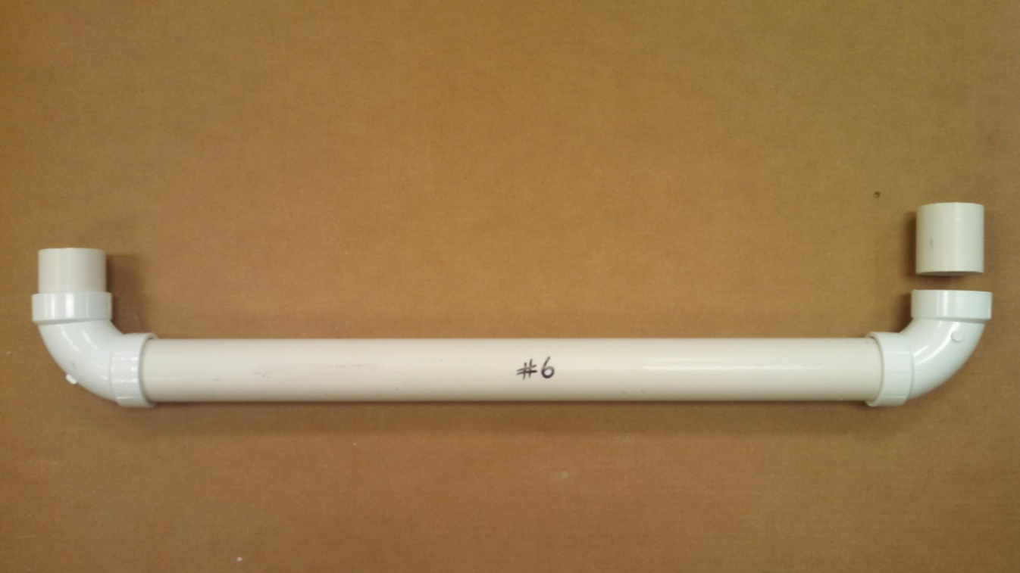
Side Connector Assembly
Step 1:
  Add a 90˚ elbow to either side of pipe #6

Slide 16

Side Connector Assembly cont’d
Step 2:
  Add a 2” pipe to both 90˚ elbow’s

Slide 17

Side Connector Assembly cont’d
Step 3:
  With side flat on a table or ground, mark and label.
    Again, this is critical for proper alignment when gluing.

Slide 18
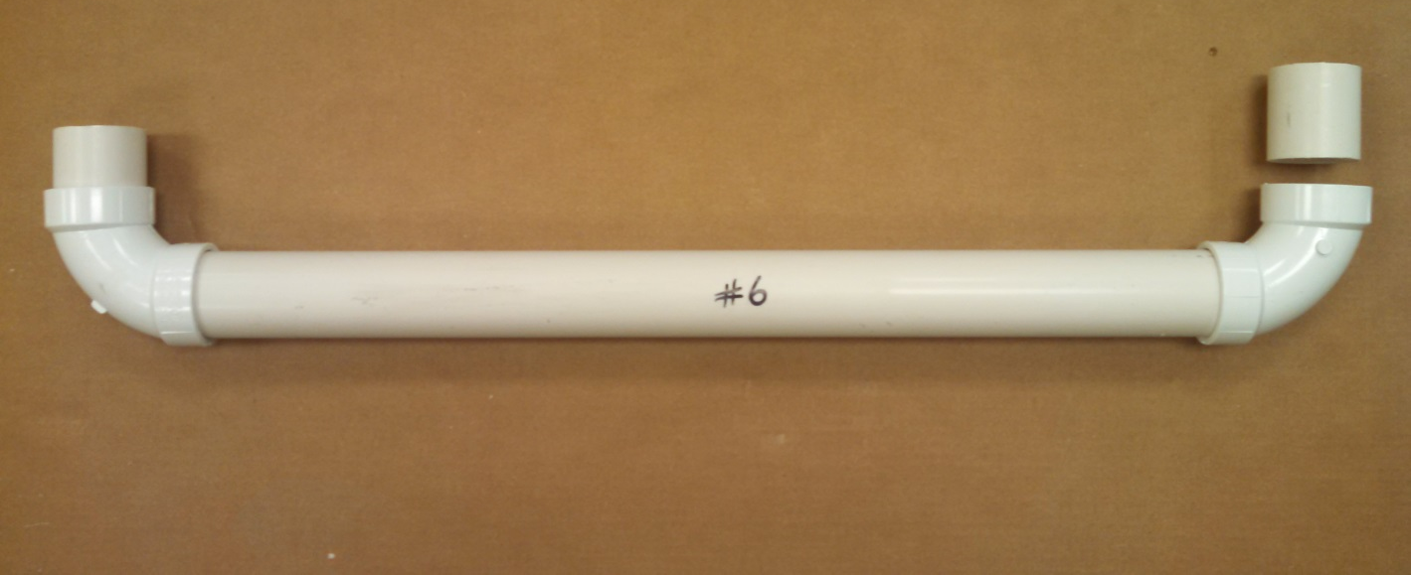
Side Connector Assembly cont’d
Step 4:
  Prime and Glue

Slide 19
Repeat Steps 1- 4

Slide 20
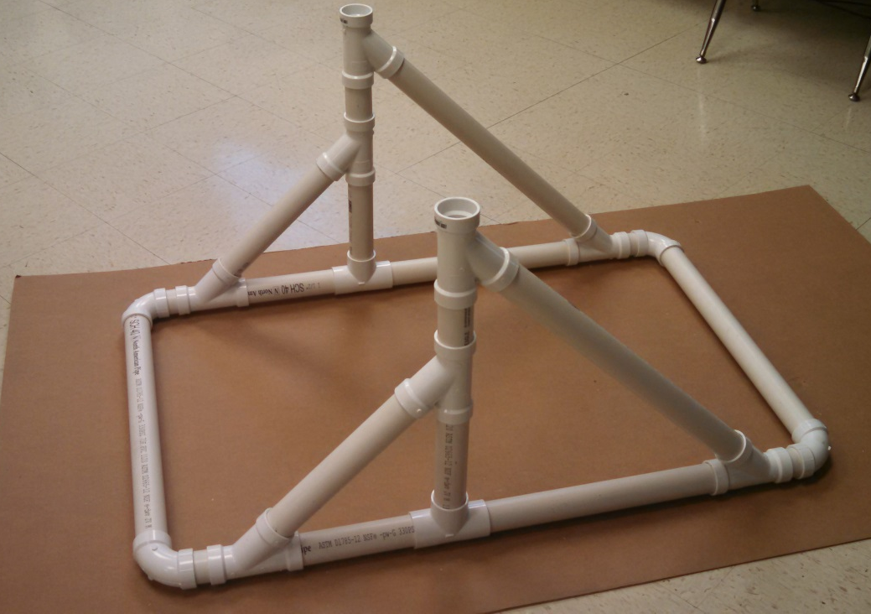
Connecting the sides
Dry fit the two sides and two side connector assemblies.
  Be certain the base sides are aligned correctly
    Shown in photo
Mark and Label
Prime
Glue

Slide 21
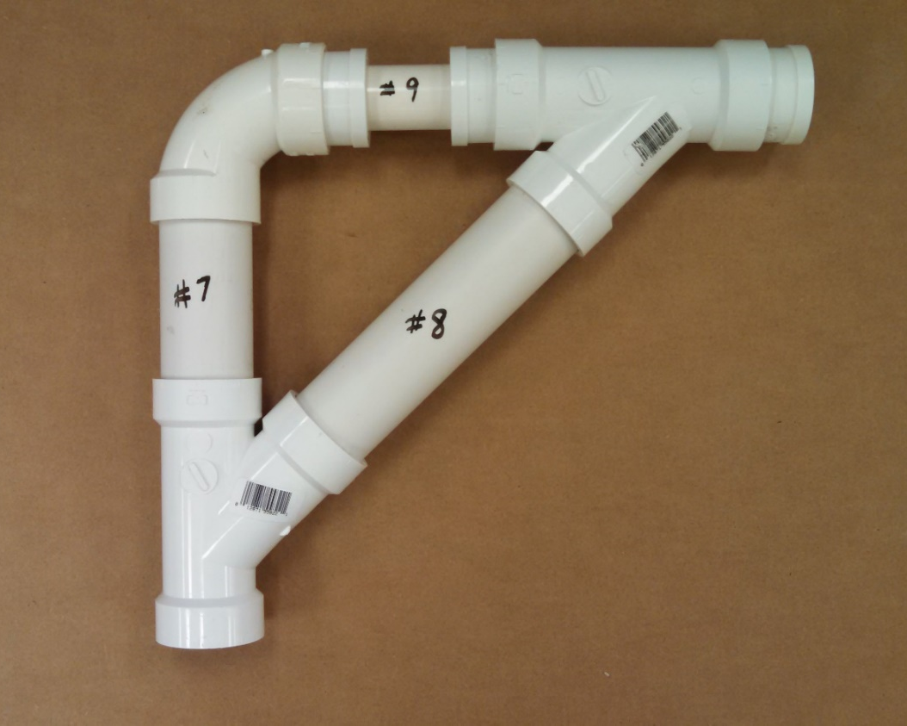
Upper Arm Assembly Parts list
Note: The following parts list is for one upper arm assembly.
Pipe Fittings:
  (2) Wye connectors
  (1) 90˚ elbow
  (3) 1 1/2” to 1” reducer
Pipe:
  #7- 4 11/16” x 1 ½” pipe
  #8- 7 1/8” x 1 ½” pipe
  #9- 3 1/2” x 1” pipe
  3/4” x 1” pipe

Slide 22
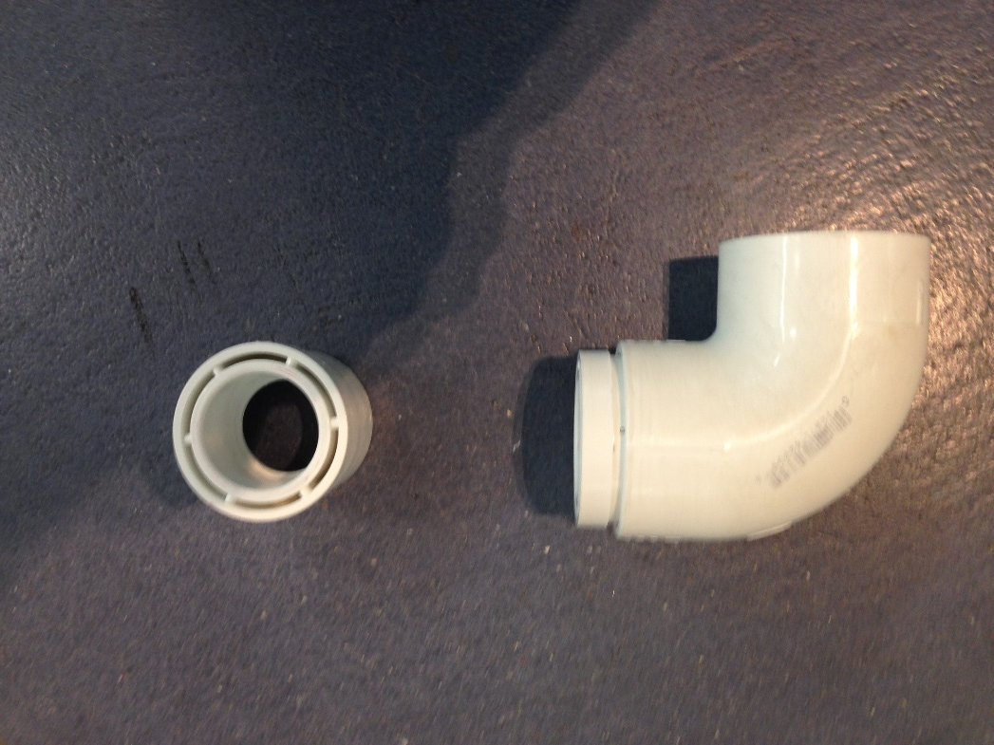
Upper Arm Assembly
Step 1:
  Put a 1.5” to 1” reducer into the 90˚ elbow

Slide 23
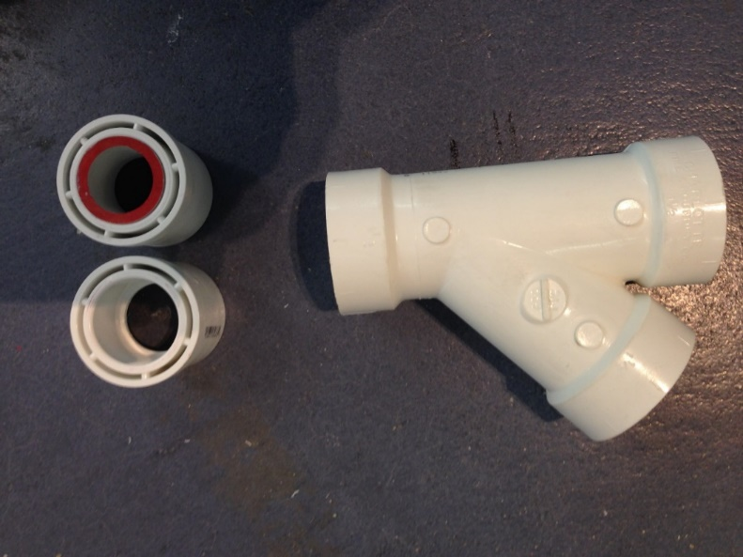
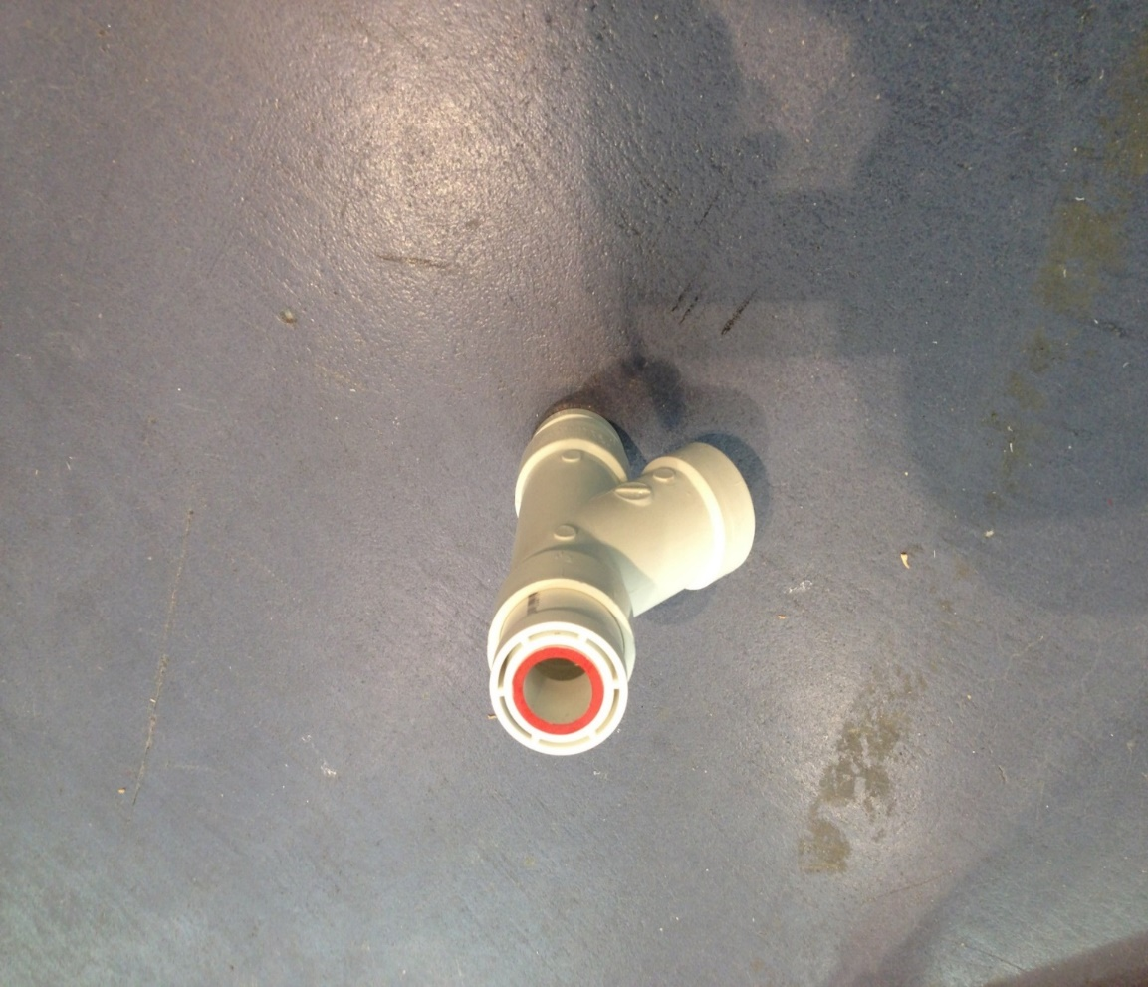
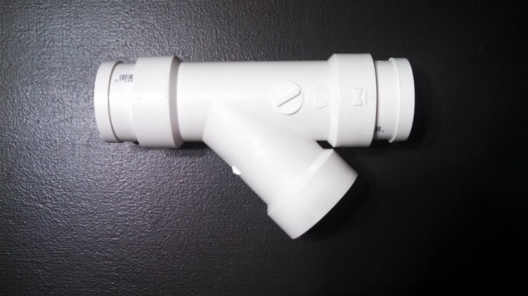
Upper Arm Assembly cont’d
Step 2:
  Put a ¾” long piece of 1” diameter pipe (the red shade) into one of the reducers and put both reducers into a wye piece like shown in the picture.
¾” x 1” pipe on this side

Slide 24
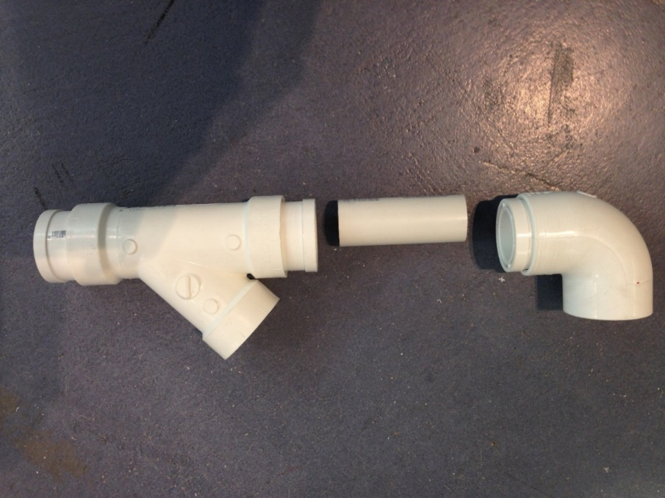
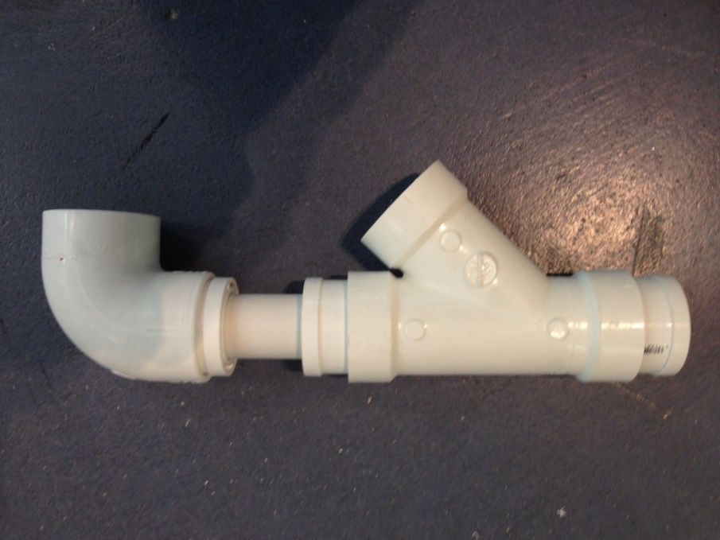
Upper Arm Assembly cont’d
Step 3:
  Put pipe #9 between the reducer in the wye and the elbow
#9

Slide 25
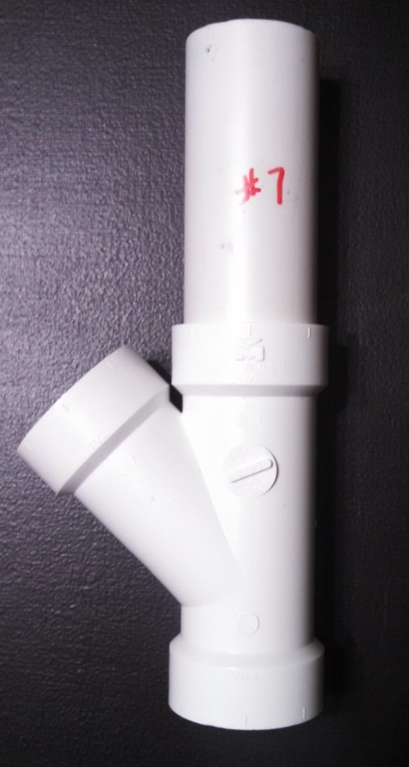
Upper Arm Assembly cont’d
Step 4:
  Put pipe #7 into the end of the wye piece as shown

Slide 26

Upper Arm Assembly cont’d
Step 5:
  Put pipe #8 in the remaining openings in the wye pieces to create the assembly

Slide 27

Base Side Assembly Cont’d
Step 6:
  With side flat on a table or ground, mark and label.
    As in previous assemblies, This is critical for proper alignment when gluing.
A
A

Slide 28
Side Connector Assembly cont’d
Step 7:
  Prime and Glue

Slide 29
Repeat Steps 1- 7

Slide 30
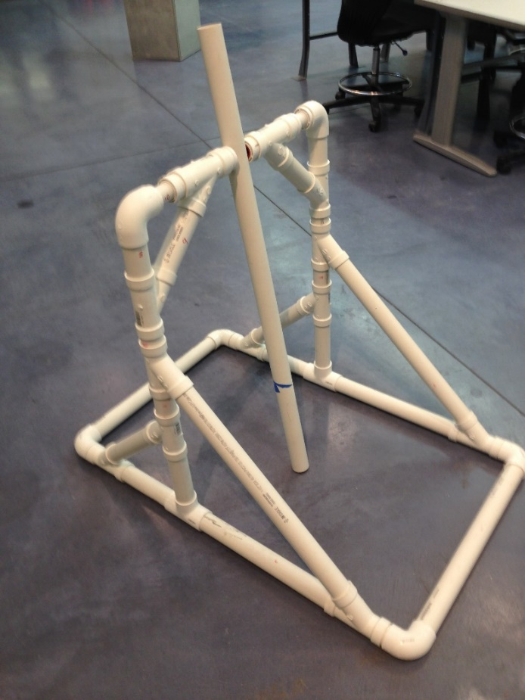
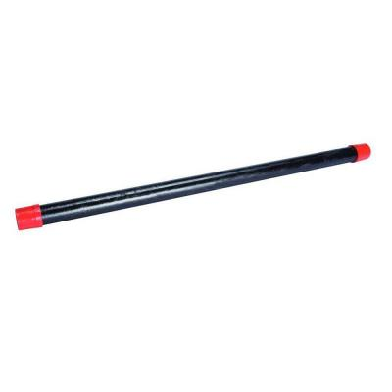
Run the axle (1/2” x 24” Black pipe) through the arm and upper arm assemblies.

Slide 31
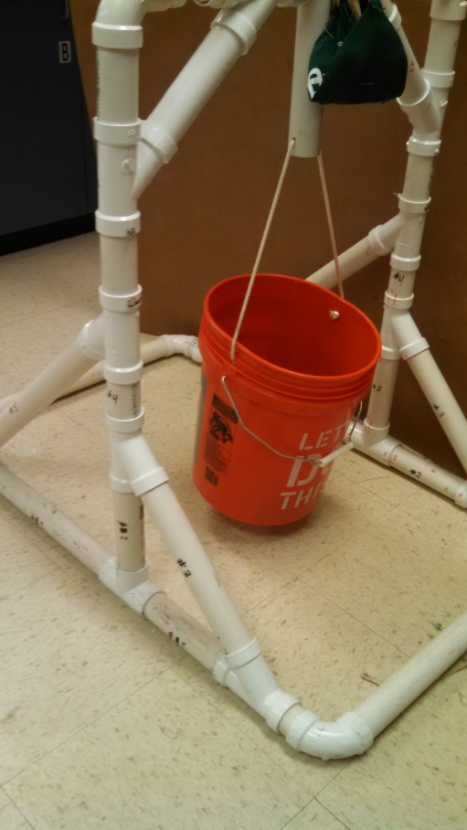
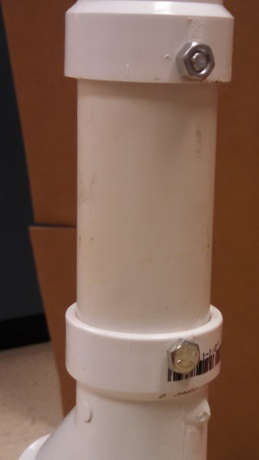
Put both completed Upper Arm Assemblies onto the already constructed base as shown in the picture below. The connector pipe will be interchangeable. For now use (2) 4” x 1 ½” pipe. Secure using a nut and bolt fastening system

Slide 32
NOTE: There are many ways to make a sling. The following slides details one possibility
Constructing the Sling

Slide 33
Initial Steps
Cut a nine by nine-inch piece of fabric. Strong material such as denim or canvas is preferable.
Fold over each edge a small amount (~1/8 in) and sew it down. This is to protect the edges.
Note: If using a sewing machine consult your teacher for the best uses of your particular machine.

Slide 34
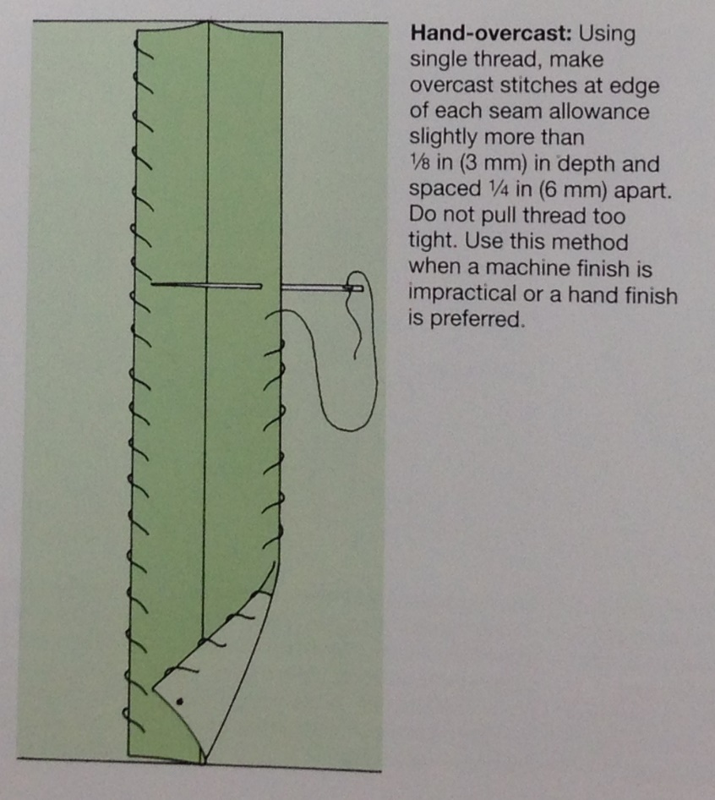
Sewing by Hand
Thread the needle with enough thread to more than finish one edge. Tie the two end together.
Insert the needle through the fabric at a corner, pull it through, wrap it back around to the first side, then repeat:

Slide 35
Finalizing the Sling
Fold over two opposite edges. Fold at least half an inch of material.
Sew these fold down, leaving a tube inside for rope to pass through.
Using a needle or a pencil, push the rope through each tube.
Your sling should be complete!

Slide 36
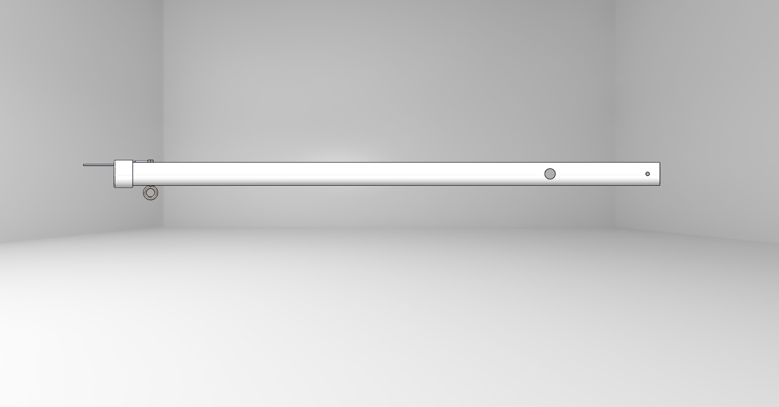
Constructing the Arm

Slide 37
Drilling the holes into the pipe
Preparing the pipe:
    Cut 1 ½” PVC pipe 44 ½” long
    Clamp pipe down
    Mark center of holes according to drawing (next slide)

Slide 38
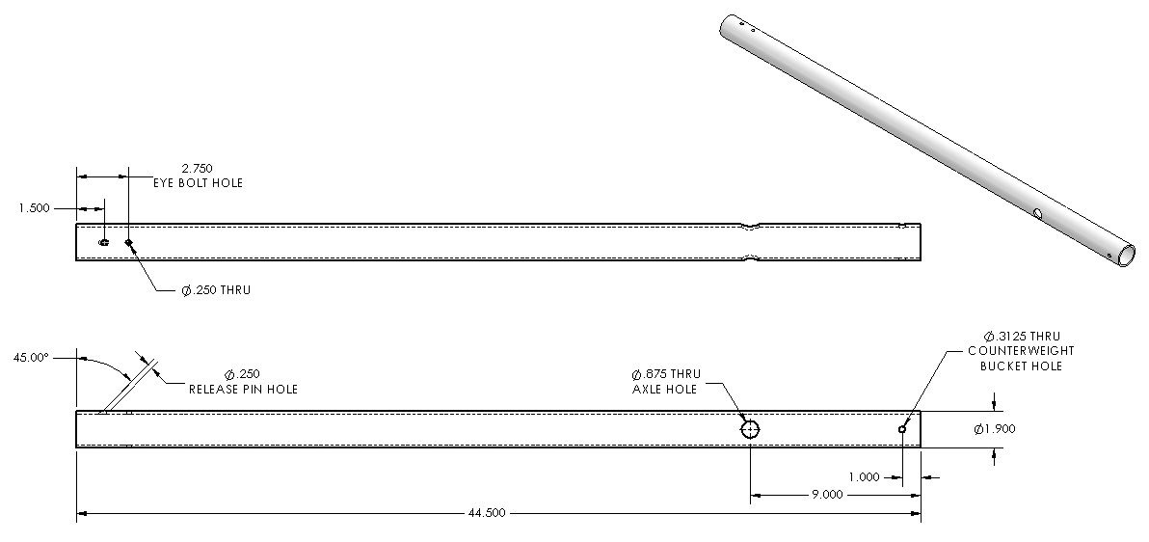
Constructing the Arm

Slide 39
…if using a Drill Press
Make sure drill press is turned off, lower to clamped down pipe and make sure center of drill is touching the center of the hole
Turn on and carefully lower drill into pipe using dip and remove technique

Slide 40
…if using a Hand Drill
Align center of drill onto marked hole. Position body above hand drill as much as possible
Firmly push drill into hole, making an informal pilot hole for drill to catch on
Have teammate double check that the drill is going straight down (look at pipe from multiple perspectives, birds-eye view usually is deceptive!)
Drill down lightly and carefully, making sure to hold the power drill steady. The PVC’s roundness will make the drill want to slip off, select a very low speed and go slow.

Slide 41
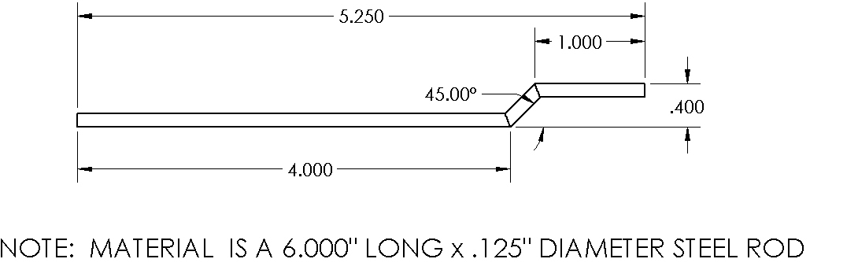
Constructing the Arm: Release pin
Use pliers to bend pin according to drawing below

Slide 42
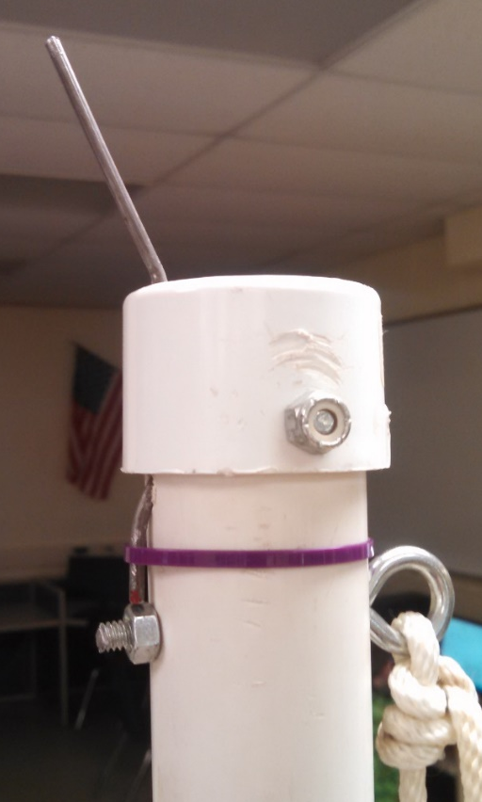
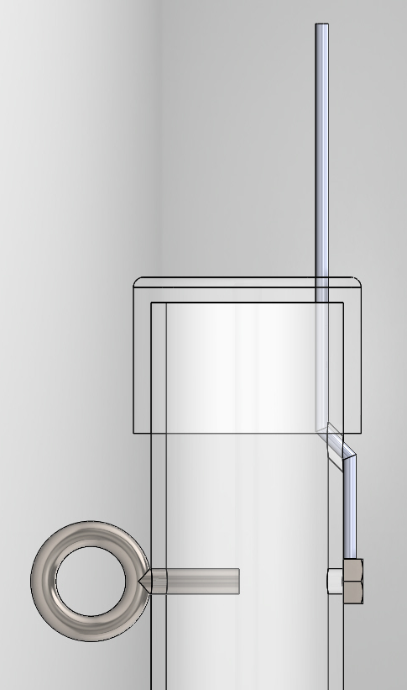
Constructing the Arm: Release pin
Secure Release Pin:
    Insert release pin through Cap and Arm
      See photo below.
      A hole will need to be drilled in cap for pin
      Secure pin with a zip tie
    Glue or bolt cap to arm
    Fasten ¼” eyebolt to arm

Slide 43
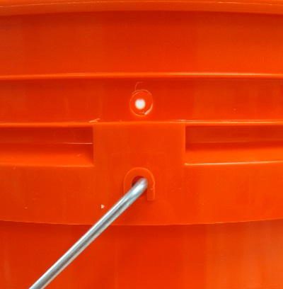
Constructing the Arm: Counterweight bucket
Attach the counterweight bucket:
    Drill 5/16” hole in bucket above handle
    Tie approximately 3 feet of ¼ ” nylon rope to bucket
      Thread through arm
        See images on next page

Slide 44
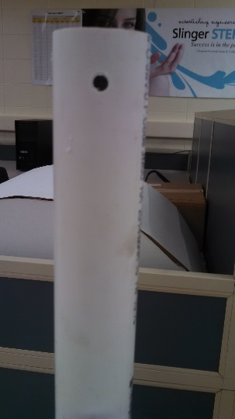
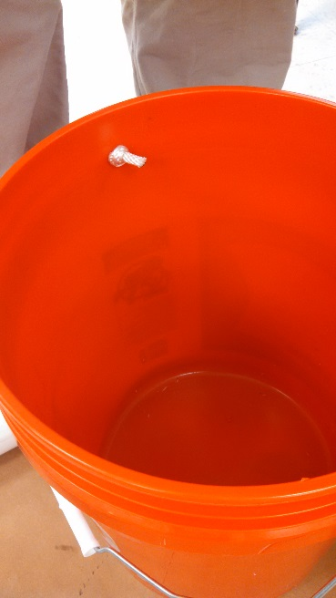
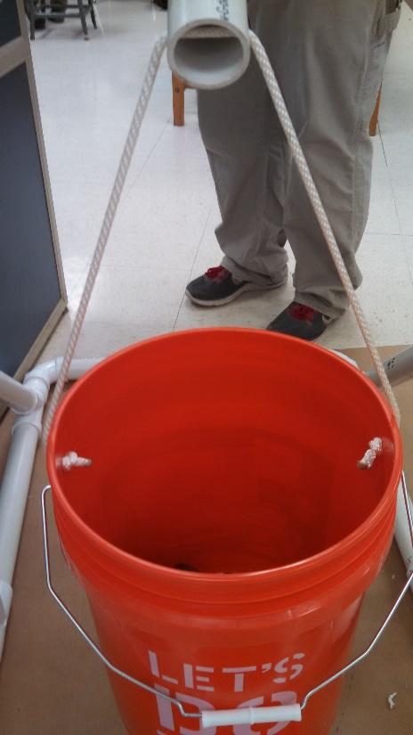
Constructing the Arm: Counterweight bucket

Slide 45
