Slide 1
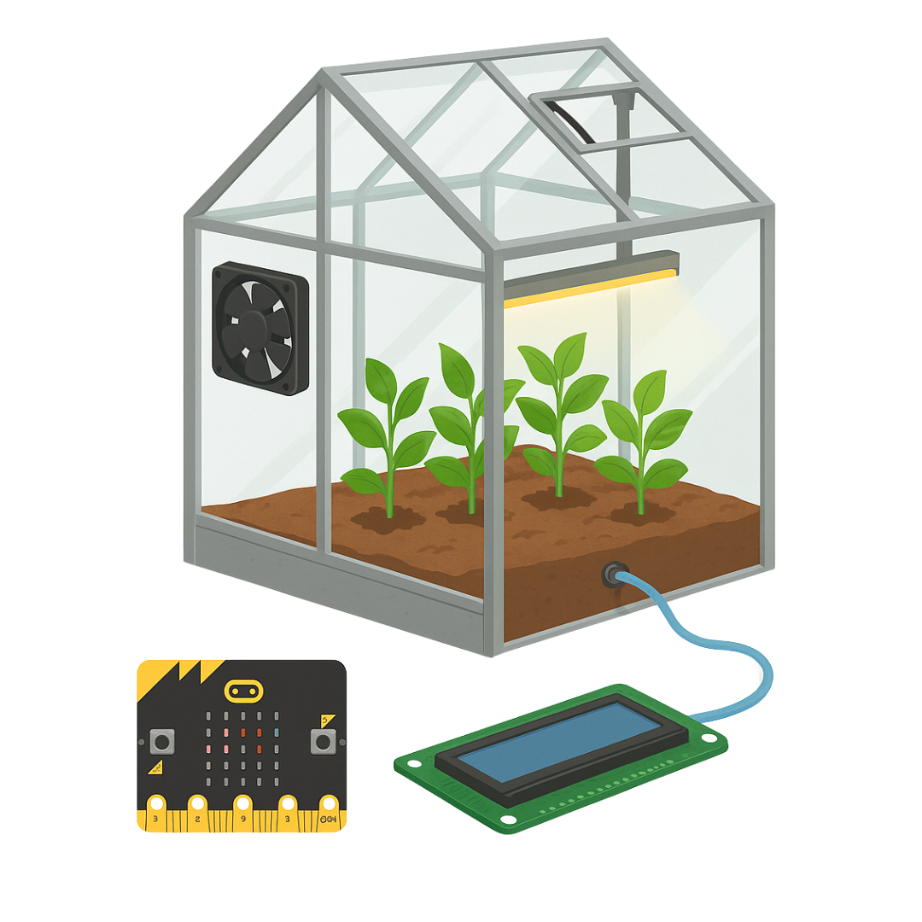
How Automated Greenhouse Works

Slide 2


What plant needs to grow:
Light: Plants use light to make food through photosynthesis.
Water: Helps plants stay alive and transport nutrients.

Slide 3


What plant needs to grow:
Temperature: Plants grow best in a controlled temperature range.
Humidity: Air moisture affects plant health; too much causes mold.
Nutrients: Soil minerals help plants grow strong.

Slide 4
An automated greenhouse is a type of greenhouse that can take care of plants by itself using technology. It uses sensors and machines to check things like temperature, soil wetness, and air humidity and can turn on lights, fans, or water pumps automatically.

Slide 5
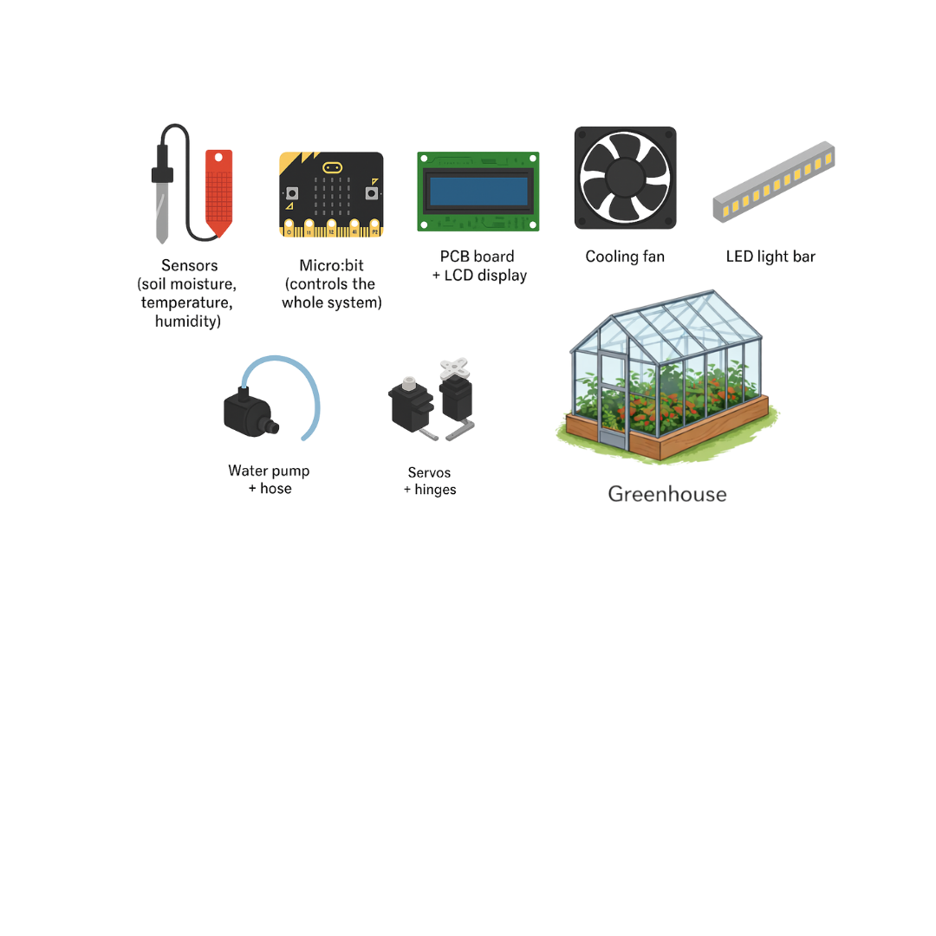
It needs several parts that work together to monitor and support plant growth.

Slide 6
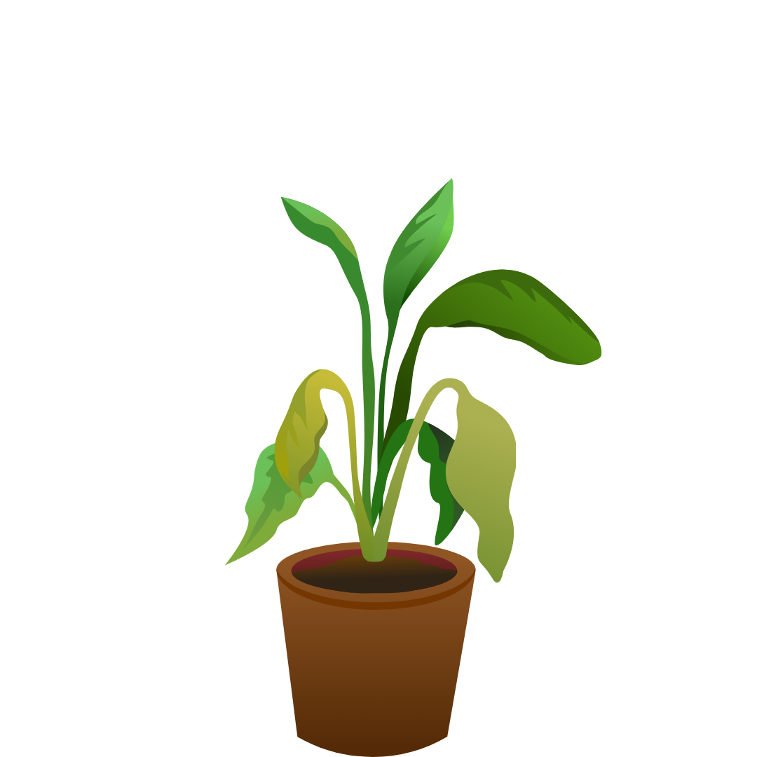
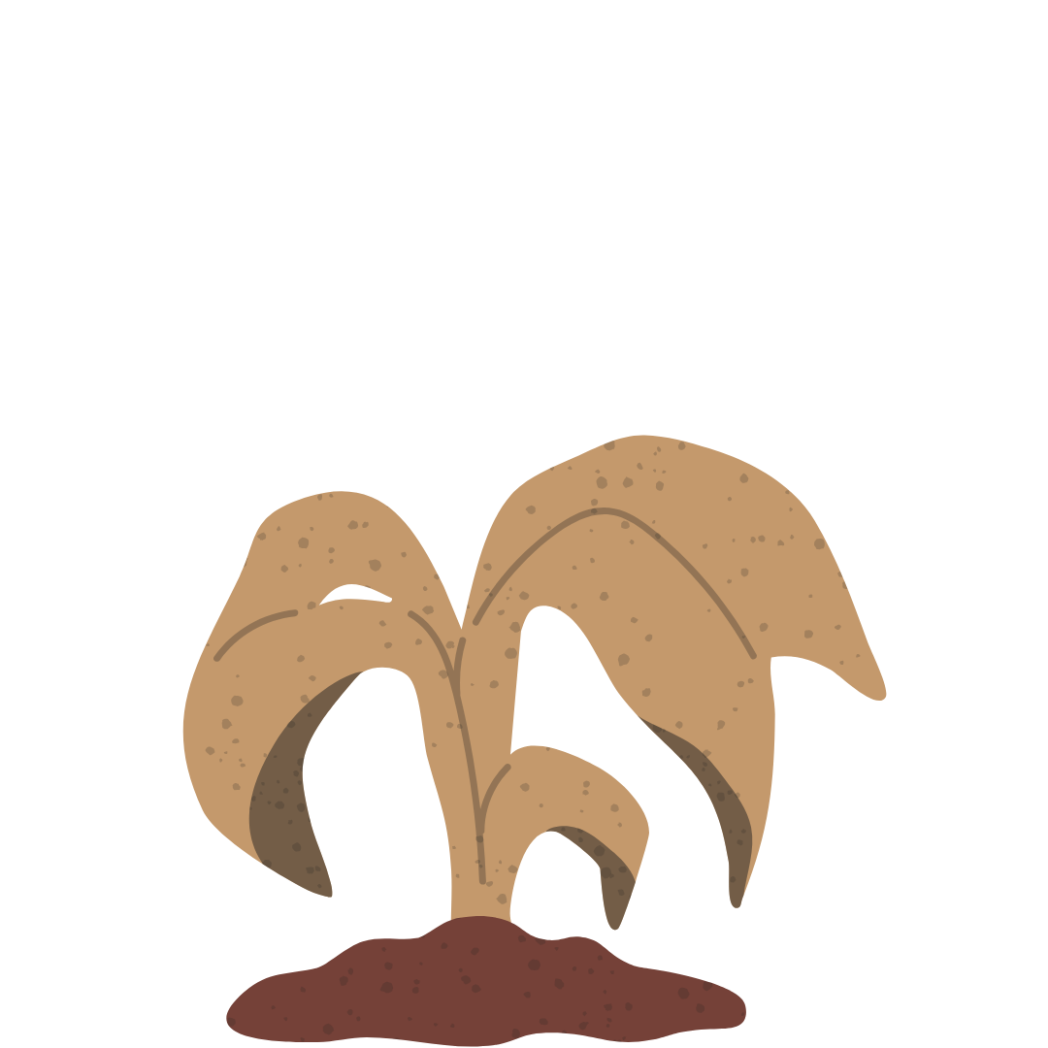

Why control is important:
Too much heat dries plants
Too little moisture causes wilting
High humidity can damage leaves
​
A greenhouse controls all these conditions.

Slide 7
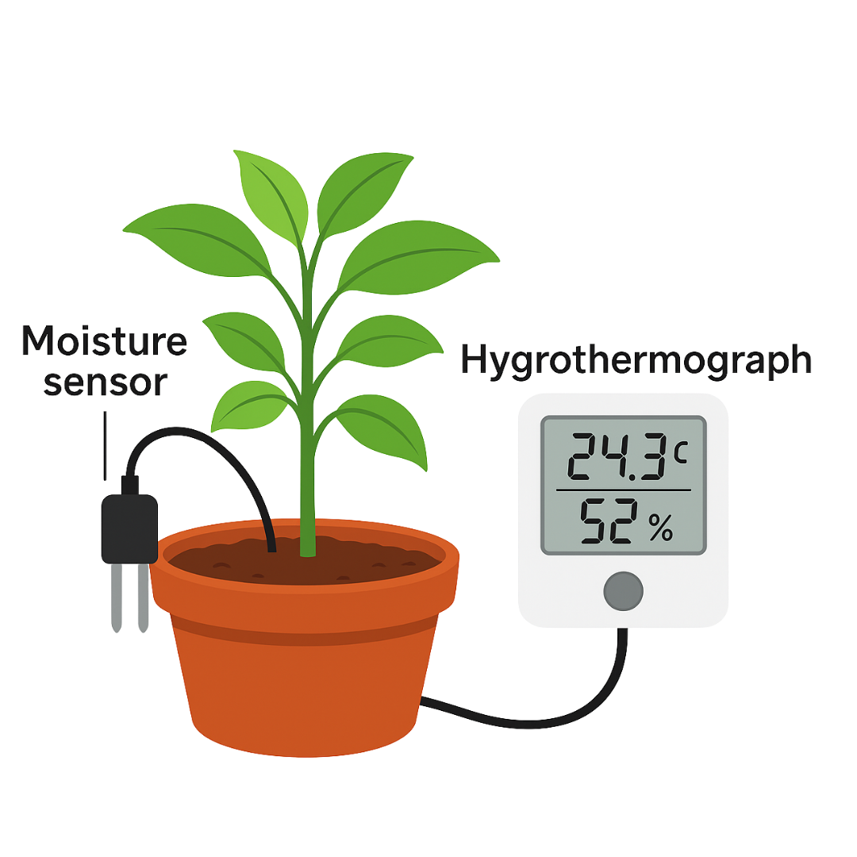
How sensor helps
Moisture sensor checks if the soil is wet or dry
Hygrothermograph measures temperature and humidity.
Real-time data helps automate the system.

Slide 8
Assembling a Greenhouse
Corner brackets + front/back panels: Form the frame
Roof panels + servos + hinges: Allow the roof to open/close for ventilation
Cooling fan: Cools the air when temperature rises
LED light bar: Acts as artificial sunlight when natural light is low

Slide 9
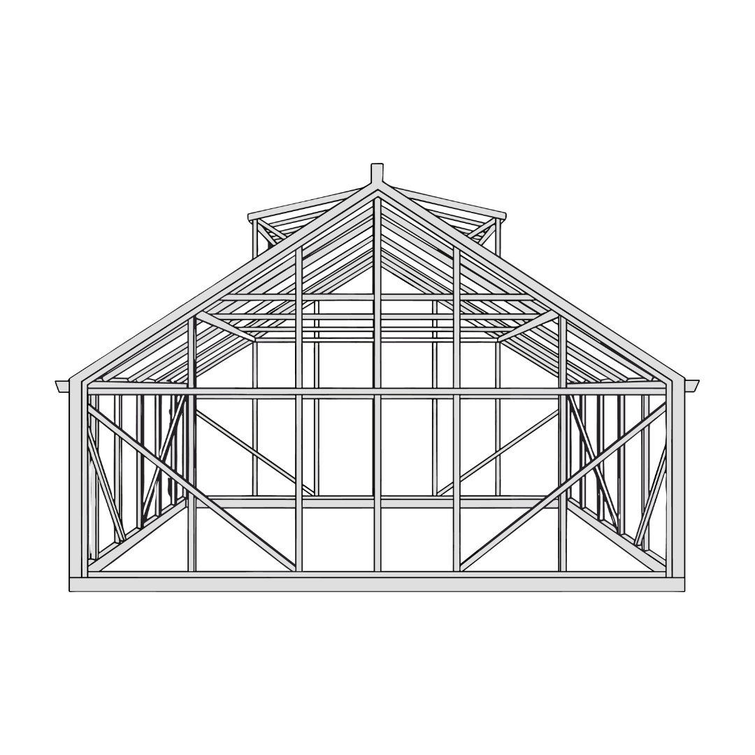
Assembling a Greenhouse
PCB board + LCD screen: The PCB links all electronics; the LCD shows sensor readings
Zip ties + PCB cover: Protect and organize wiring
Sensors mounted on walls:
Collect accurate environmental data

Slide 10
How Electricity Flows in A Greenhouse
Fan – for cooling
LED light bar – for plant light
Water pump – for automatic watering
Servos – for opening/closing vents or roof
Sensors – temperature, humidity, and soil moisture

Slide 11

How Electricity Flows in A Greenhouse
LCD display – shows readings
Micro:bit to PCB – the “brain” that controls all devices

Slide 12

Automation of a Greenhouse
We use MakeCode to program the Micro:bit. Programming tasks such as:
Showing a welcome/startup
message on the LCD screen
Reading sensor data (temperature, humidity, soil moisture)

Slide 13
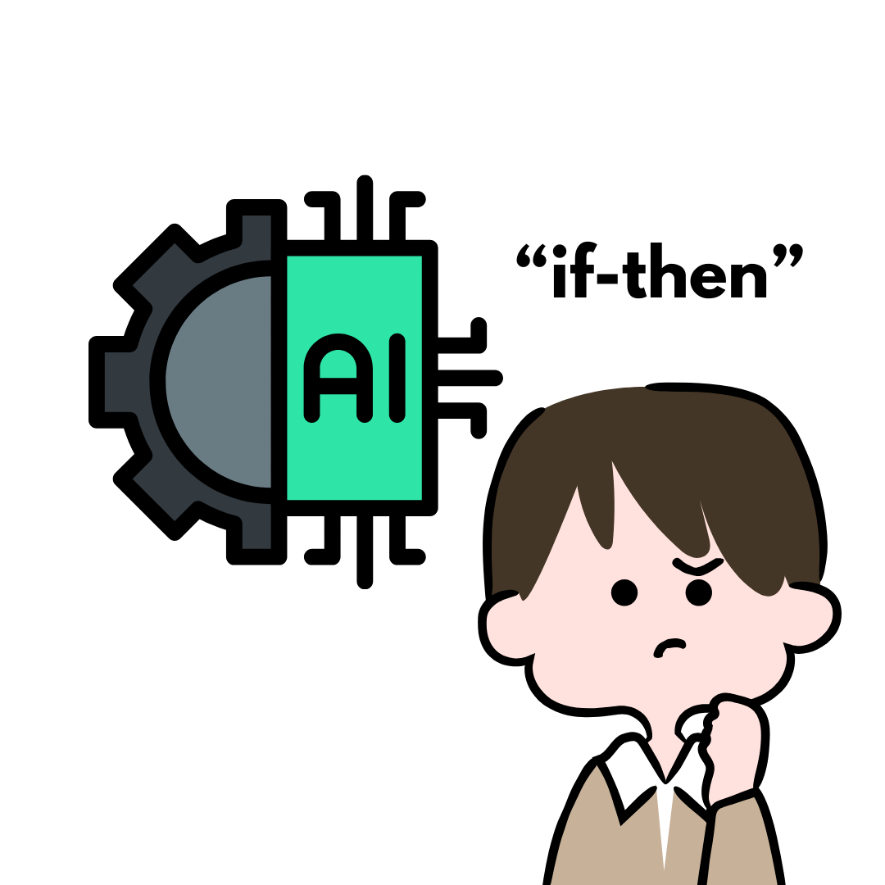
Automation of a Greenhouse
Automated systems make decisions using “if–then” logic.

Slide 14
Automation of a Greenhouse
  If the temperature is high, then turn on the fan.
  If the humidity is high, then open the vents.
  If the soil is dry, then activate the pump to add water.

Slide 15

Planting in a Greenhouse
Set up grow trays and plant seeds.
Insert moisture sensors into the soil.
Attach water hose if needed.
Turn on the automated system.

Slide 16
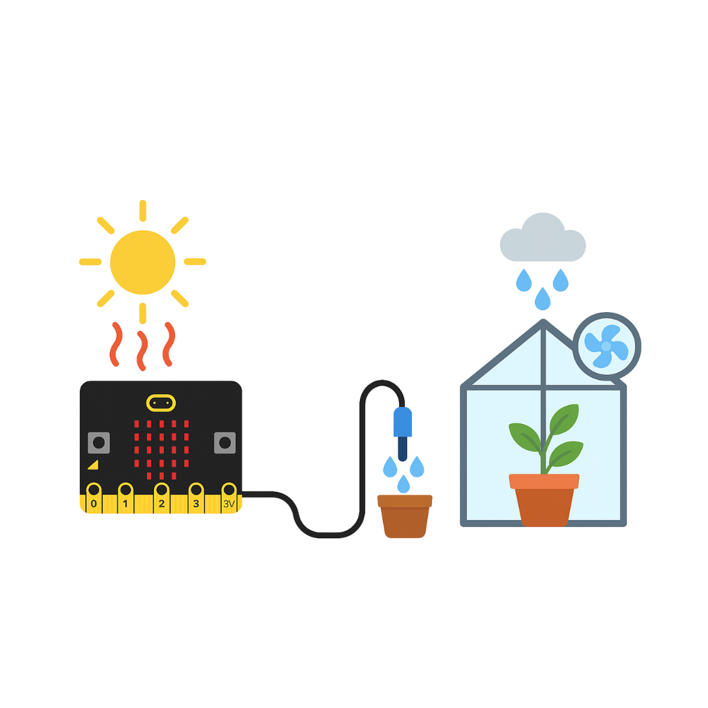
Planting in a Greenhouse
The automated system responds with cooling during heat, watering dry soil, and adjusting humidity.

Slide 17
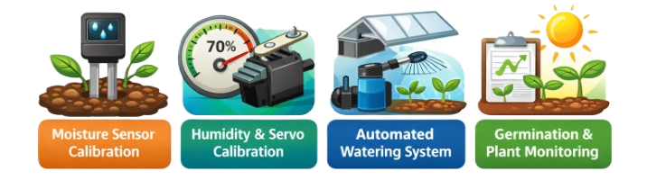
Investigation Labs
Using the concepts above, we can complete four applied investigations.

Slide 18
Calibrating the Moisture Sensor Lab
(Identifying Wet and Dry Values)
What is Calibration?
Calibration means finding the numeric values that show when soil is wet, dry, or partially wet.
Moisture sensors do not say “wet” or “dry.”
They give numbers, and those numbers must be understood before automation.

Slide 19
Calibrating the Moisture Sensor Lab
(Identifying Wet and Dry Values)
Why this matters:
Wet soil and dry soil have different numeric values
The Micro:bit uses these values to decide when to water plants
Accurate calibration helps prevent under-watering or over-watering

Slide 20
Calibrating the Servos Lab
(Identifying Humidity Thresholds)
Servos control the greenhouse roof vents.
The hygrothermograph measures humidity, and the LCD displays a numeric value.
Calibration helps determine:
What humidity level is normal
What humidity level is too high

Slide 21
Calibrating the Servos Lab
(Identifying Humidity Thresholds)
These values are used in the code so that:
When humidity rises → vents open
When humidity lowers → vents close
Different plants require different humidity levels, so calibration must match the plant being grown.

Slide 22
Watering the Plants Lab
  Automated watering uses sensor data and programmed logic.
  The moisture sensor provides numeric values that represent soil conditions.
  The Micro:bit uses if–then logic:
  If soil is dry, then turn on the water pump.
  If soil is wet, then keep the pump off.

Slide 23
Watering the Plants Lab
  Timed watering helps control how much water is delivered, reducing the risk of flooding or root damage.
  Automation allows plants to be watered even when humans are not present.

Slide 24
Germination to Plants Lab
  Germination is the process where a seed begins to grow into a plant.
  Successful germination depends on:
  Proper soil moisture
  Stable temperature
  Balanced humidity
  Adequate light

Slide 25
Germination to Plants Lab
  As plants grow:
  Water needs may increase
  Humidity levels may change
  Environmental data helps guide adjustments
  Monitoring conditions helps students understand how plant growth responds to environmental changes.

