Slide 1
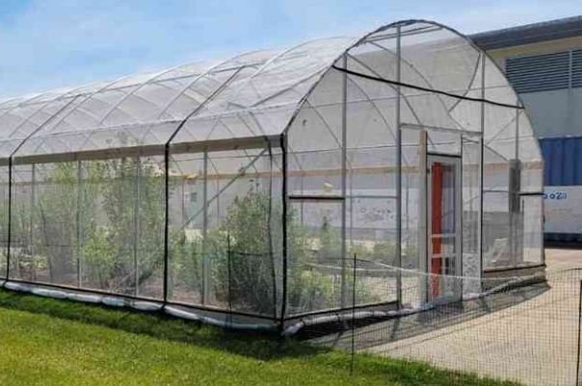
Greenhouses:
How They Work and
Why They Matter
A simple guide to understanding
greenhouses

Slide 2
What is a greenhouse?
A greenhouse is a building made of glass or clear materials that lets sunlight in to grow plants.
Purpose: It creates a controlled environment to help plants grow better, especially in cold or harsh weather.

Slide 3
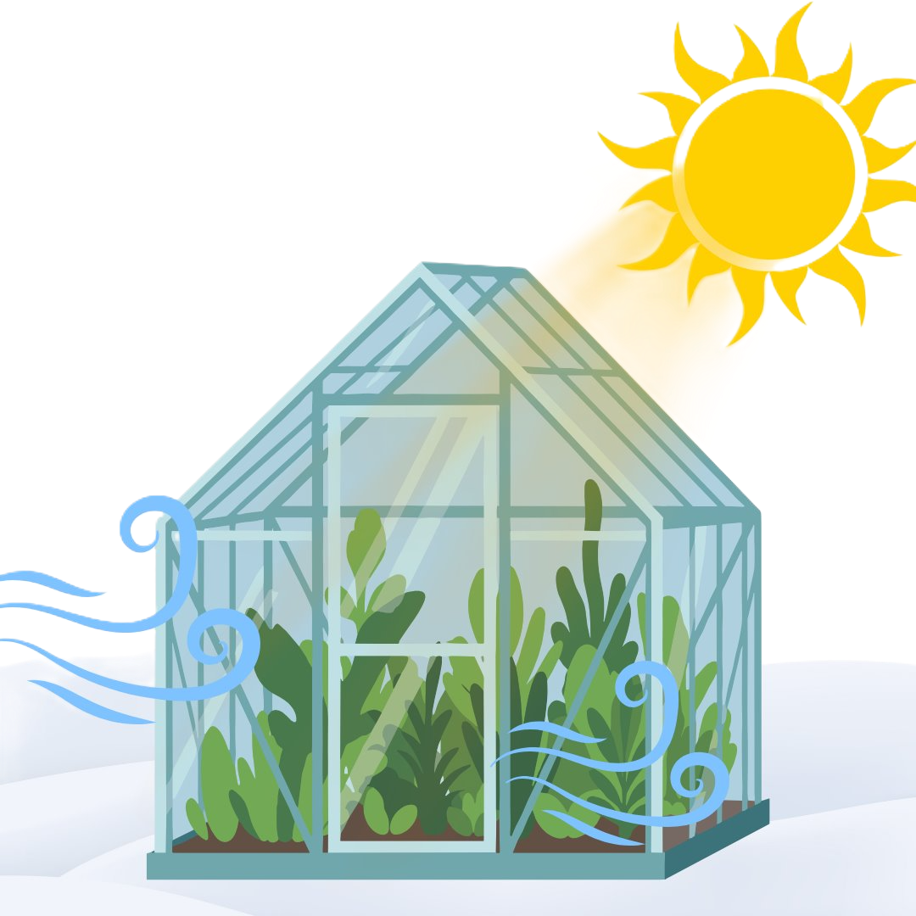
How Does a Greenhouse Work?
Sunlight enters through the glass or plastic.

Slide 4
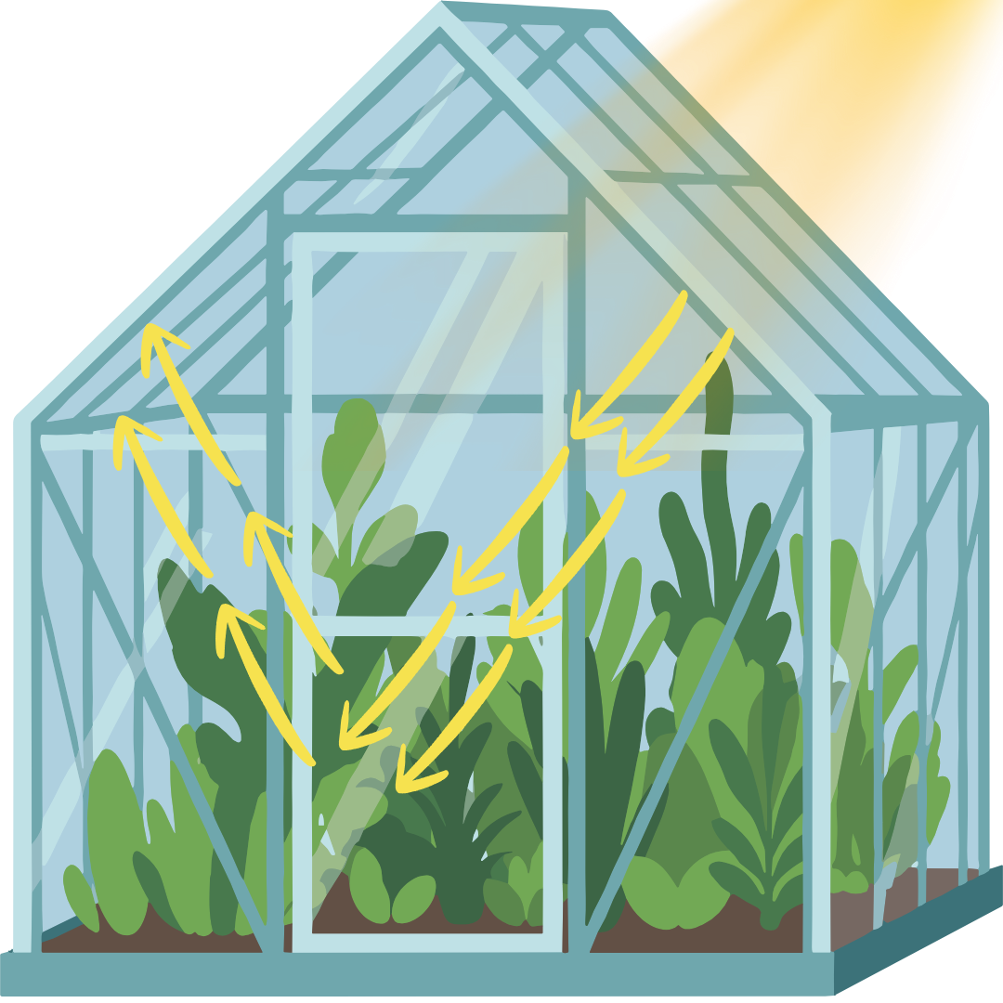
How Does a Greenhouse Work?
The heat is trapped inside, warming the air and soil.

Slide 5
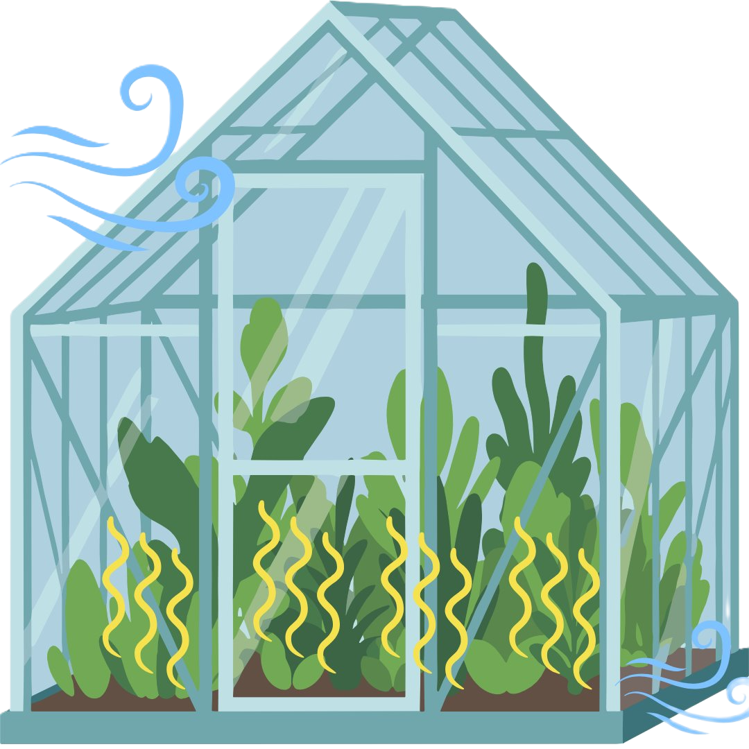
How Does a Greenhouse Work?
This creates a warm environment for plants, even when it's cold outside.
Fun Fact: This process is called the "greenhouse effect"!

Slide 6
Why Are Greenhouses Important?
Grow plants all year round, even in winter.
Protect plants from pests, bad weather, and diseases.
Scientists use greenhouses to study plants.
Many vegetables and fruits are grown in greenhouses.

Slide 7
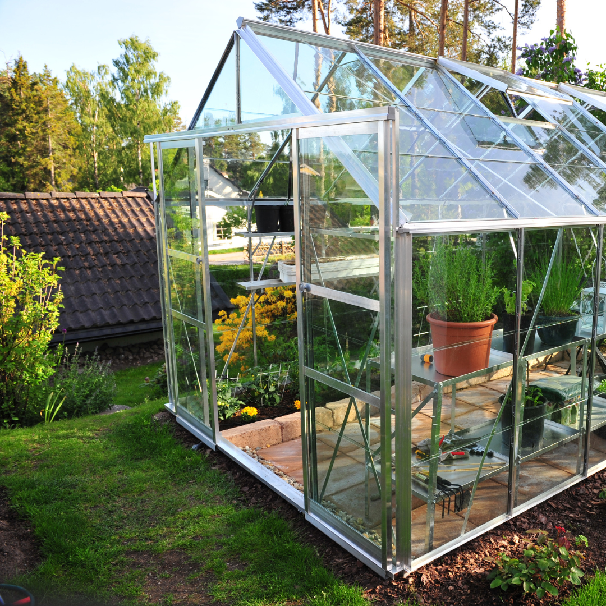
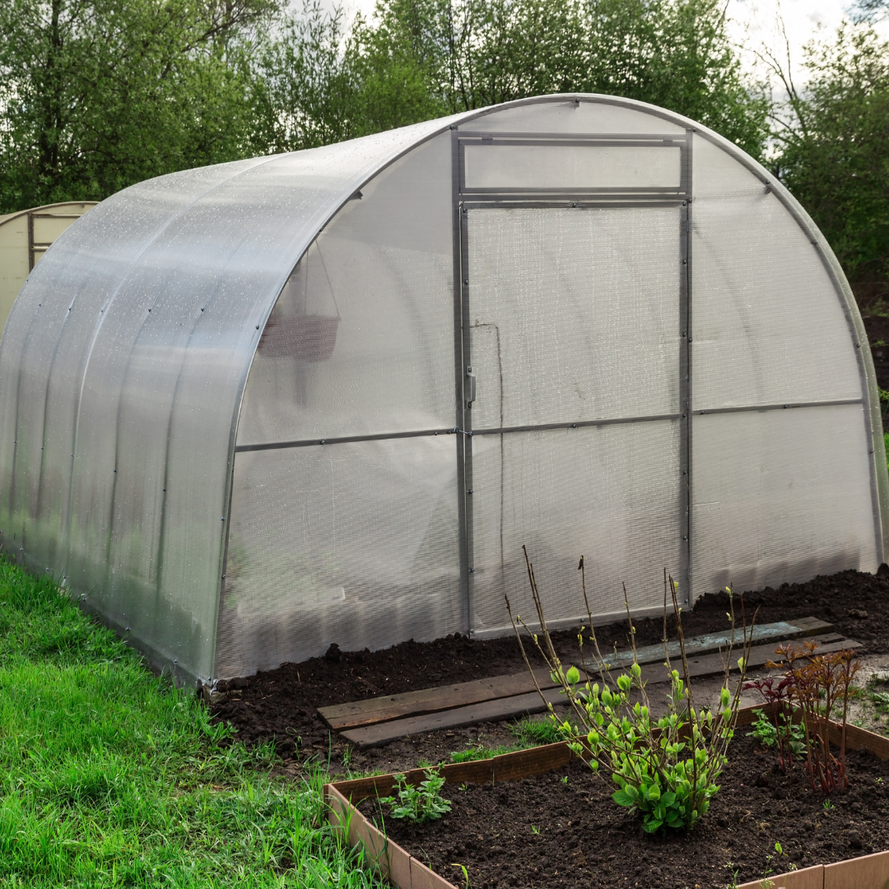
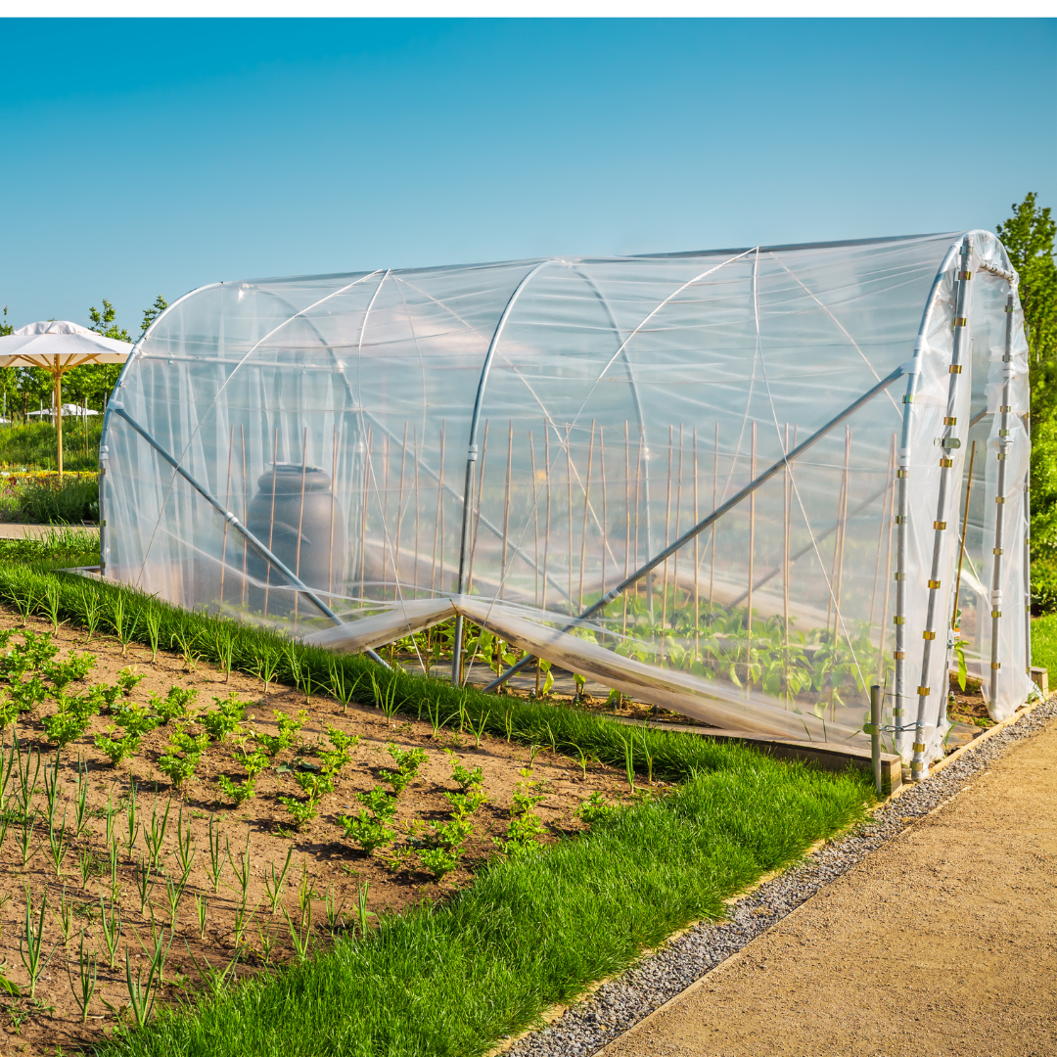
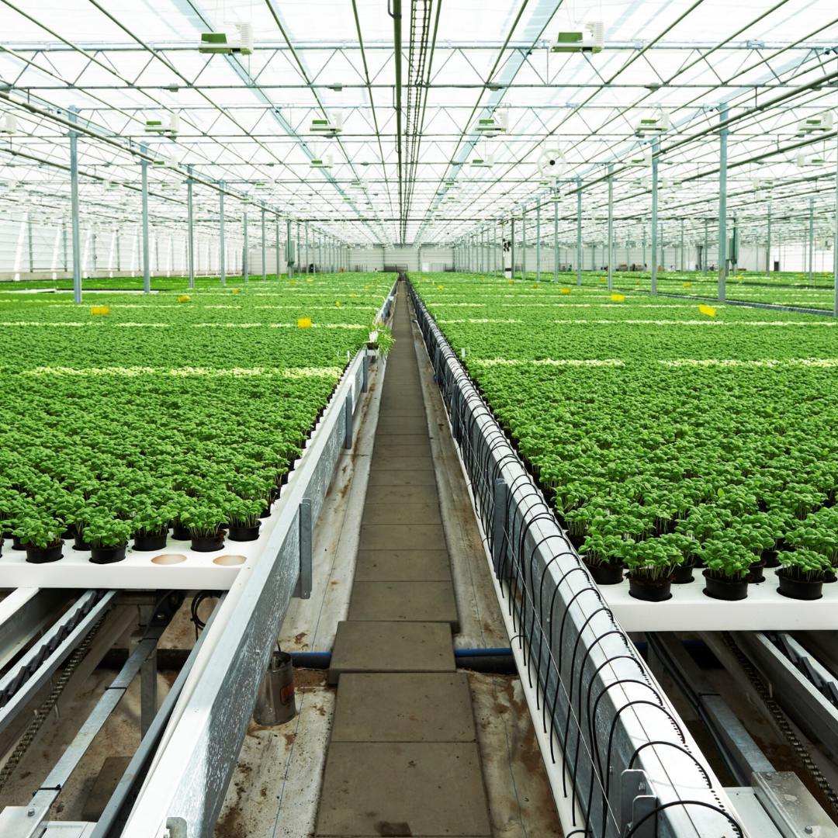
Types of Greenhouses
Glass Greenhouses: Traditional and durable.
Plastic Greenhouses: Cheaper and lightweight.
Portable Greenhouses: Small and easy to move.
High-Tech Greenhouses: Use computers to control temperature, light, and humidity.

Slide 8
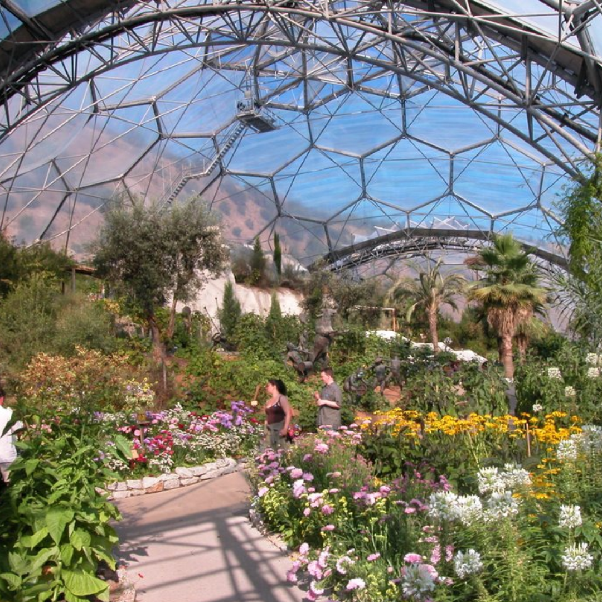
Fun Fact About Greenhouses
The biggest greenhouse in the world is the Eden Project in England!

Slide 9
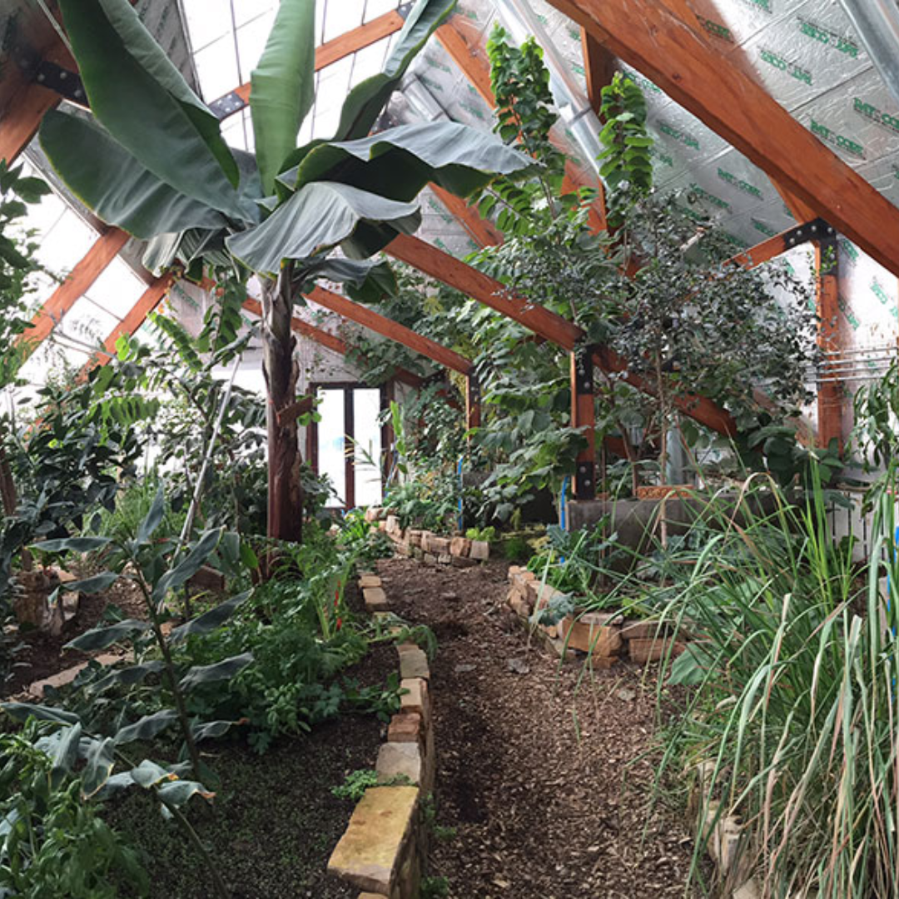
Fun Fact About Greenhouses
Greenhouses can grow exotic plants like bananas in cold climates.

Slide 10
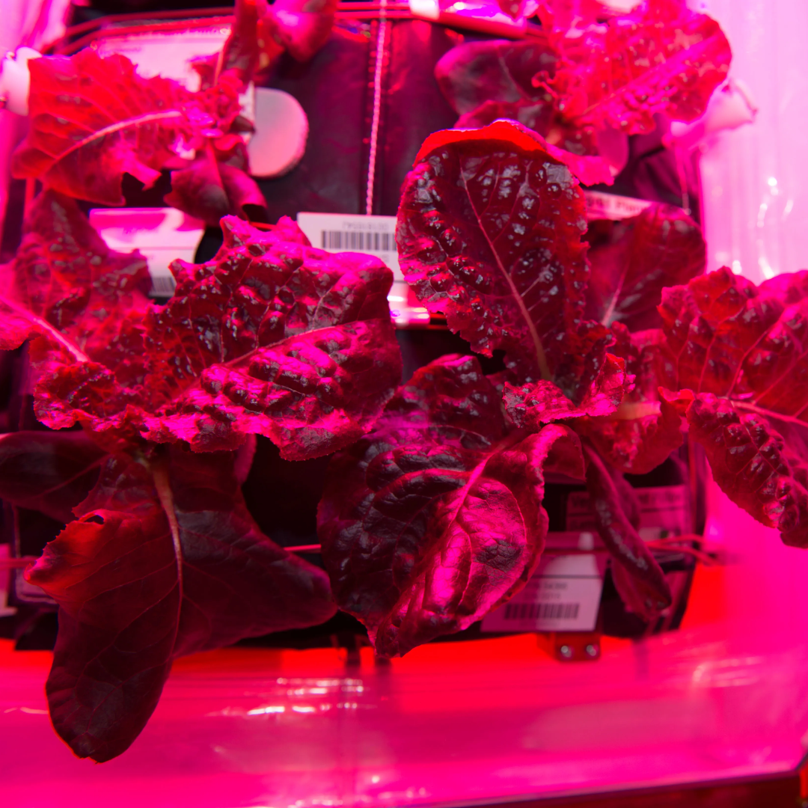
Fun Fact About Greenhouses
Some greenhouses are even used on space missions to grow food!

Slide 11
Conclusion
Greenhouses are amazing tools for growing plants and producing food.
They use the power of sunlight to create the perfect environment for plants.
With greenhouses, we can grow food all year and even help the planet!

