Slide 1

Solve with Circuits

Slide 2

Understanding Equal Groups
Multiplication is used when objects are arranged in equal groups.

Slide 3

Understanding Equal Groups
When each group has the same number of items, Multiplication helps find the total.

Slide 4
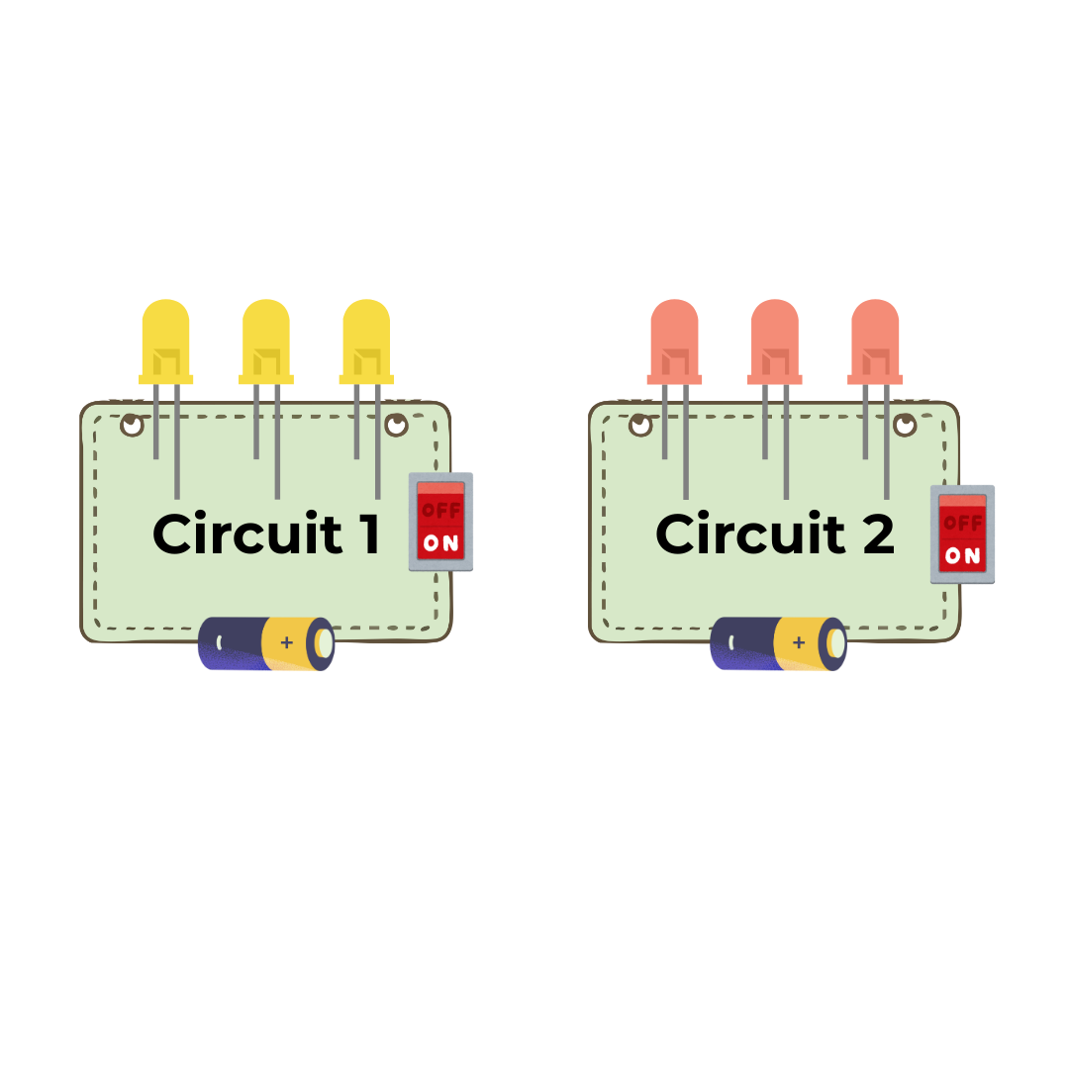
Each circuit has 3 LEDs.
We built 2 circuits.
Let's Multiply!
3 LEDs
3 LEDs
The LEDs are arranged in equal groups.

Slide 5
Let's Multiply!
How many LEDs are used?
3 LEDs × 2 circuits = 6 LEDs
3 x 2 = 6
A total of 6 LEDs are used.

Slide 6
Commutative Property
The factors can be written in any order.
3 x 2 = 6
2 x 3 = 6
factor
factor
product

Slide 7

Understanding Fair Sharing
Division is used to share equally.

Slide 8

Understanding Fair Sharing
It begins with the total, then the total is split into equal groups.

Slide 9
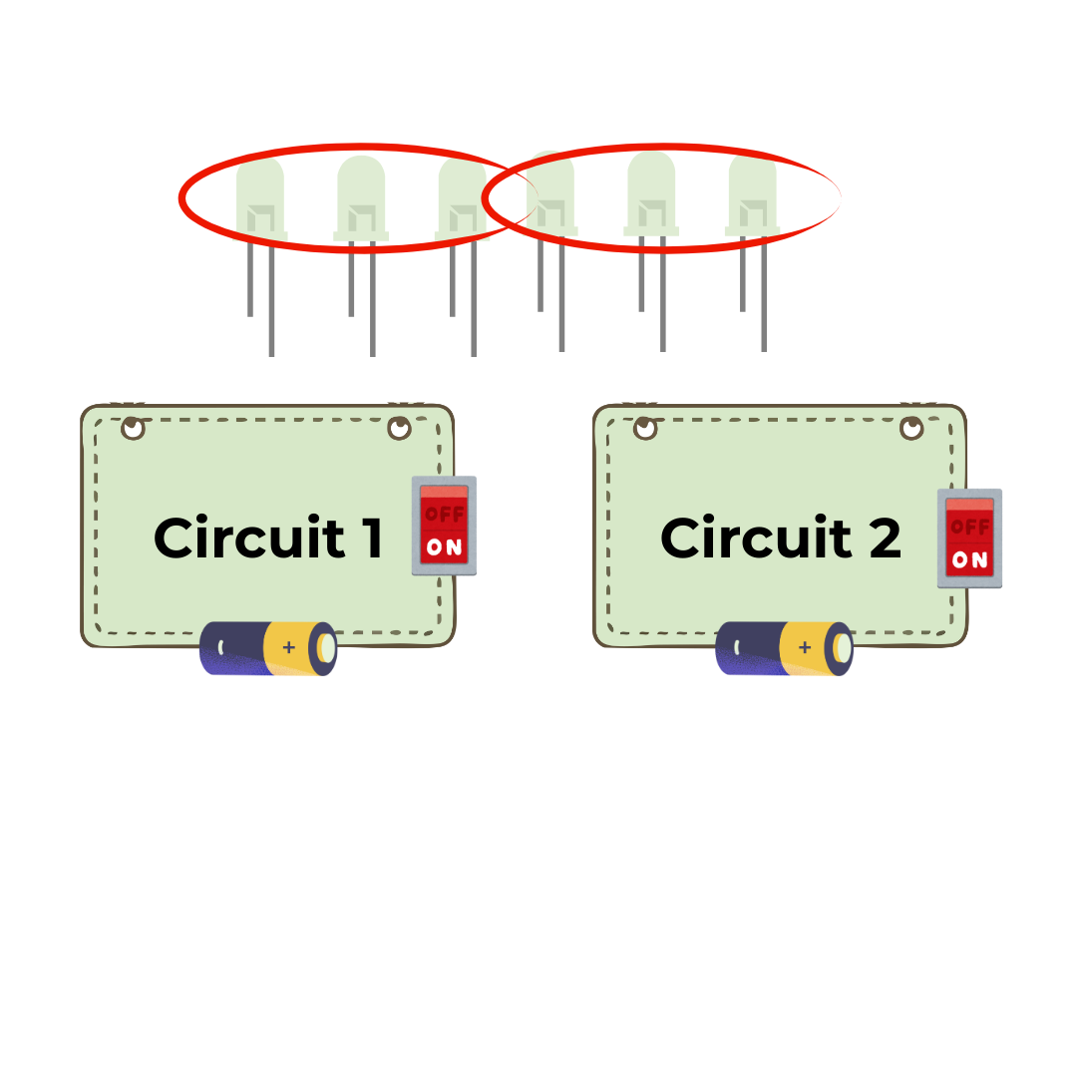
There are 6 LEDs and 2 circuits. Share the LEDs evenly.
Let's Divide!

Slide 10
How many LEDs each circuit receives?
Let's Divide!
6 LEDs ÷ 2 circuits = 3 LEDs
6 ÷ 2 = 3
Each circuit receives 3 LEDs.

Slide 11
Parts of Division
6 ÷ 2 = 3
dividend
divisor
quotient

Slide 12
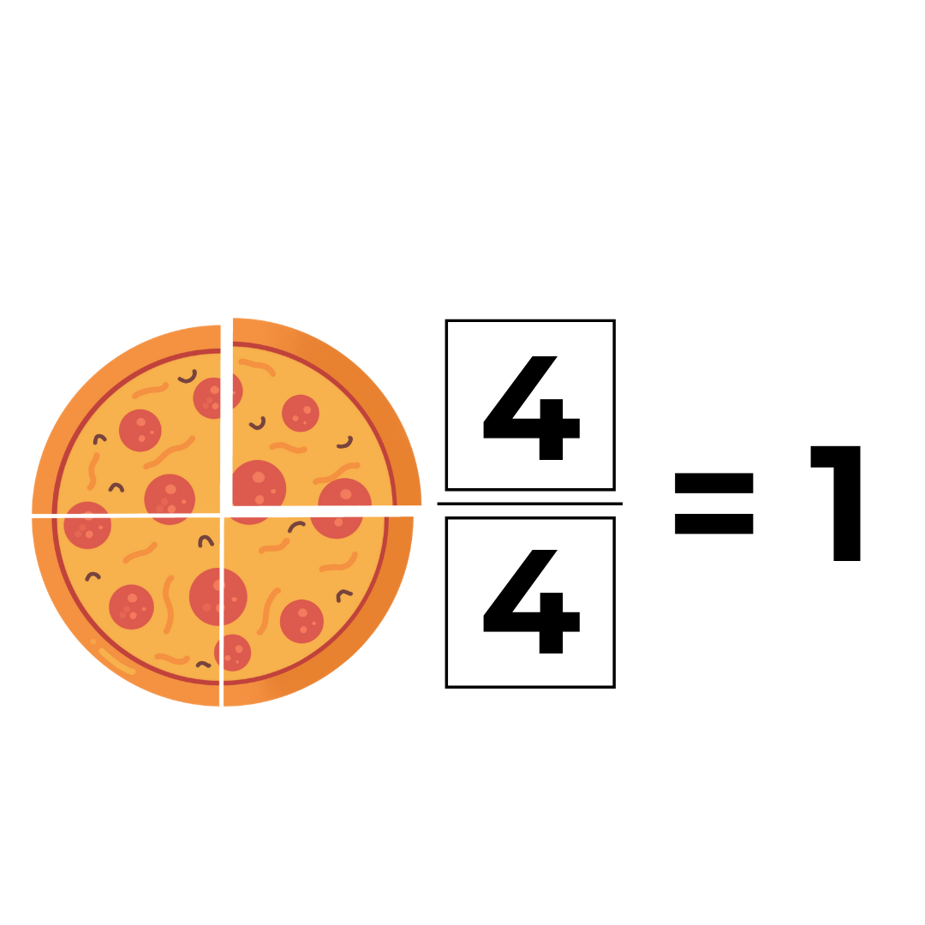
Parts of a Whole
A fraction shows part of a whole. The whole must remain the same.

Slide 13
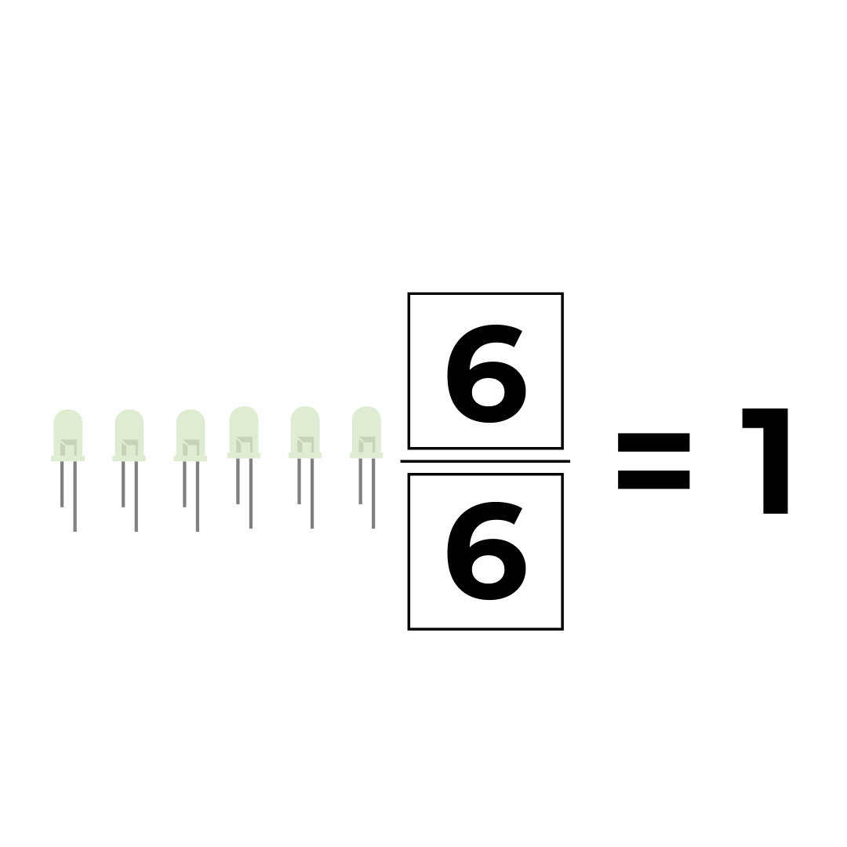
Fraction!
There are 6 LEDs in total. 6 LEDs make 1 whole.

Slide 14
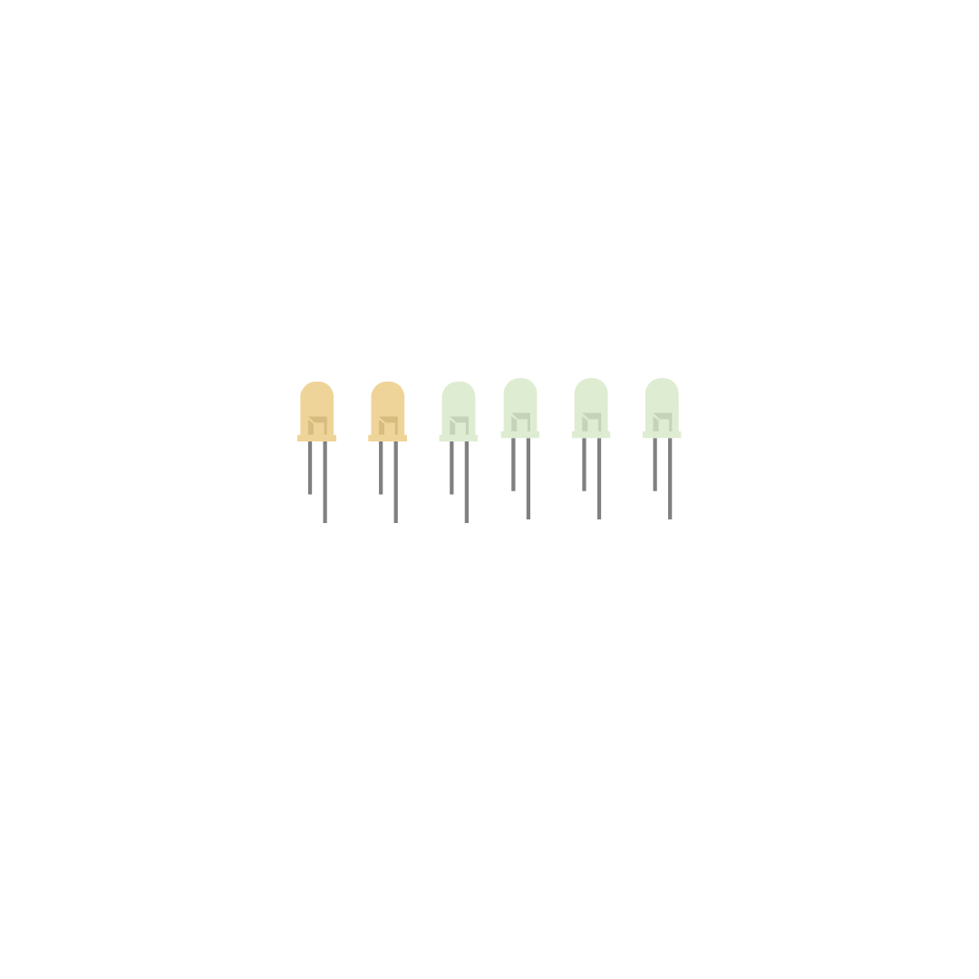
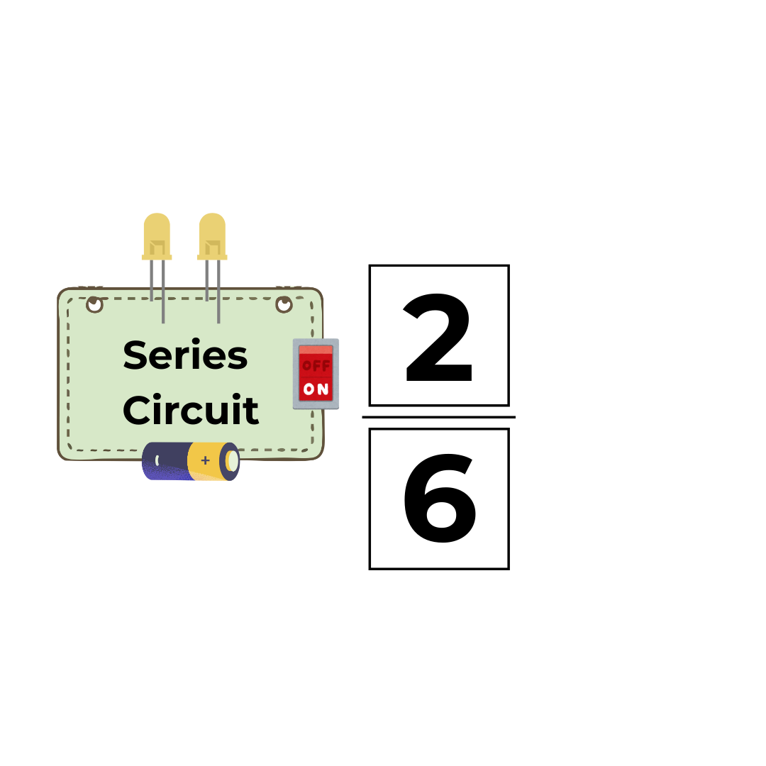
Series circuit uses 2 out of 6 LEDs.

Slide 15
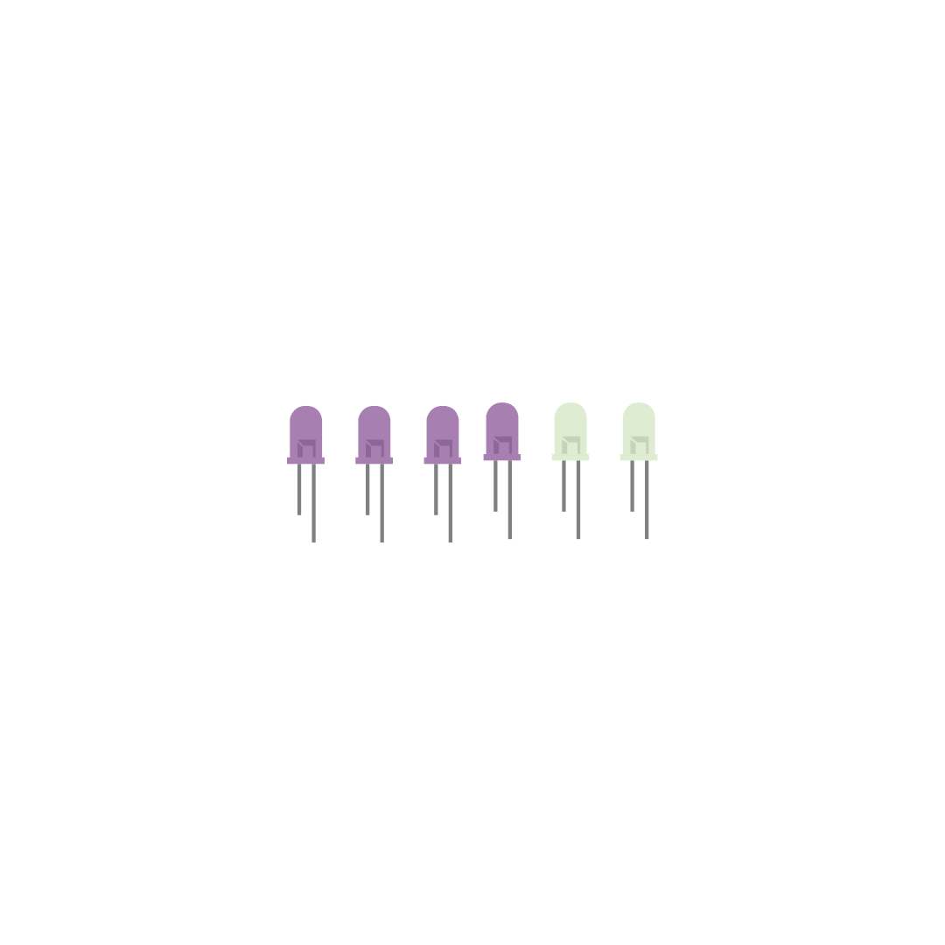
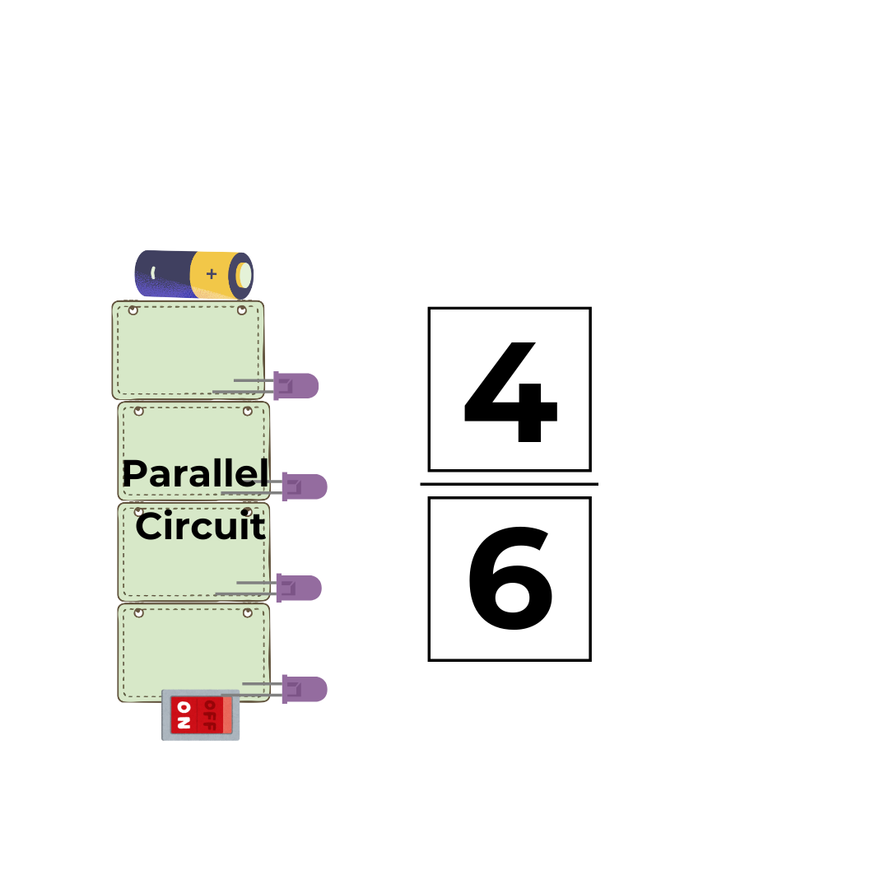
Parallel circuit uses 4 out of 6 LEDs.

Slide 16
Comparing Fractions
Before we compare fractions, we must know the whole. If there are 6 LEDs total, then 6 LEDs = one whole.

Slide 17
Comparing Fractions
Greater part – uses more of the whole
Smaller part – uses less of the whole
Equal part – uses the same amount

Slide 18
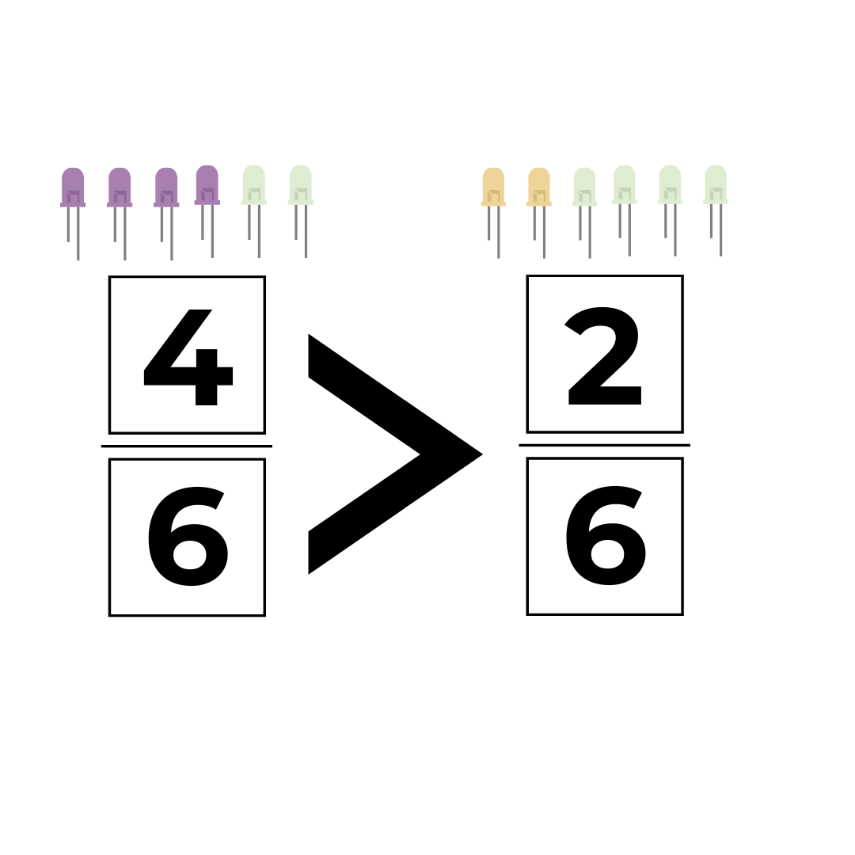
The parallel circuit uses the greater part of the whole.

Slide 19

The series circuit uses the smaller part of the whole.

Slide 20

Understanding Voltage
Voltage shows the strength of electrical power. We can check voltage using a multimeter.

Slide 21
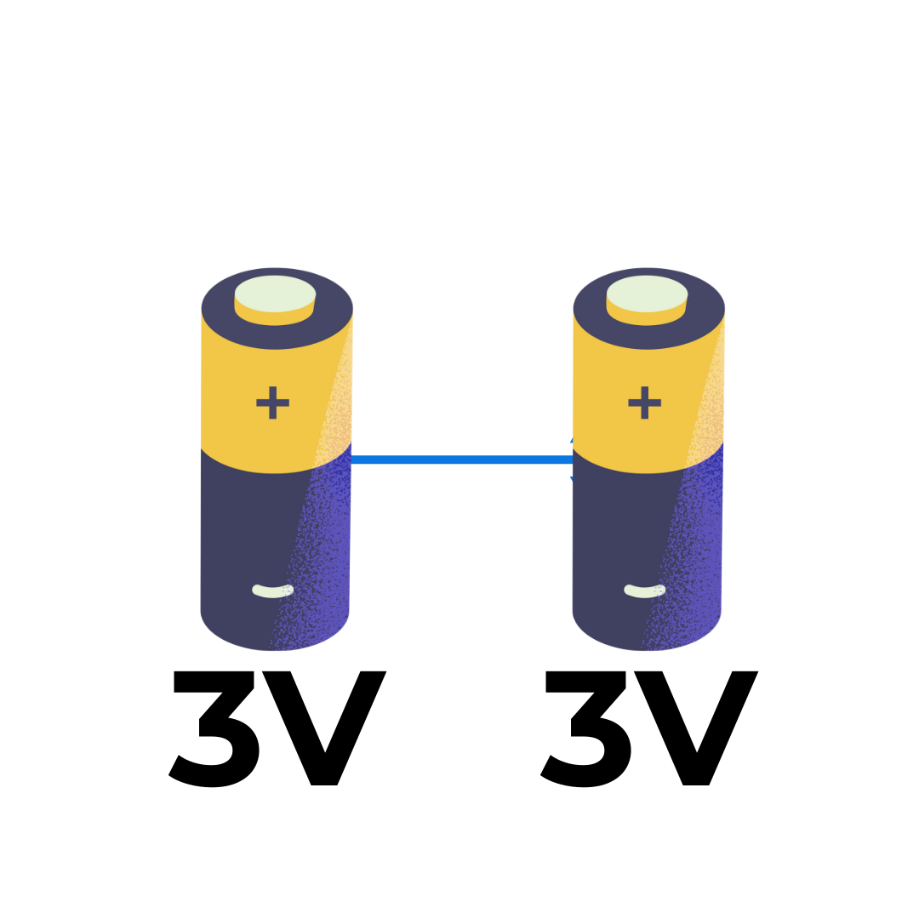
Voltage
Each battery provides 3 volts. Since they are equal, let's use multiplication.

Slide 22
Voltage
3 volts × 2 batteries = 6 volts
The total voltage increases when batteries are added.
3v x 2 = 6v

Slide 23
Understanding Voltage
If we know the total voltage, we can also use division to find how many volts each battery provides.

Slide 24
Voltage
6 volts ÷ 2 batteries = 6 volts
Each battery provides 3 volts.
6v ÷ 2 = 3v

