Slide 1
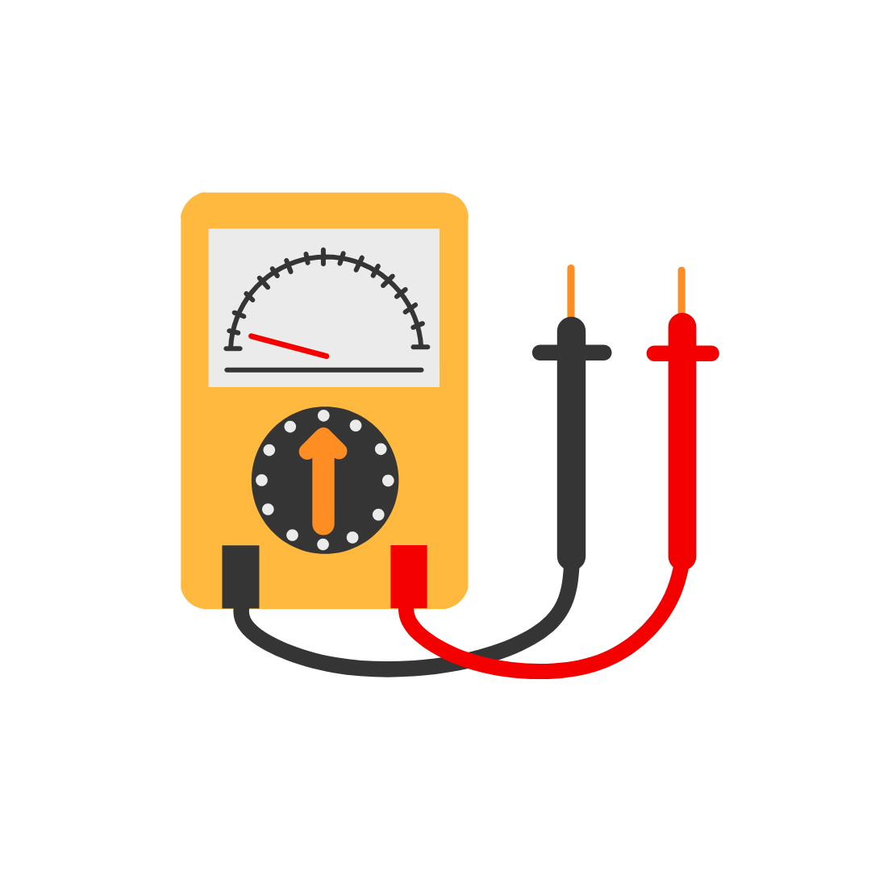
Using the Multimeter

Slide 2
What is a Multimeter?
A multimeter is a tool used to measure electricity in a circuit. It can measure:
Voltage (V) – how strong the electrical push is
Current (A) – how much electricity is flowing
Resistance (Ω) – how much a material resists electricity

Slide 3
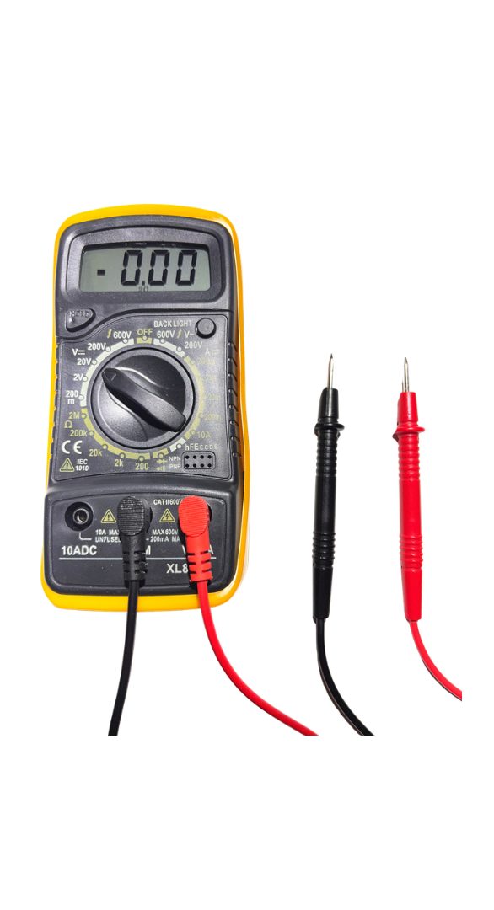
Parts of a Multimeter
A basic multimeter has three main parts:
Display Screen – shows the measurement
Dial / Selector – chooses what to measure

Slide 4

Parts of a Multimeter
Test Leads (Probes)
  Red probe → Positive (+)
  Black probe → Negative (–)

Slide 5
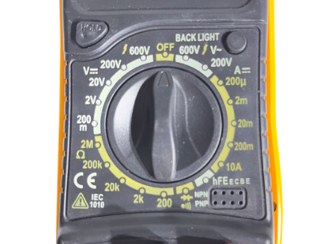
Understanding the Dial
V (Voltage) – electrical pressure
A (Current) – flow of electricity
Ω (Resistance) – opposition to flow
))) (Continuity)– checks if a path is complete

Slide 6

Safety Rules
Never touch bare metal tips of the probes
Keep hands dry
Do not force the probes into components
Always follow the instructions carefully
Ask for help if unsure

Slide 7
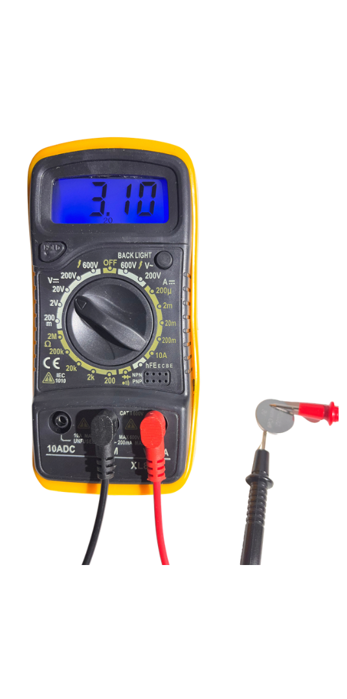

Measuring Voltage
Voltage tells us how much energy electricity has. To measure voltage:
Turn the dial to V 20V
Place the black probe on the negative (–)
Place the red probe on the positive (+)
Read the number on the screen

Slide 8

Measuring Battery Voltage
When testing a battery:
Red probe → battery positive (+)
Black probe → battery negative (–)
If the number is:
Close to the battery label → battery is good
Much lower → battery is weak or dead

Slide 9
What is Continuity?
Continuity checks if electricity can:
Travel through a wire or component
Complete a full path (closed circuit)
If electricity can flow → circuit is complete
If not → circuit is broken

Slide 10

Checking Continuity
Turn the dial to the continuity symbol
Touch probes to both ends of a wire or component
Listen for a beep
  Beep sound → electricity can flow
  No sound → broken connection

