Slide 1

Measure with Music

Slide 2
Fluency with Multi-Digit Numbers & Decimals
Musicians divide beats and time evenly when practicing.

Slide 3
A musician practices 84 beats and divides them evenly into 7 measures. How many beats are in each measure?
84 beats divided evenly into
7 measures gives 12 beats per measure
84 ÷ 7 = 12

Slide 4
A student practices scales for 6.5 minutes and chords for 2.75 minutes. How many minutes does the student practice in total?
Total practice time is 9.25 minutes
6.5 + 2.75 = 9.25

Slide 5
A musician has 9.6 minutes to practice and plans to work on 4 songs equally. How many minutes should be spent on each song?
Each song gets 2.4 minutes
9.6 ÷ 4 = 2.4

Slide 6
Factors, GCF & Distributive Property
Factors help us break numbers into smaller parts. The greatest common factor (GCF) shows what numbers have in common. The distributive property lets us rewrite a sum as a multiplication problem.

Slide 7
Let's solve the following:
What is the greatest common factor (GCF) of 18 and 24?
How many rhythm groups will there be for each sound?
Rewrite 18 + 24 using the distributive property to show the shared rhythm pattern.

Slide 8
Step 1: Find the GCF of 18 and 24
Factors of 18:
1, 2, 3, 6, 9, 18
Factors of 24:
1, 2, 3, 4, 6, 8, 12, 24
Greatest common factor (GCF) = 6

Slide 9
Step 2: Find how many groups each makes
18 ÷ 6 = 3 rhythm groups
24 ÷ 6 = 4 rhythm groups

Slide 10
18 + 24 = 6(3 + 4)
Step 3: Use the distributive property
Both numbers share a factor of 6, which allows the beats and claps to be grouped into the same repeating rhythm pattern.

Slide 11
Positive and Negative Numbers
When adding numbers with the same sign, add the values and keep the sign.

Slide 12
A student moves down 3 frets (-3) and then moves down 5 more frets (−5). What is the total movement?
The student ends -8 frets down from the starting point.
-3 + (-5) = -8

Slide 13
Positive and Negative Numbers
When adding numbers with different signs, subtract the values and keep the sign of the number with the greater absolute value.

Slide 14
A student starts on a fret and moves up the fretboard 6 frets (+6). Then the student moves down 4 frets (−4). What is the final position?
The student ends 2 frets up from where they started.
+6 + (-4) = 2

Slide 15
Positive and Negative Numbers
When subtracting a number, change the subtraction to addition and change the sign of the number being subtracted.

Slide 16
A student moves down 7 frets (−7), then moves up 2 frets (subtracting −2).
The student is 5 frets down from the start.
-7 - (-2)
-7 + 2 = -5

Slide 17
Number Line & Absolute Value
A number line shows the position of numbers. Absolute value tells us how far a number is from zero, not the direction.

Slide 18
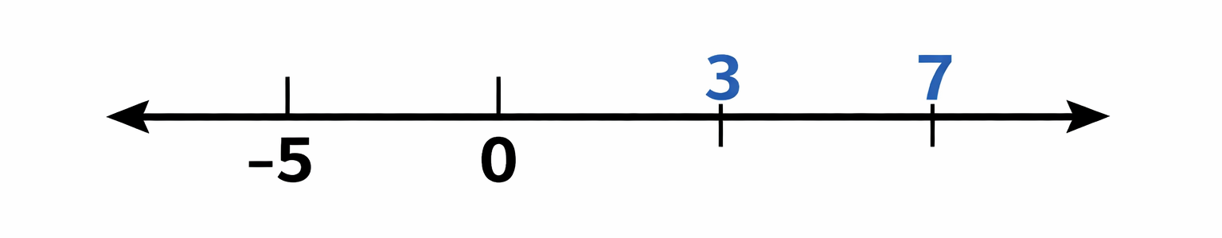
−5, 0, 3, and 7 on a number line

Slide 19
The number 0 is the starting point in the center of the number line.
The number −5 is placed to the left of 0 because it is a negative number.
The number 3 is placed to the right of 0 because it is a positive number.
The number 7 is placed farther to the right than 3 because it is a larger positive number.

Slide 20
Absolute Value
The absolute value of a number tells how far the number is from zero on a number line. It does not show direction, only distance.

Slide 21
Absolute Value
A student is standing at 0 on a number line and moves 6 units to the left to −6. How far is the student from the starting point?
Answer:
The student is 6 units away, because |−6| = 6.

Slide 22
Comparing Negative Numbers
When comparing negative numbers, the number closer to zero is greater. On a number line, numbers to the right are greater than numbers to the left.

Slide 23
Comparing Negative Numbers
A student is standing on −5 on a number line and another student is standing on −2.
Which student is closer to zero?
Answer:
The student at −2 is closer to zero, so −2 is greater than −5.

Slide 24
Coordinate Plane (All Four Quadrants)
A coordinate plane uses ordered pairs to show location. Distance between points with the same x- or y-value can be found using absolute value.

Slide 25
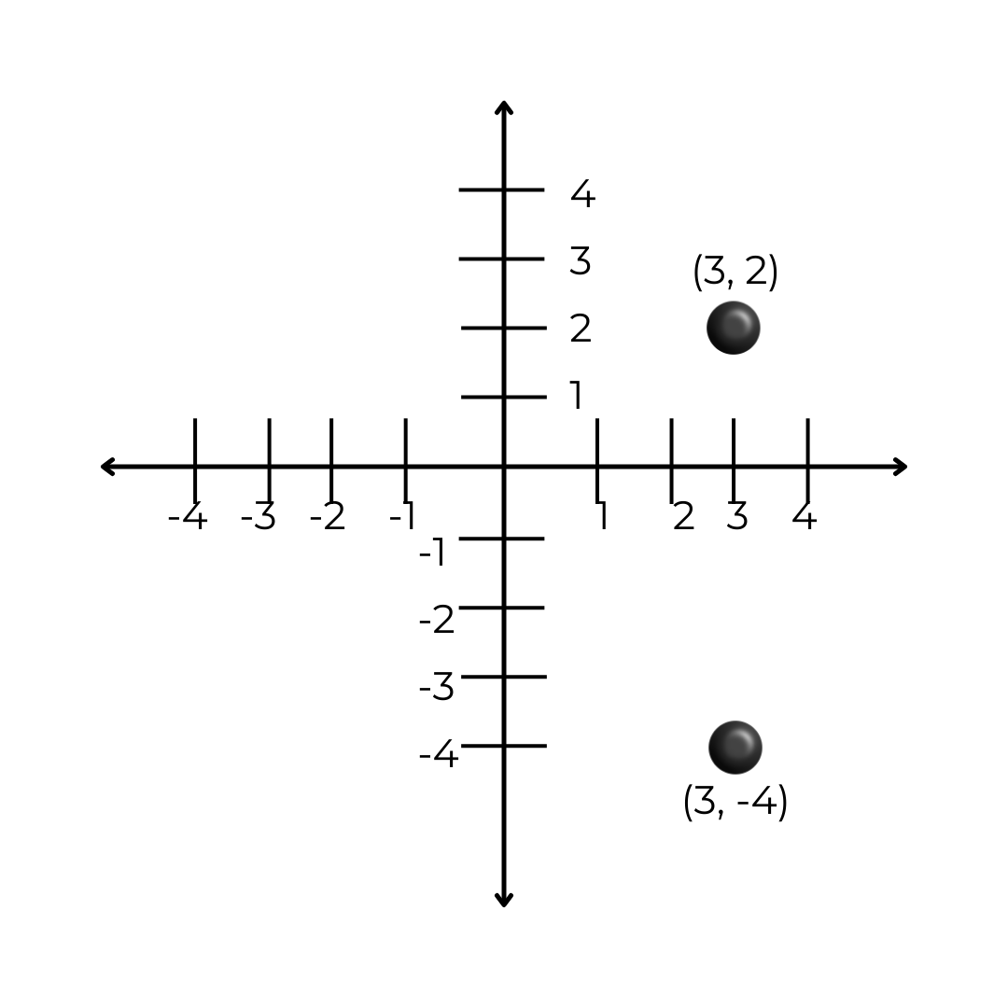
Let's find the distance:
Plot A (3, 2)
Plot B (3, −4)

Slide 26
Distance is 6.
|2 − (−4)| = 6​

Slide 27
Numerical Expressions with Exponents
Exponents show repeated multiplication. Order of operations tells us which steps to solve first.

Slide 28
Numerical Expressions with Exponents
A music student practices rhythm patterns.
Each pattern has 2 beats, and the student repeats the pattern 3 times in a row.

Slide 29
Step 1: Find the total beats in the repeated pattern
2³ = 8 beats
Then the student adds 4 warm-up beats and plays 3 rhythm sections, each using 2² beats.

Slide 30
Step 2: Write and solve the expression
4 + 2² × 3
4 + 4 × 3
4 + 12 = 16
The student plays 16 total beats during practice.

Slide 31
Algebraic Expressions
Variables represent unknown values. Expressions show relationships but do not include an equal sign.

Slide 32
A student practices music for m minutes. The student then practices 7 additional minutes.
Write an expression that represents the total practice time. If m = 12, find the total number of minutes the student practices.

Slide 33
The variable m represents the original number of minutes practiced. Since the student practices 7 more minutes, we add 7 to m.
Expression: m + 7
Substitute 12 for m: 12 + 7 = 19
The student practices for a total of 19 minutes.

Slide 34
Equivalent Expressions & Distributive Property
Equivalent expressions look different but always have the same value. The distributive property helps us rewrite expressions without changing their meaning.

Slide 35
A student practices music using 3 warm-up sections.
Each section includes 4 fixed beats and x extra beats for variation.
Write an expression that represents the total number of beats using a grouped form.
Write a second expression that represents the same total number of beats using an expanded form.
If x = 2, show that both expressions have the same value.

Slide 36
Step 1: Write the Grouped Expression
Each section has 4 + x beats, and there are 3 sections.
Grouped form: 3(4 + x)

Slide 37
Step 2: Write the expanded form
Use the distributive property, which means multiplying 3 by each term inside the parentheses.
3(4 + x) = 3 × 4 + 3 × x = 12 + 3x

Slide 38
Step 3: Check when x = 2
Substitute 2 for x in both expressions:
Grouped form:
3(4 + 2) = 3(6) = 18
Expanded form:
12 + 3(2) = 12 + 6 = 18

Slide 39
Both expressions give the same value when x = 2, and they will always give the same value for any value of x. This means 3(4 + x) and 12 + 3x are equivalent expressions.

Slide 40
One-Variable Equations
An equation is solved by finding the value that makes it true.

Slide 41
One-Variable Equations
A student practices music for x minutes.
After adding 15 extra minutes of group practice, the total time is 45 minutes.

Slide 42
Step 1: Understand the equation
The equation says a number plus 15 equals 45.
Step 2: Undo the +15
Subtract 15 from both sides.
x + 15 − 15 = 45 − 15

Slide 43
Step 3: Simplify
x = 30
30 + 15 = 45 ✔️
x = 30
The student practices music for 30 minutes before the group practice.

Slide 44
Inequalities
Inequalities show ranges of possible answers, not just one value.

Slide 45
A music teacher wants students to practice more than 20 minutes each day.
Let t represent the number of minutes practiced.
Step 1: Identify the variable
t = number of minutes practiced

Slide 46
Step 2: Understand the phrase “more than”
“More than” means the number is greater than, not
equal to.
Step 3: Write the inequality
Because practice time must be greater than 20
minutes:
t > 20

Slide 47
Check with examples:
t = 21 ✔️ (allowed)
t = 25 ✔️ (allowed)
t = 20 ✖️ (not allowed)
t > 20 shows all practice times that are greater than 20 minutes.

Slide 48
Dependent & Independent Variables
The independent variable is the value you choose.
The dependent variable changes because of it.

Slide 49
A student practices strumming on a ukulele at a steady rate of 120 strums per minute.
Let t represent the number of minutes practiced and s represent the total number of strums.
The relationship can be written as: s = 120t

Slide 50
Independent variable:
t (time) — the student chooses how many minutes to practice
Dependent variable:
s (strums) — the number of strums changes based on time practiced

Slide 51
t (minutes) | s (strums)
1 | 120
2 | 240
3 | 360
The number of strums depends on the time practiced, so time (t) is the independent variable and strums (s) is the dependent variable.

