Slide 1
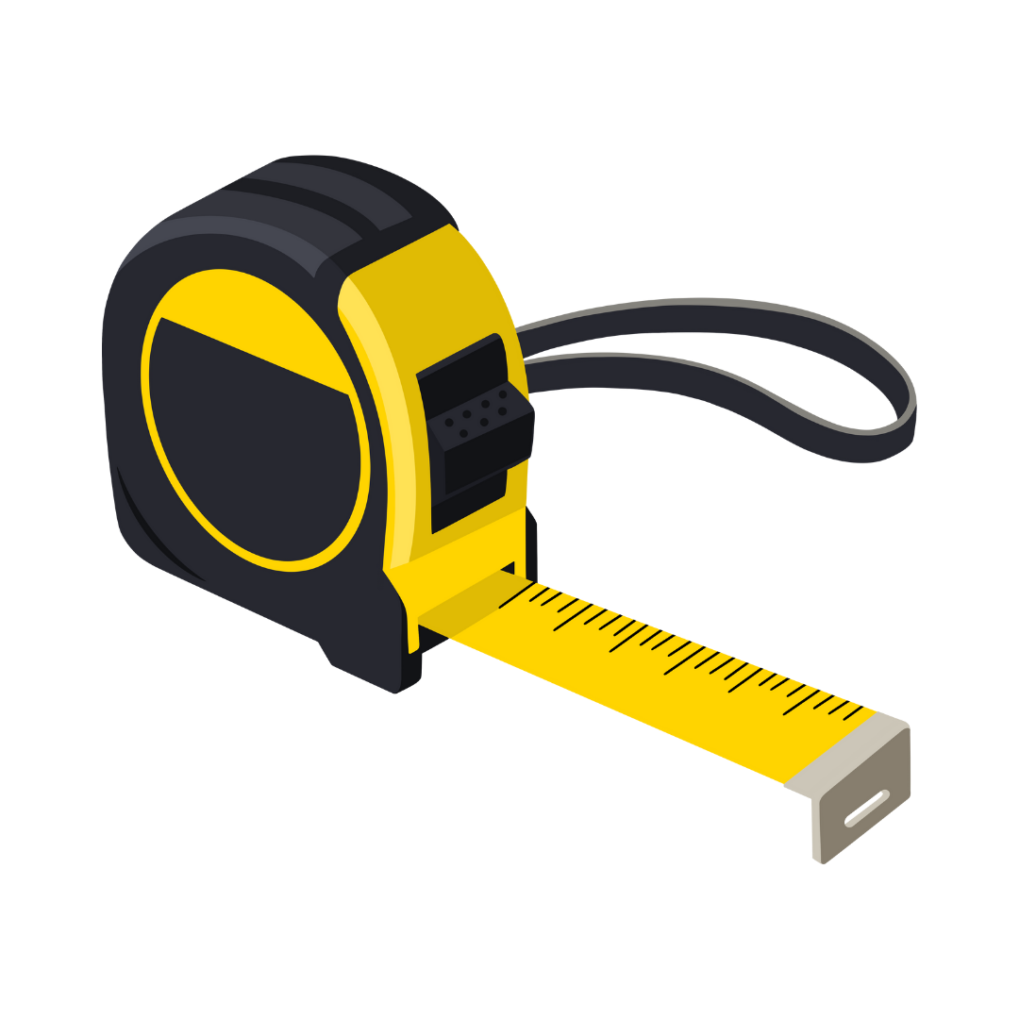
Using the Tape Measure

Slide 2
What is a tape measure?
A tape measure is a tool used to measure the length, width, or height of objects. It is commonly used to measure large objects that are too big for small measuring tools.

Slide 3
Unit Conversions
When we use a tape measure, we often read measurements in inches. We sometimes need to change them to another unit, such as centimeters.
Measurements can be converted from one unit to another using ratio reasoning.

Slide 4
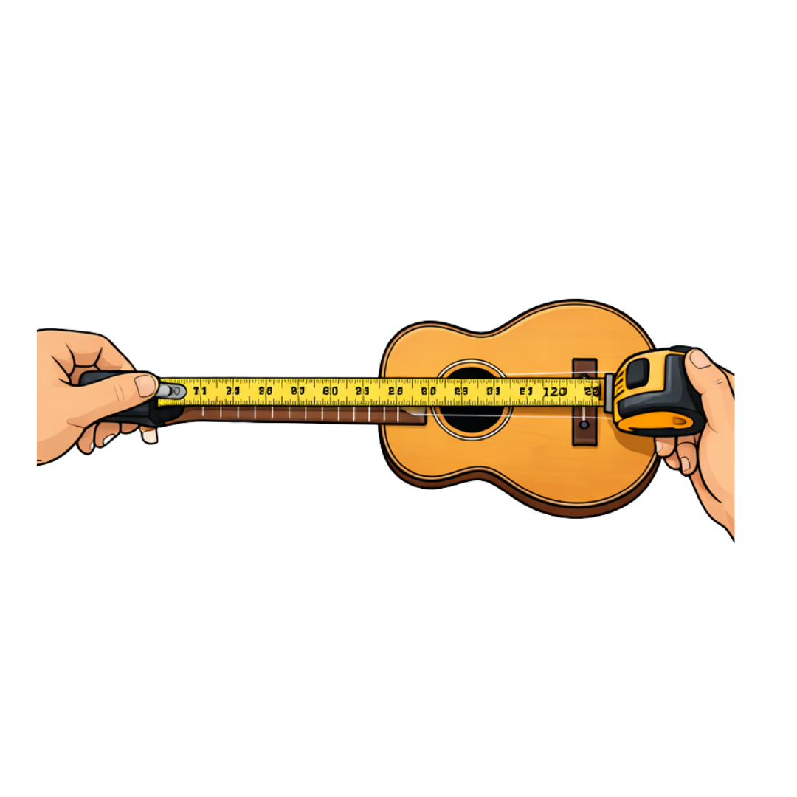
A student measures the length of a ukulele body using a tape measure. The measurement is 20 inches. Convert this length to centimeters.

Slide 5
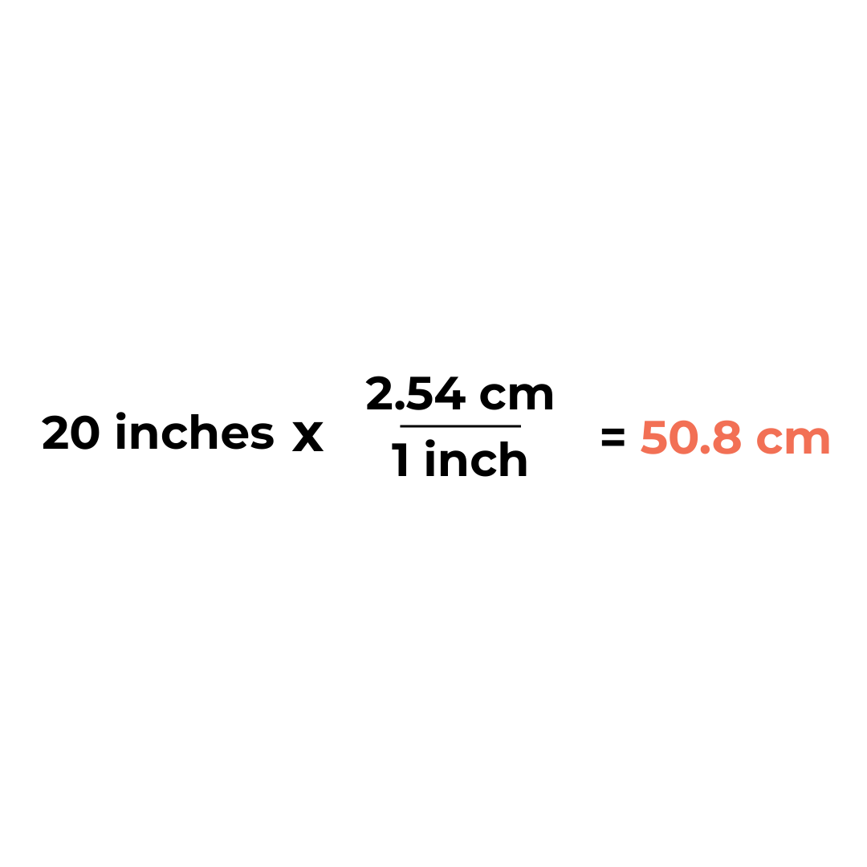
The ukulele body is 50.8 centimeters long.

Slide 6
When we use a tape measure, we often read measurements in inches, but sometimes we need the measurement in another unit, such as centimeters.
Unit conversion works because the two units have a fixed ratio. This relationship is called a unit rate.

Slide 7
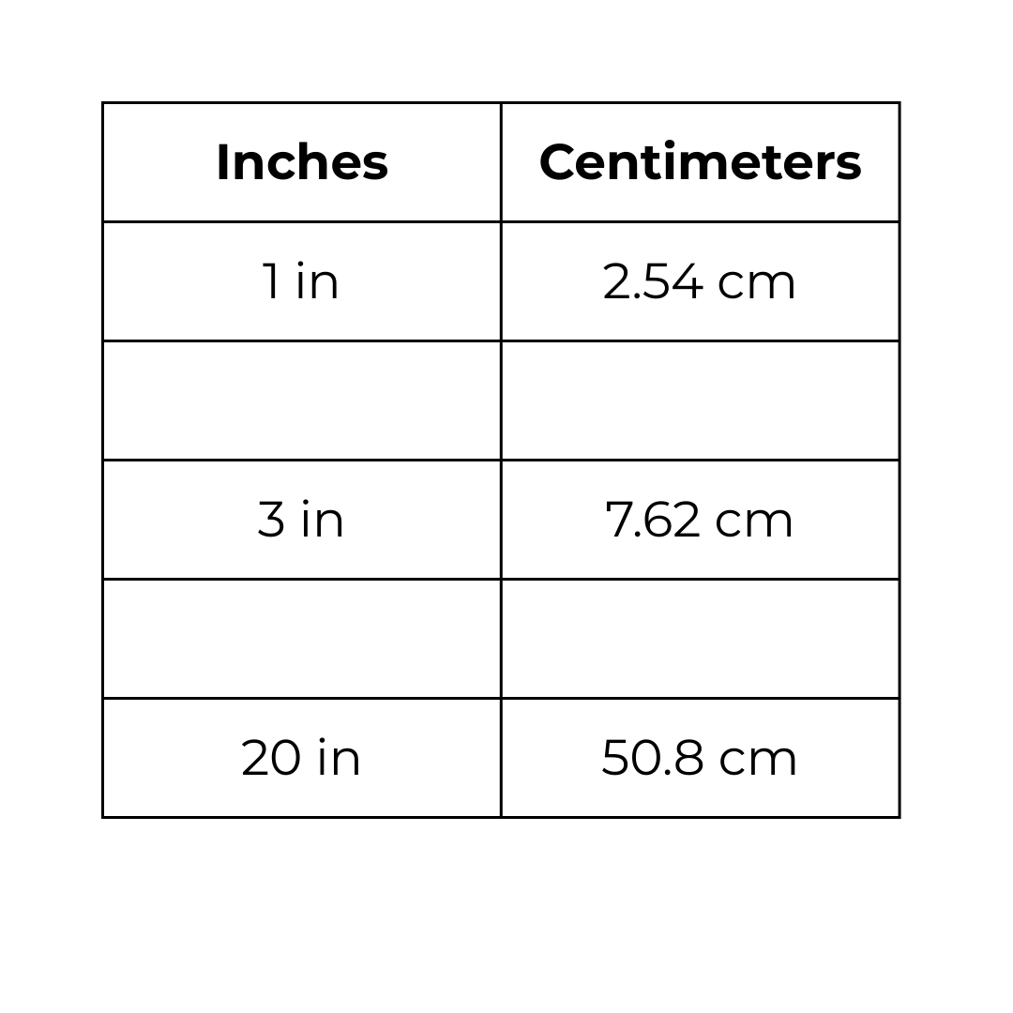
If the length of the ukulele is in given centimeters or inches, convert using the ratio table. Find the unit rate as you fill in the table.

Slide 8
Area of Polygons
A tape measure helps us find how long and how wide a surface is.
We use these measurements to find the area, or the space inside the 2D shape.

Slide 9
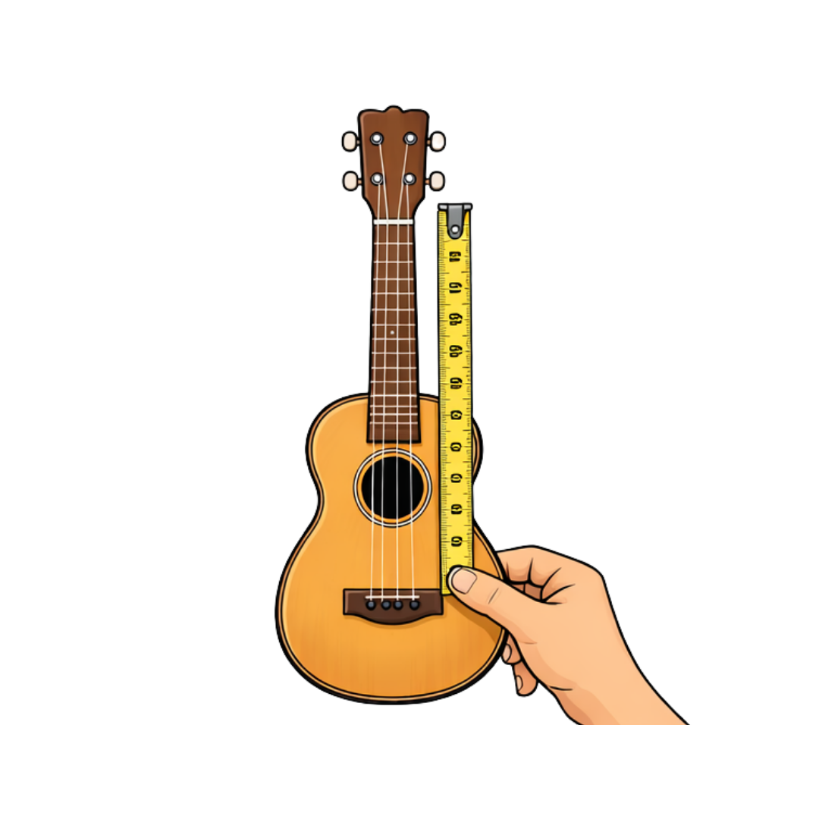
A student measures the flat front surface of a ukulele using a tape measure. In this example we are taking the overall length and overall width and calculating it like it is a rectangle.
Length = 50 cm
Width = 20 cm
What is the area of the ukulele’s front surface?

Slide 10
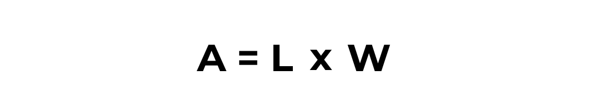
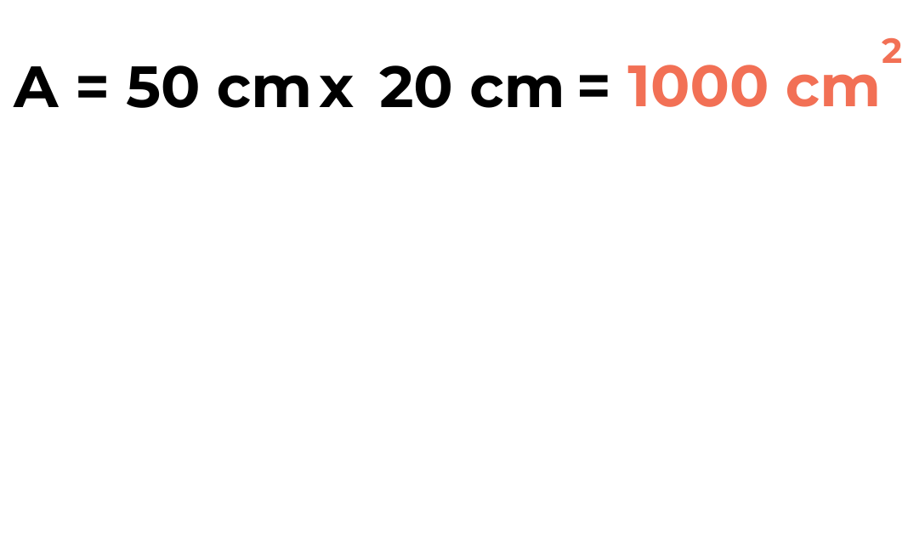
Rectangle Model
The area of the ukulele’s front surface is 1,000 square centimeters.

Slide 11
Rectilinear Model: Using Rectangles
A rectilinear figure is a shape made by combining rectangles. Instead of one large rectangle, we can divide the ukulele into:
A large body rectangle
A smaller neck rectangle
Students add areas together.

Slide 12
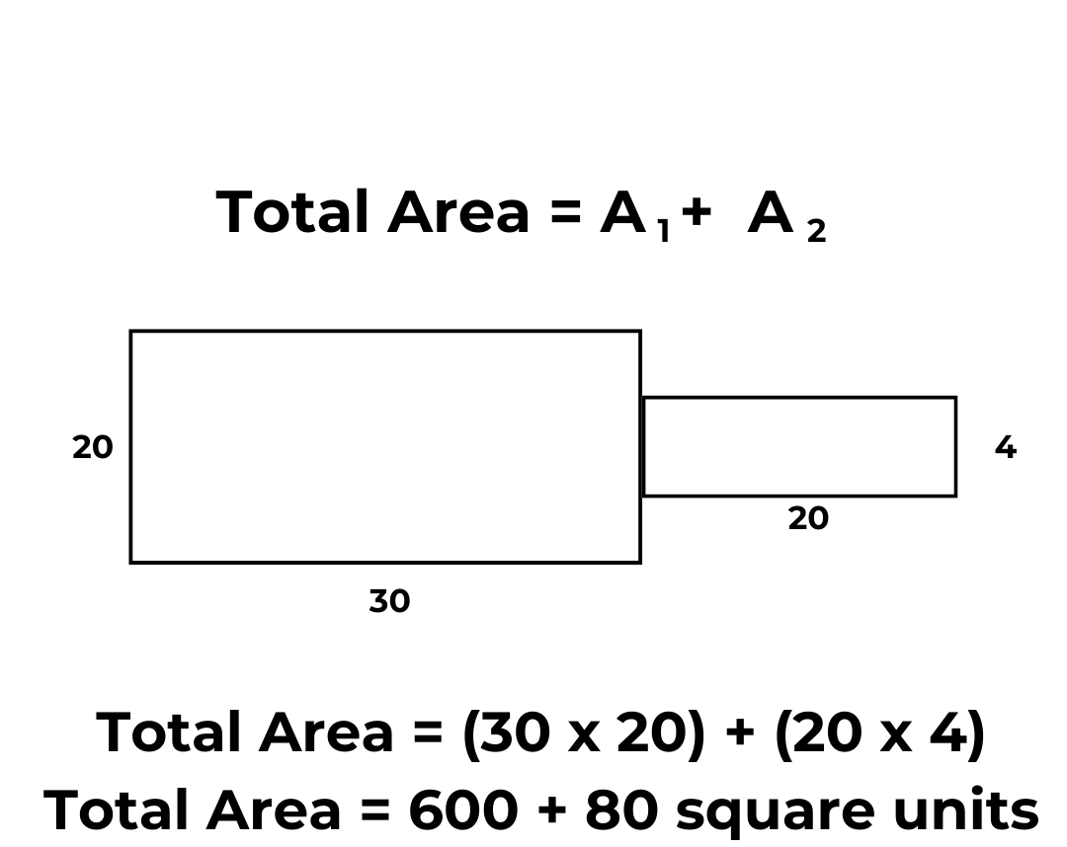


Rectilinear Model
2
Total Area = 680 cm

Slide 13
Triangle Model: Using Rectangles and Triangles
In this example we will approximate the curved sides using triangles and rectangles.

Slide 14
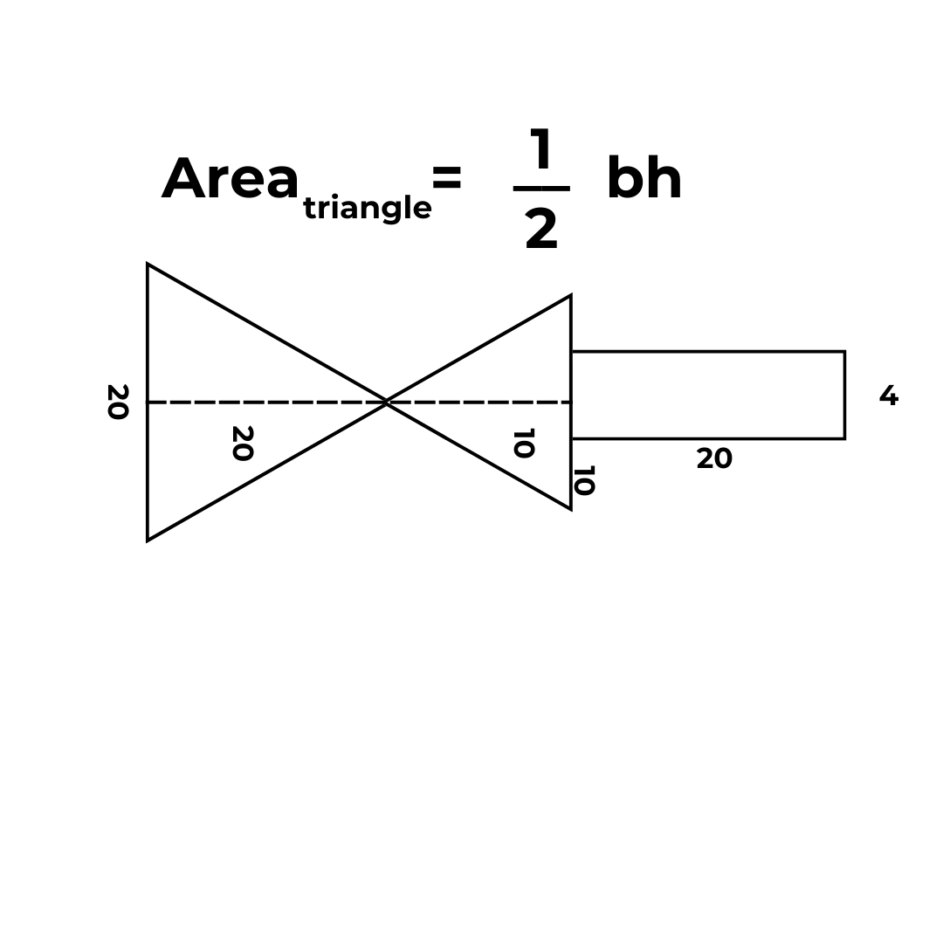


Triangle Model

Slide 15
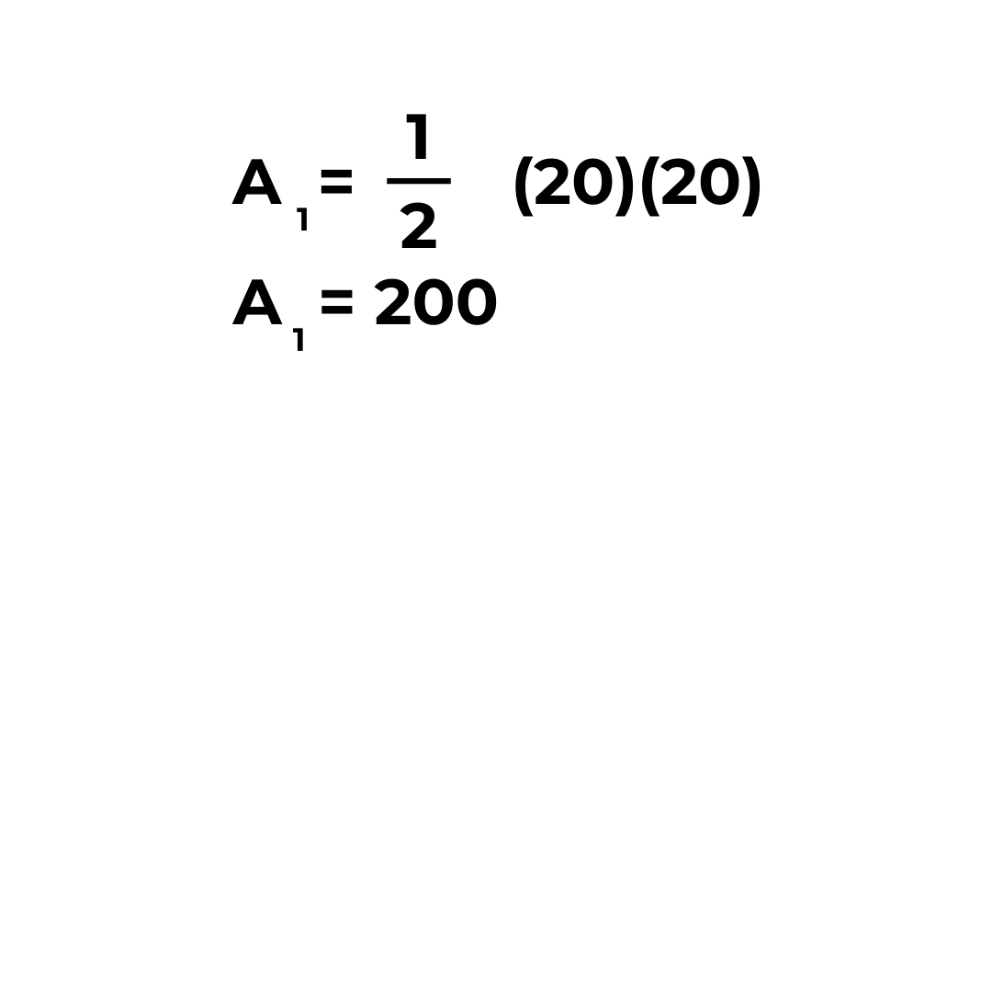
Triangle Model

Slide 16
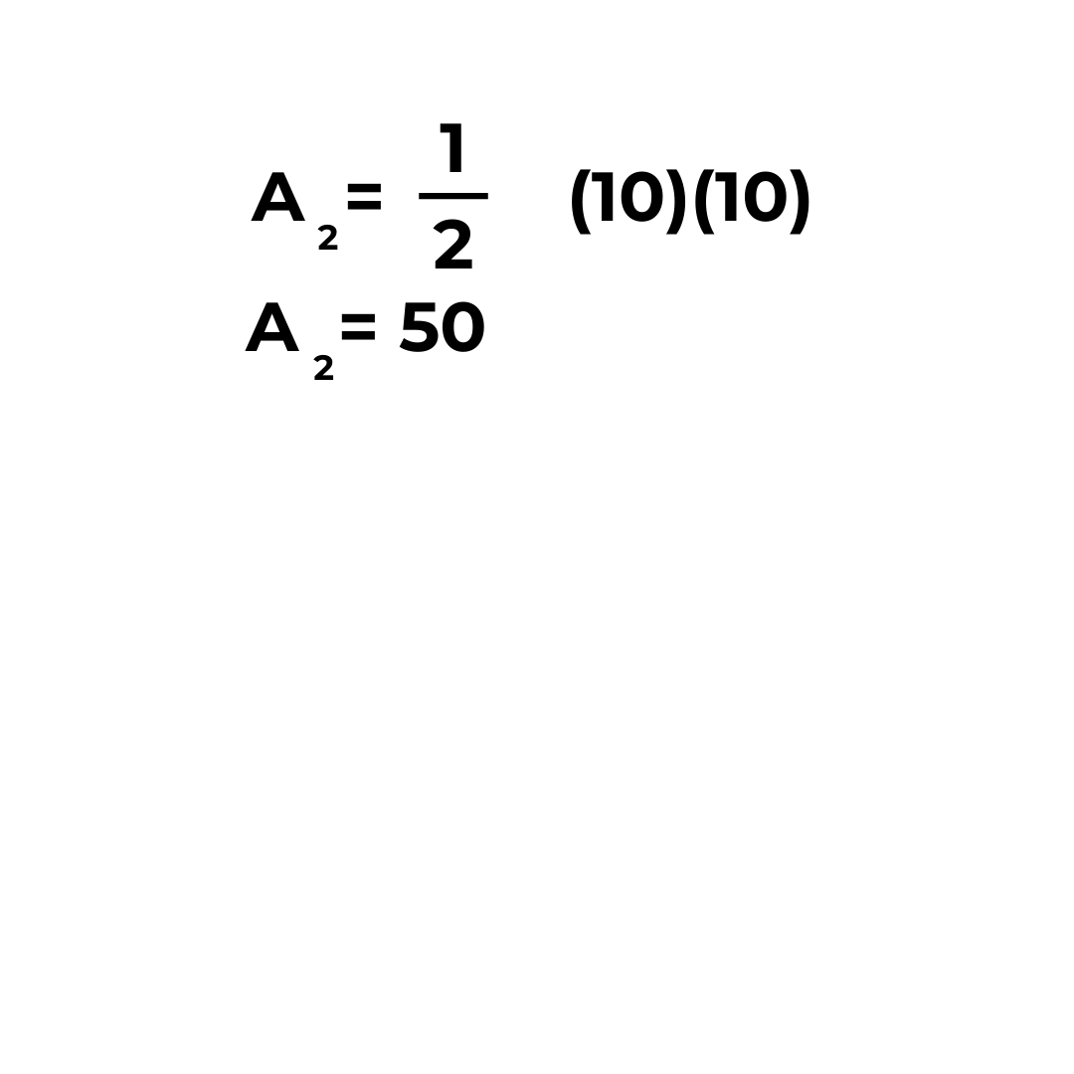
Triangle Model

Slide 17
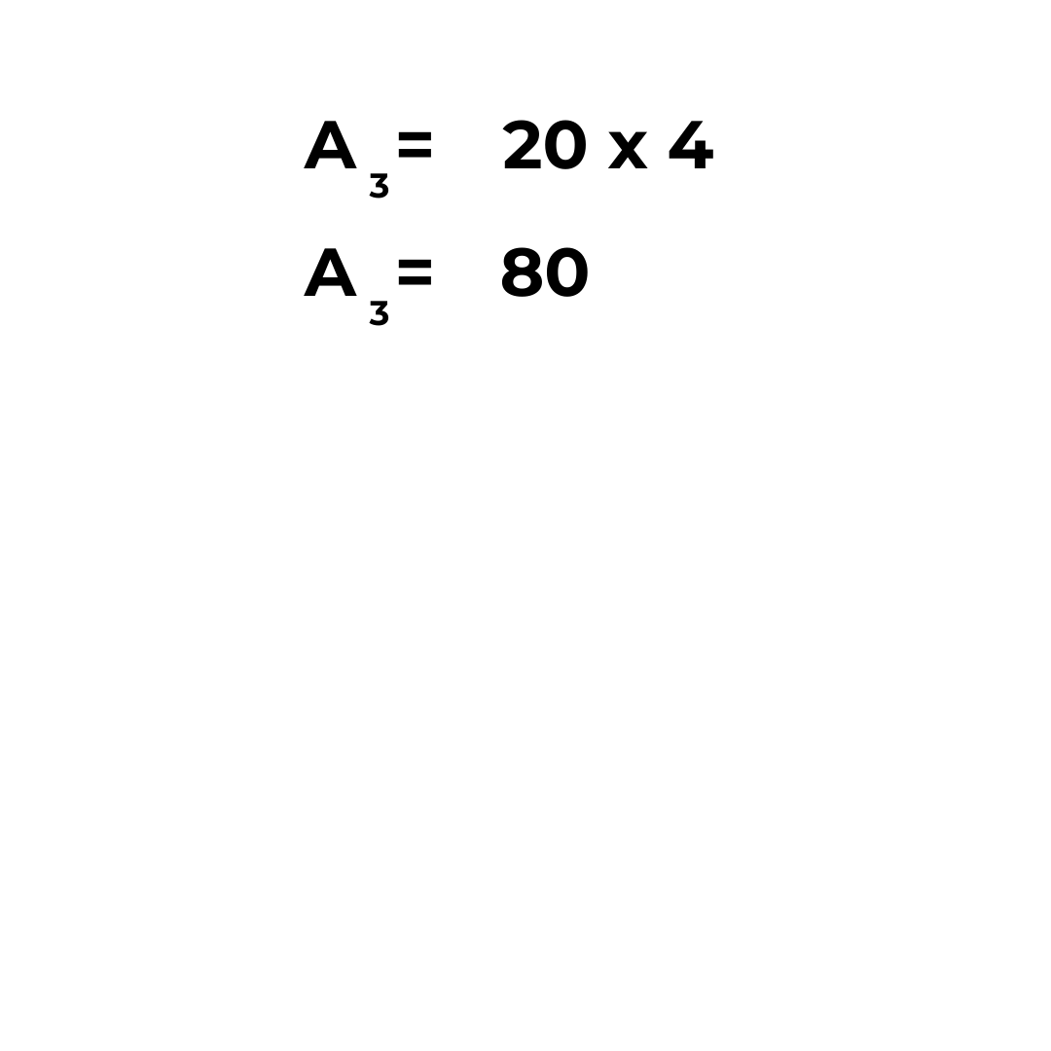
Triangle Model

Slide 18
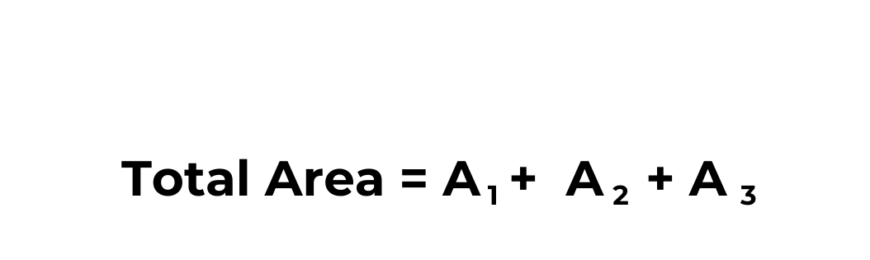
Triangle Model
Total Area = 330 cm
2

Slide 19
Overestimate or Underestimate?
Model | Area
Rectangle model | The rectangle model overestimates the area because the rectangular shape covers regions outside the curved edges of the ukulele.
Rectilinear model | The rectilinear model gives a better estimate because combining smaller rectangles follows the shape more closely, but it may still slightly overestimate due to straight edges.
Triangle model | The triangle model provides an underestimate because, although triangles approximate the slanted and curved sides, they cut off too much surface area.

Slide 20
Surface Area
Using a tape measure, we can measure the length, width, and height of a three-dimensional object, such as a box or a case.
These measurements allow us to draw a net and find the surface area, which is the total area of all faces of the object.

Slide 21
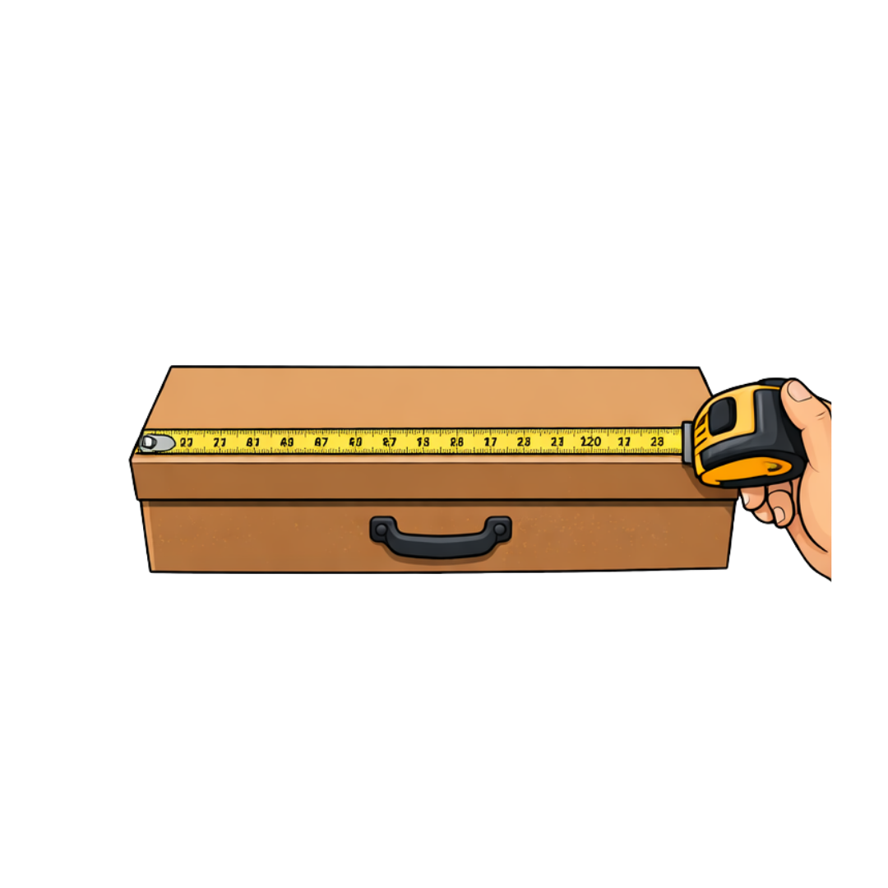
A ukulele is stored in a rectangular box.
A student measures the box using a tape measure:
Length = 60 cm
Width = 25 cm
Height = 10 cm
What is the surface area of the box?

Slide 22
Rectangular Prism and Net
A rectangular prism is a 3D shape made of six rectangular faces. When the box is opened and laid flat, it forms a net, showing all faces at once. The net helps us find the surface area.

Slide 23
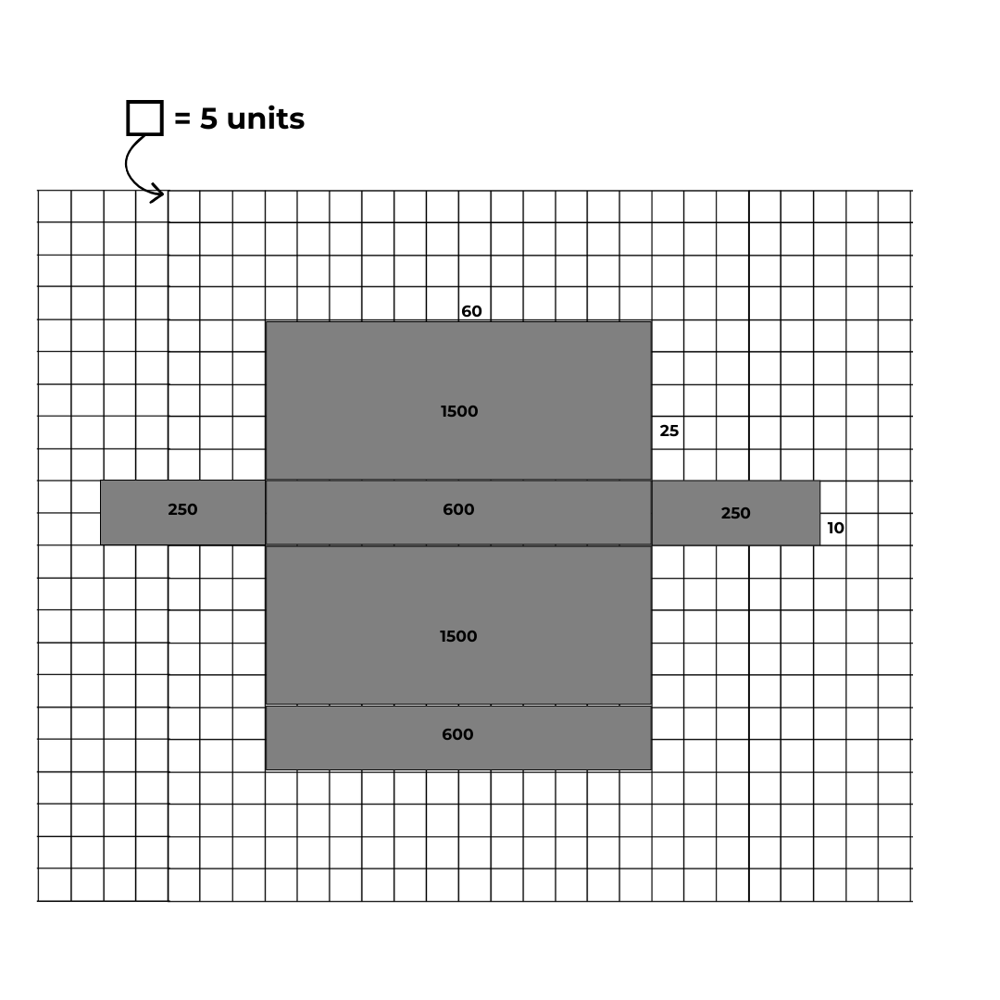
Faces of the Net
Face | Dimensions
Top & Bottom | 60 × 25
Front & Back | 60 × 10
Left & Right | 25 × 10

Slide 24
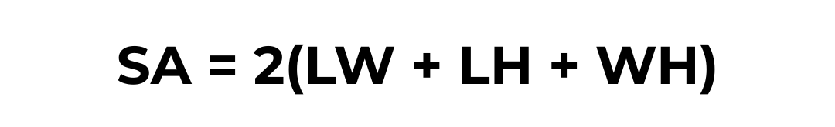
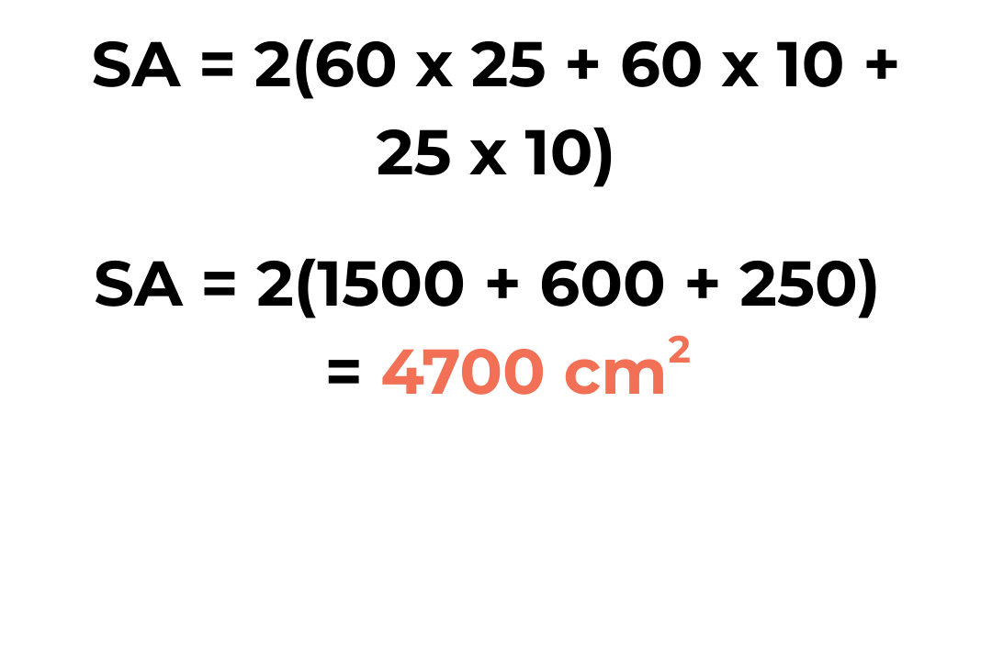
The surface area of the ukulele box is 4,700 square centimeters.

Slide 25
Volume
To confirm that the ukulele fits inside the box, we compare their volumes. Approximate both the ukulele and the box as rectangular prisms.
Volume = L x W x H

Slide 26
Object | L × W × H | Volume
Ukulele | 50 × 20 × 6 | 6000 cm³
Box | 60 × 25 × 10 | 15000 cm³
The box has more space than the ukulele.
Therefore, the ukulele will fit inside the box.

Slide 27
Vernier Caliper vs Tape Measure
Tape Measure – Used to measure large ukulele parts (body, strap, case) where overall size is needed rather than precision.
Vernier Caliper – Used to measure small ukulele parts (string diameter, slot width) where high accuracy is required.

Slide 28
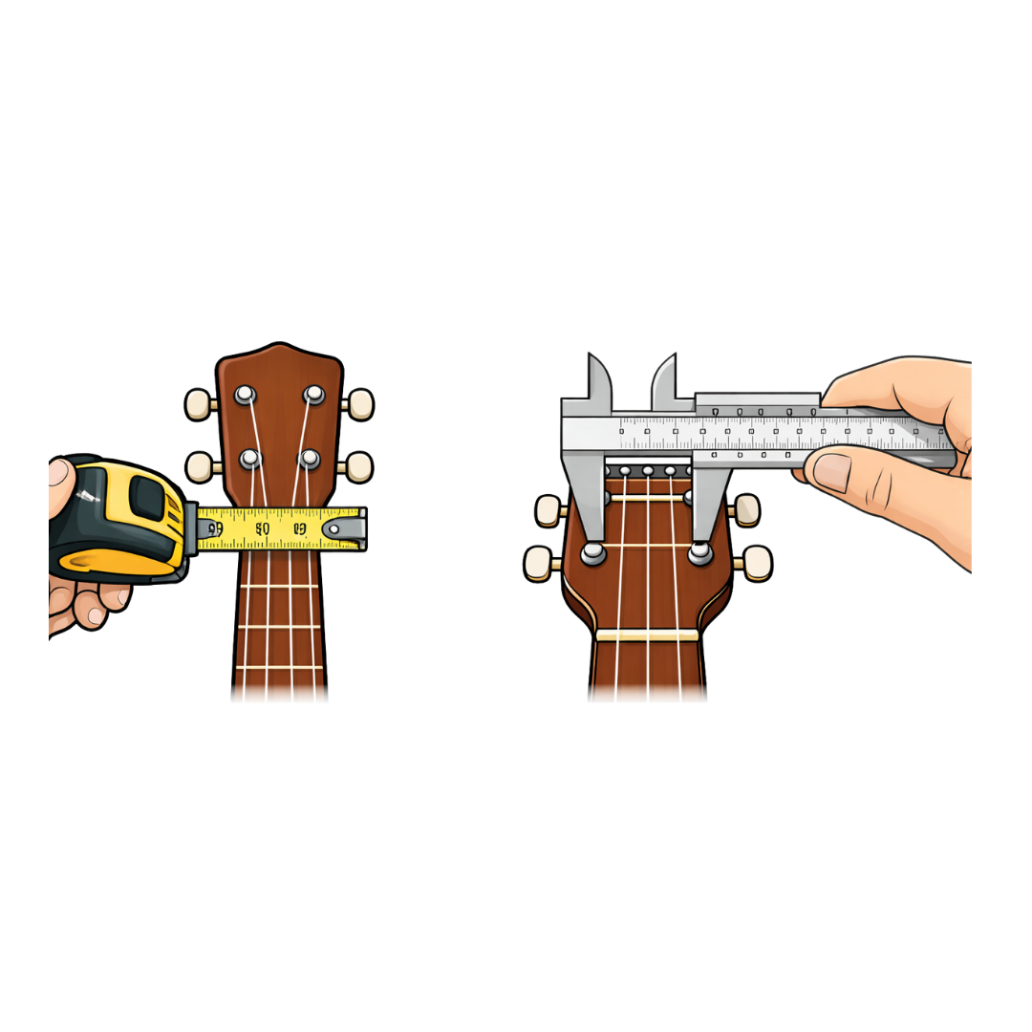
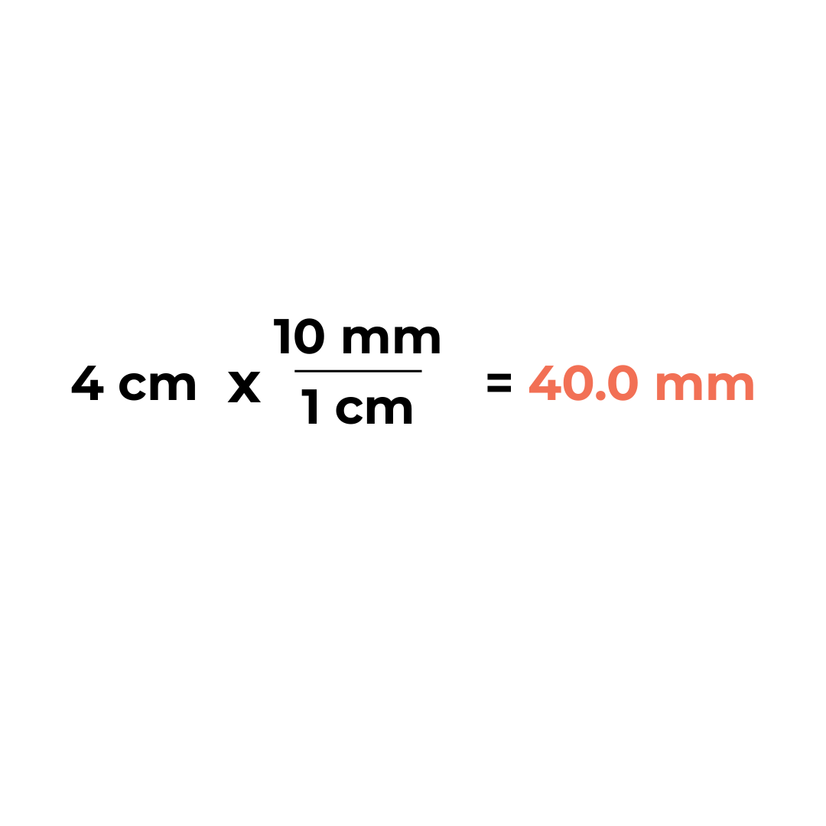
Comparing Measurements Using Two Tools
A student measures the width of the ukulele fretboard using a tape measure and records it as 4 cm. Convert to a millimeters:

Slide 29
The student then measures the same fretboard width
using a vernier caliper and records 38.6 mm.

Slide 30
This comparison shows that decimal conversion allows measurements to be compared, and that a vernier caliper provides greater precision than a tape measure.

