Slide 1
Fundamentals of Lab Work
Objective C: Compare Practices in the Real World to the Lab Setting

Slide 2
Manufacturing Styles
Mass Production
  Long Runs of Same Product
  Heavily Automated
Batch Production
  Short Runs of Many Different Products
  Automated, but machines must be adaptable
Custom Production
  Few products made, each custom made
  More craftwork required than automation

Slide 3
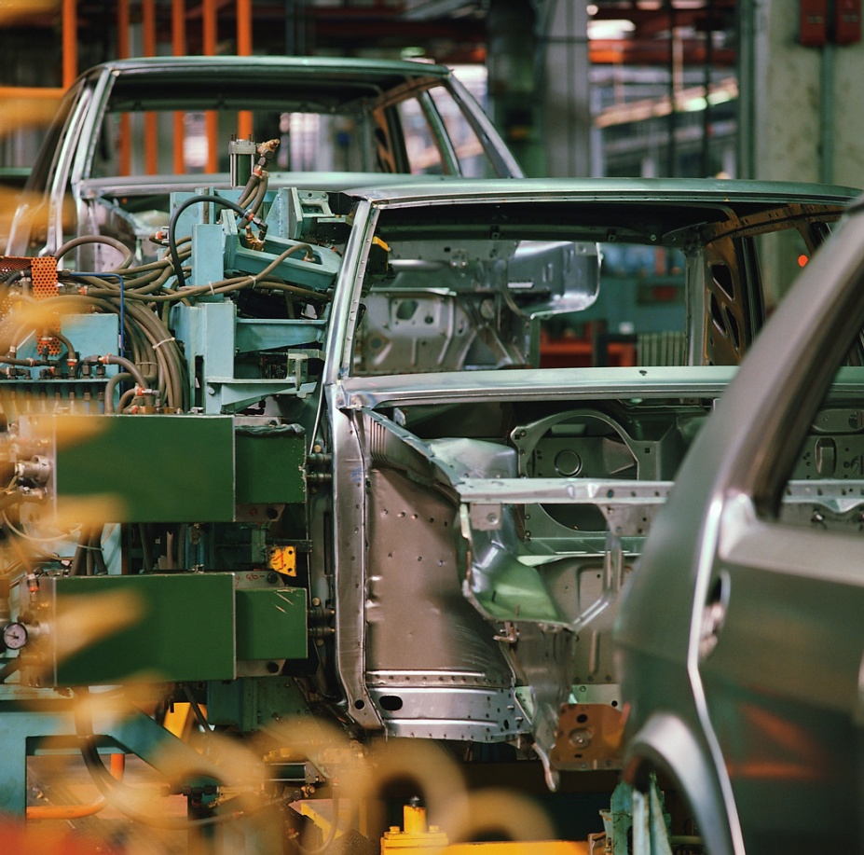
Mass Production
Lots of money invested into heavily specialized machines
Very Little Skilled Labor needed
High Yield Production (lots of products made)
Very cost efficient over long runs
Very little human powered equipment used
Require lots of space
Can you think of a company that might use Mass Production?

Slide 4
Batch Production
Useful for making smaller quantities of many different items
Requires skilled labor
Uses all types of equipment to create products
Machinery is not specific to one part, can make many different items
Many times used to create parts for a Mass Production Product
Sometimes referred to as a “Job Shop”
Are there Batch Production Facilities in your area?

Slide 5
Custom Production
Very little automated machinery used
Very high skill labor needed
Machinery is usually less expensive, but requires more labor to create products
Very low yield (not many products can be made)
Can be specialized to customers needs very easily
Can you identify a Custom Production process?

Slide 6
Types of Equipment
Automated Equipment
  CNC (Computer Numeric Controlled) Machines
Semi- Automated Equipment
  Stationary Mounted Equipment
  Power Tools
Human Powered Equipment
  Tool works using human power

Slide 7
Automated Machinery
Uses CNC (Computer Numeric Control) to create product
CAD (Computer Aided Design) is used to create product
G-Code & M-Code are languages that the CNC machines “speak”
CAM (Computer Aided Manufacturing) is used to translate design to programming language to tell the machine what to do
One programmer can create parts of many machines simultaneously

Slide 8
Semi-Automated Machinery
Machinery is controlled by a motor
Laborer must align and perform operation
Less cost than Automated Machinery, but less productive.
Requires use of Jigs & Fixtures to produce parts accurately
May make use of a technical drawing to create product

Slide 9
Human Powered Equipment
Least productive of all types of equipment
Extremely Portable, require no power source
Require skilled labor and stamina to use
May use technical drawing to make product
Usually used in assembly of products
Are very specialized to perform very specific functions

Slide 10
Activity Time!
Think of a local company that performs one of each of the manufacturing types.
  What do they produce?
  How many employees do you think they have?
  What is the skill level required to get a job there?
  What type of machinery would you find at their location?

