Slide 1
Layout
Objective C: Identify and Utilize Common Measurement Instruments

Slide 2
Types of Measurement Tools
General Measurement Tools
  Accuracy depends on operator
  Usually able to get accurate within 1/8 of an inch
  Good for Construction, Rough Layout and General Measurement
Precision Measurement Tools
  Tools are built to reduce operators input
  Can read to the ten-thousandths of an inch
  Good for precision part measurement and machining
    Engines, Rod & Bearings

Slide 3
General Measurement Tools
Steel Rulers
  Combination Square
  Speed Square
  Framing Square
  12”, 18”, 24” or 36” Straight Edge
Tape Rulers
  5’, 25’ or 30’ Wide Steel Tapes
  100’ or 250’ Thin Tapes
Walking Wheel Rulers
Spirit Levels
  Check level to earth

Slide 4
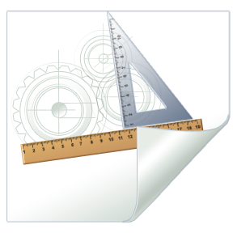
Steel Rulers
Most Accurate General Measurement Tool
Strong, Straight edge makes for good measurements
Length is limited due to construction
Can incorporate 90, 60, 45 and/or 30 degree angles as well

Slide 5
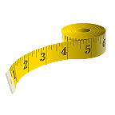
Tape Rules
Allow for longer measurements than steel rules
Accuracy is limited due to movement of parts and tautness of tape
Should be used for parts when a steel rule is too short
Due to movement of parts, sometimes two tape rules may read different measurements

Slide 6
Spirit Levels
Uses a clear cylinder filled with liquid and a small air pocket
Air pocket will move to high end of cylinder because air is lighter than fluid
When fluid rests in center of cylinder, the tool is reading a level measurement

Slide 7
Precision Measurement Tools
Calipers
  Use digital, dial or Vernier scale to read measurements
Micrometer
  Uses dial or Vernier scale to read measurements

Slide 8
Thinking Time!
What Tool would be best used to measure the following?
  Length of Classroom
  Height of Classroom
  Length of Pencil
  Diameter of Pencil
  Piston for Car Engine
  Distance from Madison, WI to Springfield, IL?

Slide 9
Activity Time!
Using the tools available in the lab:
  Measure the Length, Width and Height of a common table in the room.
    What tool will be best used for this purpose?
  Measure the Thickness of the Table Top
    What tool will be best used for this purpose?

