Slide 1
Layout
Objective D: Communicate Design Information through Technical Drawings
Objective E: Interpret Machining Requirements from Technical Drawings

Slide 2
Technical Drawings
The way the Design Engineer and the Fabrication Technologist will communicate
  Many times the designer and the fabricator are miles apart and cannot talk about the product
The Designer needs to include all the information that the Fabricator will need to make the part
The Designer will need to use standardized communication to make sure that the Fabricator can understand
The Fabricator needs to be able to read the drawings and understand the symbols and abbreviations used

Slide 3
Parts of a Technical Drawing
Pictorial View of Object
  Either in Isometric View or Orthographic Projection
Dimensions of Parts
  Using dimension lines or leaders
Notes
  Communicates details that may not be able to show with dimensions
Title Block
  Communicates who drew the drawing, who checked it, what the part is, how it relates to other parts
Bill of Materials
  Tells Fabricator what each component should be made of
Detail Views
  Using a section or auxiliary view to show more detail to the fabricator

Slide 4
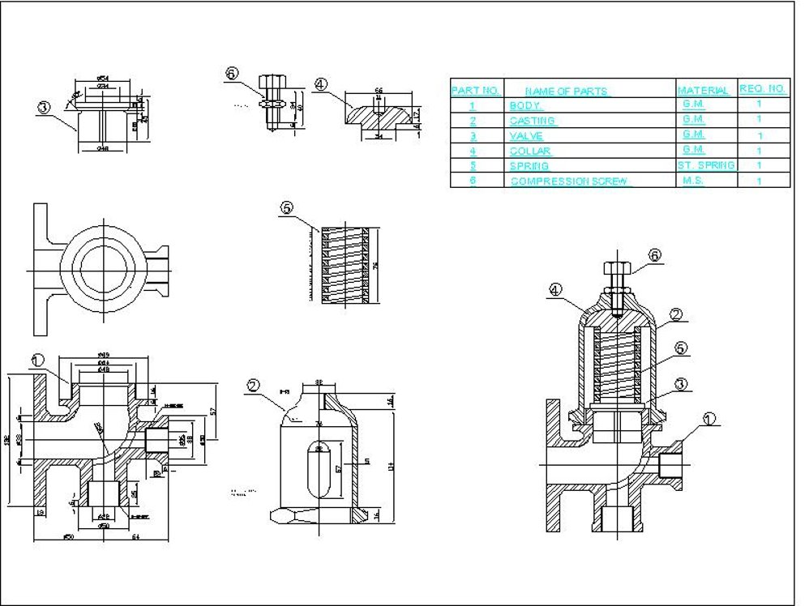
Technical Drawing Example
Bill of Materials
Auxiliary View
Notes
Section View
Orthographic Projection
Dimensions

Slide 5
Assembly Drawing
Shows how components of a product will fit together
  Useful for fabricator to know how parts will be mated together
  Useful for final assembly of product
Usually shows parts and the order in which they are assembled together

Slide 6
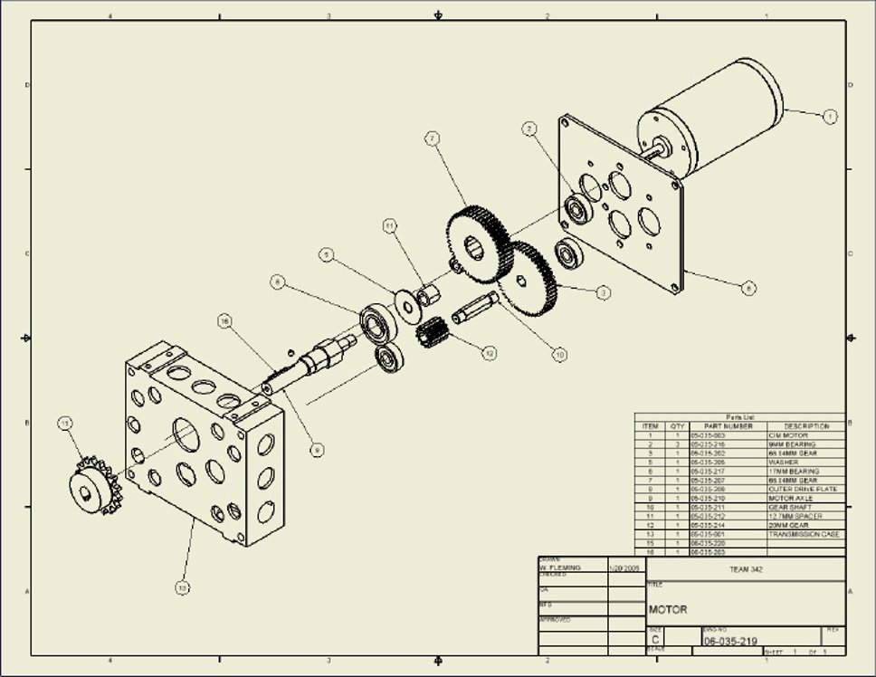
Assembly Drawing

Slide 7
What Information can we get off a Technical Drawing?
You can use a technical drawing to determine
  Cut List
    Size of materials that need to be used to create part
    Type of material each part needs to be
  Plan of Procedure
    Steps that will be taken to produce part
  Part Finish
    How the part should be finished when it is made
  Accuracy of Part
    Check tolerances of parts
    Will the part be acceptable?

Slide 8

Cut List
List the amount of pieces needed
Figure the materials to be used to create each part
Figure the length, depth, thickness, width, area, etc. of each part
Allows Fabricator to determine how much material will be necessary to complete parts

Slide 9
Plan of Procedure
Allows the Fabricator to lay out the steps for creating a part
  Not all people will use the same steps
  Allows the Fabricator to create the part as efficiently as possible
    Material Availability
    Machine Availability
    Operator Skill & Knowledge
    Which parts are the most critical to the process?

Slide 10
Material Finish
Tells Fabricator how nice the finish of the part must be
  Parts can be buffed, polished, sanded, ground, knurled and painted
  Each finish requires a special operation to prepare the part for its particular finish

Slide 11
Accuracy of Part
Tolerances of Parts
  When parts must fit inside or around other parts, a tolerance may be listed
    Tolerance gives the maximum and minimum sizes a part can be
Overall Size of Part
  If a part is not the correct size it must be scrapped
  A Technical Drawing will show the acceptable size limits for a part

Slide 12
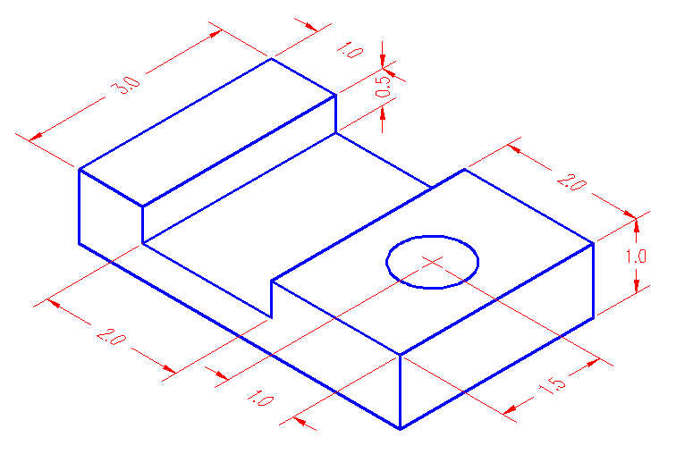
Thinking Time!
What does this Technical Drawing tell us?
What does it not tell us?
What is this Technical Drawing asking us to do?
What would a cut list for this part look like?
What would a Plan of Procedure look like?

