Slide 1
Marking Aids
Use Straight Edges or Curves to mark lines
  Straight lines lead to straighter cuts
Use of Square or Angle Guide to mark angles
Use of Compass to mark circular components

Slide 2
Transfer Methods
Not all writing methods will work on all materials
  Pen, Marker & Ink will require a lot of sanding to remove from wood
  Pencil can be very hard to see on steel and plastics
  Heat will burn off ink and marker from steel
  Plastic will easily scratch if not protected when marked

Slide 3
Wood
The best method for transferring marks to wood is pencil
  Light lines are easily seen and very easy to erase by sanding
A scratch awl will also make good lines that require no sanding
  Wood is a rough surface, scratching might be difficult
Pen and Marker will soak into wood fibers and require much sanding

Slide 4
Non- Heated Steel
The best method for marking non heated steel is marker
  Allows for easy marks to be made with little clean up
Marking Fluid and a Scratch Awl are also good ways to mark non-heated steel
Pencil and Pen will be hard to see and hard to make marks with

Slide 5
Steel that will be Heated
Soapstone, Chalk or Scratch Awls are the best ways to mark steel that will be heated
  Soap & Chalk will not melt off, scratch is in metal and will be visible
Sharpie, Pencil and Pen will all melt off as temperature gets hotter

Slide 6
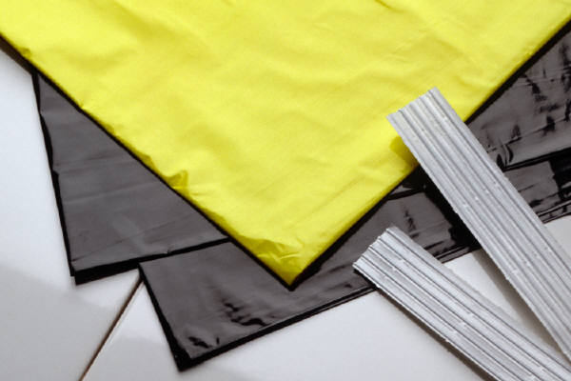
Plastics
Plastics are very hard on the surface, therefore a separate surface should be overlaid for marking
  Masking Tape or a cling-wrap are great for this purpose
After the marking layer is applied, a marker is the best tool for laying out on plastic
Pencils, Pens & Scratch Awls are all sharp and may penetrate the surface of the plastic, leaving scratches

