Slide 1
Safety in the Lab
Objective B: Safety Rules for Lab

Slide 2
Why is Safety Important?
ANY accident in the lab puts EVERYONE at risk
  The operator is not the only one at risk when an accident occurs
    Flying Debris
    Dangerous Materials
    Break Equipment
    Waste Materials
You are the best protector of your own safety
  Act according to the safety rules
  Call out those who aren’t
If the instructor is to trust you to operate equipment, that trust must be earned
EVERYONE in the lab has the right to feel safe
The most important thing in the lab are the humans
Because no one WANTS to get hurt or to hurt anyone else

Slide 3
What are Safety Rules?
Safety Rules are a list of rules that ARE NOT NEGOTIABLE
In the Lab area ALL Safety Rules must be followed
Safety Rules regulate how we act in the lab
Safety Rules define the operation of the equipment in the lab
Set of Rules to keep everyone in the lab Safe

Slide 4
Safety Rule #1
Safety Glasses Must be worn at all times in the lab
When operating equipment, the safety glasses prevent foreign materials from penetrating your eyes
When in the lab, others operating equipment may cause flying debris. Everyone must wear safety glasses
If glasses are dirty clean them, or bring them to the instructor’s attention

Slide 5
Safety Rule #2
Proper PPE Must be Worn when in the Lab
The correct clothing is required for operating equipment in the lab
  Closed Toe Shoes
  Faceshield
  Long Sleeves and Pants
  Darkened Lenses
No dangling Jewelry, Hair or Clothing in the Lab
  Creates a hazard when using rotational tools, chemicals or pinching in slots and gaps

Slide 6
Safety Rule #3
Do NOT Operate Machinery unless you have Permission to do so.
Before you may operate a tool you MUST have been approved to use the tool
  Safety Test or Operation Check-Off
  Instructor’s Direct Supervision
Instructor Must be in the Lab
  Do not operate tools if the instructor in not in direct supervision

Slide 7
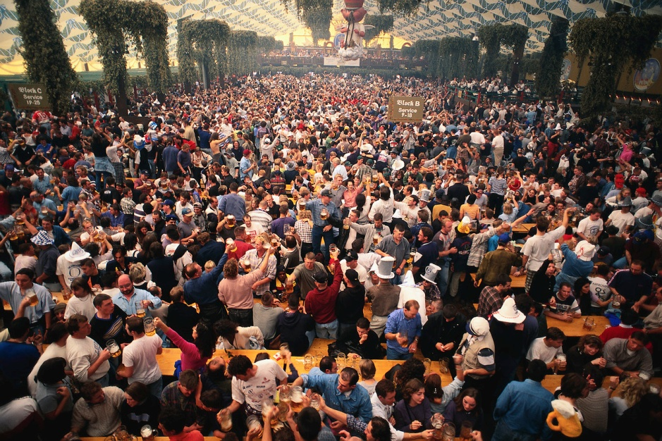
Safety Rule #4
Be Aware of Others in the Lab Area
Do not operate a machine if someone else is in the machine safety zone
  Scrap or waste may be obstructed by them
  Debris could fly off and hurt others
Stay out of the way of other machine operators
  Be aware of how you might affect others operating machinery
Do not hog a machine
  Everyone needs to share the limited machines we have
  Hogging machine time leads others to rush

Slide 8
Create your Own Safety Rules
What other Safety Rules would you add to the previous 4?
Safety Rules should apply to the whole lab
Aim to have 10 Safety Rules that are simple to follow
Discuss as a class what the consequences for not following the safety plan will be
Print the Safety Rules out and post them at various places in the lab area.

