Slide 1
Safety in the Lab
Objective C: Locate Safety Information for all tools in the lab

Slide 2
What is Safety Information?
Safety Information on Equipment
General Safety Information posted in the lab
Material Safety Data Sheets
Emergency Action Information posted in lab

Slide 3
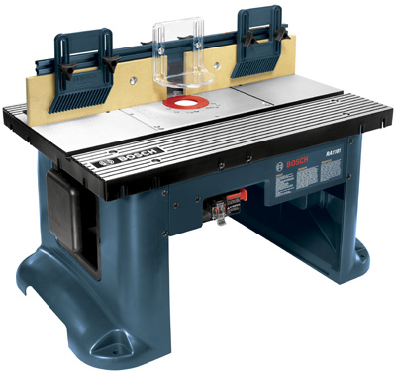
Safety Information on Equipment
Each stationary piece of equipment should have safety rules for the machine posted on or near it
  Many manufacturers will provide a poster with the equipment
Information should be posted in clear view of the machine operator
Read this information before operating the machine

Slide 4
General Information Signs in Lab
Warning Signs that indicate dangerous situations or PPE needed
Should be Identified before going into lab
Make sure that you understand what a sign means before you go into lab
  Ask questions if you don’t know!

Slide 5





Activity Time!
Match the signs on the right to the warnings below
Must wear Safety Glasses
Electrical Hazard
Must wear Hearing Protection
Caution! Hot Surface
Must Wear Gloves

Slide 6
Material Safety Data Sheet
Contains information about chemical make-up, clean-up procedures and first aid plan
Should have a MSDS for all chemical products used in lab
Should be stored in a public place
Must be available to emergency crews in case of an accident

Slide 7
Emergency Action Plan
What do you do in case of
  Tornado?
  Earthquake?
  Fire?
  Chemical Spill?
  Serious Accident in Lab?
EAP’s should be posted in clear view in a public place
EAP’s should be practiced so that everyone knows what to do in an emergency situation

Slide 8
Practice Time!
Practice your lab’s Emergency Action Plan
  Create a scenario where a serious accident occurs in the lab
    What things need to happen?
    Who will do them?
    What is your role?
    Who is responsible for contacting teachers, administrators, custodial staff, etc. ?
    Where should you go?

