Slide 1
Structural engineering AND CIVIL ENGINEERING

Slide 2
Basic Concepts of Engineered Structures

Slide 3
What to expect
We will explore different structures throughout time and how those ideas have evolved into engineered structures used today.
Structures
Towers, tunnels, cantilevers, bridges, dams, foundations, offshore structures, waterways, pyramids, and various types of infrastructure.
Live Loads, dead loads…. What are they?
Structural engineering career opportunities.
How to apply the design process to structural AND civil engineering opportunities.

Slide 4
Structural Engineering
Structural Engineering is a field of engineering dealing with the analysis and design of structures that support or resist loads. Structural engineering is usually considered a specialty within the civil engineering, but it can also be studied in its own right.

Slide 5
Civil Engineering
Civil engineering is the design and construction of public works, such as dams, bridges and other large infrastructure projects. It is one of the oldest branches of engineering, dating back to when people first started living in permanent settlements and began shaping their environments to suit their needs.

Slide 6
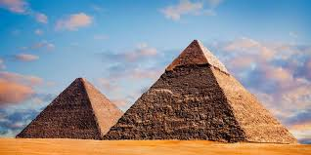
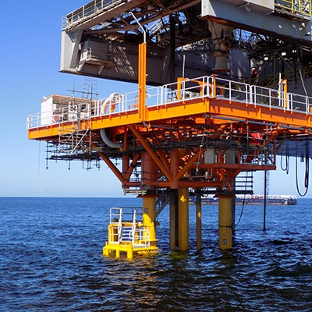
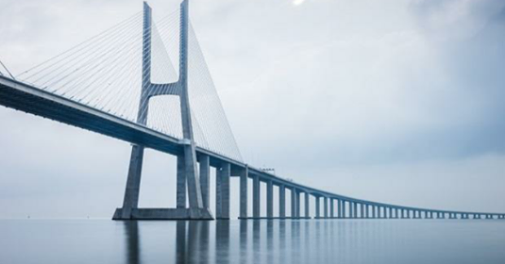
Engineering Structures
Towers, tunnels, cantilevers, bridges, dams, foundations, pyramids, etc.
Offshore structures, waterways
Various types of infrastructure.
Notes:
www.loc.gov/rr/scitech/SciRefGuides/engineersociety.html

Slide 7
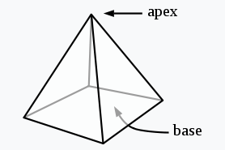
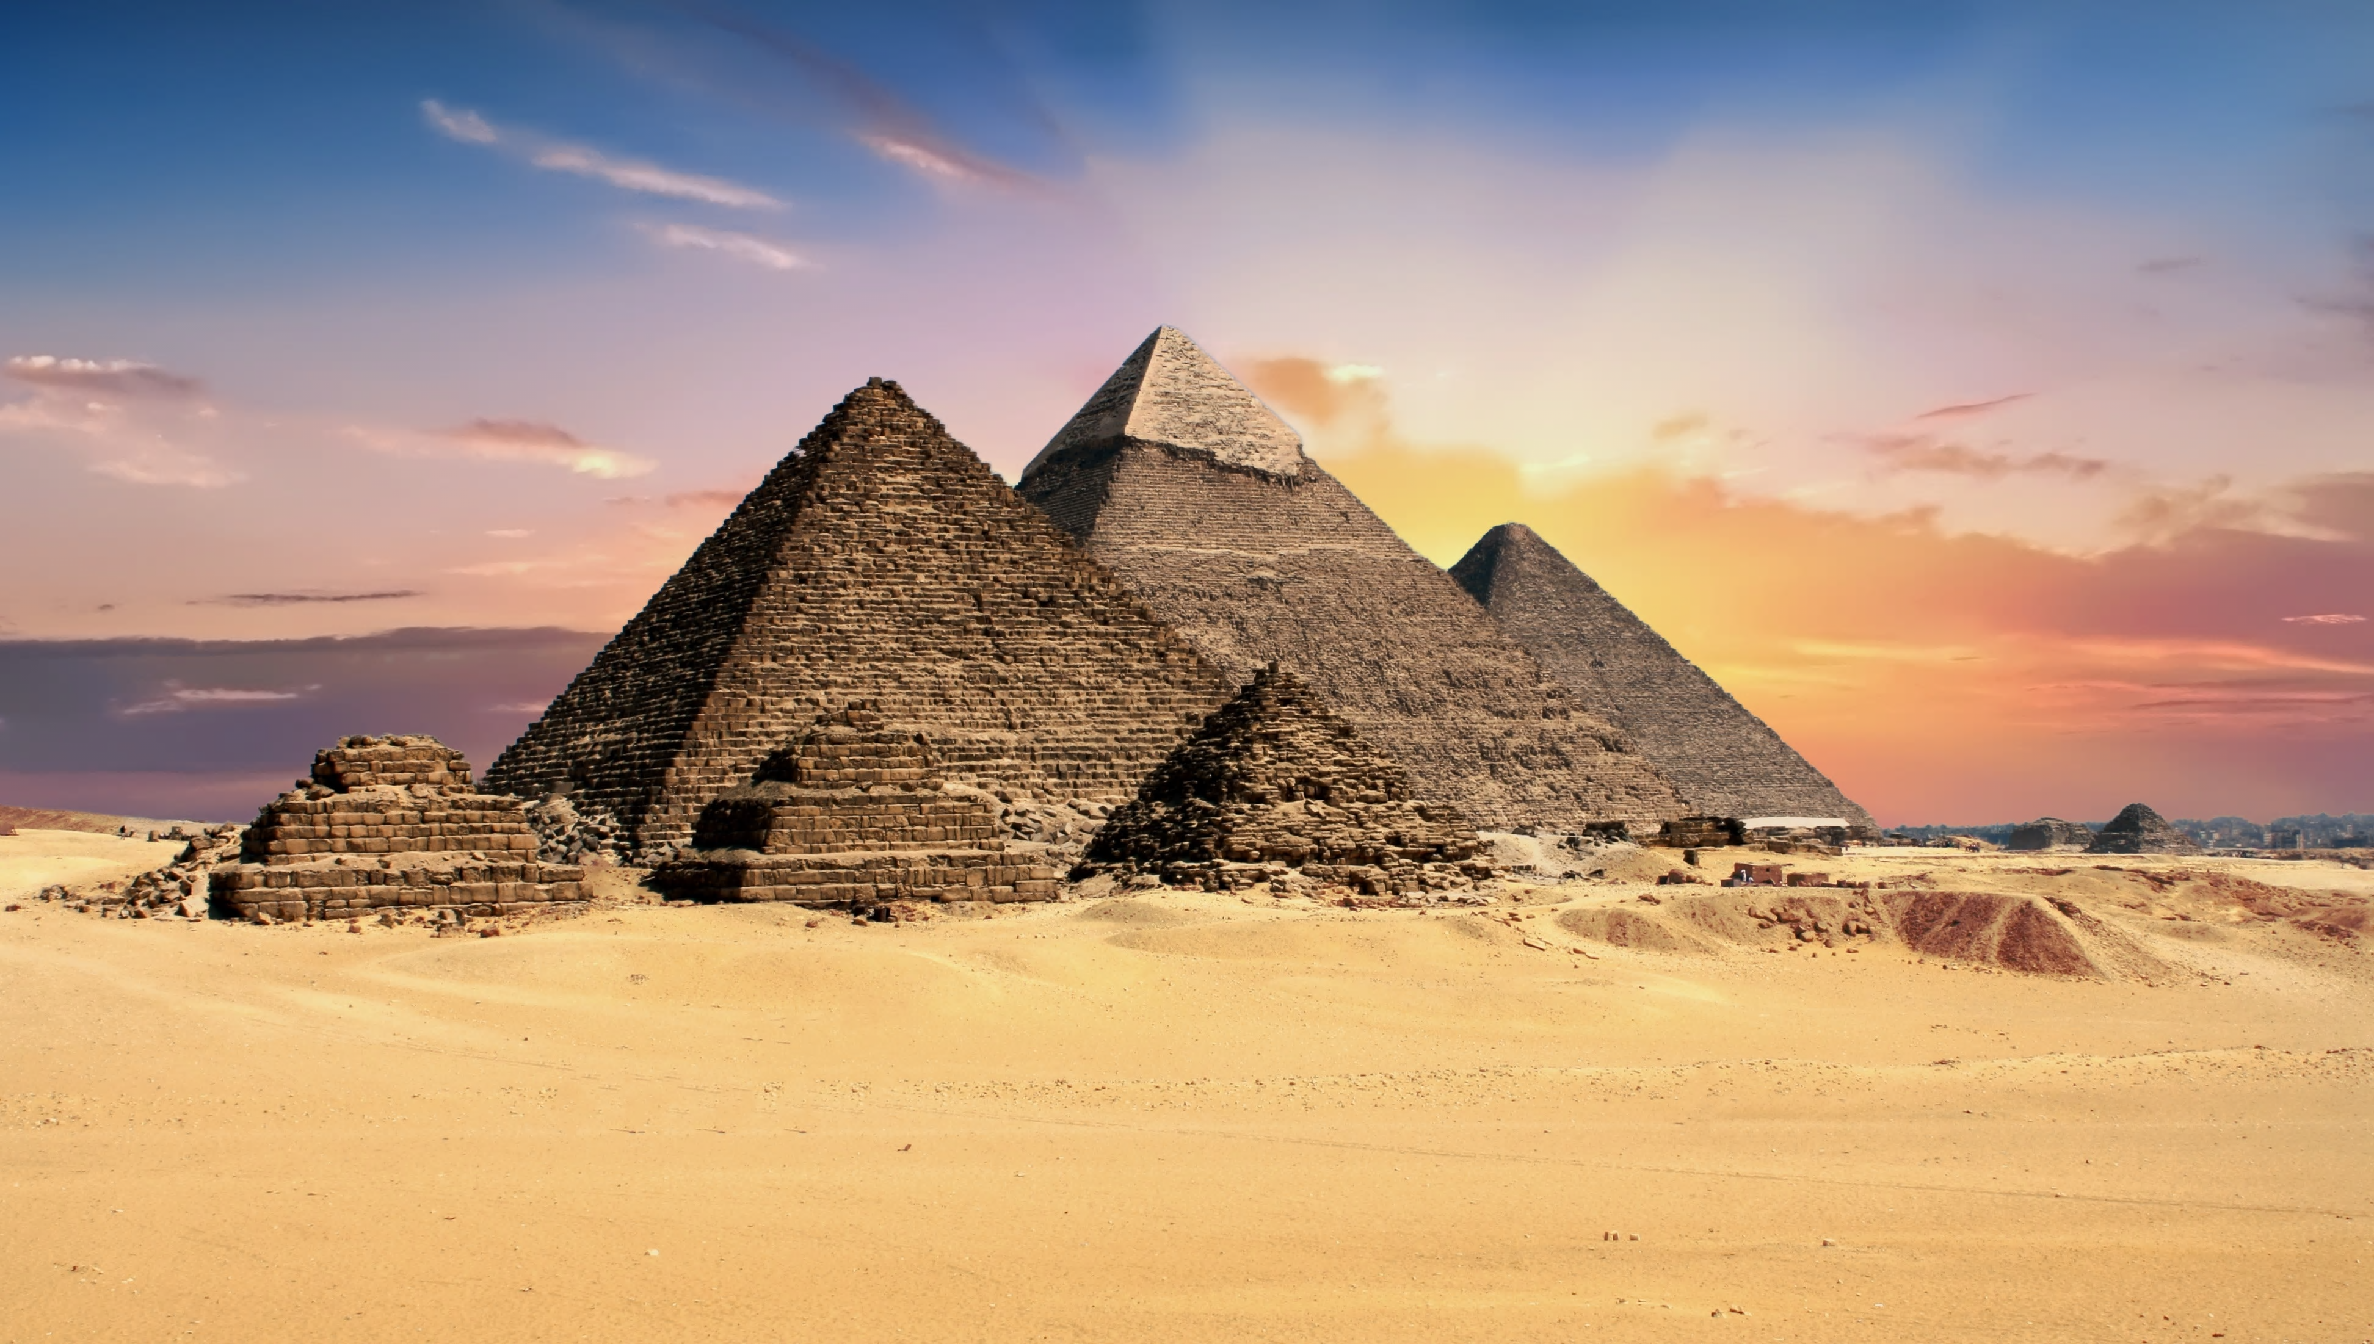
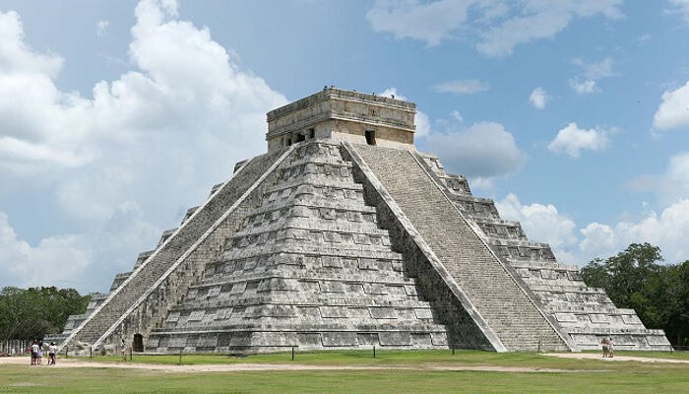
Pyramids
Pyramid, in architecture, a monumental structure constructed of or faced with stone or brick and having a rectangular base and four sloping triangular (or sometimes trapezoidal) sides meeting at an apex (or truncated to form a platform).
A triangular structure is very stable because it has a wide base. The Eiffel Tower is a good example of a triangular structure. Occasionally, triangular structures, with a point at the bottom, are used for hydroelectric power towers.
El Castillo, also known as the Temple of Kukulcan, is a Mesoamerican step-pyramid built by the Maya civilization in around 1000 AD. The pyramid is the central structure of the Chichen Itza archaeological site in Yucatan, Mexico. (right)
All three of Giza's famed pyramids and their elaborate burial complexes were built during a frenetic period of construction, from roughly 2550 to 2490 B.C. (left)
Notes:
http://www.asce-philly.org/achievements05.asp

Slide 8
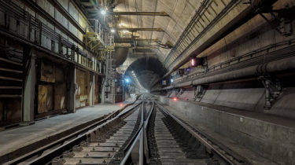
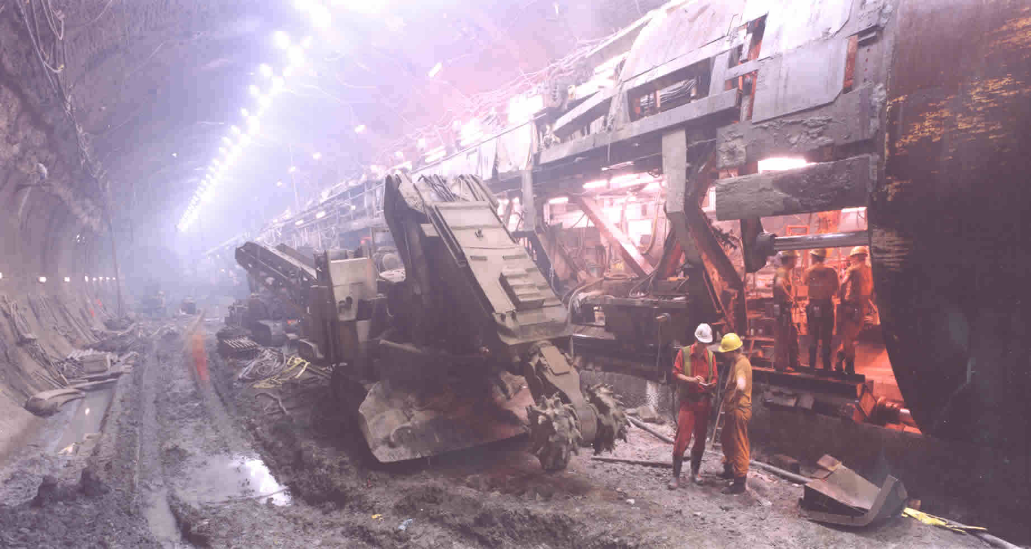
Tunnels
600 B.C. - Samos Aqueduct Tunnel
Water supply routed through a hill on Greek island
Persian and Armenian tunnels in Iran brought water to towns in the 8th century
By 17th century, tunnels widely used to route canals through hills rather than around
Marc Isambard Brunel developed a shield for boring under the Thames River in 1820
Tunnels allow rapid and unobstructed transport facilities in big congested cities. Tunnels protect the system (railway track, highway, sewer line or oil line etc.) for which it is constructed from weather effects such as snow, rain etc. Thus tunnels reduce the maintenance cost of the system
The Channel Tunnel (often called the 'Chunnel' for short) is an undersea tunnel linking southern England and northern France. (above)
The Channel Tunnel boring machine, photo taken during construction. (above)
Notes:
http://www.greatbuildings.com/buildings/Iron_Bridge_at_Coalbrookdale.html

Slide 9
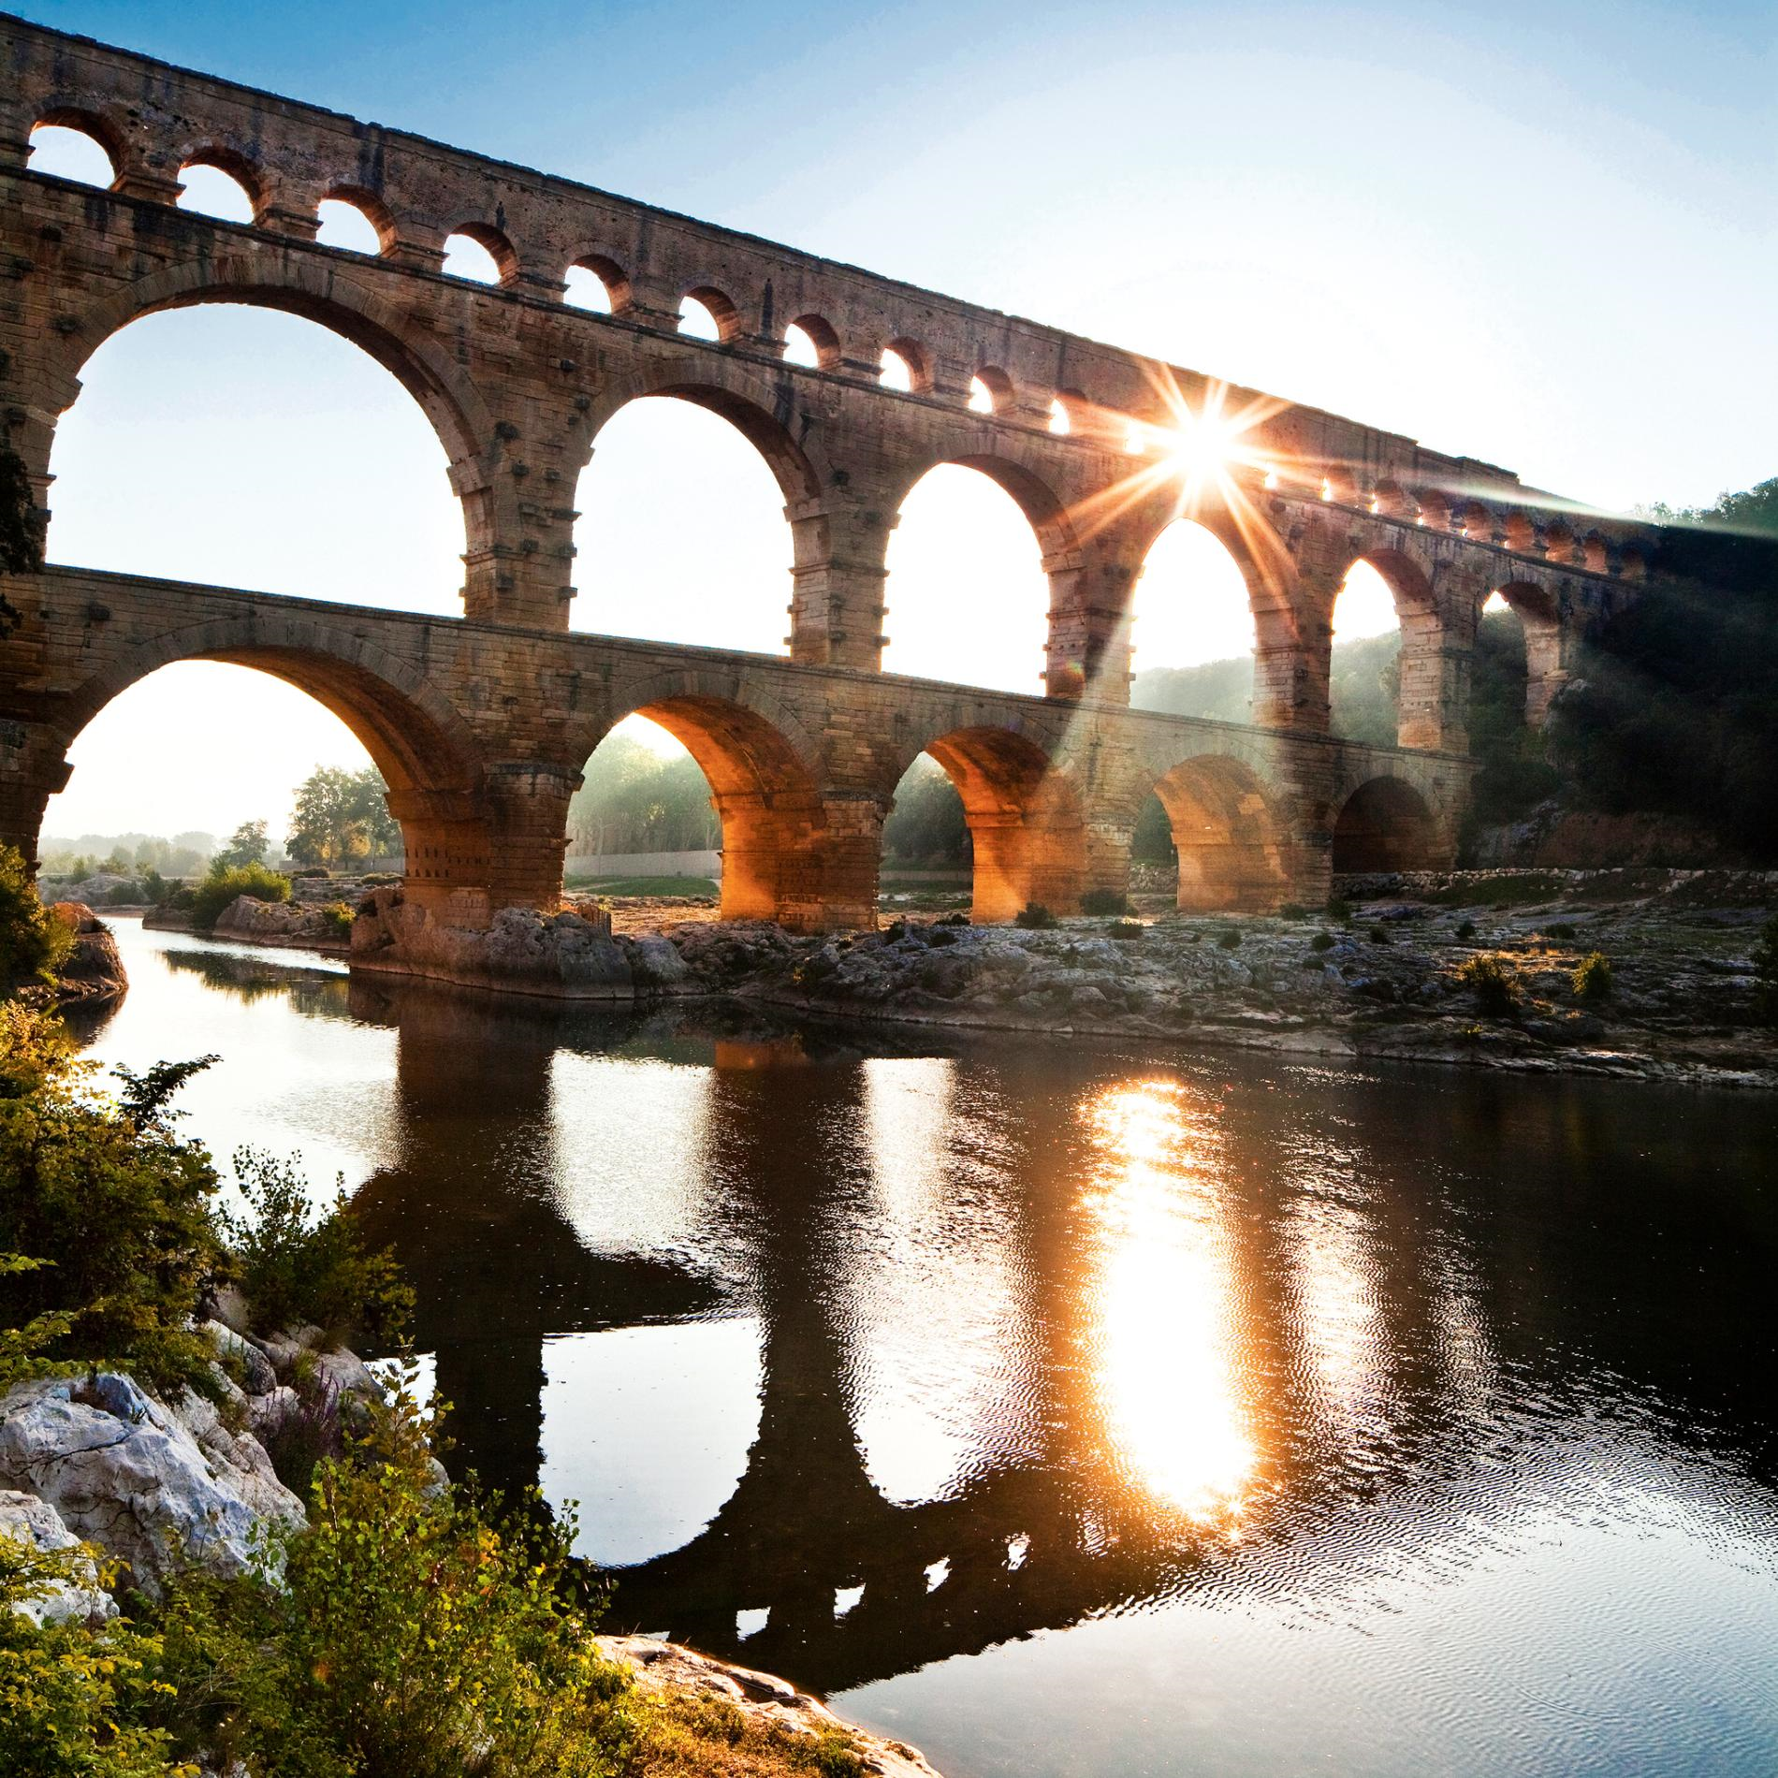
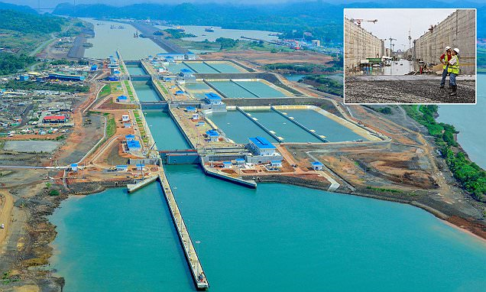
Waterways
The first recorded aqueduct in Ancient Rome was the Aqua Appia, which was said to be built in 312 B.C. The Romans completed their 11th aqueduct, Aqua Alexandria, in 226 A.D. Rome has over 359 miles of aqueducts that lead into the city.
Aqueducts - pipes or channels designed to transport water from a remote source
Usually takes advantage of gravity
Bridge-like structures support a conduit or canal passing over a river or low ground
Canals - artificial waterways or artificially improved rivers used for travel, shipping, or irrigation
The Panama Canal is an artificial 82 km (51 mi) waterway in Panama that connects the Atlantic Ocean with the Pacific Ocean. The canal cuts across the Isthmus of Panama and is a conduit for maritime trade.
Notes:
http://www.maine.gov/mdot-stage/
covered-bridges/sewalls.php

Slide 10
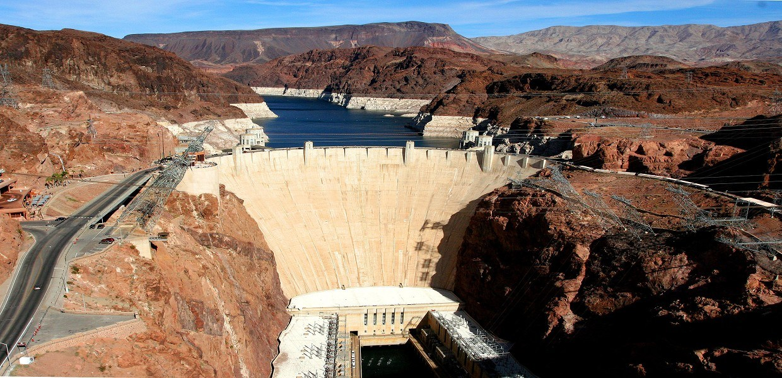
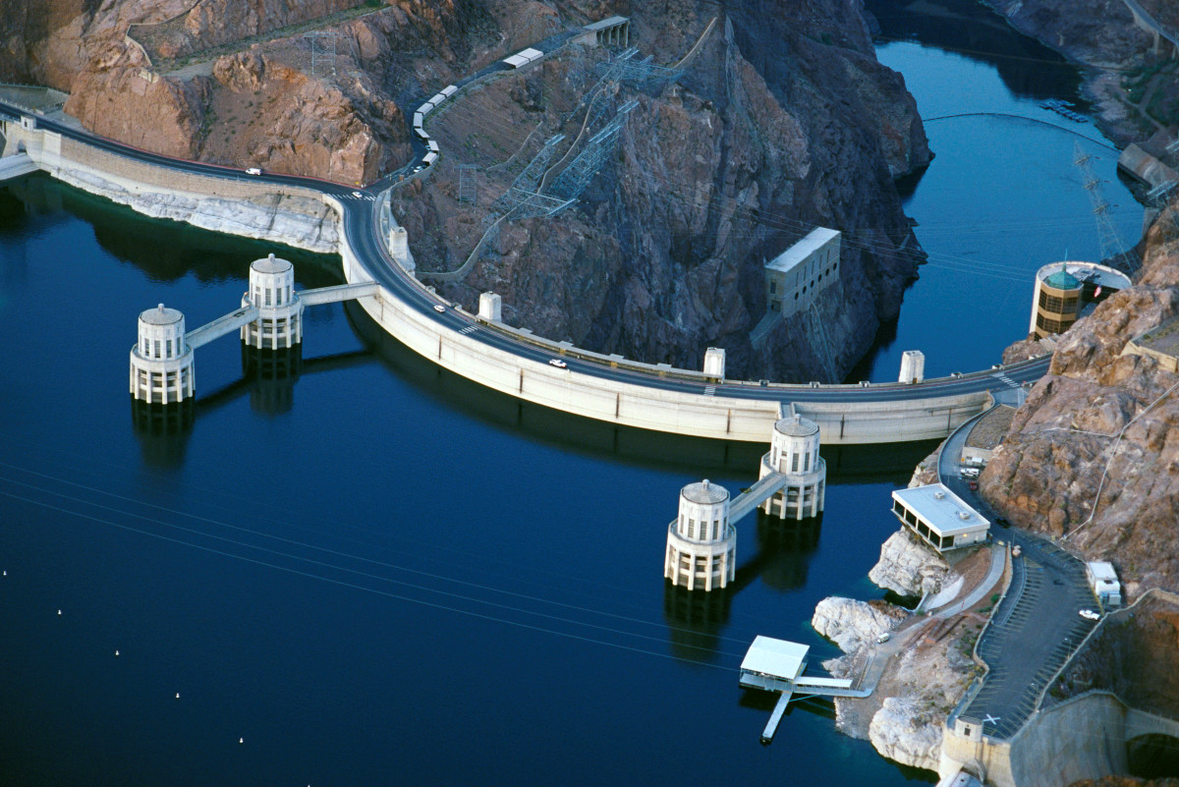
Dams
Dams - barriers constructed across a waterway to control the flow or raise the level of water
Strong enough to resist reservoir water backed behind dam
Impervious to water
Resists leaks and erosion
Hoover Dam -Boulder City, Nevada
Generates enough energy every year to serve over 1 Million people!
Notes:
http://web.umr.edu/~rogersda/dams/

Slide 11
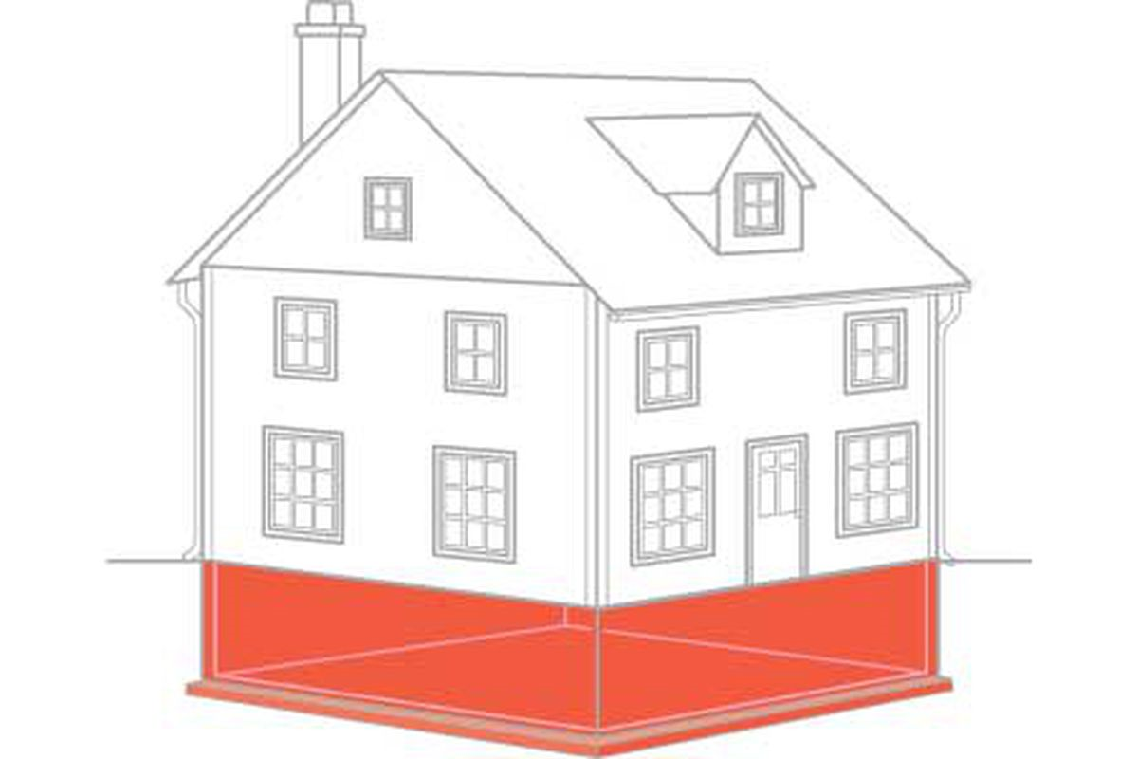
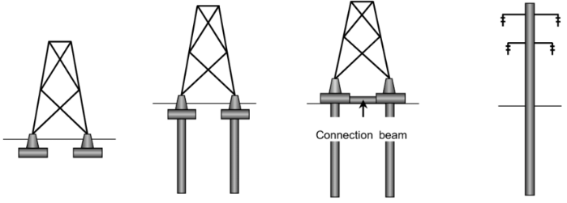
Foundations
A structural foundation is the part of a building that fixes it into the soil. ... One of the duties of civil engineers is to consider the bearing capacity of the soil, and design these foundations to resist shear stress, overturning, and sliding.
In engineering, a foundation is the element of a structure which connects it to the ground, and transfers loads from the structure to the ground.
Foundations are generally considered either shallow or deep. Foundation engineering is the application of soil mechanics and rock mechanics (Geotechnical engineering) in the design of foundation elements of structures.
Notes:
http://www.maine.gov/mdot-stage/
covered-bridges/sewalls.php

Slide 12
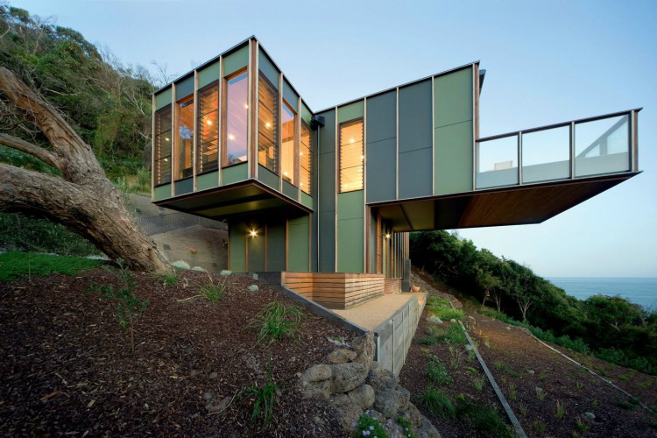
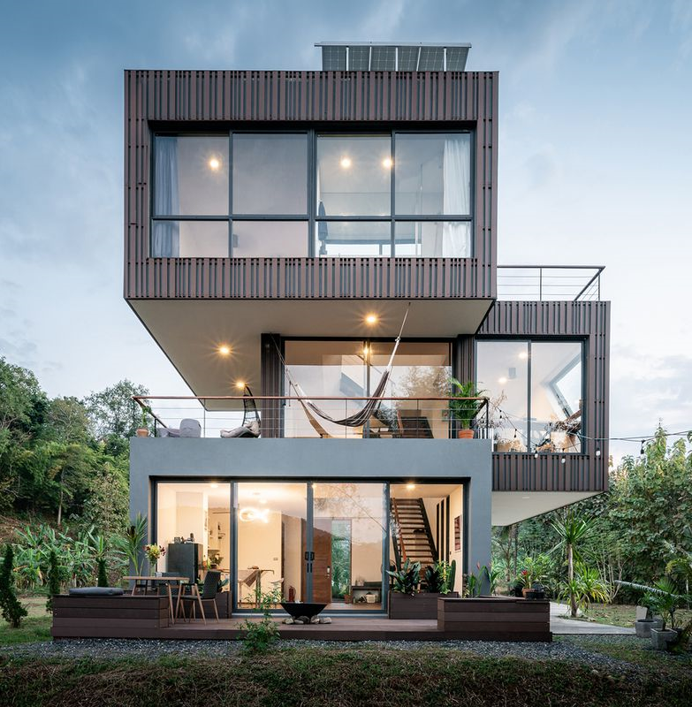
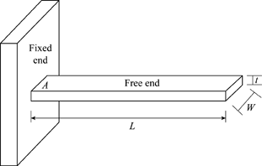
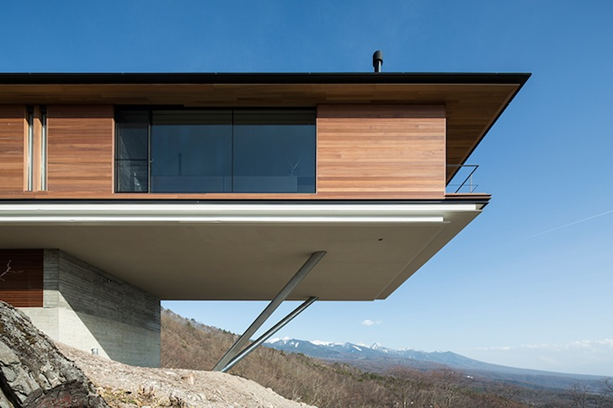
Cantilevers
A cantilever is a rigid structural element, such as a beam or a plate, anchored at one end to a support from which it protrudes; this connection could also be perpendicular to a flat, vertical surface such as a wall. Cantilevers can also be constructed with trusses or slabs.
Many modern architectural
designs feature
cantilevered floors
Notes:
http://www.maine.gov/mdot-stage/
covered-bridges/sewalls.php

Slide 13
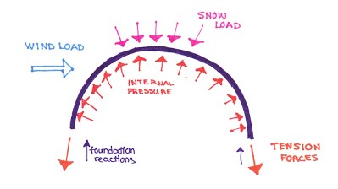
What is a structural load?
Load - this is the technical term for determining if a structure can support the weight or pressure that it will have to endure.
Live Load - include any temporary or transient forces. that act on a building or structural element. Typically, they include people, furniture, vehicles, and almost everything else that can be moved throughout a building. This also includes natural weights such as a heavy snowfall.
Dead Load - The dead load includes loads that are relatively constant over time, including the weight of the structure itself, and immovable fixtures such as walls, plasterboard or carpet. The roof is also a dead load. Dead loads are also known as permanent or static loads.

Slide 14
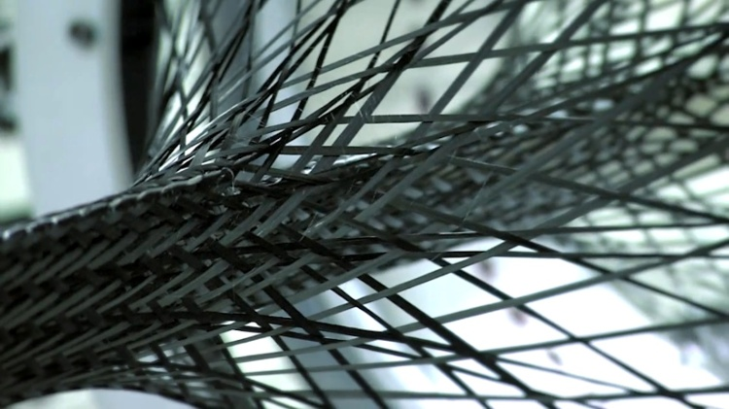
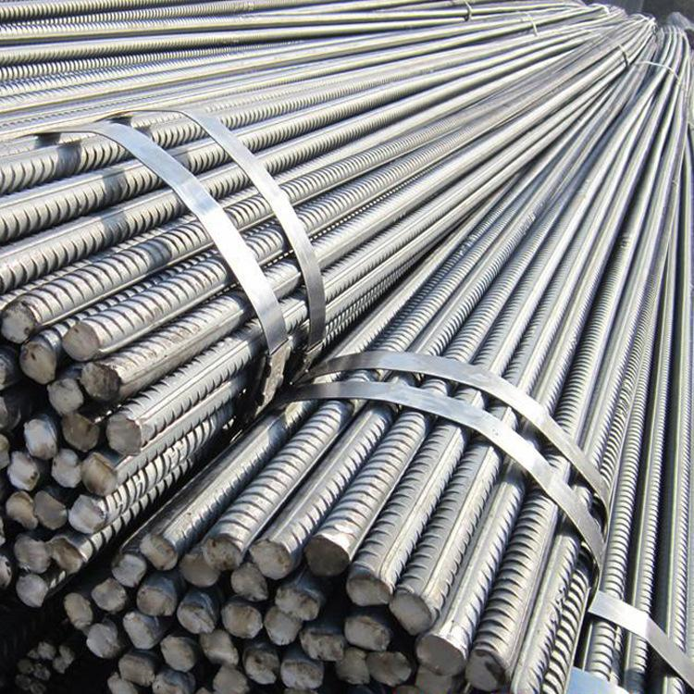
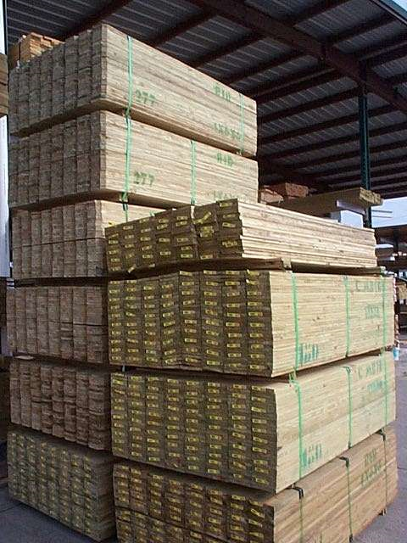
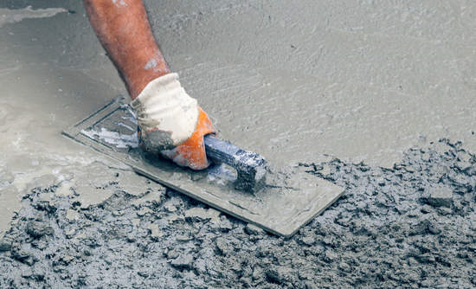
Commonly used building materials
Iron, wrought iron, cast iron, steel, stainless steel, concrete (reinforced, prestressed), aluminum, composites, alloy, masonry, timber, bamboo, carbon fibers, plastics, mudbrick, and roofing materials.

Slide 15
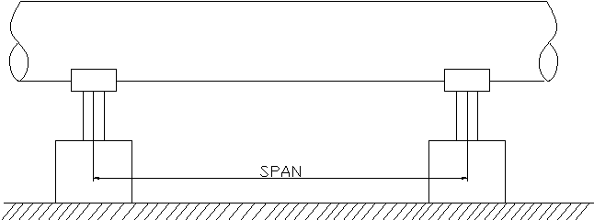
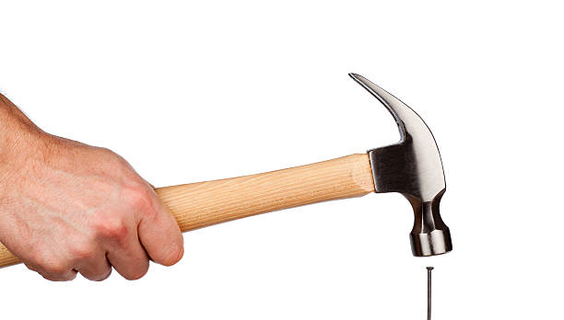
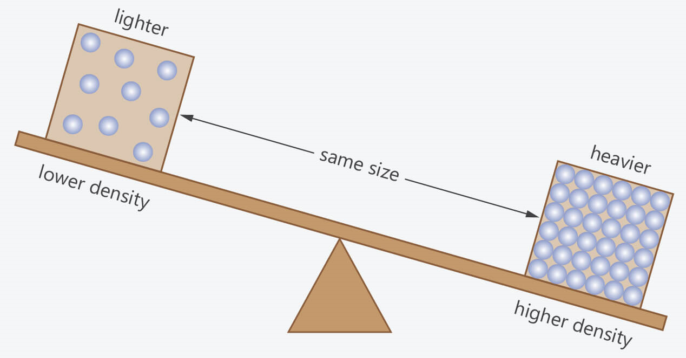
Important Terminology
Span - the full extent of something from end to end; the amount of space that something covers.
Thrust - push (something or someone) suddenly or violently in the specified direction.
Density - describe how much space an object or substance takes up (its volume) in relation to the amount of matter in that object or substance (its mass). Another way to put it is that density is the amount of mass per unit of volume. If an object is heavy and compact, it has a high density.

Slide 16
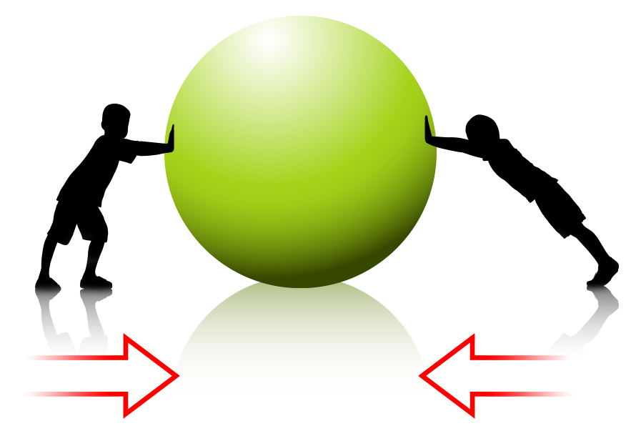
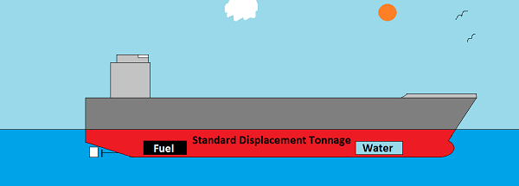
Important Terminology
Force - force is the push or pull on an object with mass that causes it to change velocity (to accelerate).
Moment of Inertia – resistance to angular acceleration. It is the sum of the products of the mass of each particle in the body with the square of its distance from the axis of rotation. Moment of inertia can be used to describe an objects breaking point.
Displacement - is defined as the change in position of an object. It is a vector quantity and has a direction and magnitude. It is represented as an arrow that points from the starting position to the final position.

Slide 17
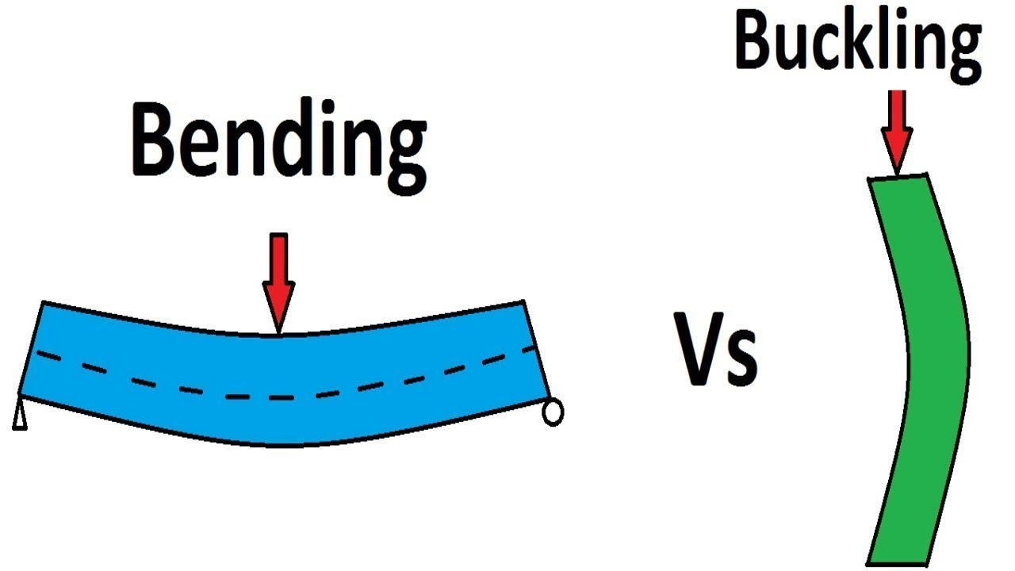
Important Terminology
Buckling - buckling is the sudden change in shape of a structural component under load such as the bowing of a column under compression or the wrinkling of a plate under shear.
Yielding - the yield point is the point on a stress-strain curve that indicates the limit of elastic behavior and the beginning of plastic behavior. Prior to the yield point, a material will deform elastically and will return to its original shape when the applied stress is removed.

Slide 18
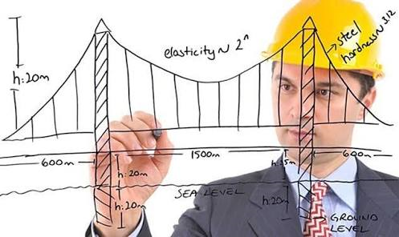
Career Opportunities
Structural Engineer- Structural Engineers analyze, design, plan, and research components and structural systems to achieve design goals and ensure the safety and comfort of users or occupants. Their work takes account mainly of safety, technical, economic and environmental concerns, but they may also consider aesthetic and social factors.

Slide 19
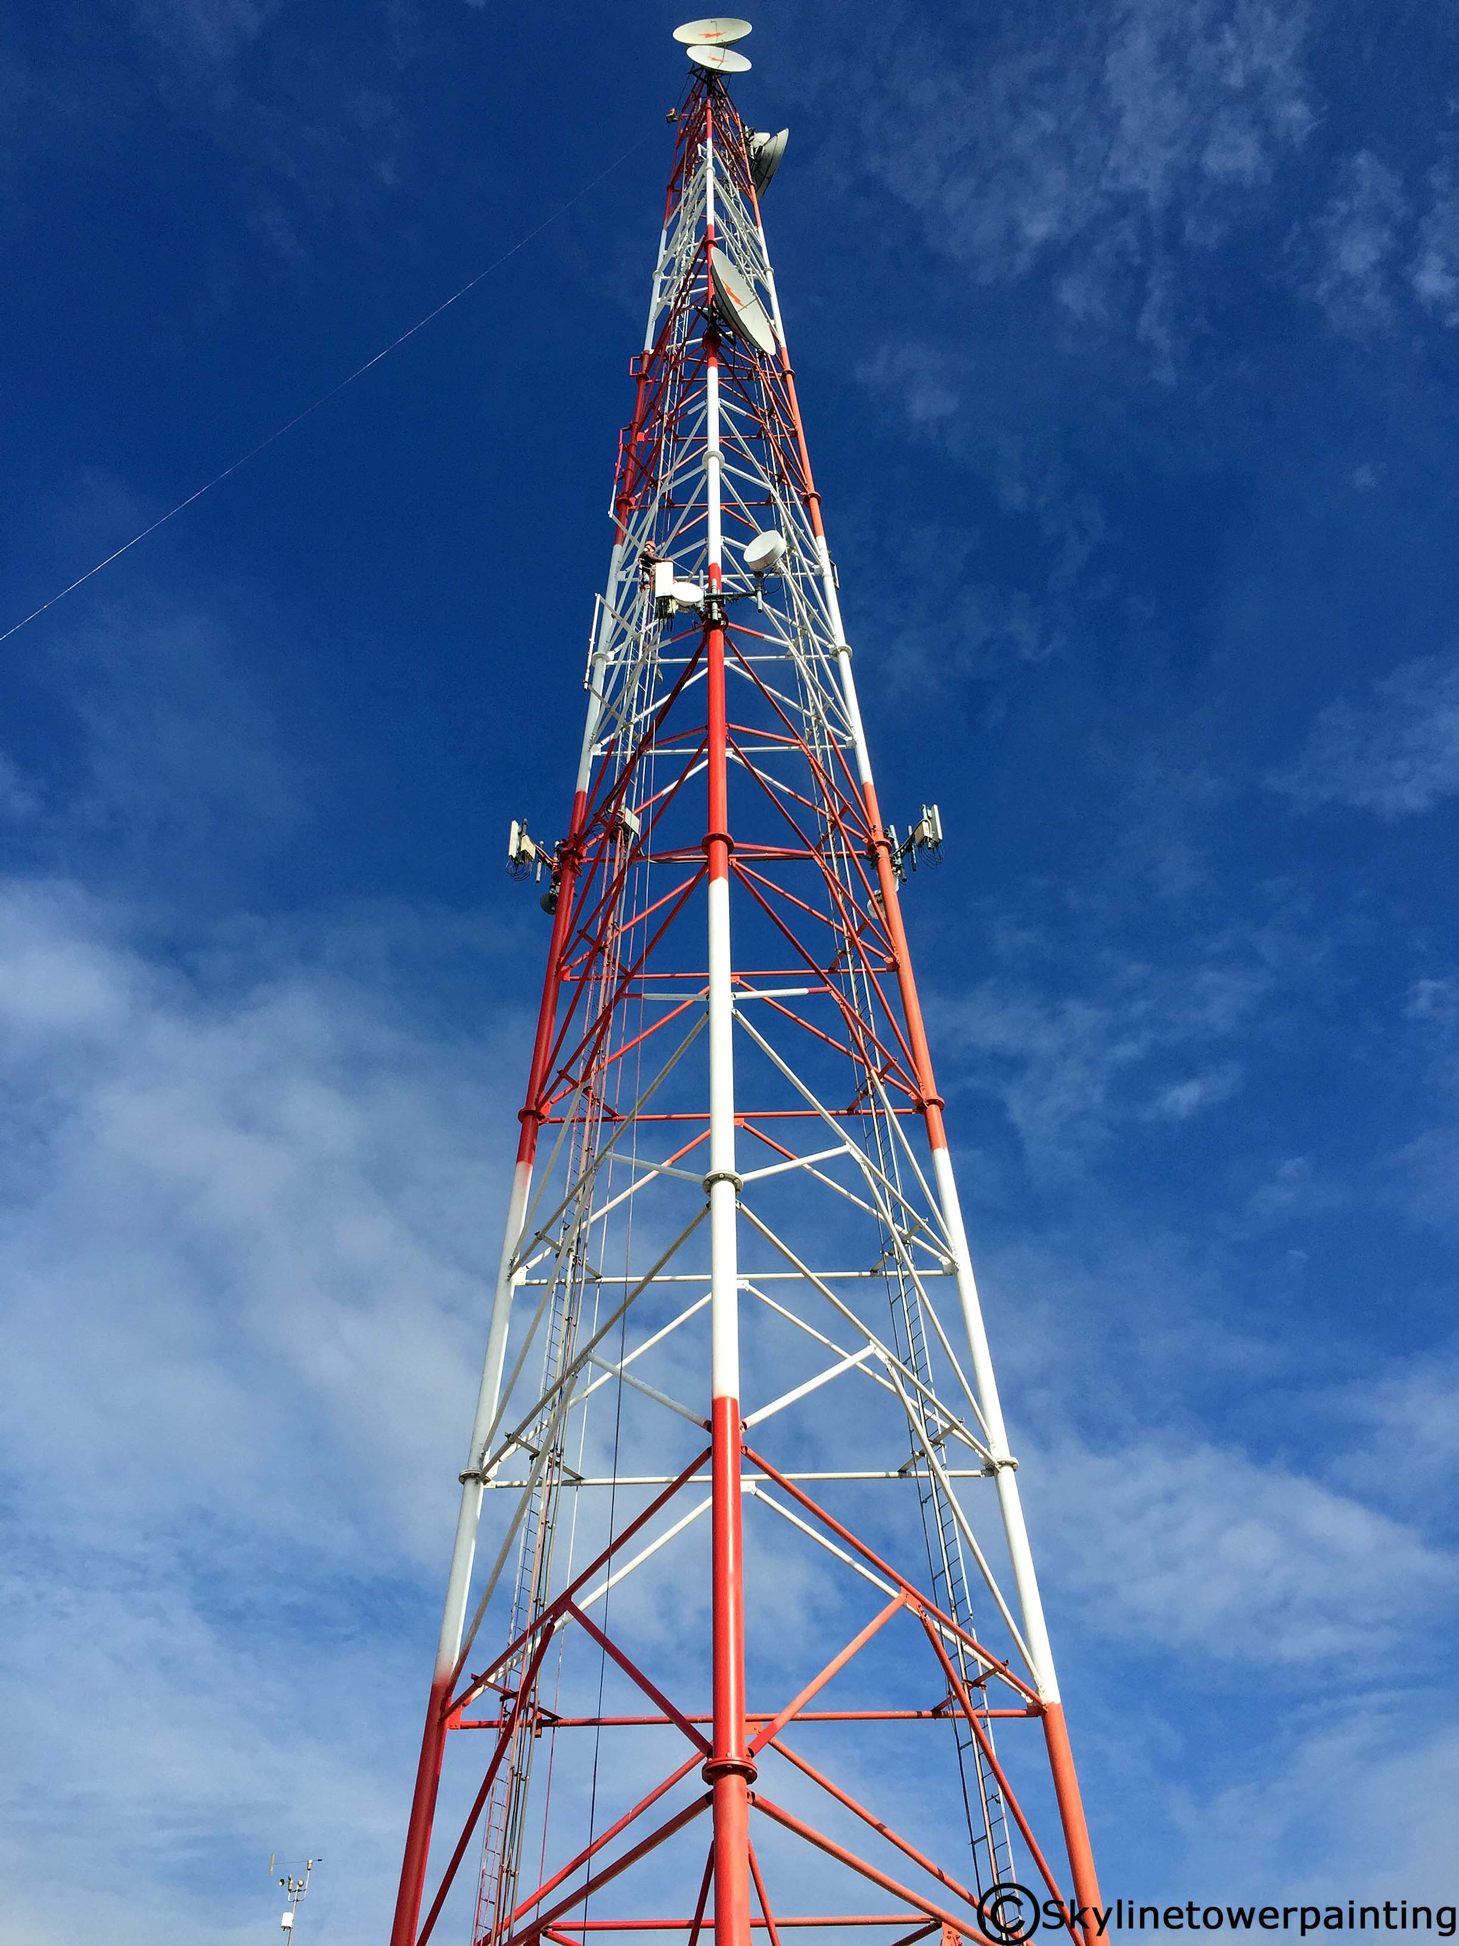
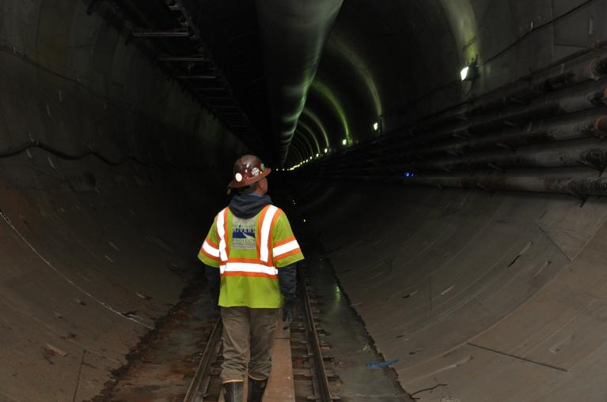
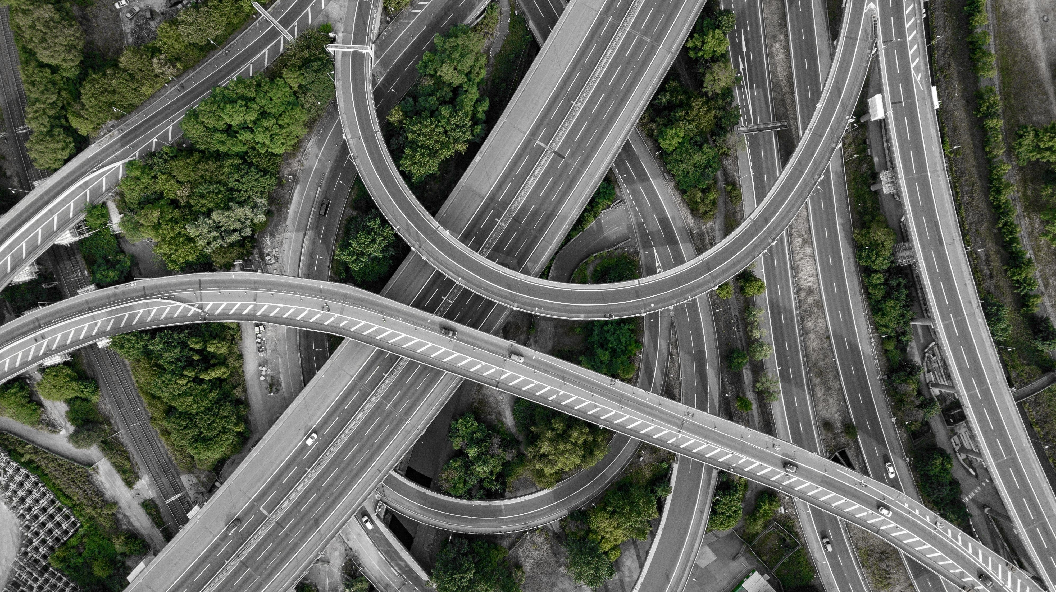
Infrastructures
Infrastructure is the basic physical and organizational structures and facilities (e.g. buildings, roads, power supplies) needed for the operation of a society or enterprise.
Some of the most integral infrastructure systems are commonly not seen in everyday life. These systems include: water distribution, electrical grids, sewage, and even communication.
Engineers need to carefully plan all of these systems together in order for a house, town, city, and country to operate safely and efficiently.
Notes:
http://www.maine.gov/mdot-stage/
covered-bridges/sewalls.php

Slide 20
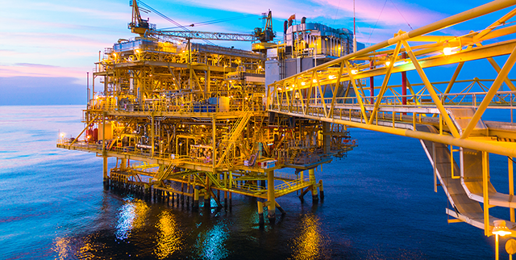
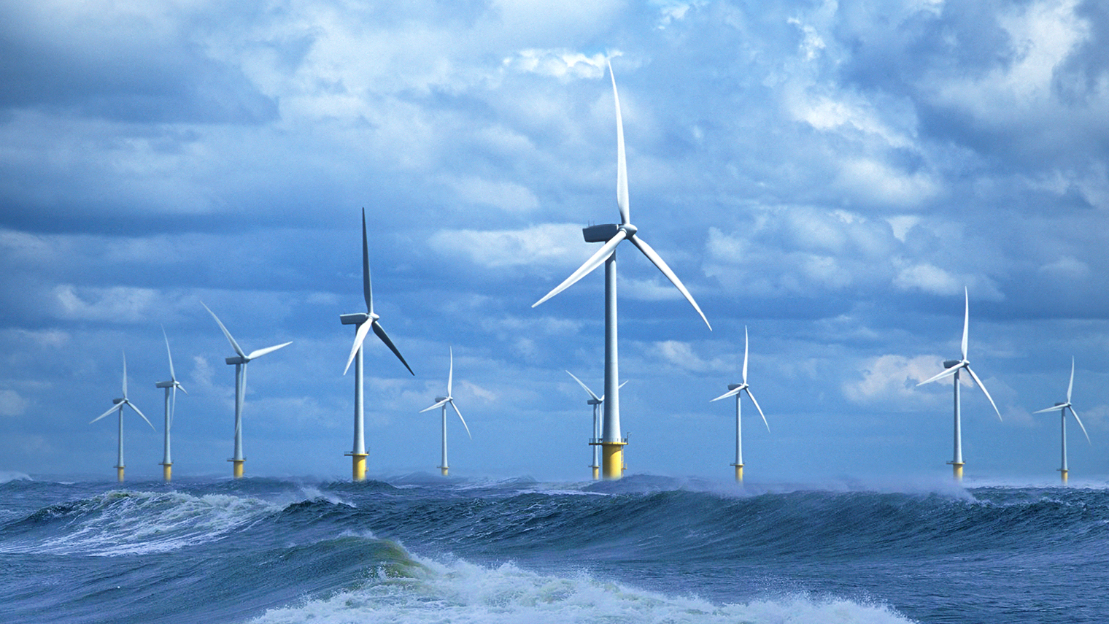
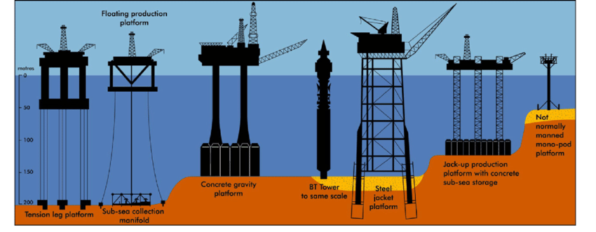
Offshore Structures
Offshore structures consist of offshore oil platforms and offshore wind turbines (OWTs). They are special type of complex structures. The offshore oil platforms are large-scale structures situated in the sea. They can accommodate the facilities and equipment to drill, extract, and process oil and natural gases.
Notes:
http://www.maine.gov/mdot-stage/
covered-bridges/sewalls.php

Slide 21
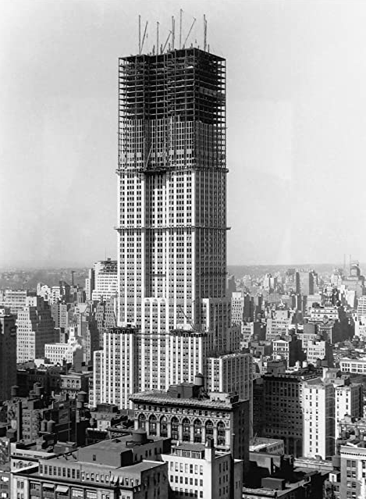
Towers - Buildings
Buildings and towers have evolved for as long as humans have inhabited the earth. Many towers began as flat, natural buildings but have quickly grown due to the advancements in materials (alloys, concrete, etc.).
Many architectural/civil engineers focus on the strength of buildings in relationship to the building load capacities and natural forces including wind shear and earthquake resistance.
Architectural engineering (AE) is the application of practice and theory to the engineering design of building systems. ... Architectural engineers apply their discipline-specific expertise in interdisciplinary team environments to conceptualize, design, construct, operate, and maintain built infrastructure.
1930 - Construction of the
Empire State Building
2019 – Burj Khalifa, Dubai
829.8 Meters high – tallest man-made structure in the world.
160 stories tall, 64 KM/Hour (40 MPH) elevators
Notes:
http://www.maine.gov/mdot-stage/
covered-bridges/sewalls.php

Slide 22
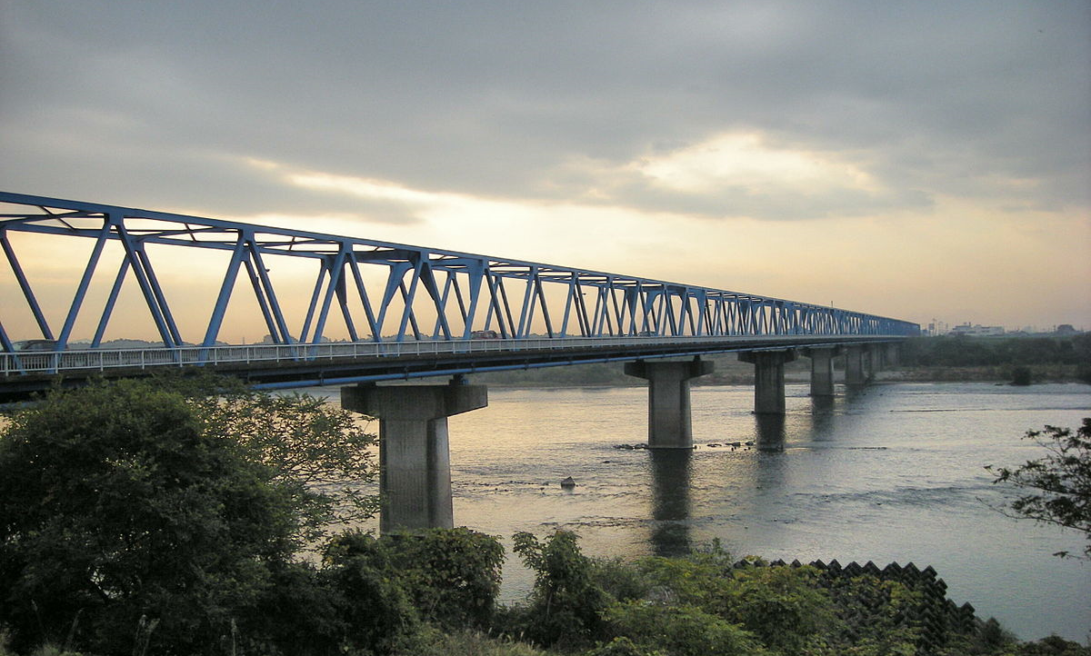
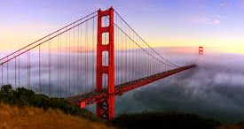
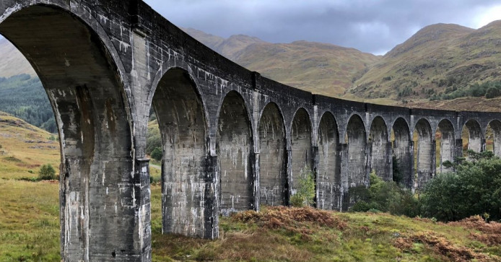
Bridges – Three classes of Bridges
Beam Bridge
Suspension Bridge
Arched Bridge
Notes:
http://www.walkingbritain.co.uk/walks/walks1/w001d.shtml
http://education.sdsc.edu/enrich/brid.html
http://www.photo.net/photo/pcd3448/golden-gate-bridge-94

Slide 23
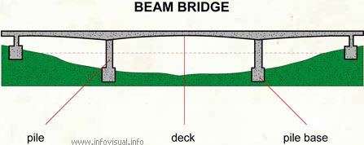
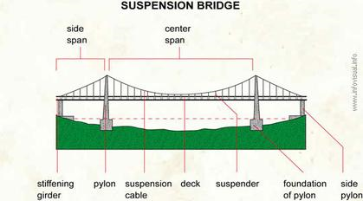
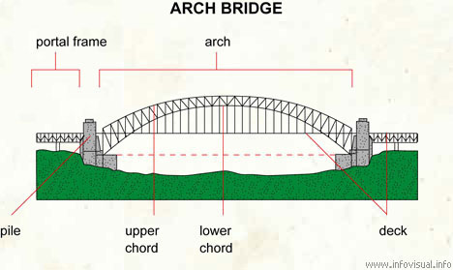
Bridges
Beam Bridge - also known as stringer bridges, are the simplest structural forms for bridge spans supported by an abutment or pier at each end. No moments are transferred throughout the support, hence their structural type is known as simply supported.
Suspension Bridge - a bridge in which the weight of the deck is supported by vertical cables suspended from larger cables that run between towers and are anchored in abutments at each end.
Arched Bridge- a bridge with abutments at each end shaped as a curved arch. Arch bridges work by transferring the weight of the bridge and its loads partially into a horizontal thrust restrained by the abutments at either side.
Notes:
http://www.maine.gov/mdot-stage/
covered-bridges/sewalls.php

Slide 24
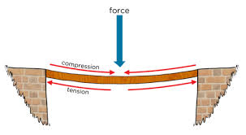
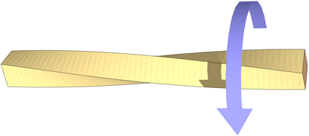
Important Terminology
Compression –the action or state of being squished down or made smaller or more pressed together. When a pile of material is squished together and made smaller and more dense, this is an example of compression
Tension - tension is described as the pulling force transmitted axially by the means of a string, a cable, chain, or similar one-dimensional continuous object, or by each end of a rod, truss member, or similar three-dimensional object
Torsion - the action of twisting or the state of being twisted, especially of one end of an object relative to the other.

Slide 25
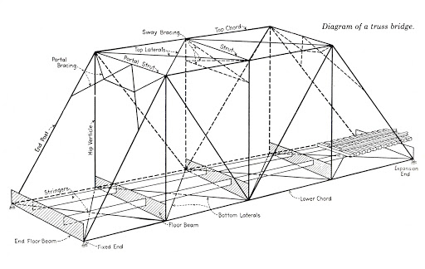
Important Terminology
Chords - a principal member of a truss extending from end to end, usually one of a pair of such members, more or less parallel and connected by a web composed of various compression and tension members.
Verticals – members of a truss system extending perpendicular to a horizontal surface. Resists against compression forces.
Diagonals – members of a truss system that aligns itself between a 90 and 0 degree angle. Helps resists against torsion forces.

Slide 26
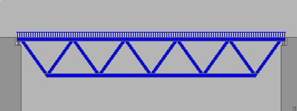
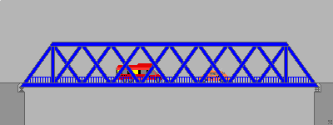
Important Terminology
Truss - a framework, typically consisting of rafters, posts, and struts, supporting a roof, bridge, or other structure.
Deck Truss - refers to a truss under a bridge.
Through Truss - refers to a truss on top of a bridge.

Slide 27
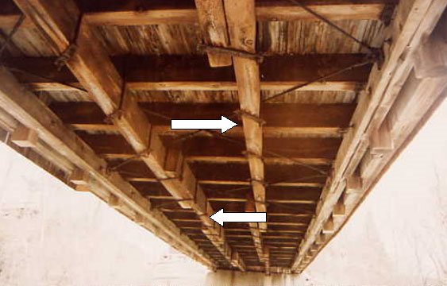
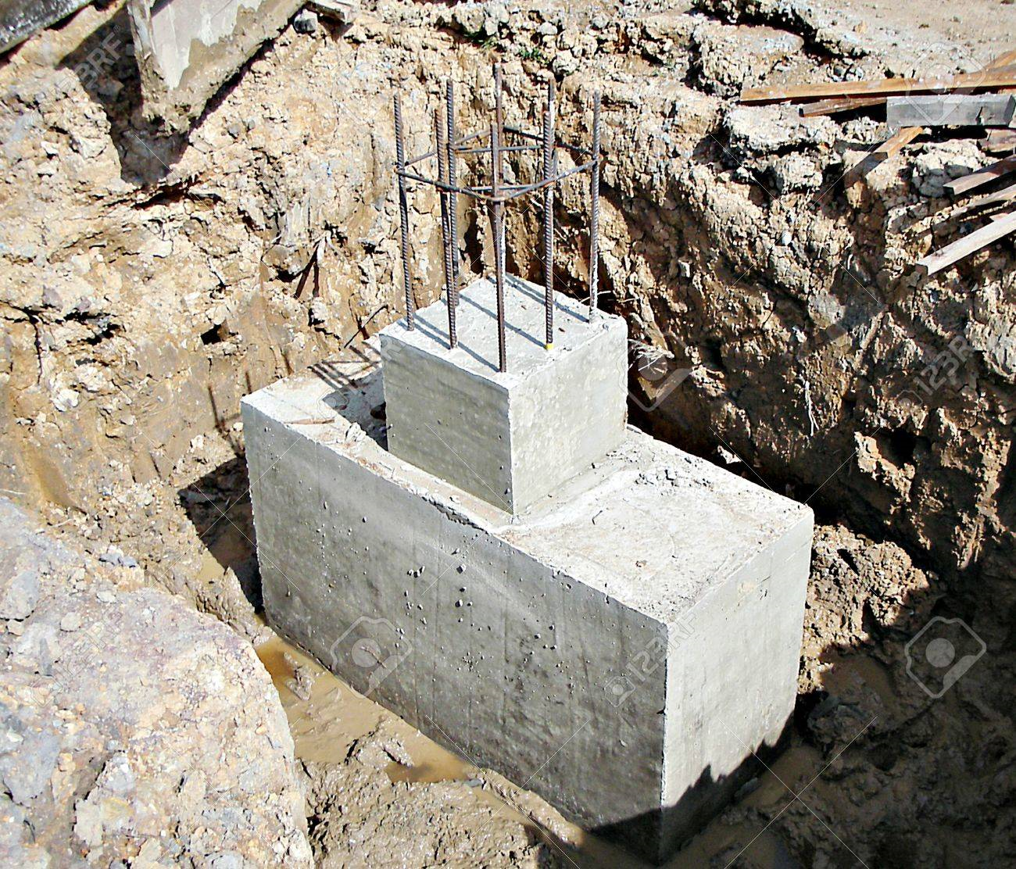
Important Terminology
Deck - Any raised flat surface that can be walked on: a balcony; a porch; a road bed; a flat rooftop.
Floor Beams – often referred to as a joist, it is a horizontal structural member used in framing to span an open space, often between beams that subsequently transfer loads to vertical members.
Footing - The footing is a formation which is in contact with the ground. Foundation is a structure which transfers its gravity loads to earth from superstructure.

Slide 28
Important Terminology
Abutment - the substructure at the ends of a bridge span or dam whereon the structure's superstructure rests or contacts.
Pier - vertical loadbearing member such as an intermediate support for adjacent ends of two bridge spans. In foundations for large buildings, piers are usually cylindrical concrete shafts, cast in prepared holes, while in bridges they take the form of caissons, which are sunk into position.
Cable Anchorage - anchoring a cable, for example a stay cable comprising multiple strands (50), against an axial tension force.

Slide 29
Important Terminology
Pinned Support - A pinned support is a very common type of support and is most commonly compared to a hinge in civil engineering. Like a hinge, a pinned support allows rotation to occur but no translation (i.e. it resists horizontal and vertical forces but not a moment).
Roller Support - are free to rotate and translate along the surface upon which the roller rests. The surface can be horizontal, vertical, or sloped at any angle. The resulting reaction force is always a single force that is perpendicular to, and away from, the surface.

Slide 30
Career Opportunities
Civil Engineer – Civil Engineers work on complex projects, and they can achieve job satisfaction in seeing the project reach completion. They usually specialize in one of several areas. Construction engineers manage construction projects, ensuring that they are scheduled and built in accordance with plans and specifications.

