Slide 1
Measurement

Slide 2
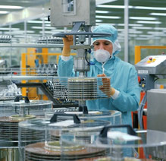
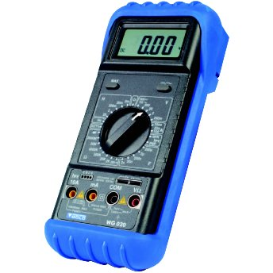
What is Measurement?
Measurement is an established standard for comparing
Easier way to compare items to each other
Can pass information to other people which is easy to understand
Set up a system for commerce ($$$)
http://www.oicm.com/images/ph_hard_disk_lab.jpg
http://www.maplin.co.uk/images/full/4393i0.jpg
http://www.theblindfactory.com/content/images/measuring.jpg

Slide 3
How did measurement start?
People measured comparing items to their own arms or fingers, or other objects
Couldn‘t transfer information to another person
Appendages would be different sizes!
People wanted to trade goods with each other
Needed a common basis for establishing price
http://members.westnet.com.au/molinasantos/strands/measurement/hand.gif

Slide 4
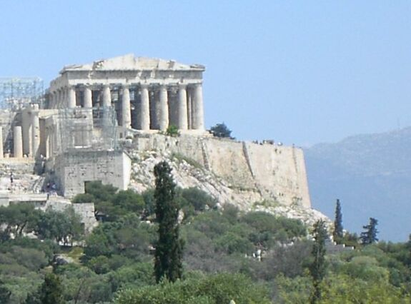
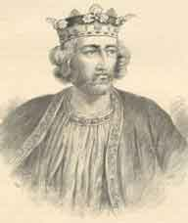
History of Measurement
Greek Parthenon
Different Society’s had their own units of measurement
Greeks, Babylonians, Romans, etc. all had their own, separate systems
King Edward of England established the “Yard” measurement in the 13th Century
Length of his arm
http://en.wikipedia.org/wiki/Image:Ac.parthenon5.jpg
King Edward I (Longshanks)
http://www.castles.me.uk/images/king-edward-i.jpg

Slide 5
How do we know a Foot is a Foot??
Every Country sets it’s own standard for measuring
The U.S. Department of Commerce
National Institute for Standards and Technology
Length of material established to be one foot
Made of materials that will not shrink or decay
http://www.apta.org/AM/Images/APTAIMAGES/ContentImages/ptandbody/foot/footandankle.gif

Slide 6
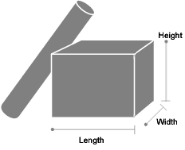
Length, Width, Height, Diameter
Every object has a length, width and height
Length
How far an object extends
Width
How wide an object measures
Height
How tall an object measures
Diameter
Cylindrical objects distance across the circle
http://postcalc.usps.gov/images/package_lhw.gif

Slide 7
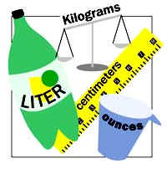
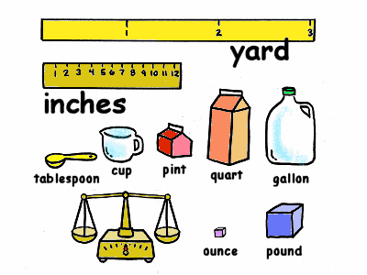
Different Standards in the World
Metric System
Base Ten system
Meter, Gram, Liter, Second
Imperial System
Different divisions
Foot, Pound, Ounce, Second
http://www.sierraexpressmedia.com/wp-content/uploads/2011/04/Metric_System.jpg
http://www.techyard.net/wp-content/uploads/images/UnitConversionTool_DD54/units_of_measure.gif

Slide 8
Metric System (What are their labels?)
Kilo x1000
Hecto x100
Deca x10
Base x1
Deci x.1
Centi x.01
Milli x.001
Length Mass Volume
Kilometer Kilogram KiloLiter
Hectometer Hectogram HectoLiter
Decameter Decagram DecaLiter
Meter Gram Liter
Decimeter Decigram DeciLiter
Centimeter Centigram CentiLiter
Millimeter Milligram MilliLiter

Slide 9
Imperial System (What are their labels?)
Length Weight Volume
Mile x5280
Yard x3
Foot x1
Inch 1/12
Ton x2000
Pound x1
Ounce 1/16
Gallon x16
Quart x4
Pint x2
Cup x1
Fluid Ounce 1/8

Slide 10
Time (Common between both Systems)
Year x31536000 (365 Days)
Week x604800 (7 Days)
Day x86400 (24 Hours)
Hour x3600 (60 Minutes)
Minute x60
Second x1
Milli-Second x.001 – Correct for both standards?

Slide 11
Use Labels!
Inch = in or “
Foot = ft or ‘
Yard = yd
Mile = mi
Ounce = oz
Pound = lb
Ton = ton
Fluid Ounce = fl oz
Cup = c
Pint = pt
Quart = qt
Gallon = gal
Meter = m
Liter = L
Gram = g
Milli- = m
Centi- = c
Deci- = d
Deka- = da
Hecto- = h
Kilo- = k
Second = s or “
Minute = min. or ‘
Hour = hr

Slide 12
Inch in Fractions
1/8”
1/16”
1/4”
1/2”
1”

Slide 13
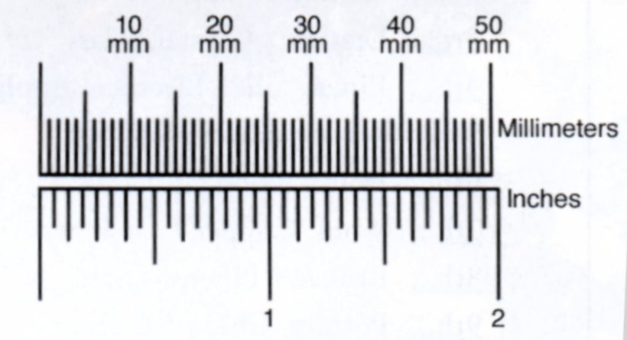
cm & mm
1mm
1cm

