Slide 1
Package Design
and Engineering
Notes:
Introduce yourself.
Hi, my name is Zack and I’m a senior in the Packaging Program at UW-Stout. I’m here to talk to you guys a little about packaging, what it is that a packaging engineer does, and the future job outlook for you guys if you do decide to join the program.
Let’s get started..NEXT SLIDE

Slide 2
What is Packaging?
Notes:
What sort of materials do you guys think of when you hear packaging?...NEXT SLIDE

Slide 3
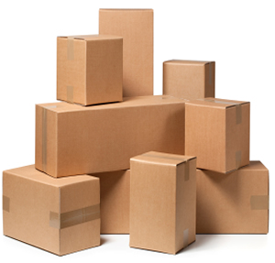
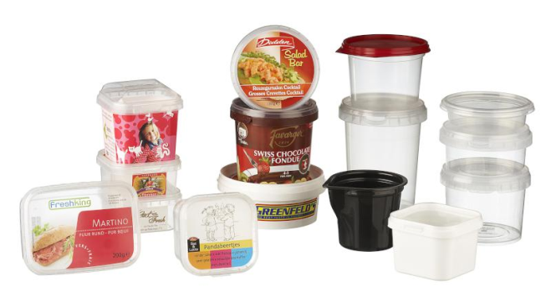
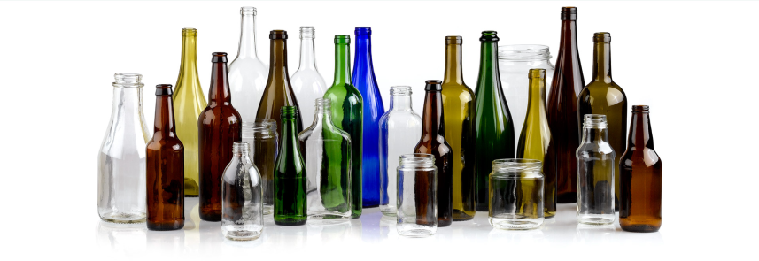
Corrugate (Cardboard)
Paper Board
Plastics
Metal
Glass
Notes:
These are the 5 main materials that make up packaging.
Corrugate (boxes), Paperboard (Mac dons carton), Plastics (for pretty much everything), Metal (tin cans), and finally Glass (bottles or jars).
These materials make up packaging...NEXT SLIDE

Slide 4
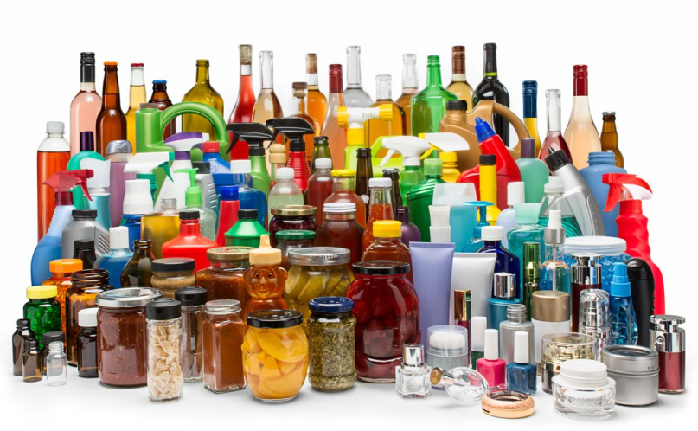
PACKAGING IS…
The material/combination of materials used to protect, contain, and promote a product from the moment it’s manufactured to the point of purchase.
Notes:
Read Definition
..NEXT SLIDE

Slide 5
What is Packaging for?
Notes:
And why is it important to protect, contain, and promote our products?

Slide 6
WHY IS IT IMPORTANT?
Product Protection
Broken or leaking product
Product Containment
Holds a product for efficient handling
Product Promotion
- Markets a brand and product’s qualities
Notes:
- Protection: We don’t want customers opening up a product and having it be broken, or in the case of food, rancid. You want the customer to be happy with the product they just paid for. ex. Shattered phone screen
- Containment: Products need to be grouped for better handling not only for transportation but for customers as well. ex. flour
- Promotion: Packaging is a great marketing tool. To cooler the packaging, the better the chance of a product being bought and remembered. This leads to more sales. ex. Tide Pods
- These are all things you need to keep in mind when you’re working as a packaging engineer..NEXT SLIDE

Slide 7
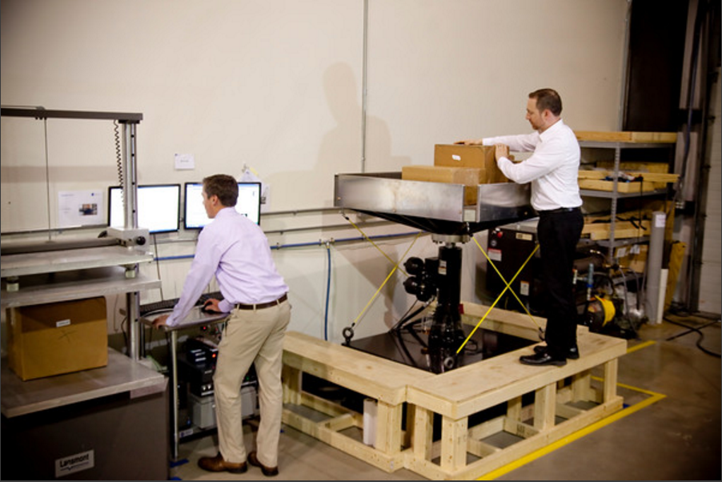
WHAT DOES A PACKAGING ENGINEER DO?
R&D
Packaging innovations
Design
Structural: Technical and Physical needs
Testing
Distribution and environmental
Manufacturing
Feasibility of a design
Notes:
R&D or research and development is going out and finding and developing new ways to package. Whether that’s new materials or packaging processes.
Packaging Design refers mainly to structure and how physically strong or weak a packaging structure may be.
Testing is a huge part of packaging as well. Distribution testing makes sure a product and the packaging is going to hold up during transport. ex. Vibe table
Packaging engineers also work with Manufacturing to ensure a design can be ran. Does the design need to be altered?...NEXT SLIDE

Slide 9
WHAT’S IT LIKE?
4 year Bachelor of Science degree
Core Curriculum: Intro to Packaging, Packaging Materials: Paperboard and Plastics, Distribution, Consumer Packaging, Industrial Management, etc.
Emphasis: R&D, Foods/Packaging, Printing, Sustainability, Plastics, Packaging Machinery, Manufacturing/Quality
Requires a 3-6 month co-op

Slide 10
FUTURE JOB OUTLOOK
98% of Graduates Employed or Continuing Education
Average Median Salary: $68,000
Types of companies that you might work with: Pepsi, Milwaukee Electric Tool, Johnson & Johnson, 3M, General Mills, ect.

Slide 11
There’s something for everyone in Packaging!

