Slide 1
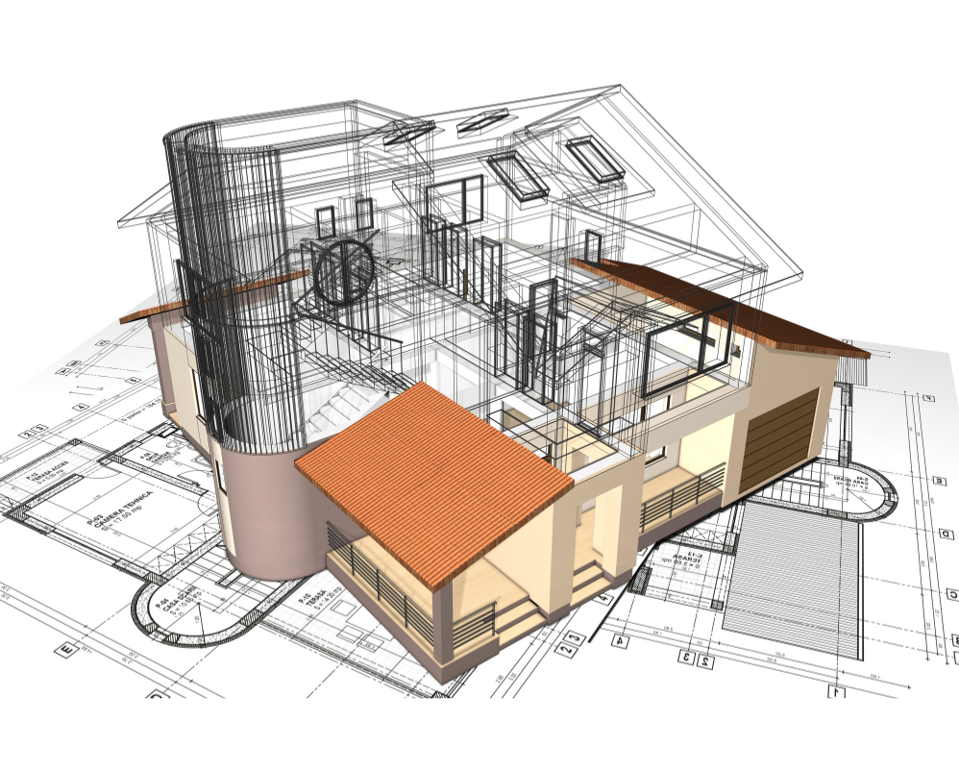
Architectural Design
Level 2

Slide 2
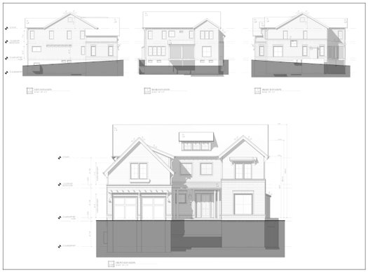
Elevation
What is an Elevation?
An elevation is a flat representation of one side of a building
It shows the height and features of the building
Think of it like taking a picture of just one side of a house

Slide 3
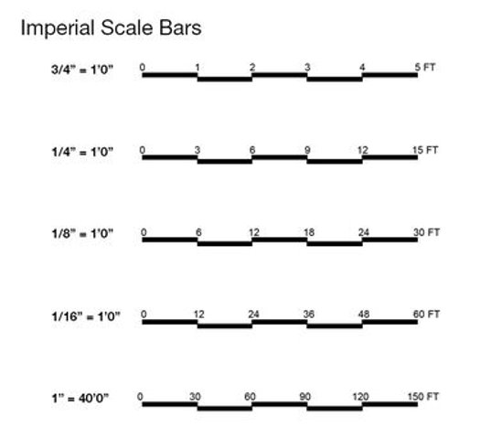
Scale
Scale is the ratio of the drawing size to the actual building size
It helps us draw buildings accurately on paper
Example: 1:100 scale means 1 cm on paper = 100 cm in real life

Slide 4
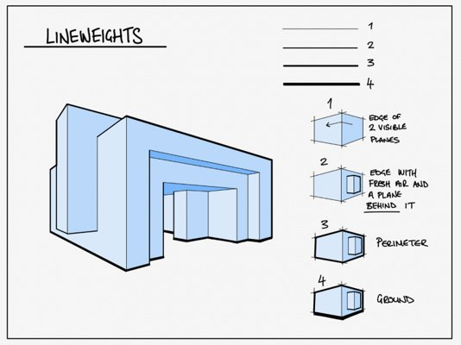
Line Weights
Line weight refers to how thick or thin we draw lines
Thicker lines: Used for walls and main structures
Thinner lines: Used for details and less important elements
Varying line weight helps make drawings clearer and more interesting

Slide 5

Proportion
Proportion is about the size relationship between different parts
It helps make sure windows, doors, and other features look right
Example: A door should be taller than it is wide

Slide 6
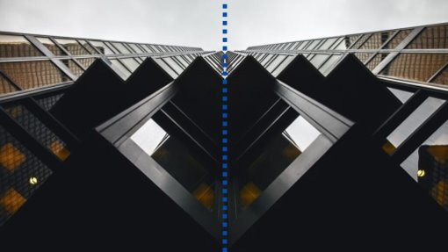
Symmetry
Symmetry means having a balanced design on both sides
Imagine folding the building in half - both sides should match
Many buildings use symmetry to look neat and organized

Slide 7
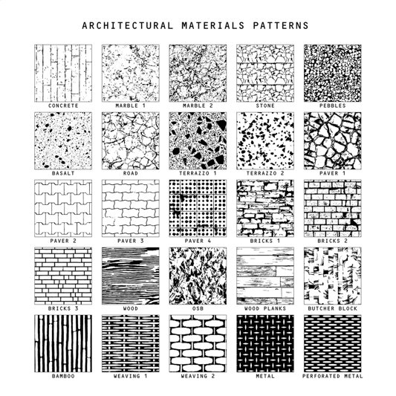
Texture
Texture represents how surfaces of the building feel
We can show texture through shading or patterns
Examples: Bricks, wood grain, or smooth concrete

Slide 8
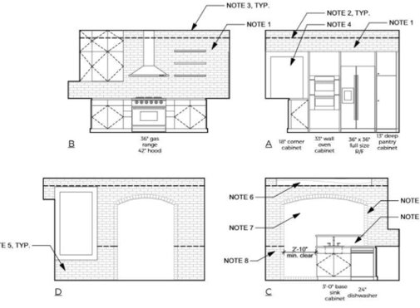
Detailing
Details make our sketches more realistic and interesting
Include things like:
- Windows and doors
- Decorative elements (moldings, cornices)
- Unique architectural features

Slide 9
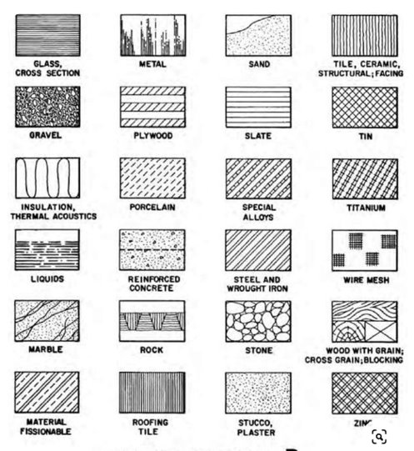
Hatching
Hatching uses lines to show shadows or different materials
It can make flat drawings look more three-dimensional
Different patterns can represent different surfaces

Slide 10
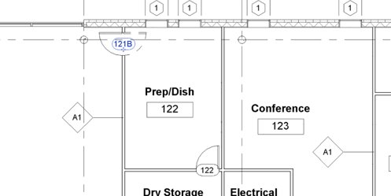
Annotations
Annotations are labels and notes we add to our sketches
They provide extra information about the building
Examples: Measurements, material types, or design notes

Slide 11
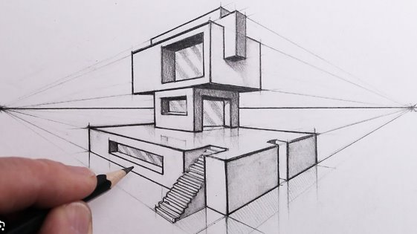
Perspective
While elevations are flat, knowing perspective helps
Perspective shows how things look smaller as they get farther away
It helps us understand how the building looks in real life

Slide 12
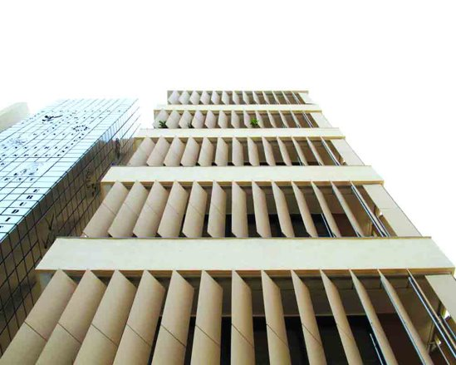
Fenestration
Fenestration is how we arrange windows and doors
It affects how the building looks and functions
Good fenestration balances light, ventilation, and appearance

Slide 13
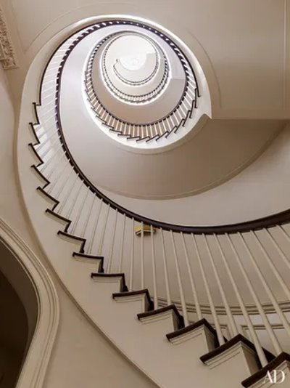
Focal Point
The focal point is the main attention-grabber in the elevation
It could be a grand entrance, a unique window, or a special feature
A good focal point makes the building design more interesting

Slide 14
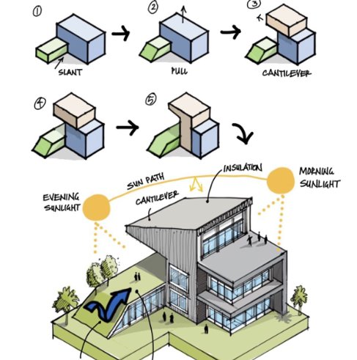
Massing
Massing is the overall shape and form of the building
Context is how the building fits into its surroundings
Both are important for creating buildings that look good and work well

