Slide 1
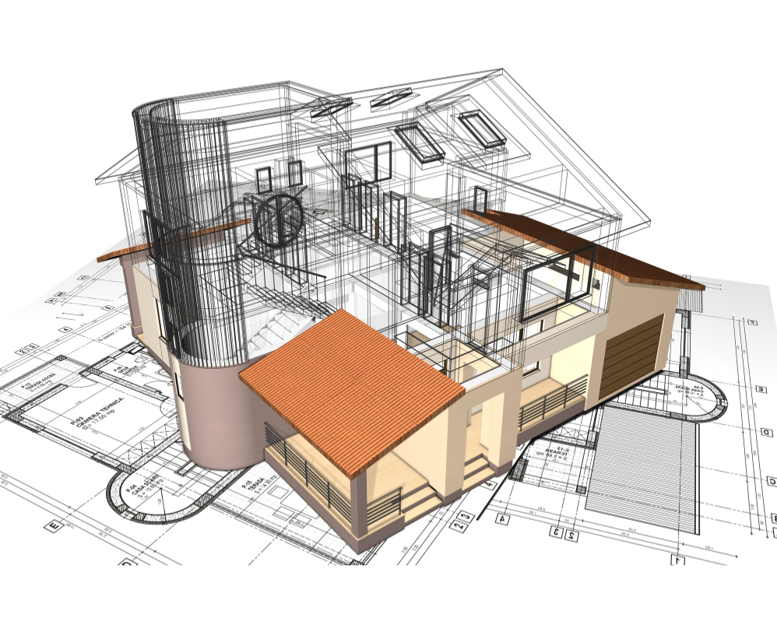
Architectural Design
Level 3

Slide 2
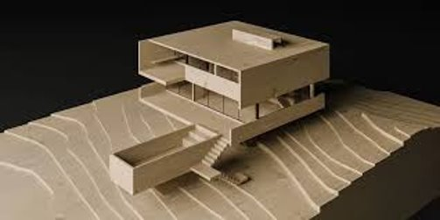
Scale
Example: A model of a house built at a 1:100 scale, meaning that 1 cm on the model represents 1 meter of the actual building.
Explanation: The scale ensures that every part of the model is in proportion to the real building, allowing for an accurate representation of size and relationships between elements.

Slide 3
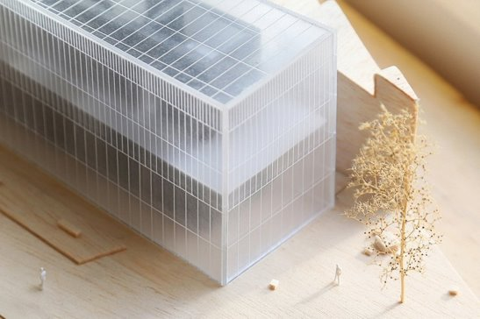
Materials
Example: A model made using foam board for walls, acrylic for windows, and wood for structural beams, with paper used for small decorative elements like trees.
Explanation: Choosing the right materials is essential for creating a durable, detailed model. Foam board is lightweight but strong, acrylic can simulate glass, and wood adds a natural texture.

Slide 4
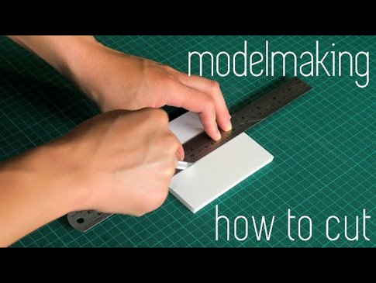
Cutting Techniques
Example: Scoring foam board before folding to create crisp, clean edges for walls, or using an X-Acto knife for precise cutting of small, intricate parts like window frames.
Explanation: Different materials require different cutting techniques. Laser cutting can be used for highly detailed and precise cuts, while shearing is suitable for straight cuts on thicker materials.

Slide 5
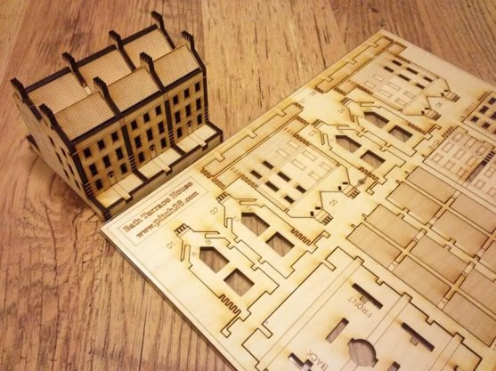
Joinery
Example: Using glue to attach walls to the base of a model, with tabs inserted into pre-cut slots for stronger joints, or small pins for mechanical fastening in wood models.
Explanation: Joinery techniques help ensure the model's stability and durability. Tabs are often used in cardboard models, while adhesives like tacky glue or wood glue are common in most models.

Slide 6
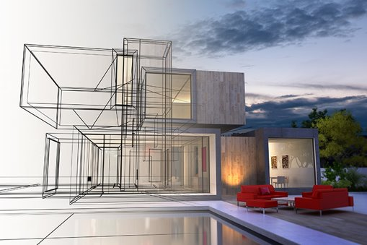
Rendering
Example: A digital rendering of the model using software like SketchUp to show the finished design, or a hand-drawn sketch with shading and textures to represent materials and light.
Explanation: Rendering is essential for communicating the design concept, whether through realistic digital models or artistic hand sketches that convey atmosphere and details.

Slide 7
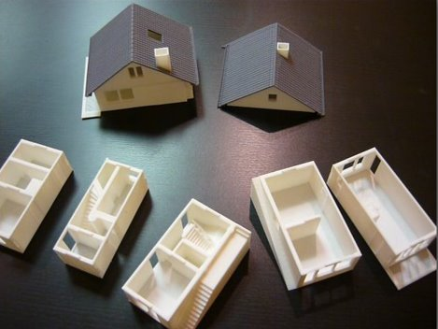
Prototyping
Example: Creating a cardboard prototype of a building to explore massing and layout before moving on to a more detailed and accurate model using higher-quality materials.
Explanation: Prototyping allows designers to test ideas quickly and identify potential issues with scale, proportion, or construction methods before committing to the final model.

Slide 8
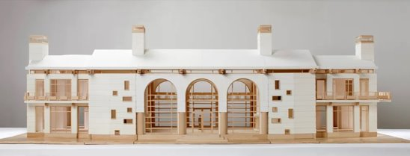
Elevation
Example: A flat elevation drawing of a building showing one side of the structure, such as the front façade, to help visualize window placement and overall height.
Explanation: Elevation drawings are a key tool in both architecture and model-making, showing the vertical relationships of elements like doors, windows, and roofs.

Slide 9
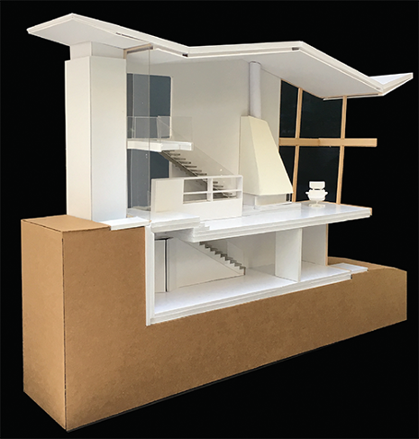
Section
Example: A section cut through the middle of a model of a multi-story building, showing how different floors are arranged and how spaces like staircases connect.
Explanation: Section drawings or models show internal spaces and structural relationships that aren’t visible in elevation or plan views, making them essential for understanding the design functionality.

Slide 10
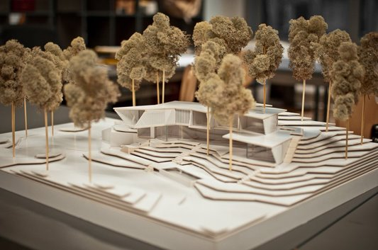
Site Context
Example: A model placed on a topographic base that shows the surrounding terrain, with adjacent buildings and trees included to show how the new building fits into its environment.
Explanation: Including site context helps viewers understand how the model interacts with its surroundings, which is critical for designs that need to respond to specific environmental or urban conditions.

Slide 11
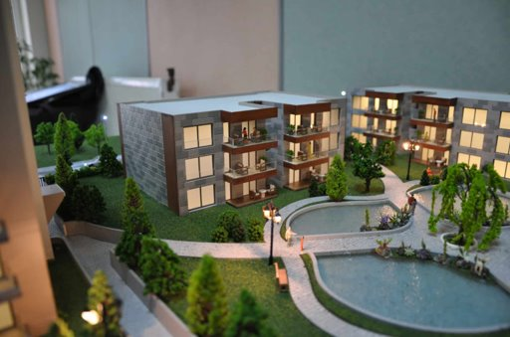
Presentation
Example: Displaying the final model on a black foam core base, with spot lighting to highlight key features, and accompanying annotated boards explaining the design concept and materials.
Explanation: A well-thought-out presentation can make a model much more impactful, helping to communicate the design clearly and attractively to viewers.

Slide 12
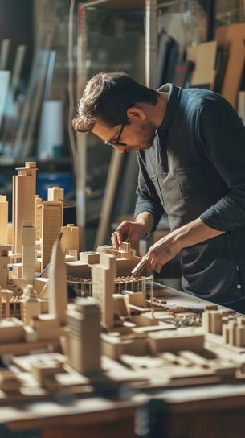
Assembly
Example: Systematically assembling the model by first building the walls, then adding interior partitions and the roof, followed by details like windows and landscaping.
Explanation: Assembly requires careful planning and patience, ensuring that each part fits together accurately and securely to create a cohesive final model.

Slide 13
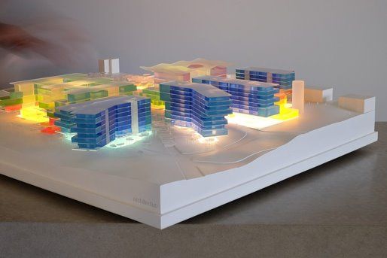
Base
Example: A MDF (medium-density fiberboard) base used to support a building model, providing stability and offering space to display the building’s relationship to surrounding paths, streets, or landscape features.
Explanation: The base is often an integral part of the model, serving as a stable foundation and sometimes representing the site's topography or urban environment.

Slide 14
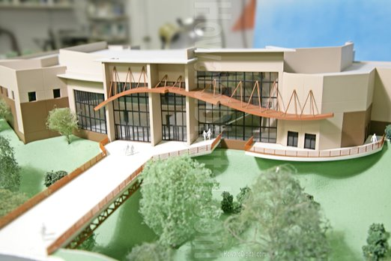
Scale Figures
Example: Small 3D-printed figures of people placed in front of a model building to give a sense of scale and show how humans interact with the space.
Explanation: Scale figures help viewers understand the size of the building in relation to human dimensions and can also enhance the narrative by showing how the space will be used.

