Slide 1
Introduction to electromagnetism

Slide 2
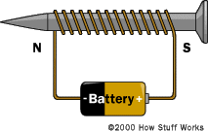
Goals:
Understand Electricity and Magnetism
Understand the theory of electromagnetism
Understand how electricity creates magnetism
Identify applications of electromagnetism
in daily life
Notes:
Image taken from: http://www.howstuffworks.com/electromagnet2.htm

Slide 3
Electricity and Magnetism Basics
Electricity is the flow of electrons, tiny particles that carry energy.
  Static Electricity
Magnetism is a force that can attract or repel certain objects, like iron.
  Opposites attract
Notes:
Demonstrate with a simple static electricity activity (rub a balloon on hair and stick it to the wall).
Show magnets attracting/repelling small objects.

Slide 4
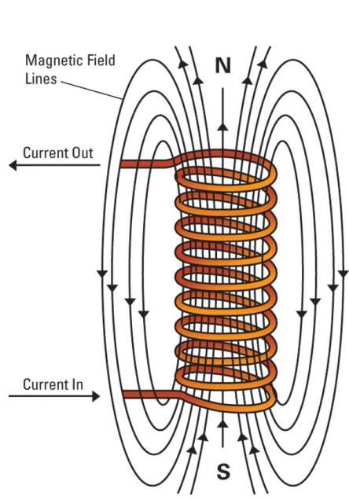
How Electricity Creates Magnetism
When an electric current travels through a wire, a magnetic field is produced around the wire – Electromagnetism
A coil of wire will concentrate and increase
the magnetic field
Notes:
Talk about electric motors, trains, and how electromagnets are used in cranes to lift heavy metal objects.

Slide 5
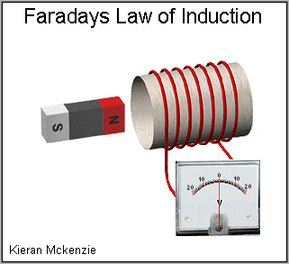
How Magnetism Creates Electricity
When a magnetic field is moved or altered inside a coil of wires, current travels through the wires - induction
The magnetic field lines must be changing (moving or disrupted) through the conductor
This is how we “create” electricity – hydroelectric
dam, nuclear power plant, wind turbine, etc
Notes:
Mention power plants that use this principle to generate electricity.

Slide 6
Electromagnetism in Daily Life
Speakers
Phones
TV’s
MRI machines

