Slide 1
Introduction to electromagnetism and induction

Slide 2
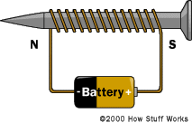
Goals:
Understand the theory of electromagnetism
Understand the theory of induction
Understand how a speaker uses
electromagnetism to create sound waves
Notes:
Image taken from: http://www.howstuffworks.com/electromagnet2.htm

Slide 3
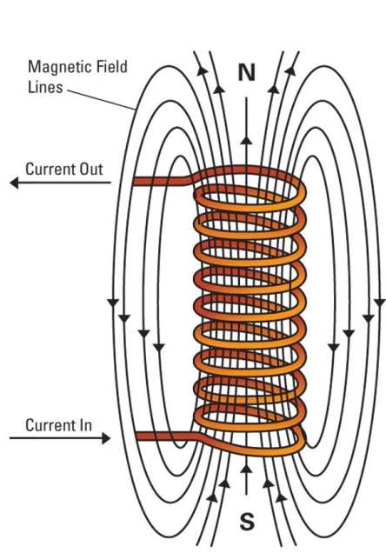
Electromagnetism
When an electric current travels through a wire, a magnetic field is produced around the wire – electromagnetism
A coil of wire will concentrate and increase
the magnetic field
Notes:
Demonstration - Take an electromagnet and put it close to a compass and show the class how the compass needle is deflected.

Slide 4
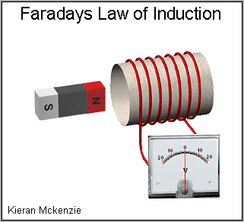
Induction
When a magnetic field is moved or altered inside a coil of wires, current travels through the wires - induction
The magnetic field lines must be changing (moving or disrupted) through the conductor
This is how we “create” electricity – hydroelectric dam, nuclear power plant, wind turbine, etc
Notes:
Demonstration: wrap wire around a plastic tube (depending on wire size you may need up to 1000 windings or more) and hook the wires up to a Galvanometer. Move a magnet through the coil of wires and watch the needle move on the galvanometer). Show students that if you don’t move the magnet, current flow is not produced.
Demonstrate: purchase a shake flashlight that works off induction and charging of a capacitor
Demonstrate power generation video with hydroelectric dam, wind turbine, etc. - YouTube
Image taken from: http://blogs.cas.suffolk.edu/muntasir1993/2013/11/03/generator-lab-and-faradays-law

Slide 5
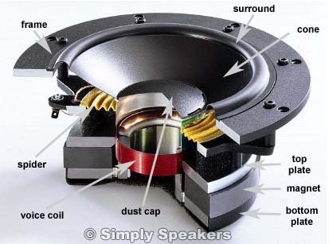
Parts of a Speaker
Notes:
Demonstration – get some old speakers and take them apart in front of the class.
Image taken from: http://www.simplyspeakers.com/speaker-repair-how-to-tips-tricks-faq.html

Slide 6
Speaker-Parts
Frame: holds suspended cone in place
Surround: flexible material, often foam, used to connect cone to frame yet allow flexibility
Cone: stiffer cardstock type material that vibrates and pushes and pulls air molecules at different frequencies
Spider: flexible accordion style material used to support coil
Dust cap: center of cone
Top Plate: shield and support for magnet
Magnet: used to create repel attract force against voice coil
Bottom Plate: shield and support for magnet
Voice Coil: coil of thin wire used to create electromagnet causes coil to move at different frequencies

Slide 7
Speaker - Operation
1. Takes pulses of current and turns them into sound waves
2. Radio sends frequency of electrons into speaker
3. Speaker coil creates magnetic field at rate of electron frequency
4. Speaker magnet is repelled/attracted from coil moving attached speaker cone
5. Cone oscillates sound waves at given frequency
Notes:
Demonstration – show video of how the ear works.
How the Ear Works http://www.youtube.com/watch?v=qgdqp-oPb1Q

Slide 8
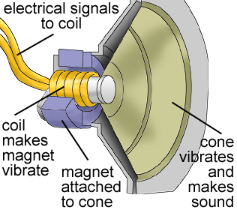
Notes:
Image taken from: http://explorephysics.edublogs.org/2010/09/15/speakers-and-physics

