Slide 1

Code Your Own
Animation

Slide 2

Getting Started
Navigate to https://scratch.mit.edu and log in to your student account
EXPLORE projects made by other “Scratchers”
click for video
Take a tour of the CREATE workspace
click for video

Slide 3

Selecting and Changing the Looks of a Sprite
The possibilities to customize your project with sprites are endless.
Change poses or “costumes”
Change size and color
Draw your own unique sprite features or create a whole new sprite
Upload your own images
SPRITE – any programable
character or object
click for video

Slide 4
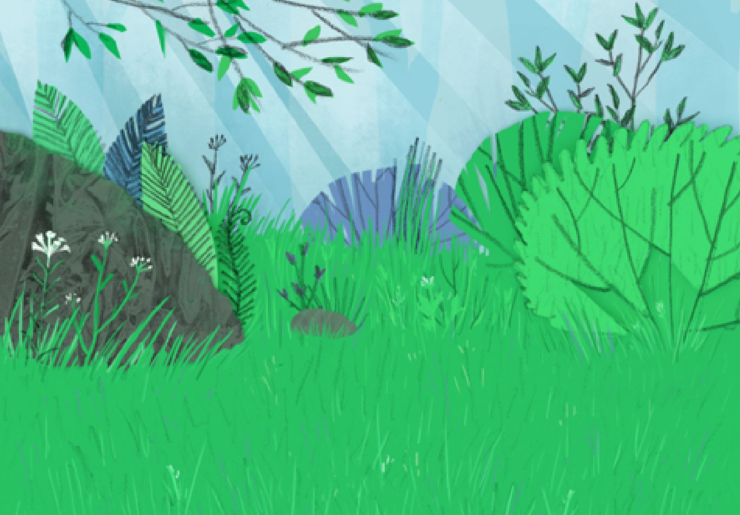
Selecting and Changing a Backdrop
Backdrops create the setting for your project.
Choose from the library, upload, or draw your own
Customize backdrops by changing colors and effects
Switch between backdrops to create movement or continue the story in a new location
BACKDROP – background
scene
click for video

Slide 5
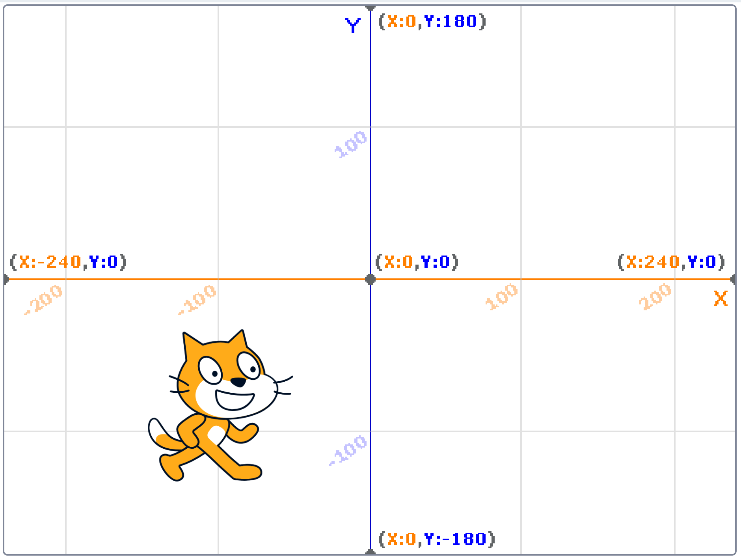
Moving on the Coordinate Plane
Glide Blocks – a sprite slides from one point to the next – you can see it glide the entire pathway
Go To Blocks – a sprite moves to the next point – you cannot see it travel along the pathway, as if it "teleported" to the next point
click for video
click for video
Computers operate at a very fast speed. The "wait" block, found in the "Control" menu, can help slow the program so single commands can be seen or time out the way you wish.

Slide 6
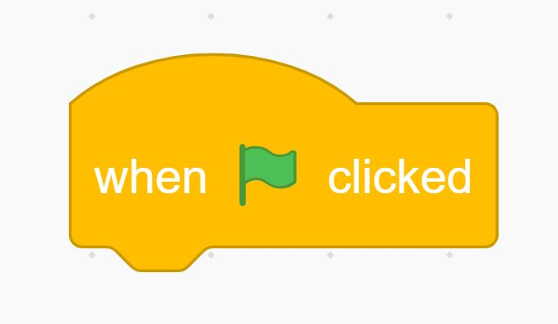
Run your Animation
Click a code block at any time to test that single code.
Link blocks together and the program will continue to run each block's code in that order.
"Events" blocks can be added to trigger the start of a code group without having to directly click on the code blocks in the script.
click for video

Slide 7
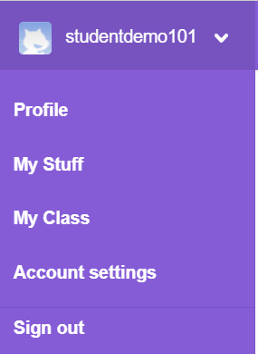
Saving & Naming Your Project
Scratch autosaves all projects on a timed schedule. If you see the words "Save Now" at the top right of your screen, click to save any last-minute changes to your project.
Each time you go in to "Create", it gives your project an "untitled" title including the number of projects you currently are working on.
Before you share a project, you should change the title. Do not use your name or other personal information in your title. Be sure to use proper and correct Capitalization and Spelling.
You can view your current projects and delete unwanted ones, by clicking the pull-down menu arrow next to your username in the top right corner, and choosing "My Stuff".
click for video

Slide 8
Share Your Project
"Sharing" your project makes it live for others to view.
Before you decide to share, be sure to:
Be finished with your project and have teacher &
guardian permission to share.
Think of a title for your project that doesn't include personal information.
Check with your teacher about any other requirements.
click for video

Slide 9

Beyond the Basics
Click any of the links below for short video tutorials on additional animation coding blocks and techniques.
Think/Say - Use comic book style thinking and speech bubbles
Broadcast – Code multiple sprites to interact with one another
Broadcast 2 - Code backdrops or costumes to change
Hide/Show - Have sprites appear or disappear during the animation
Still wanting to learn more? Click the Tutorials link at the top of
the page in "Create" for specific short lessons from Scratch!

