Slide 1

Code Your Own
Video Game

Slide 2

Getting Started
Navigate to https://scratch.mit.edu and log in to your student account
EXPLORE games made by other “Scratchers”
click for video
Take a tour of the CREATE workspace
click for video

Slide 3

Video Game Tutorials
A great way to get inspired and learn video game coding techniques is by searching and viewing the Scratch Tutorials.
click for video

Slide 4


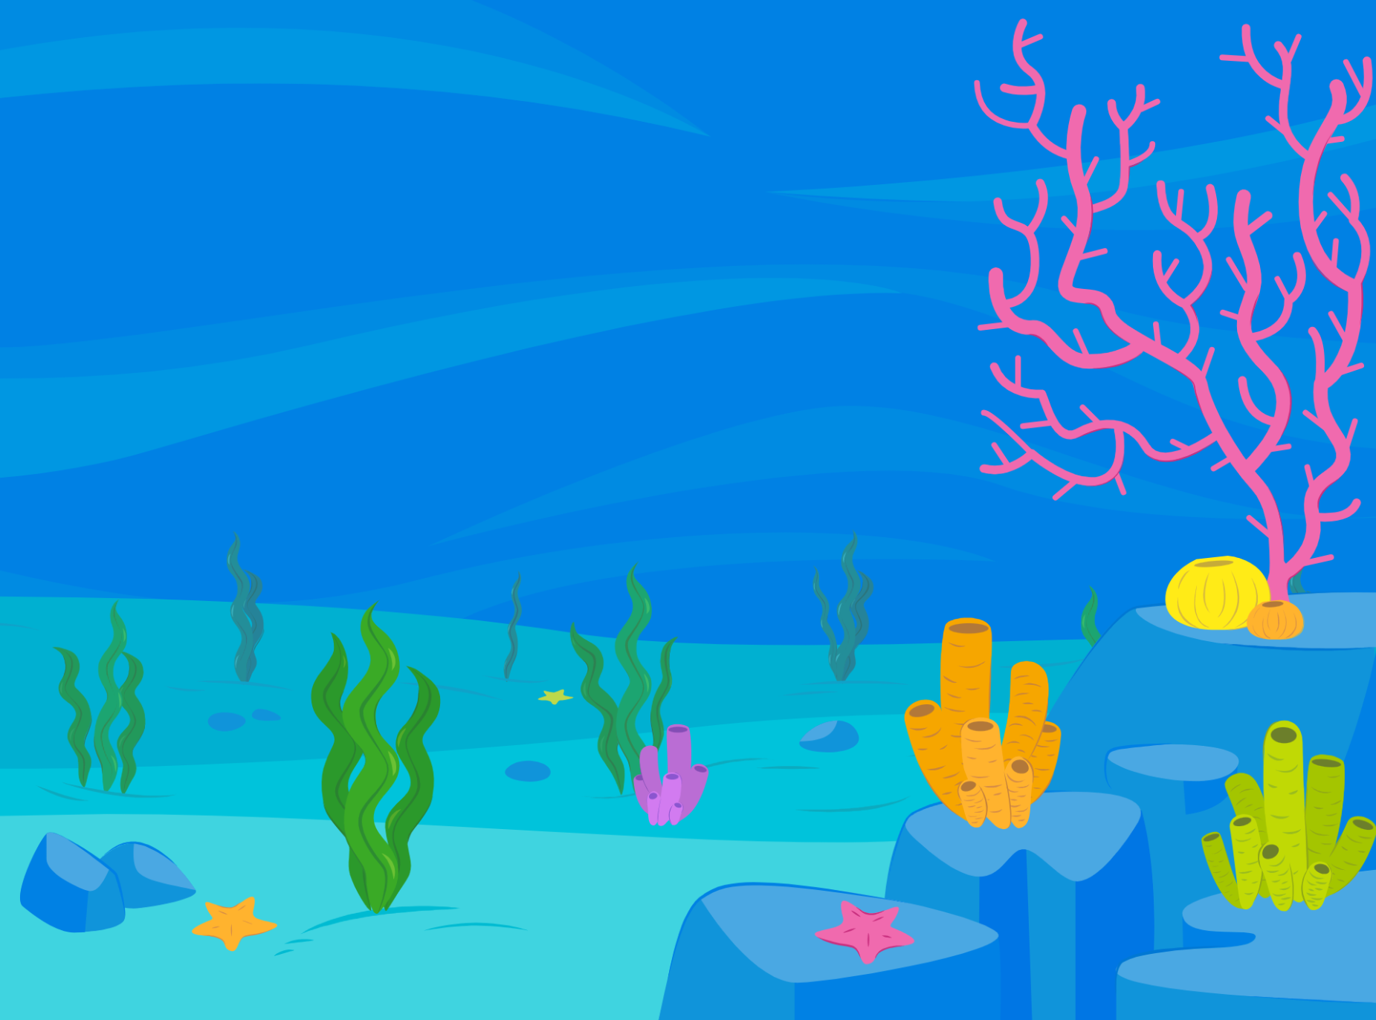
Code a "Chase" Game
A basic "Chase" game is an excellent first-time video game to code. There are many ways you can customize your game to make it unique.
Choose a "Sprite" as your main character that will do the chasing
Choose a "Sprite" that will be chased
Choose a "Backdrop"
SPRITE – any programable
character or object
BACKDROP – background
scene
click for video

Slide 5

Selecting and Changing the Looks of a Sprite
The possibilities to customize your project with sprites are endless.
Change poses or “costumes”
Change size and color
Draw your own unique sprite features or create a whole new sprite
Upload your own images
click for video

Slide 6
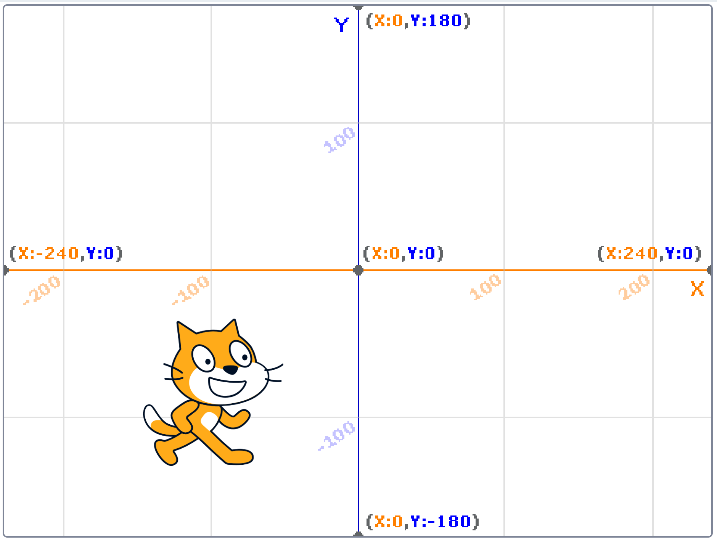
Moving on the Coordinate Plane
Coding a Sprite to move with the keyboard arrow keys - Chasing
click for video
Coding a Sprite to keep moving to a random position – Being Chased
click for video

Slide 7
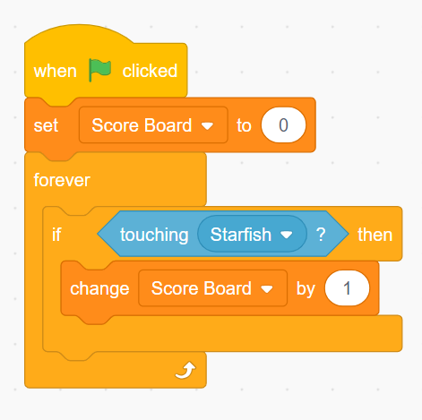
Create a Variable – Keep Score
Variable Blocks can be created for many creative reasons. One of the most common is to keep score.
Variable Blocks usually need to work together with control brackets and sensing blocks.
"If...then" statement control brackets can be used to create variety and interaction in a project or game.
click for video

Slide 8

Level Up
There are endless ways you can add unique features to make your games interesting and challenging.
Change Backdrops to start a new level.
Make the sprite you need to catch smaller or move faster.
Add obstacles or a third sprite that will cause you to lose points when tagged.
Add fun features like sprite color changes or sound effects when tagged.
Be creative and inspired. Be adventurous and try new blocks to see what they do!

Slide 9

Beyond the Basics
Click any of the links below for short video tutorials on additional coding blocks and techniques.
Think/Say - Use comic book style thinking and speech bubbles
Broadcast – Code multiple sprites to interact with one another
Broadcast 2 - Code backdrops or costumes to change
Hide/Show - Have sprites appear or disappear during the animation
Still wanting to learn more? Click the Tutorials link at the top of
the page in "Create" for specific short lessons from Scratch!

Slide 10
More ways to move on the coordinate plane
Glide Blocks – a sprite slides from one point to the next – you can see it glide the entire pathway
Go To Blocks – a sprite moves to the next point – you cannot see it travel along the pathway, as if it "teleported" to the next point
click for video
click for video
Computers operate at a very fast speed. The "wait" block, found in the "Control" menu, can help slow the program so single commands can be seen or time out the way you wish.

Slide 11
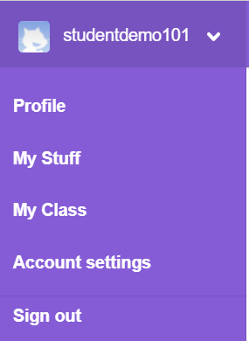
Saving & Naming Your Project
Scratch autosaves all projects on a timed schedule. If you see the words "Save Now" at the top right of your screen, click to save any last-minute changes to your project.
Each time you go in to "Create", it gives your project an "untitled" title including the number of projects you currently are working on.
Before you share a project, you should change the title. Do not use your name or other personal information in your title. Be sure to use proper and correct Capitalization and Spelling.
You can view your current projects and delete unwanted ones, by clicking the pull-down menu arrow next to your username in the top right corner and choosing "My Stuff".
click for video

Slide 12
Share Your Project
"Sharing" your project makes it live for others to view.
Before you decide to share, be sure to:
Be finished with your project and have teacher &
guardian permission to share.
Think of a title for your project that doesn't include personal information.
Check with your teacher about any other requirements.
click for video

