Slide 1
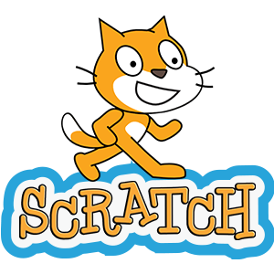
How to Set up Teacher & Student
Scratch
Accounts

Slide 2

Request a Teacher Account
by navigating to https://scratch.mit.edu/educators
You will need to provide the following information:
Username (not real name, will appear on screen to students
and others)
Password
Actual First and Last Name, Birth Month and Year, Gender, Country
A phone number Scratch can call if needing to verify teacher request
School or Organization name and address
You will get personal account access right away, but it may take
time for Teacher Account features to be approved and activated.
click for video

Slide 3
Setting Up Classes
With an approved Teacher Account teachers can:
Create a class or multiple classes to invite students to join
Generate a unique URL address link that students can click on to join
Organize student assignments & share or grade finished projects
For additional teacher resources and features, such as
setting up "Studios", try the resources linked on the last slide.
click for video

Slide 4
Monitoring Student Accounts
Once Students join a Scratch Class teachers can:
View student profiles and usernames
Manually change a student's password - It is recommended that you collect student usernames and passwords and store in a secure location for reference.
View student activity, shared and favorite projects
Receive notifications from the Scratch team of any questionable activity
click for video

Slide 5
Student Accounts
Teachers can invite a student to join a Scratch Class
Students will need to click the link shared by the teacher to join
Usernames – the username will appear on screen for others to view
  Must be anonymous
  No identifying information such as first, middle, or last names, address, school name, etc.
  Must be unique – many are already taken, get creative – try adding numbers before or after the username as an option
Passwords – 6 characters or longer
"Personal Information" - This is actually "General Information" Scratch uses to ensure appropriate content for its users
  Birth month and year
  Gender
  Country
click for video

Slide 6
Quick Reference Resources
Scratch provides various sources to support educators. There are also many YouTube videos, and forum tutorials created by scratch users on the internet.
Teacher Accounts Guide – Written instructions on teacher account features
Educator Resources - Educator tab of the scratch website, includes various information and instructions

