Slide 1

Photoresistor
Arduino Programming Notes
Things you need to know.

Slide 2

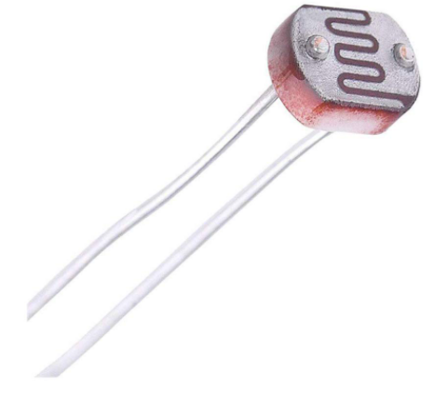
What is a Photoresistor?
A photoresistor is also called a LDR (Light Dependant Resistor)
This is a variable resistor and it will give different values based on how much light is shining onto its surface.
This is an analog sensor. It will give values from completely on, to completely off, and everything in between.

Slide 3
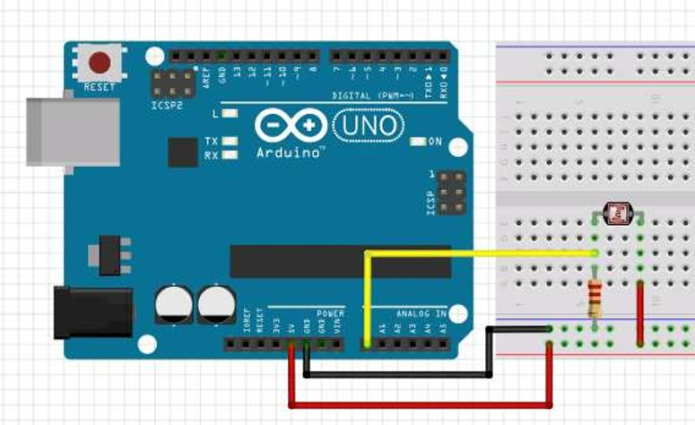
Wiring a Photoresistor
Wiring a photoresistor is very similar to wiring a switch.

Slide 4
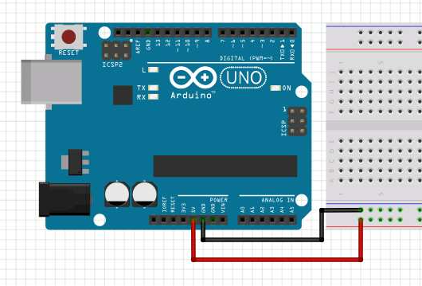
Connect 5V to (+) and GND to (-)

Slide 5
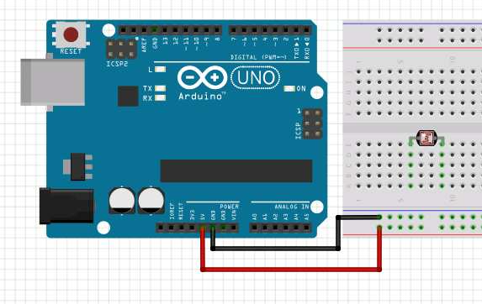
Place the photoresistor in the breadboard.
Place each leg into a separate terminal strip.

Slide 6
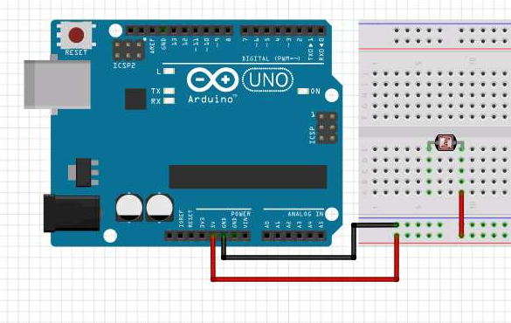
Wire one side of the photoresistor to 5V

Slide 7
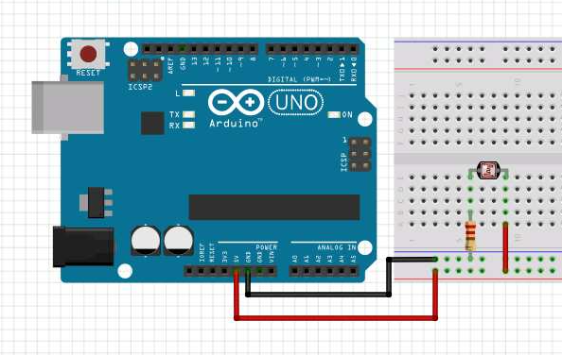
Use a 10K ohm resistor on the other photoresistor leg
Jump from the photoresistor to GND using the 10K ohm resistor.

Slide 8
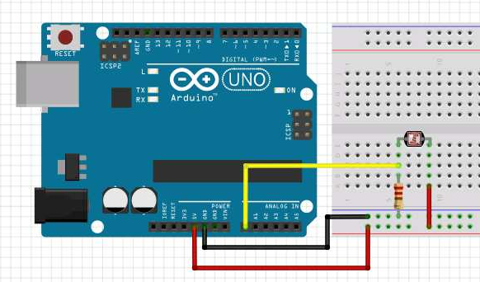
Jump to an analog input
Jump from the same terminal strip as the 10K pull down resistor to an analog input. For this example, use A0

Slide 9
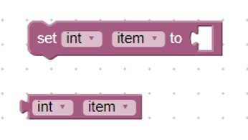
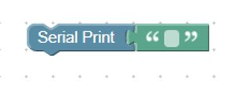
Code Blocks
The Serial Print block tells the arduino to print out information in human readable text.
Variables are used to hold onto a changing piece of information. We will use a variable to store the resistance value of the potentiometer. Click the drop down box on “item” to change the variable’s name.

Slide 10
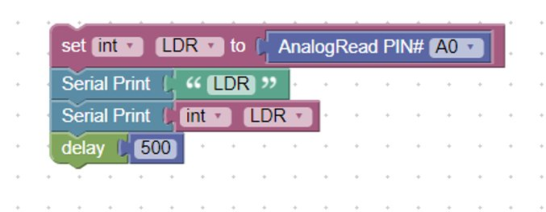
Reading a Photoresistor (LDR)
Wire the photoresistor how it is shown in the previous slide.
Write the following program on Blockduino. Its OK to have to look around a little bit to find the correct blocks.
This bock sets the variable LDR to the value of the light in the room.
This block tells the arduino to print the variable value.
This blocks tells the arduino to label the print as “LDR”
The delay slows the readings of the LDR in order to increase their quality.

Slide 11

Running it on Arduino

Slide 12
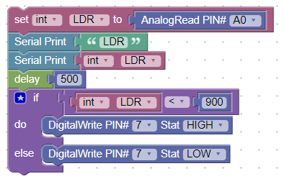
Using the Photoresistor
To use the photosensor, add IF brackets below the sensor and variable code that are dependant on the reading of the photoresistor. For example:
The IF bracket tells digital pin 7 to be HIGH if the photoresistor reading is greater than 900.

