Slide 1

Blink
Light up those LEDs!

Slide 2
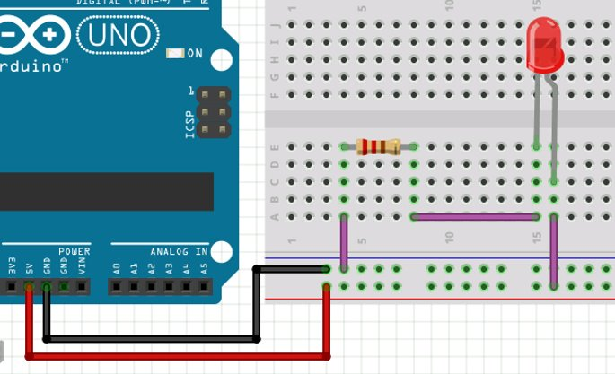
Wiring the Arduino
To program a LED you will use the same basic circuit you made in the previous step with ONE change.
Here is the series circuit you made in the last step. You will need to move the wire in the yellow circle.

Slide 3
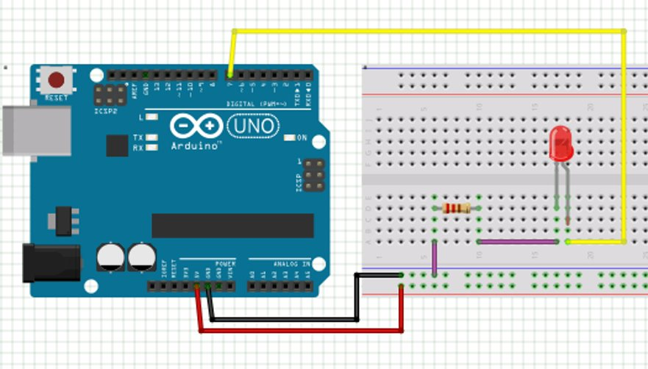
Move the jumper to a digital pin
The Anode (long side, +) of the LED will be connected to a digital pin instead of the (+) power rail. (Yellow Jumper)
For each LED you want to use, you will need to connect a different series circuit, and then connect the (+) side of the LED to another digital pin.
You can connect to any digital pin 2-13.

Slide 4
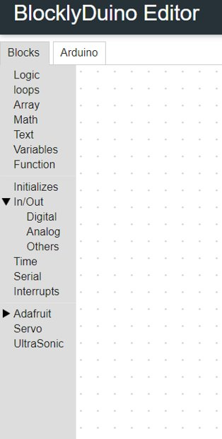



Programming Your LEDs
Use the Blockyduino Chromebook App to program your Arduino.
This block turns your LED on and off.
PIN# should be set to the digital pin that your LED is plugged into
Stat HIGH = LED on Stat LOW = LED off

Slide 5

Programming Your LEDs
Use the Blockyduino Chromebook App to program your Arduino.
This timer block pauses your program in its current state.
Time is measured in milliseconds.
1000 milliseconds = 1 Second
500 milliseconds = ½ Second
Etc.

Slide 6

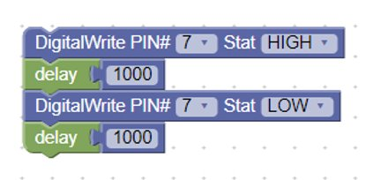
Writing a program
All blockyduino programs are looped. So, as soon as it is your code is complete, it will run over again.
What does this program do?

Slide 7
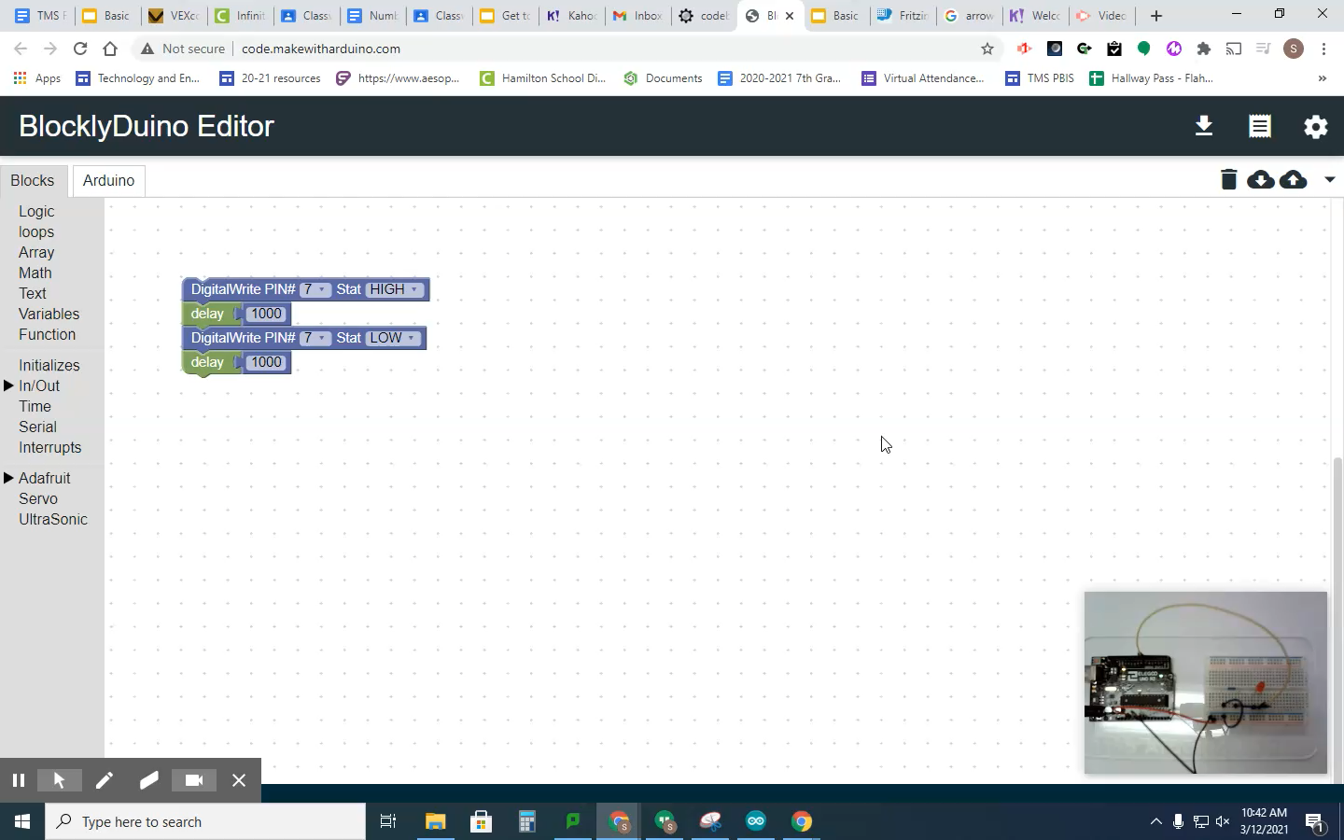
Send your program to the Arduino
Upload From a Desktop / Laptop

