Slide 1

Blink
Wire Multiple LEDs - The easy way!

Slide 2
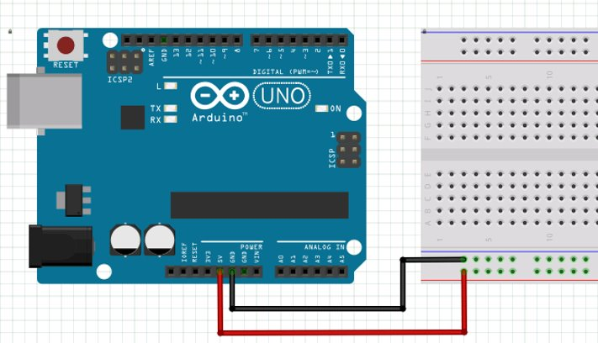
Fewer wires = Fewer mistakes
More wires make for more chances to make a mistake in wiring. Use this technique to wire each LED using only ONE jumper wire.
Start by wiring the (+) power rail to 5V and the (-) power rail to GND.

Slide 3
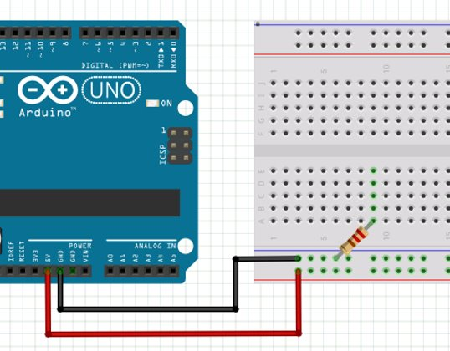
Plug the resistor into the (-) power rail and a terminal strip.
It doesn't matter which terminal strip you use.

Slide 4
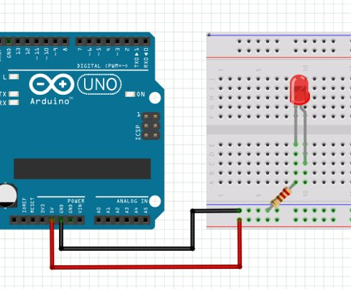
Plug a LED (short side) into the same terminal strip as the resistor.
The long side of the LED goes into a different terminal strip.

Slide 5
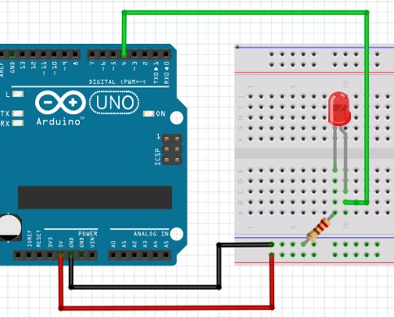
Jump from the long side of the LED to a digital output.
Any digital output 3-13 will work. Just make sure you program the correct one!

Slide 6
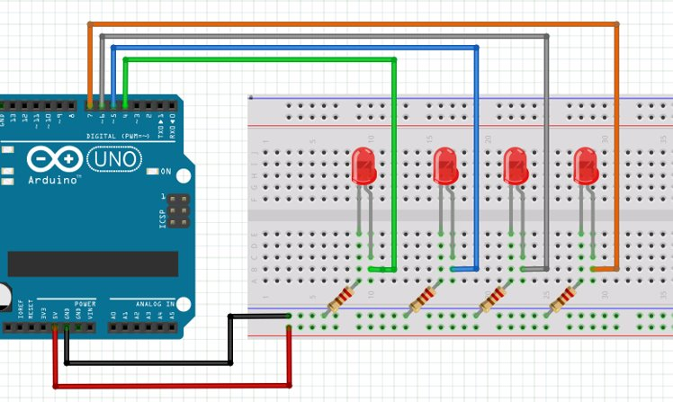
Repeat this process for up to 10 LEDs!
Here's an example with 4 LEDS.

