Slide 1

Servo
Arduino Programming Notes
Things you need to know.

Slide 2
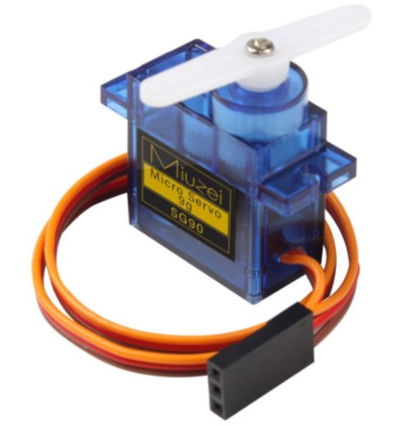
What is a Servo?
A servo is an electric motor that will spin to a specific angle.
The servos included in your kit will spin to any angle between 0 and 180 degrees.

Slide 3
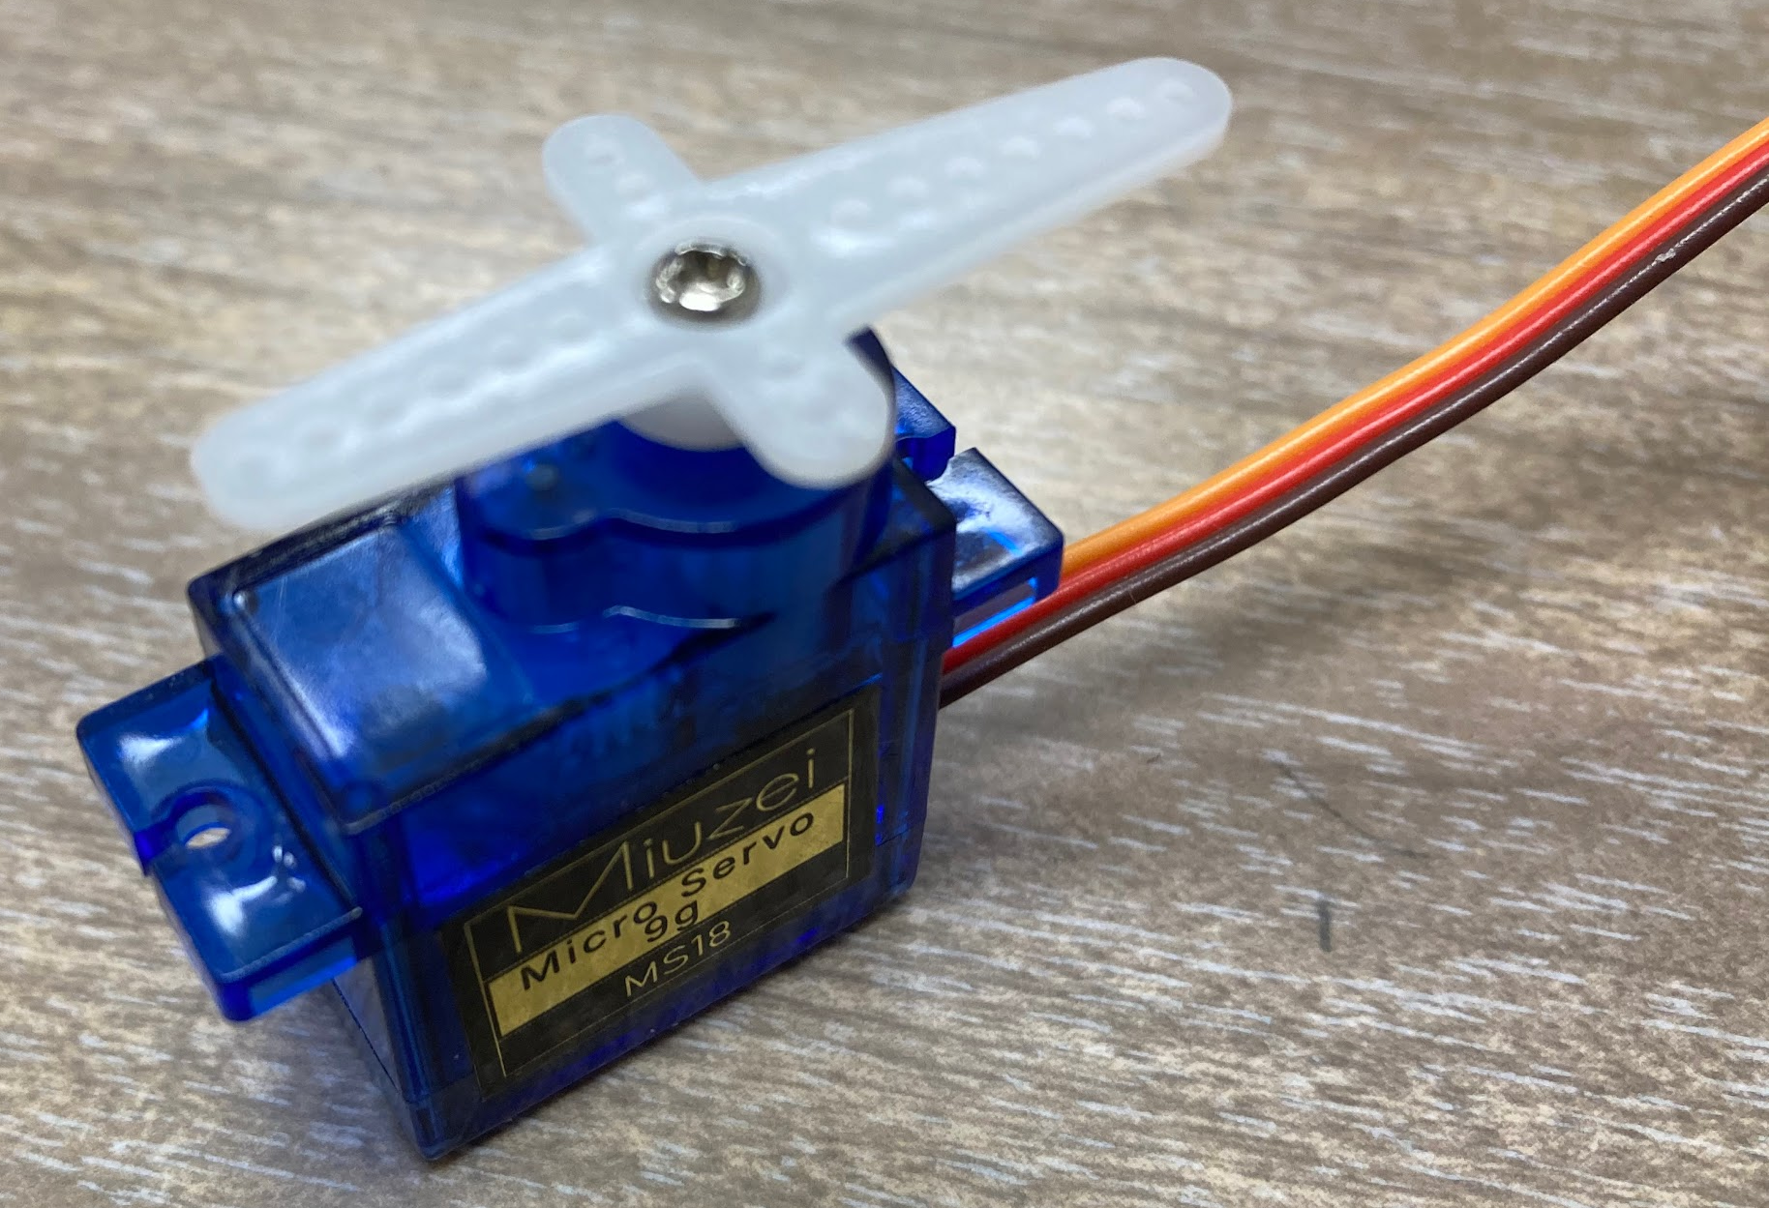
What’s in the bag
The servo bag includes the servo motor, three screws, and three horns. The servo horns are connected to the end of the servo motor using the smallest screw. Go ahead, and attach one of the horns to the servo using the small screw.
Put the rest of the parts back in the bag so you do not lose them.
Small Screw
Horn
Servo

Slide 4
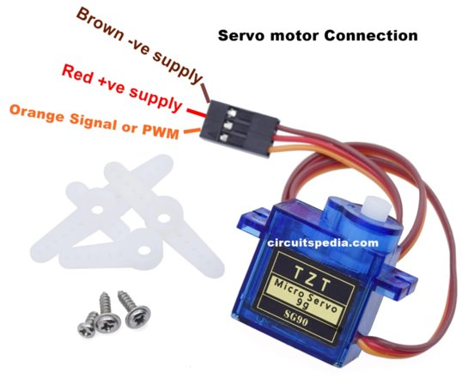
Wiring a Servo
It's easy!
Red => 5V
Brown => GND
Orange => digital pin

Slide 5
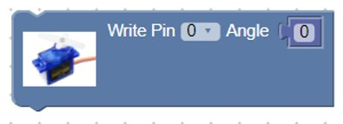
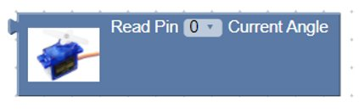
Coding a Servo
Tells the servo what angle to turn to.
Write Pin is the digital pin it is plugged into
Angle is the angle you want to set it to. (0-180 degrees)
Tells you what the current angle of the servo is. Use in conjunction with a serial print block.

