Slide 1

SWITCH
Arduino Programming Notes
Things you need to know.

Slide 2
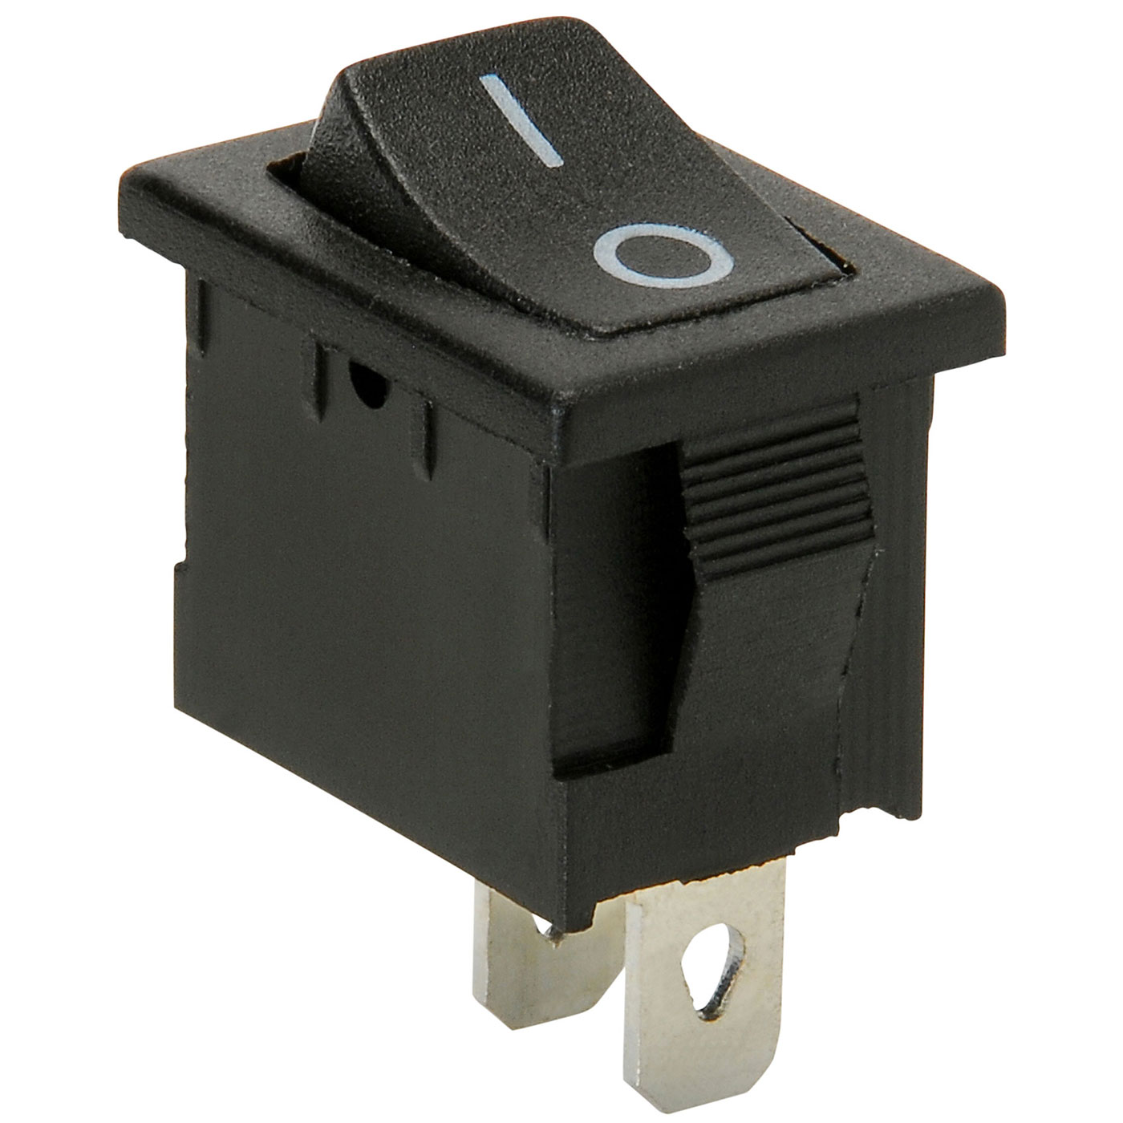
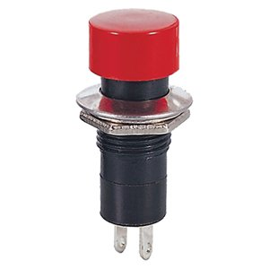
Types of Switches - SPST Button
or Rocker
There may be different switches in your kits. They all work the same, but are wired slightly differently.
The button type switches are on ONLY when the button is pressed.
The rocker type switches can be flipped on or flipped off.
Both switches are wired the same way. One clip to each pin.

Slide 3
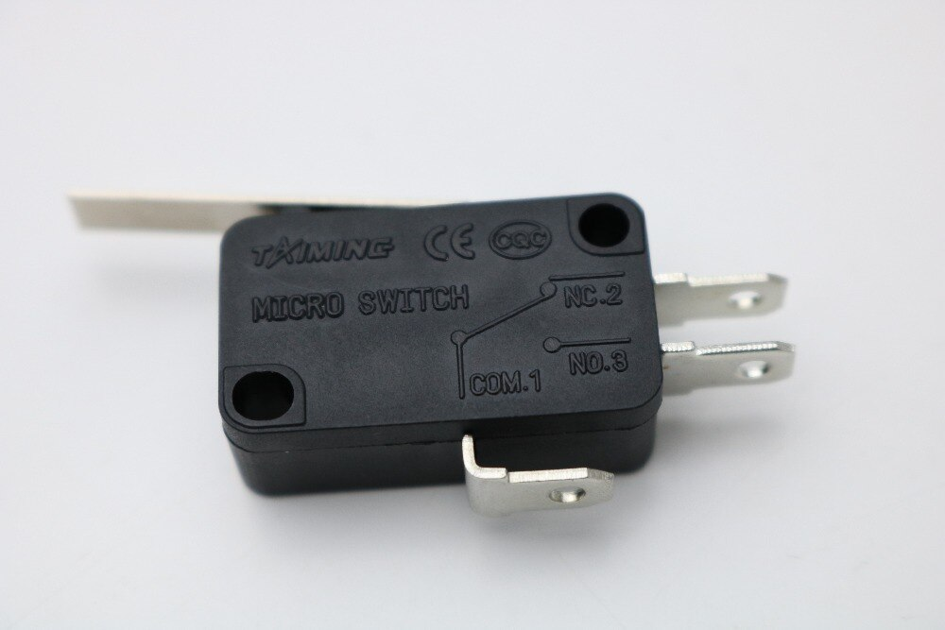
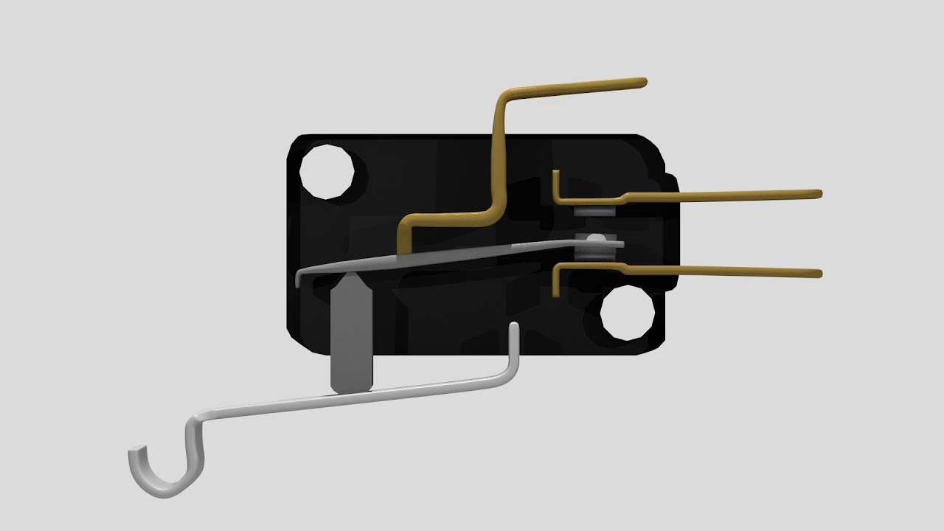
Types of Switches - Microswitches
Microswitches can be wired either NORMALLY OPEN or NORMALLY CLOSED. You learned about this with the bug project.
We will ALWAYS wire these NORMALLY OPEN. That means the bottom pin marked COM and the middle pin marked NO will get the alligator clips. The top NC pin will be left alone.

Slide 4
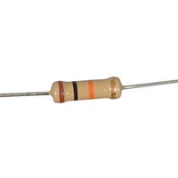
Pull down Resistor
10K ohm resistor: This is used as a “pull down” resistor and is wired in parallel with the switch. It will keep the digital input from “floating” between high and low by providing a consistent “low” reading.
You will need one “pull down” resistor for each switch you use.

Slide 5
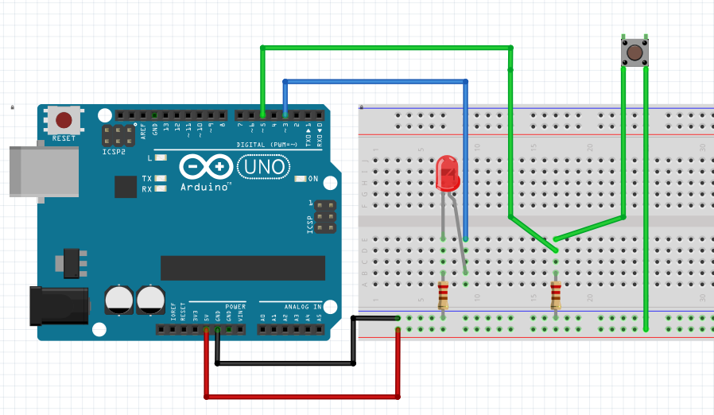
Switches and LEDs
When using a switch to control a LED, you will wire the LED just like you did in the BLINK unit, and wire the switch in a separate circuit. The program is what controls the function of the LED.
In this example, the blue wire is for the LED circuit and connects to D3.
The green wire is for the switch circuit and connects to D5.
They are independent circuits and not connected on the breadboard.

Slide 6
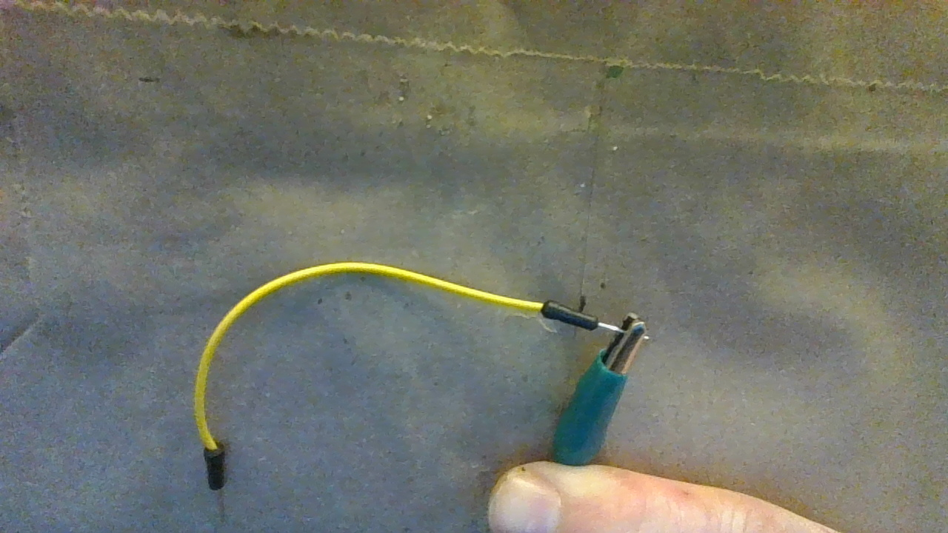
Wiring a Switch
Here are two resources for wiring in a switch. The switch is not placed in the circuit with the LED as it was in our electricity unit. It is wired to a separate digital pin and the Arduino senses when it is open or closed.
Use your alligator clips to connect the switch to the breadboard like this.
Clip one side to the jumper wire like in the picture and the other side to the switch tab.

Slide 7
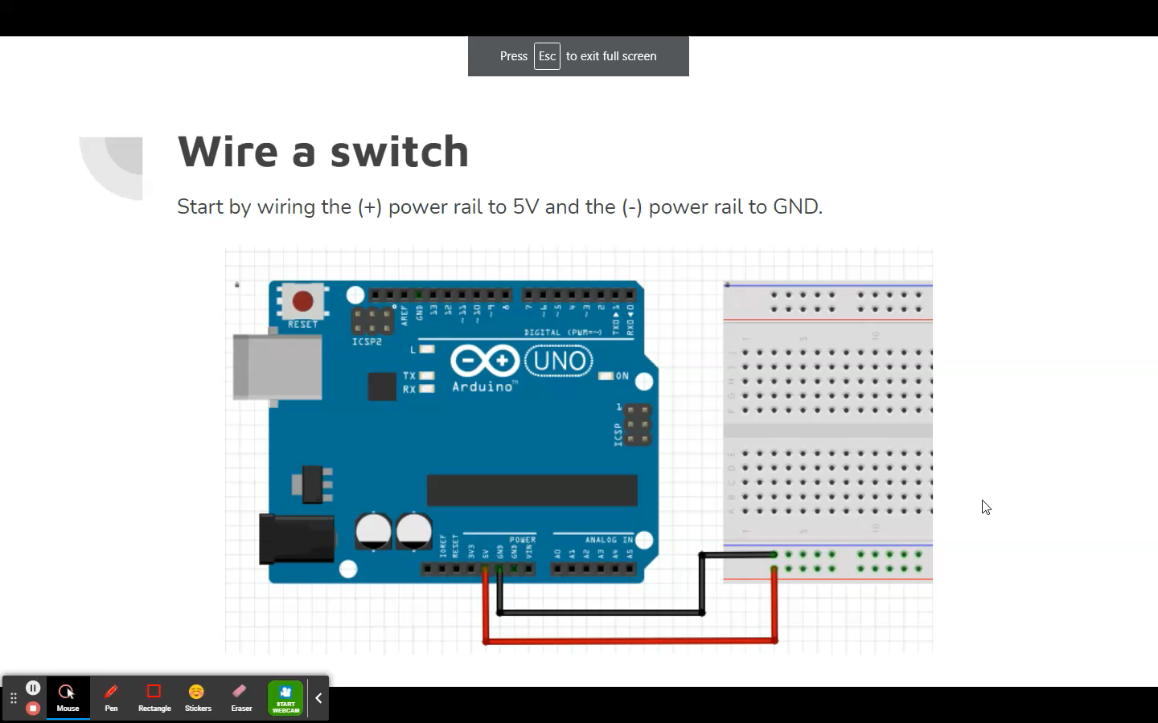
Wiring a Switch Video

Slide 8

Programming a Switch - DigitalRead
The DigitialRead block above is used to tell the arduino which digital pin the switch is connected to. So, set the pin number to whichever one you have the switch plugged into.
“Pullup” should remain OFF since we are using a “Pulldown” resistor.

Slide 9


Programming a Switch - If
The If bracket only works if the statement is true. Otherwise, nothing happens.
In this code, only IF the switch attached to Digital Pin 6 is pressed, THEN the LED attached to pin 4 will light.

Slide 10


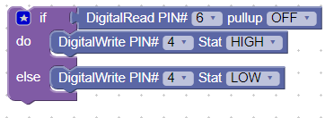
Programming a Switch - IfElse
The IfElse block tells the arduino what to do IF the statement is NOT true.
In this code, IF the switch attached to Digital Pin 6 is pressed, THEN the LED attached to pin 4 will light. ELSE the LED attached to pin 4 will not light.
To make this block, click the star on the IF bracket, and drag the else into the bracket as shown.

Slide 11



A few More Coding Blocks
These blocks are used together with IF brackets and DigitalWrite blocks.
The AND block is used when you want two or more inputs read together.
For instance two switches pressed at the same time.
The OR block is used if you want one OR the other input to be read.
For instance, one switch OR the other switch.
The NOT block converts its input to its opposite.
For instance, a switch NOT being pressed

Slide 12
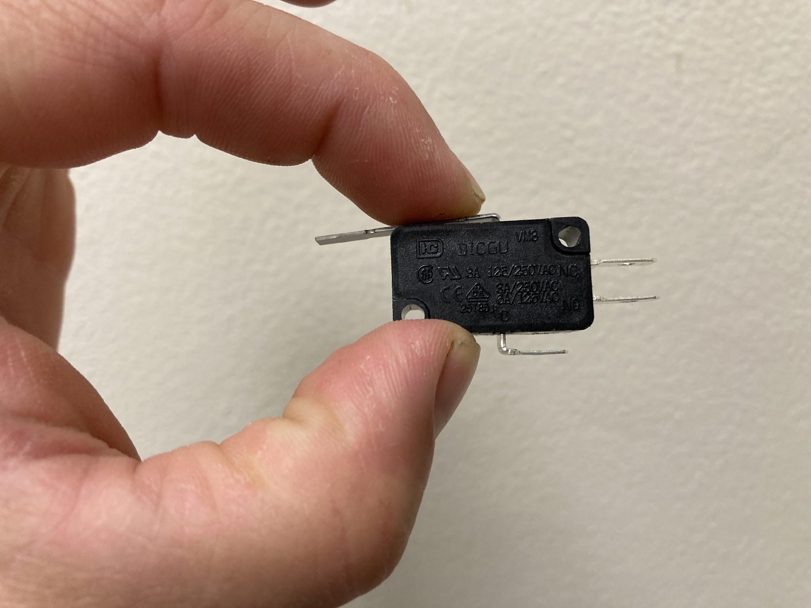
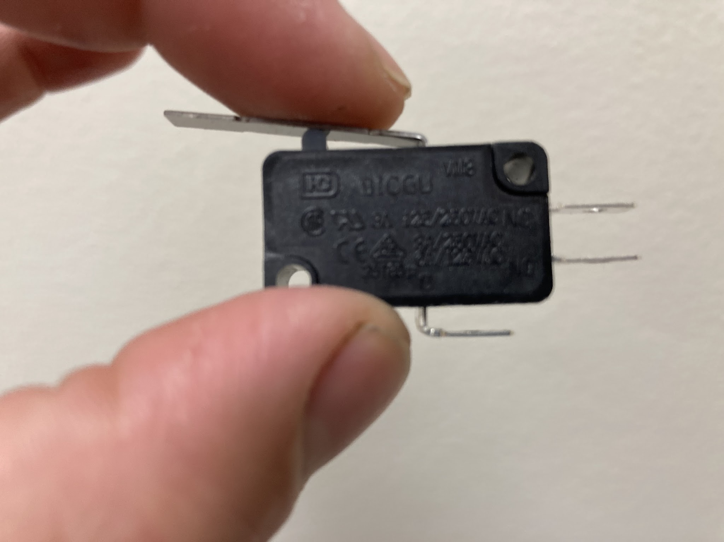
Even More Coding Blocks
You can put IF, AND, and NOT blocks together to make a logic statement.
For instance, this code reads…
IF switch 5 OR switch 7 is pressed AND switch 5 AND switch 7 are NOT pressed...
Switch 5
Switch 7
OR
do
OR
do
AND NOT
else

