Slide 1

Blink Solutions
Example Solutions - There are lots of ways to solve these problems, this document includes one for each challenge.

Slide 2
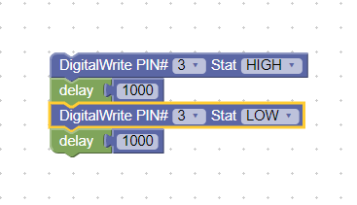
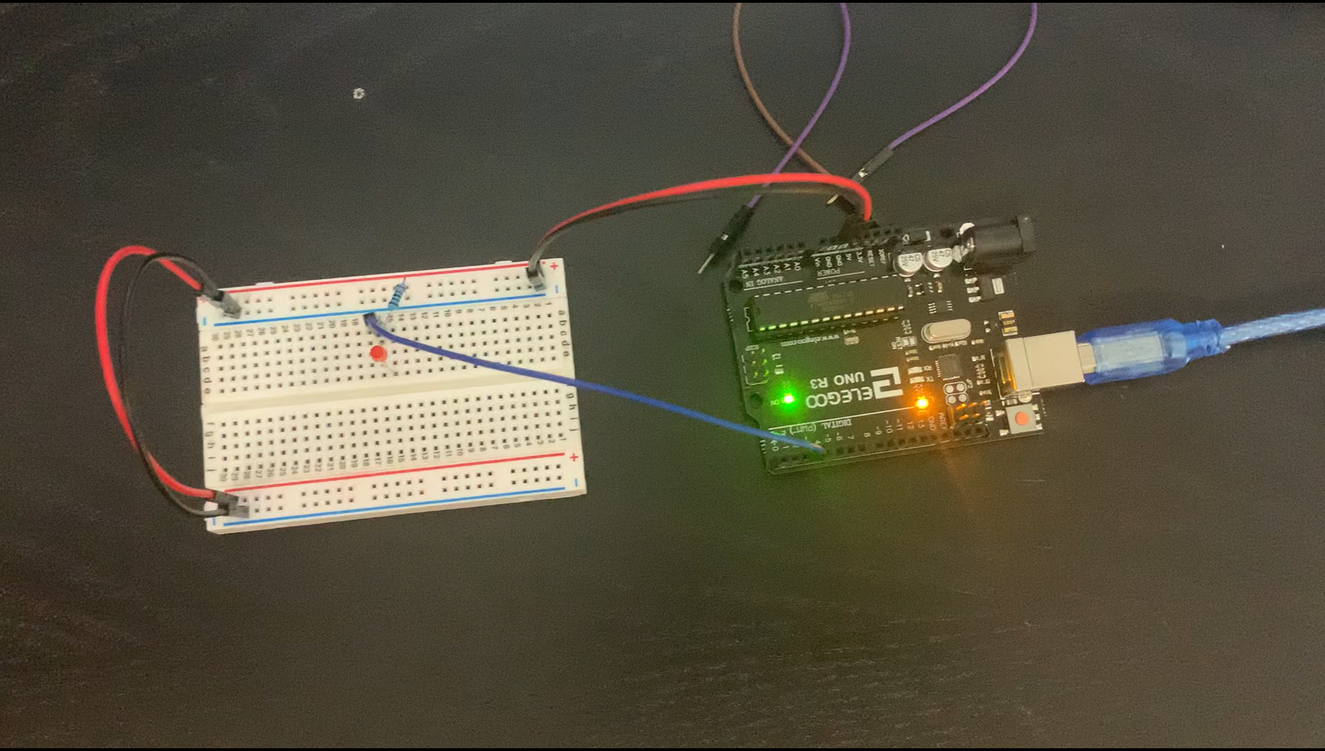
Blink Challenge 1
Program your LED to blink on and off. There should be a ½ second interval between blinks.

Slide 3
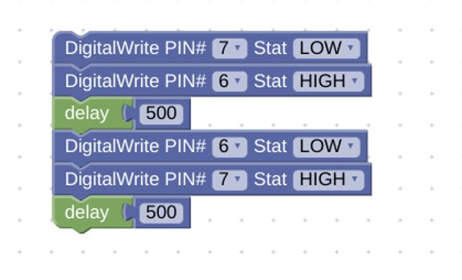
Blink Challenge 2
Program two LEDs to alternate blinking.
a. Each LED should blink for ½ second.
b. There should be no pause between blinks

Slide 4
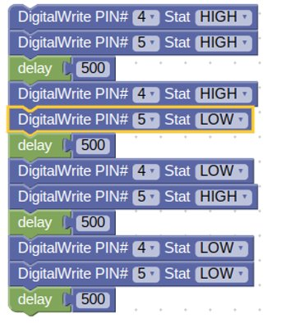

Blink Challenge 3
Design a program that blinks 2 LEDs:
a. One LED should blink in 1 second intervals.
b. The second LED should blink in 1/2 second intervals.
c. Check out this graphic representation of the problem.

