Slide 1

Photoresistor
Solutions
Example Solutions - There are lots of ways to solve these problems, this document includes one for each challenge.

Slide 2
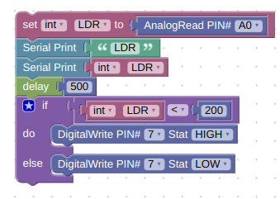
Photoresistor Problem 1
Program your arduino so that an LED turns on when it is dark and turns off when it is light. Raise and lower a book over the photoresistor to change the light levels. You should not have to touch the photoresistor to activate it. You will need to use the (<) or (>) commands within the "IF" bracket to quantify the analog value of the photoresistor.

