Slide 1

Servo Solutions
Example Solutions - There are lots of ways to solve these problems, this document includes one for each challenge.

Slide 2
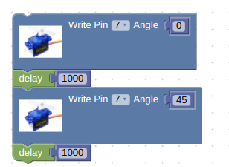
Servo Problem 1
Write a program so that your servo motor will switch from 0 to 45 degrees at 1 second intervals.

