Slide 1

Switch Solutions
Example Solutions - There are lots of ways to solve these problems, this document includes one for each challenge.

Slide 2
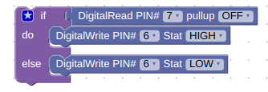
Switch Problem 1
Program a LED to light up when the switch is pressed and turn off when the switch is not pressed.

Slide 3
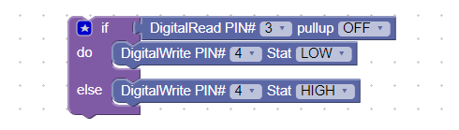
Switch Problem 2
Program a LED to light up when the switch is NOT pressed and turn off when it is pressed. If using a microswitch, the switch should still be in the NORMALLY OPEN position. Change your code so that it lights when it is NOT pressed.

